Slide 1
Safety profile and immunogenicity of a phase 1 clinical trial using germline-targeting trimer GT1.1 Karlijn van der Straten On behalf of the IAVI-C101 team 28-11-2023 k.vanderstraten@amsterdamumc.nl
Image credit: David Goodsell
Depiction of germline-targeting Env trimers (pink) or boosting immunogens (pink with dark pink) binding to B cell receptors (green)

Slide 2
Disclosure of speaker’s interest
(Potential) conflict of interest | None

Slide 3
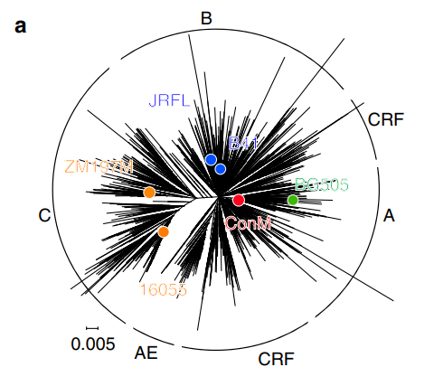
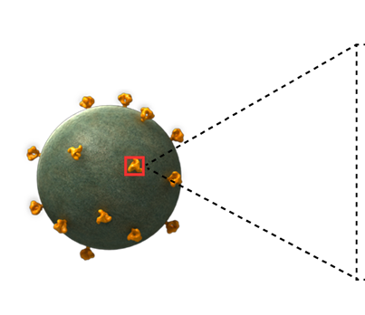
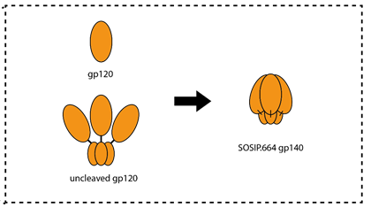
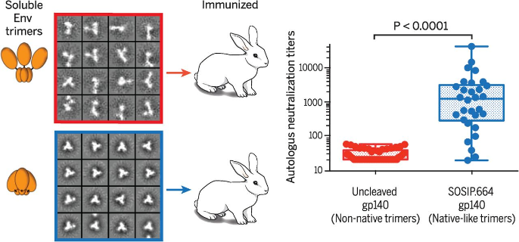
Background
Trial design & baseline characteristics
Safety
Serum binding
Serum neutralization
Conclusion
An effective HIV-1 vaccine should induce broadly neutralizing antibodies
1.3 million people worldwide became newly infected in 2022
38% reduction in number of cases compared to 2010
The HIV-1 envelope glycoprotein (Env) is the major target of neutralizing antibodies
Stabilization (SOSIP) of Env results in a more native-like appearance and higher neutralizing antibody titers after vaccination
The sequence diversity of Env complicates the development of an effective HIV-1 vaccine
Sliepen et al. 2019
Env-specific B cells acquire breadth over time due to exposition to different Env proteins
Antibody breath
Germline
Ab lineage
Env variants
Sanders et al, 2015
Adapted from Gruell H et al, 2014

Slide 4
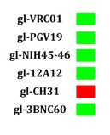
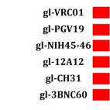
Background
Trial design & baseline characteristics
Safety
Serum binding
Serum neutralization
Conclusion
Germline-targeting strategy to induce broadly neutralizing antibodies
Antibody breath
Prime
BG505 SOSIP.GT1.1 gp140
Germline
Ab lineage
GT1.1 vaccinations effectively prime broadly neutralizing antibody precursor B cells in pre-clinical studies (data not published yet)
Env variants
Prime
‘Shape’
‘Polish’
Polish
BG505 SOSIP. 664 gp140
ConM SOSIP.v7 → Talk of E. Reiss
Lyumkis et al. 2013
Sanders et al. 2013
Sanders et al. 2015
Broadly neutralising
antibodies (bNAbs)
Germline
Sanders et al. 2013
Adapted from Gruell H et al, 2014
Notes:
BG505 does bind bNAbs, but not the precursors of these bNAbs. GT1.1 derives from the BG505 664 but is specifically adapted in such a way that the CD4 binding site and apex are more accessible and therefore germline versions bind. Also in pre-clinical VRC01 precursor B cells were primed.

Slide 5
Background
Trial design & baseline characteristics
Safety
Serum binding
Serum neutralization
Conclusion
Low dose 30 µg GT1.1+AS01b
High dose 300 µg GT1.1+AS01b
Placebo TrisNaCl
The IAVI-C101 trial is a multicenter, double-blinded, placebo-controlled (1:5), dose-escalating phase I trial
Amsterdam UMC (dr. de Bree), George Washington University (dr. Diemert), Rockefeller University (dr. Caskey, PI)
N=47 HIV-negative adults in general good health
Dose groups have comparable baseline characteristics
Reactogenicities collected 15-days post vaccinations
Safety follow-up till 1.5 years after first vaccination
Safety data is blinded still
Immunogenicity: serum, PMBCs (incl. leukapheresis), FNAs
Immunogenicity till 48 weeks after first vaccination
 | Low-dose (n=24) | High-dose (n=23) | Overall (n=47)
Sex at birth, n (%)
Female | 11 (46%) | 10 (44%) | 21 (45%)
Male | 13 (54%) | 13 (57%) | 26 (55%)
Age, years
Mean, (range) | 31 (20-47) | 29 (19-43) | 30 (19-47)
BMI, kg/m²
Mean, (range) | 25.3, (18.1-34.9) | 26.2 (19.1-33.6) | 25.7 (18.1-34.9)
Notes:
Low dose = 4 placebo; high dose = 4 placebo.
Mentioning leukapheresis and FNA.

Slide 6
Background
Trial design & baseline characteristics
Safety
Serum binding
Serum neutralization
Conclusion
The GT1.1 vaccine is well-tolerated and has an acceptable safety profile
 | Vaccination #1 | Vaccination #2 | Vaccination #3
Local AEs
Site pain | 72% | 61% | 73%
Site tenderness | 77% | 76% | 75%
Systemic AEs
Malaise | 43% | 61% | 50%
Myalgia | 32% | 52% | 55%
Headache | 49% | 50% | 43%
No serious adverse events (SAEs) associated with the GT1.1 vaccinations were reported
Most commonly reported AEs were solicited AEs
The frequency of local AEs where comparable between vaccinations
Mainly grade 1 and 2 AEs were reported that were self-limiting within a few days
Grade 3 AEs were reported after the second and third vaccination
No major differences in the frequency or severity of AEs between dose groups (not shown here)
Higher frequency of systemic grade 3 AEs were reported after mRNA-1273 vaccination compared to GT1.1 vaccine (Baden et al. 2021)
 | Vaccination #1 | Vaccination #2 | Vaccination #3
Local AEs (%)
Grade 1 | 69% | 48% | 61%
Grade 2 | 31% | 49% | 38%
Grade 3 | 0% | 3% | 1%
Systemic AEs (%)
Grade 1 | 71% | 55% | 55%
Grade 2 | 29% | 39% | 40%
Grade 3 | 0% | 6% | 5%
Notes:
Moderna COVID-19 Vaccine's Reactions and Adverse Events | CDC

Slide 7
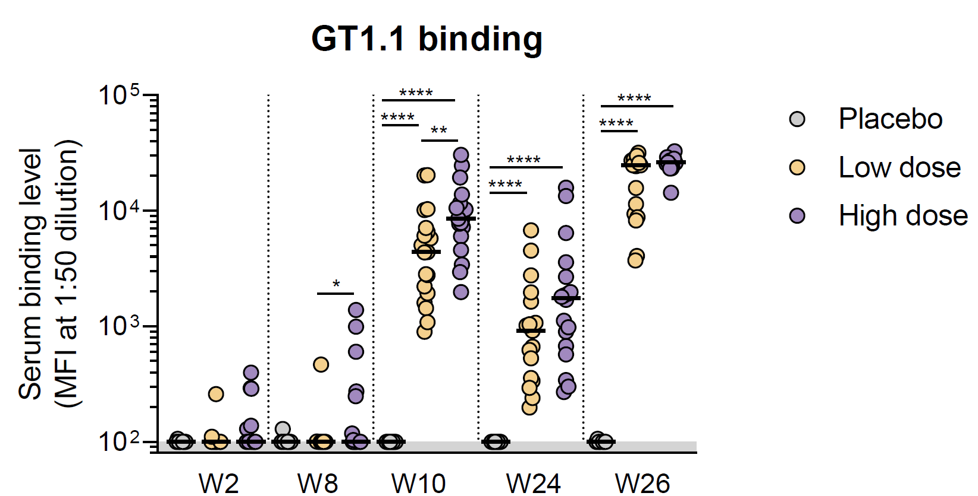
Background
Trial design & baseline characteristics
Safety
Serum binding an neutralization
CD4bs-specific
Conclusion
GT1.1 induces antigen-specific binding and neutralizing antibodies
All vaccine recipients developed detectable GT1.1-binding antibodies after two vaccinations
High dose group recipients had statistically significant more GT1.1-binding antibodies after two vaccinations
No differences in GT1.1-binding levels were found at W24 or W26 between dose groups
Longevity data at 1 year after vaccination (W48) will follow
High dose recipients showed a higher response rate after second vaccination (W10) compared to low dose recipients
No statistical significant differences in GT1.1-specific neutralization was found between dose groups after three vaccinations (W26)

Slide 8
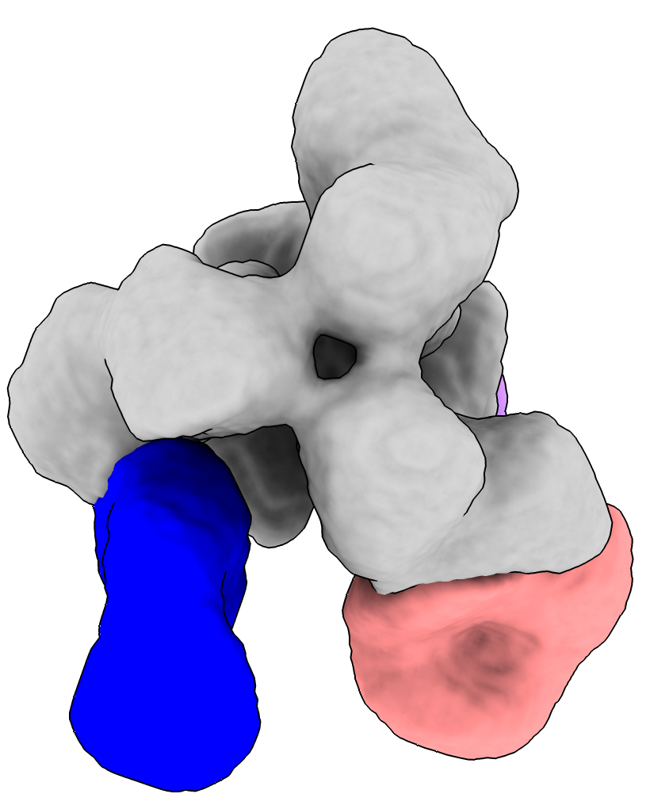
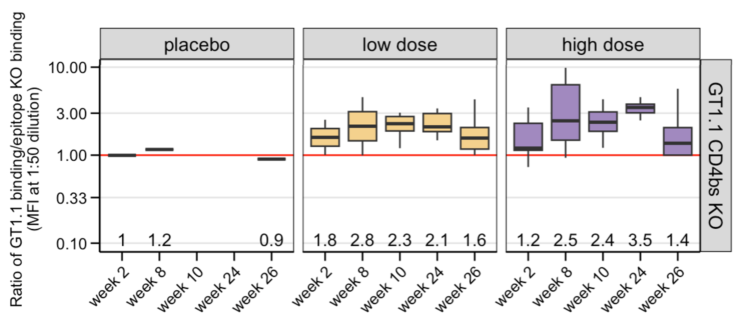
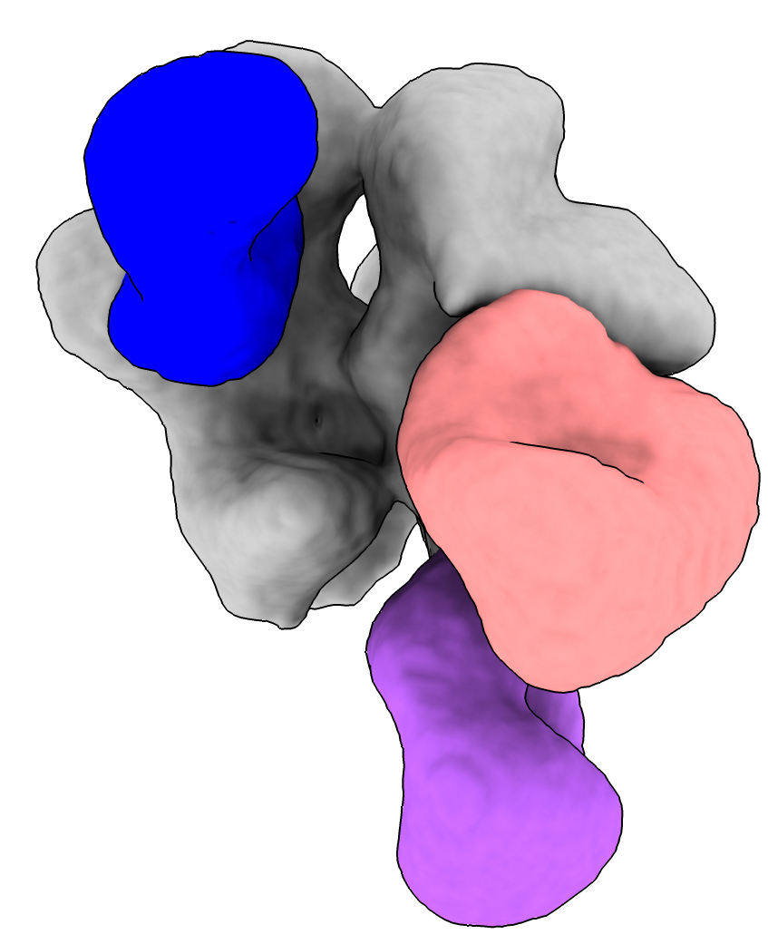
Background
Trial design & baseline characteristics
Safety
Serum binding
Serum neutralization
Conclusion
GT1.1 induces CD4 binding site-directed antibodies in humans
SR47-59
Env trimer
Top
CD4bs
gp120-GH
CD4bs
Using a CD4 binding site knock-out (KO) protein, we found an increased ratio GT1.1/GT1.1 epitope KO, indicating a CD4 binding site-directed response
Ratio >3 indicates a strong CD4 binding site-directed response
At W26 of high dose group we found CD4 binding site-directed antibodies using EMPEM
Side
gp120-GH
gp41-base
Grace Gibson, Wilma Lee, Ryan Lin, Andy Tran, Gabriel Ozorowski, Andrew Ward

Slide 9
Conclusion
BG505 SOSIP.GT1.1 gp140, adjuvanted with AS10b, has an acceptable safety profile and is well-tolerated
GT1.1 induces strong binding and neutralizing responses in both dose groups
GT1.1 induces CD4 binding site-directed antibody responses in the high dose group after three vaccinations
In follow-up studies (IAVI-C110 and -C107) we will try to boost this response with BG505 SOSIP.664 gp140 + 3M-052AF+Alum as polishing immunogen
Next presentation: Tom Caniels, in depth analysis of CD4 binding site-directed B cell response
Prime
‘Shape’
‘Polish’
Broadly neutralising
antibodies (bNAbs)
Germline
Image credit: David Goodsell
Depiction of germline-targeting Env trimers (pink) or boosting immunogens (pink with dark pink) binding to B cell receptors (green)

Slide 10
Acknowledgements
Amsterdam UMC (lab)
Rogier Sanders
Tom Caniels
Ronald Derking
Tom Bijl
Jonne Snitselaar
Joey Bouhuijs
Isabel Baken
María Ríos Carrasco
Marit Van Gils
Mathieu Claireaux
Rockefeller U
Marina Caskey
Katrina Millard
Martina Turroja
Melissa La Mar
Leah Todd
Irina Shimeliovich
Bennett Chirco
Juan Dizon
VRC / CCVIMC
Richard Koup
Adrian McDermott
Sarah Andrews
David Leggat
Madhu Prabhakaran
Jennifer Bohl
Abhinaya Srikanth
Weiwei Wu
Jalen Jean-Baptiste
Flavio Matassoli
Supra Gajjala
Rhianna Bronson
Rory Malek
Supra Gajjala
Duke University/CAVIMC
David Montefiori
Georgia Tomaras
Nicole Yates
Sheetal Sawant
Miroslawa Bilska
Marcella Sarzotti-Kelsoe
Hongmei Gao
Kelli Greene
Scripps Research
Andrew Ward
Gabriel Ozorowski
Wilma Lee
Jeffrey Copps
Leigh Sewall
Sara Richey
Hannah Turner
Shiyu Zhang
IAVI PDC
Angela Lombardo
Sangeetha Sagar
Dagna Laufer
Preveen Ramamoorthy
Vince Philiponis
Devin Hunt
Yelena Sigal
Francesco Sanchez
Heather Siefers
Jennifer Santos
Allison Kennedy
Letetia Mason
Kaylin Terhune
Stella Marincheva
Polina Kishinevskaya
Ricardo Yglesias
Melissa Schroeter
Dani Vooijs
Harriet Park
Eddy Sayeed
Kristen Syvertsen
Jane Halpern
Anna Schoenfelder
Min Ding
Lian Smink-van Ruitenbeek
Priyanka Agarwal
Venkateswarlu Yanamandra
Kofoworola Bombata
VISC
Ollivier Hyrien
Drienna Holman
Solmaz Shotorbani
Mike Duff
Yung-Wen Liu
Bhavesh Borate
Keith Curtis
Marie Vendettuoli
Valeria Duran
Kellie MacPhee
Cornell U
John Moore
Al Cupo
George Washington (GW)
David J. Diemert
Jeffrey Bethony
Aimee Desrosiers
Elissa Malkin
Larissa Scholte
Guacyara Erwin
Lara Hoeweler
Rafaela Thur
Anna Peterson
Etelvina Guerra
Hanna-Grace Rabanes
Laura Vasquez
Nadia Khati
Amsterdam UMC (clinic)
Godelieve de Bree
Karlijn van der Straten
Emma Reiss
Marinus Liesdek
Annelou van der Veen
Michelle Klouwens
Ronald van Leersum
Neeltje Kootstra
Agnes Harskamp
Rob Hurks
Liffert Vogt
Anita van Noort
Monique Kooijman
Azra Beganovic
Stefanie Krens
Nienke van Rein
GSK
François Roman
Marguerite Koutsoukos
Cécile Carton
Jasper Solomon
BMGF
Pervin Anklesaria
Susan Barnett
Carlos Diazgranados
Nina Russell
Emilio Emini
FNIH/CCVIMC
David Brown
Rebeca Salmeron
& our gratitude to all C101 participants
(& C107/C110 participants!)

