Slide 1
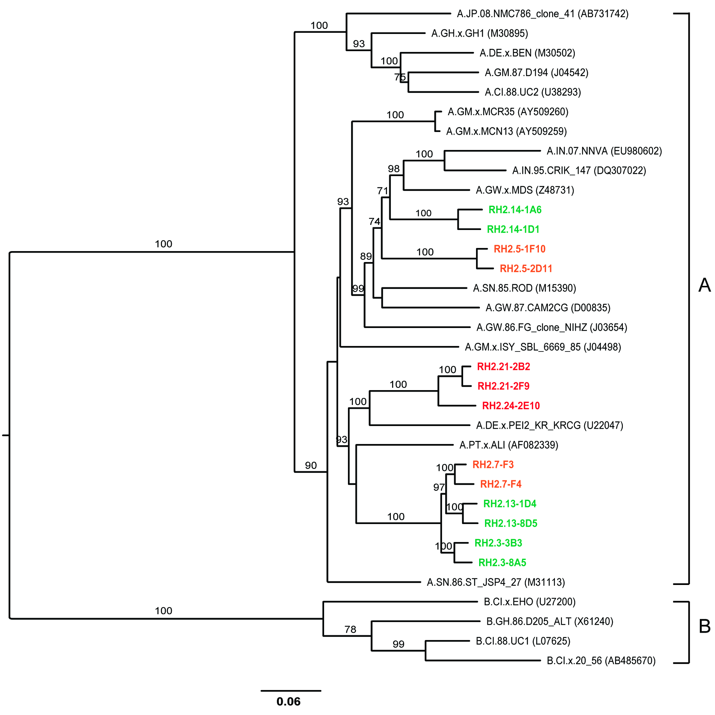
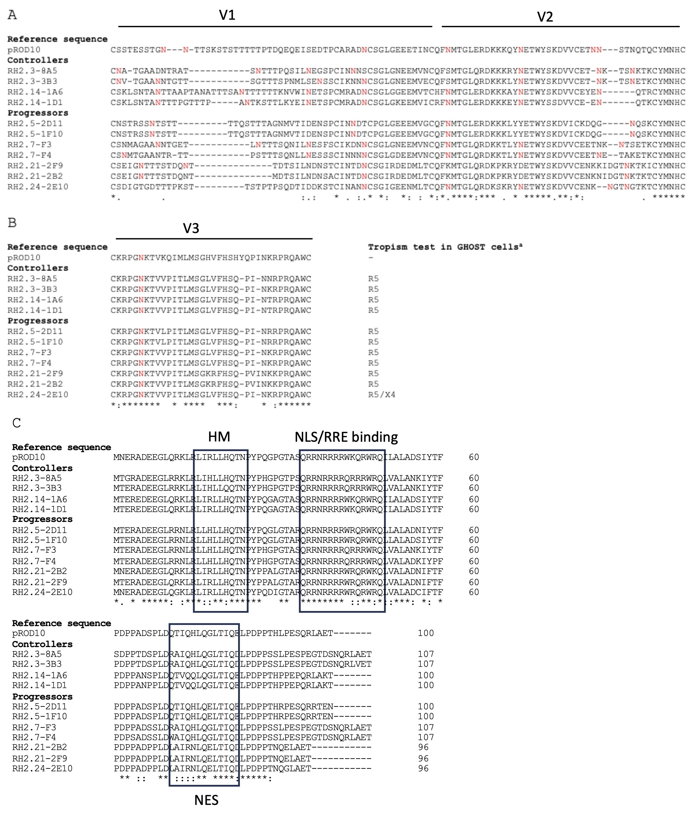
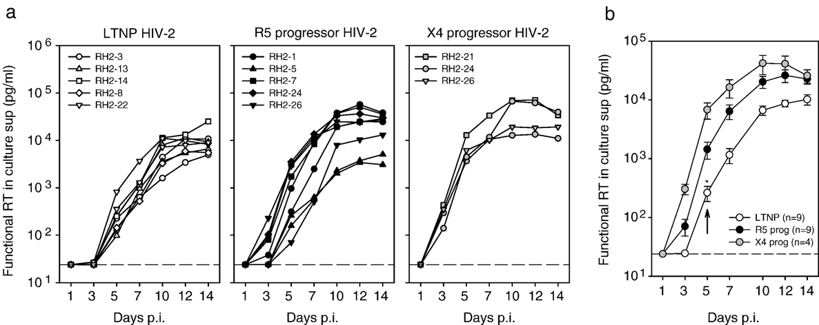
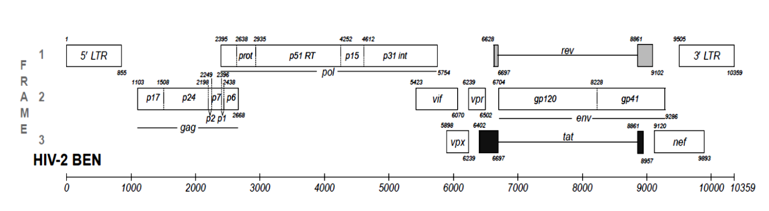
Genotypic and phenotypic characterization of replication competent HIV-2 isolated from controllers and progressors
Poster 17
Rob A. Gruters, Cynthia Lungu, Ronald Overmars, Esmée Grundeken, David A.M.C. van de Vijver, Jeroen J.A. van Kampen and Thibault Mesplede
From ¹Viroscience lab, Erasmus MC, Rotterdam
Contact: Erasmus MC, ‘s-Gravendijkwal 230, 3015 CE Rotterdam, the Netherlands. E-mail: r.gruters@erasmusmc.nl and t.mesplede@erasmusmc.nl
Introduction
While some HIV-2-infected patients develop severe immunodeficiency and AIDS-related complications similar to HIV-1-infected patients, most (>50%) have a better prognosis and may never develop AIDS in their lifetime. This dichotomous HIV-2 infection is reflected in the general immune activation as seen in CD4/CD8 ratio (Figure 1).
We have previously isolated biological clones from asymptomatic, aviremic individuals (long-term non-progressors (LTNP)) and HIV-2 progressors. We reported that HIV-2 variants from LTNP have lower replication rates than variants from individuals who progress to AIDS (Figure 2) suggesting an association between in vitro replication capacity and disease progression similar to what is known for HIV-1.
In this study we have sequenced and characterized complete genome sequences of HIV-2 biological clones from LTNP and progressors (Table 1) to identify viral factors that may be linked to biological phenotype.
Results
At the time of virus isolation (year 2001), HIV-2 LTNP had spontaneous suppression of plasma viral load (pVL) <50 copies/mL and stable >550 CD4 T cells/µL, without cART. One LTNP (RH2-13) experienced a sudden drop in CD4 T cells during follow up (2005) and cART was therefore started. Progressors had detectable pVL (>500 copies/mL) and 10-120 CD4 T cells/µL (Table 1).
We reconstructed Maximum likelihood trees based on whole genome nucleotide sequences and reference sequences from the Los Alamos HIV Sequence Database, as well as based on the amino acids of the individual ORFs and the LTR. A similar distribution over the subtype A tree was observed. Our phylogenetic analysis showed clusters consisting of both LTNP and progressors, indicating that fast progression is not a viral characteristic that can be distinguished at the genome level (Figure 4).
No distinct patterns were observed in terms of length or number of N-linked glycosylation sites within the V1-V2 region of Env sequences. The net charge of the V3 loop (# of basic amino acids) was higher in progressors, compared to LTNP but there were no distinctive differences in co-receptor usage (Figure 5).
In tat genes from biological clones with fast replication, there was bias towards a higher number of non-synonymous mutations vs. synonymous mutations. However, the activities of Tat and the LTR were not evidently different for biological clones with slow or intermediate replication (Figure 6).
Fig.1. T cell-ratios in individuals with aviremic (LTNP) and progressive HIV-2 infection.
Table 1: Characteristics of HIV-2-infected participants
a: CDC stage at time point of virus isolation (year 2001-2003)
b: Absolute CD4 T cell counts per µL of blood at time point of virus isolation
c: Copies of plasma viral RNA per millilitre
d: 2022 for RH2-3 and RH2-13, 2016 for others
* on cART
Abbreviations: RH2, Rotterdam HIV-2; pVL, plasma viral load; LTFU, Lost to follow up
Fig.2 a-b. Replication kinetics of HIV-2 variants from aviremic individuals (LTNP) vs progressors. Accumulation of functional RT activity in supernatants of acutely infected PBMCs consisting of a mixture of cells from 5 donors during 14 days of infection
Fig.5. Alignment for Env variable loops V1-2 (A), V3 (B) and Rev (C). Env: N-linked glycosylation sites are marked with an N. Rev: homo-multimerization region (HM), nuclear localization signal/Rev-response element-binding motif (NLS/RRE binding), and nuclear export signal (NES) are indicated.
Materials and Methods
HIV-2-infected individuals with undetectable (LTNP) (n=3) or detectable plasma viremia and progressive disease, progressors (n=4), were all attending the Rotterdam outpatient clinic. Two-to-three HIV-2 biological clones per patient were isolated by co-cultivation of patient PBMCs with healthy donor (CD8-depleted) PBMCs in limiting dilution series. Genomic DNA was isolated from infected cell pellets for PCR amplification of three overlapping regions spanning the entire HIV-2 genome (Figure 3). Purified PCR products were sequenced by Sanger sequencing, using BigDye® Terminator on an ABI Genetic Analyzer 3130 (Applied Biosystems). Contiguous sequences were assembled and visually inspected for quality using SeqMan Pro in DNASTAR software 10.1. Manual sequence editing and alignment by Clustal W was implemented in MEGA 7.0. Maximum-likelihood phylogenetic trees were reconstructed using PhyML 3.0. (http://www.atgc-montpellier.fr/phyml/).
Fig.4. ML phylogenetic tree of complete genome sequences of HIV-2 clones and HIV-2 subtype reference sequences. Tree was inferred based on a GTR+G+I model and verified by 1000 bootstraps. HIV-2 clones are colour-coded corresponding to their replication capacities: green= slow, orange =intermediate, and red= fast. Horizontal branch lengths are proportional to the scale bar indicating nucleotide substitutions per site.
Conclusions.
All patients included in this study were from the same epidemiological region and infected with HIV-2 group A, which makes our dataset homogenous. The distinction between the HIV-2 variants isolated from LTNP and progressors is mostly attributed to differences in replication capacities. Results from a cross-sectional sequence analysis of biological clones did not yet reveal major differences in viral factors that may be associated with spontaneous viral suppression in LTNPs. However, differences in tropism between slow and fast replication viruses may contribute to increased in vivo replication, due to a larger number of target cells for the latter.
Differences of Tat in combination with autologous LTR’s driving a reporter system did not show differences between progressors and controllers.
Longitudinal analysis of biological clones isolated from individuals that lose control may provide additional insights, therefore we further investigate HIV-2 progressors and LTNP in the Rotterdam cohort by regular sampling and biobanking (https://eheg.nl/en/Our-Projects/HIV-Biobank).
Figure 6. Conservation of transcriptional transactivation between HIV-2 controllers and progressors. A) Relative transactivation of LTRs from controllers and progressors in response to co-transfection with various amounts of a plasmid encoding the Tat protein from the reference virus ROD. Basal transcription levels were arbitrarily set to a value of 1 (dashed line) and did not differ between controllers and progressors (not shown). B) Relative transcriptional activity (in relative luminescence units, RLUs) of LTRs from controllers and progressors in response to co-transfection with various amounts of matched Tat from the same donor
References
van der Ende M et al 1996 AIDS vol 10 p1649 Guillon C, 1998 J Virol. vol 72 p6260–3
van der Ende M et al 2000 J Gen Virol. vol 81 p507–13 Blaak H et el 2004 JAIDS vol 36 p777-78
Blaak H 2005 Meth Mol Biol vol 304 p95–112 Blaak H et al 2005 J Virol. vol 79 p1686–700
Blaak H et el 2006 Virology vol 353 p144-154 Blaak H et al 2008 ARHR. vol 24 p473–84
Khalid M 2012 J Virol. vol 86 p4906–20 Yu H et al 2013 Retrovirology, vol 10 p27
Nyamweya S et al 2013 Rev Med Virol vol 23 p221–40 Esbjörnsson J et al, 2019 AIDS Res Ther vol 16 p24
Genbank accession numbers: MF595854.1 to MF595866.1
HIV-2 biological clones can be obtained through the EVAg program:
https://www.european-virus-archive.com/search/node/HIV-2
Supported by a grant from the Dutch AIDSfonds (60804)
Fig.3. Amplification strategy to obtain full-genome sequences for HIV-2 biological clones.

