Slide 1
Majority of infected cells from peripheral blood of ART-treated individuals transcribe HIV-1 cell-associated gag RNA
Alexander O. Pasternak

Slide 2
Disclosure of speaker’s interests
None

Slide 3
HIV-1 persistence = silence?
HIV DNA+ cell

Slide 4
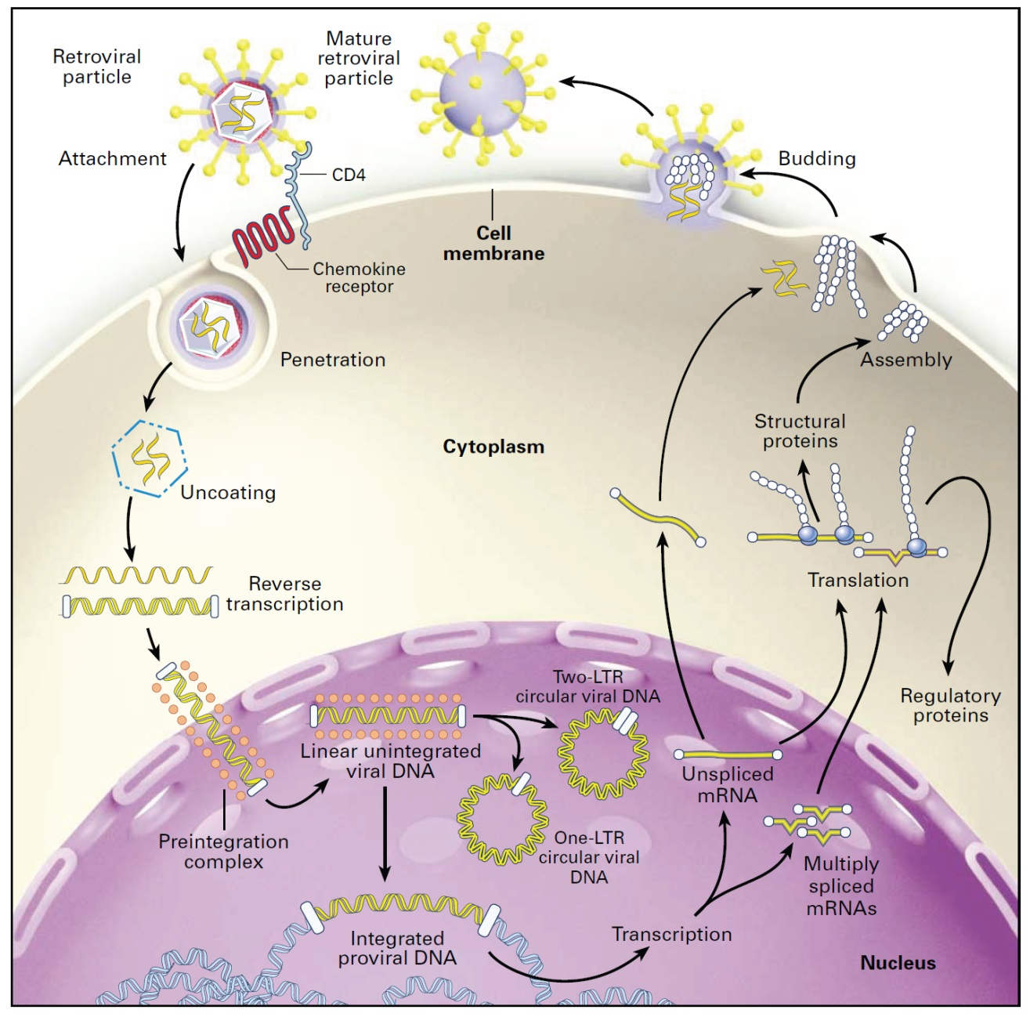
ART does not stop viral gene expression

Slide 5
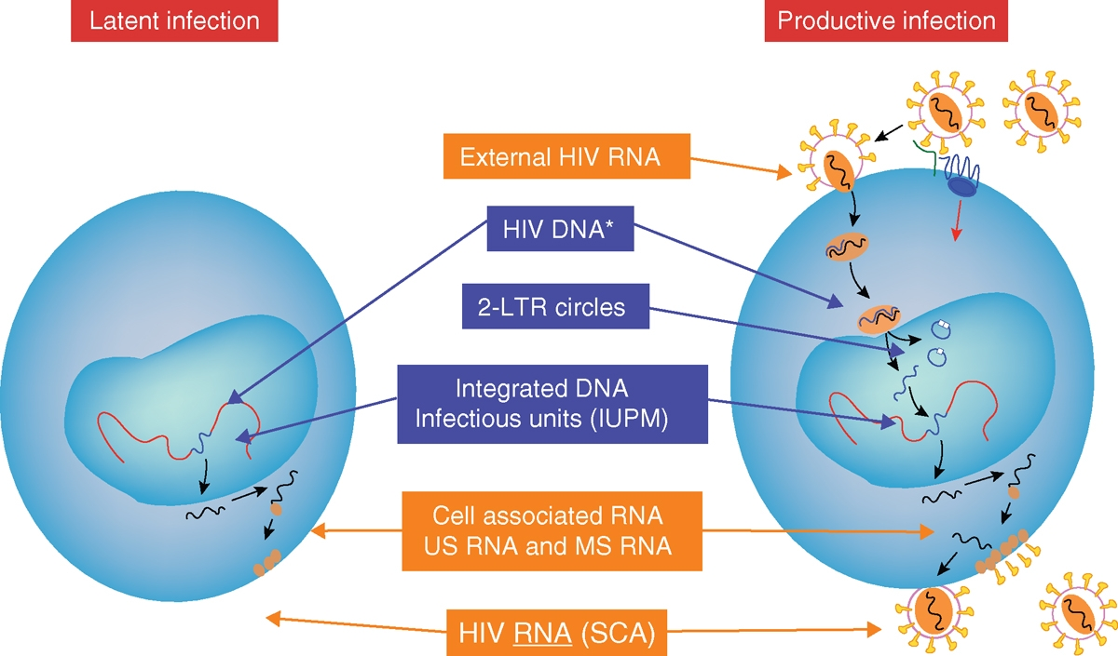
Latently infected cells can transcribe viral RNA

Slide 6
How big is the active reservoir?

Slide 7
How big is the active reservoir?
5%?

Slide 8
How big is the active reservoir?
10%?

Slide 9
How big is the active reservoir?
25%?

Slide 10
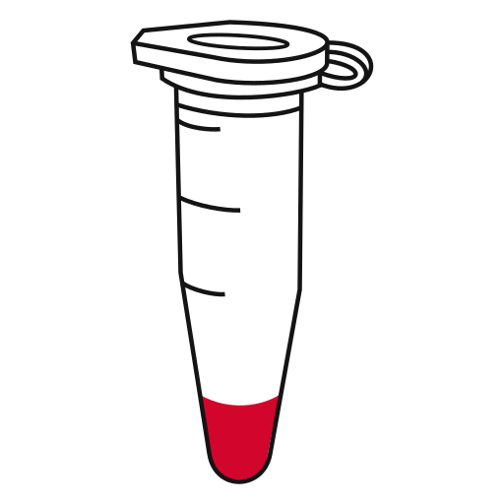
Bulk cell-associated HIV RNA levels are not informative about the size of the active reservoir
100 cells with 1 copy/cell
10 cells with 10 copies/cell
100 copies HIV-1 RNA

Slide 11
AREA (Active Reservoir Evaluation Assay)
Optional: cell stimulation
PBMCs from HIV-infected individual
Limiting dilution in
0.5 million uninfected
donor PBMC/well
RNA isolation
by the Boom method
DNase treatment
PBMC per dilution
2,000,000
500,000
125,000
31,250
7,813
1,953
488
122
US RNA+ cells
MS RNA+ cells
One-step RT + 1st PCR
(multiplex US + MS RNA)
qPCR US RNA (gag)
qPCR MS RNA (tat/rev/nef)
Frequencies of US+ or MS RNA+ cells are determined using the maximum likelihood method
AREA corrects for a number of factors that influence the output: (i) RT-PCR inhibition by cellular RNA, (ii) primer/probe-template mismatches, (iii) RNA loss during isolation, resulting in improved assay precision

Slide 12
Frequencies of cells containing HIV-1 molecular forms
3 viremic therapy-naïve individuals, 5 aviremic ART-treated individuals, 2 elite suppressors
834 PBMC samples
No ex vivo cell stimulation performed
All HIV-1 forms detectable in all participants
Groen et al., J Clin Invest., in revision

Slide 13
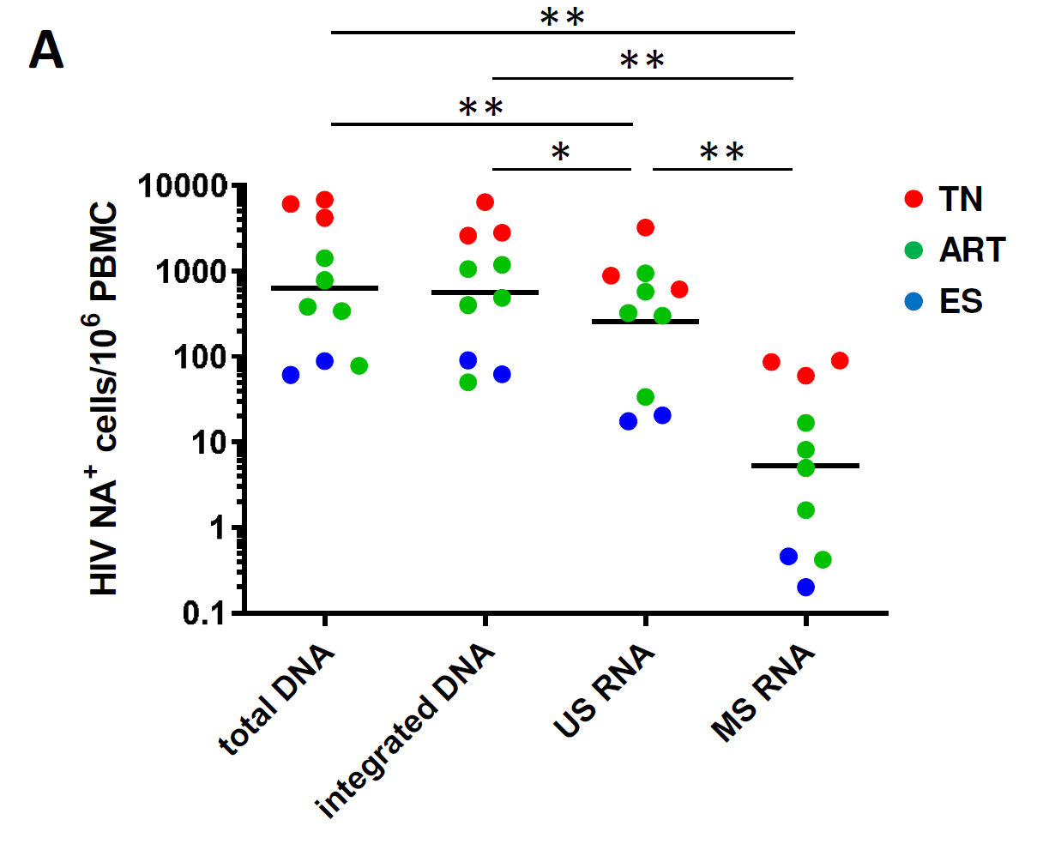
Frequencies of cells containing HIV-1 molecular forms
Groen et al., J Clin Invest., in revision

Slide 14
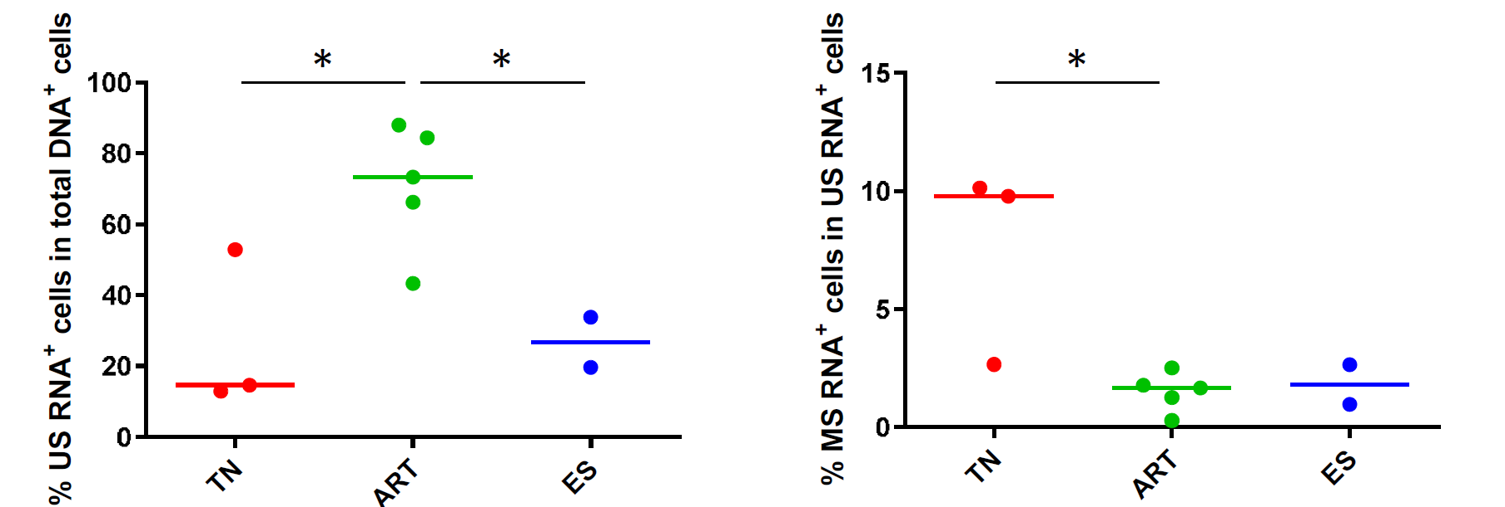
Majority of infected cells from peripheral blood of ART-treated individuals transcribe HIV-1 cell-associated gag RNA
% US RNA+ cells
among total DNA+ cells
% MS RNA+ cells among US RNA+ cells
Groen et al., J Clin Invest., in revision

Slide 15
US and MS RNA average copy numbers per expressing cell
US RNA
MS RNA
*
Groen et al., J Clin Invest., in revision

Slide 16
US and MS RNA copy numbers per expressing cell – single cells
US RNA
MS RNA
Groen et al., J Clin Invest., in revision

Slide 17
HIV-1 persistence ≠ silence
US RNA
MS RNA

Slide 18
Conclusions
AREA revealed a large, previously underestimated, HIV-1 US RNA+ reservoir in ART-treated individuals, questioning transcriptional latency as the main mechanism of HIV-1 persistence on ART
US RNA copy numbers per expressing cell in ART-treated participants and elite suppressors were as high as in therapy-naïve participants, arguing against the shutdown of viral transcription as a principal mechanism of HIV-1 persistence on ART and in natural controllers
The low percentages of MS RNA+ cells in all groups imply that with or without ART, most US RNA+ cells are not productively infected
Our results support the shift of HIV-1 latency paradigm from silence to transcriptional activity and argue for the corresponding shift of HIV-1 latency reversal strategies from stimulating HIV-1 transcription initiation and proximal elongation to the downstream steps such as distal elongation, splicing, or nuclear export of HIV-1 RNA
AREA can serve as a robust tool for the measurement of HIV-1 reservoir in curative interventions

Slide 19
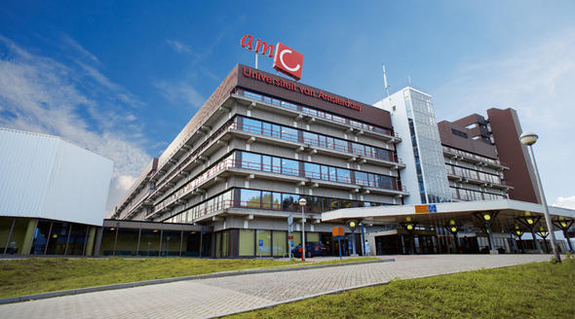
Kevin Groen
Maria Feuchert
Aurelija Cicilionytė
Philipp Adams
Yara L. Verschoor
Gilles Darcis
Marilia R. Pinzone
Laura K. DeMaster
Una O’Doherty
Ben Berkhout

