Slide 1
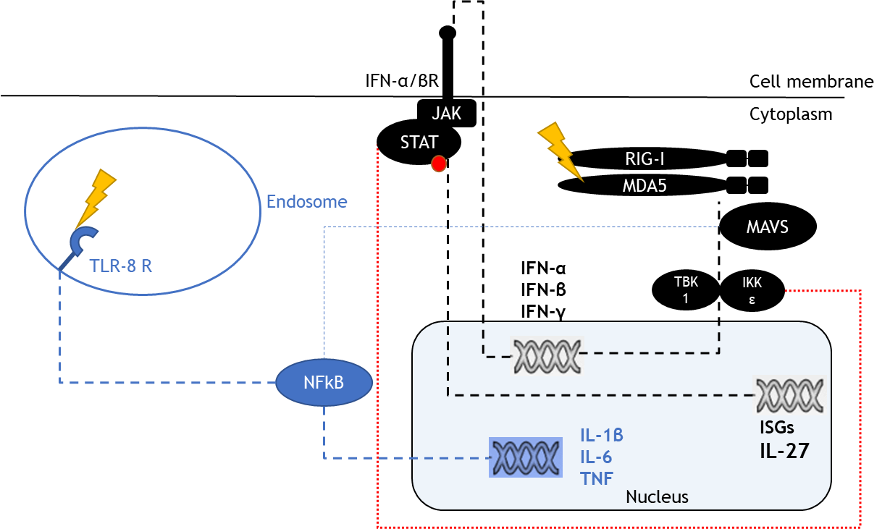
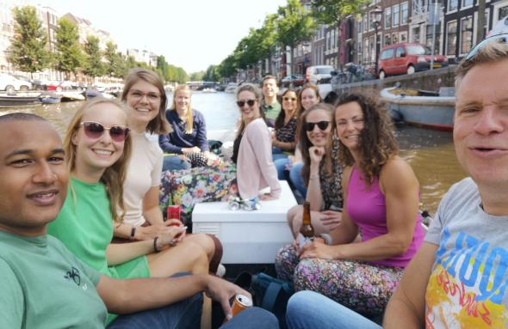
Amsterdam Institute for Infection and Immunity
Co-stimulation of TLR-8 and RIG-I-like receptors to eliminate re-activated HIV-1 reservoirs by enhancing antiviral immune responses
Killian E. Vlaming, MD^{1,2}, Kelly van Wijnbergen^{1,2}, Tanja M. Kaptein^{1,2}, Monique Nijhuis, PhD³, Neeltje A. Kootstra, PhD^{1,2}, Godelieve J. de Bree, MD, PhD⁴, Teunis B. Geijtenbeek, PhD^{1,2}
¹ Amsterdam UMC location University of Amsterdam, Department of Experimental Immunology, Meibergdreef 9, Amsterdam, The Netherlands;
² Amsterdam institute for Infection and Immunity, Amsterdam, The Netherlands
³ Translational Virology, Department of Medical Microbiology, University Medical Center Utrecht, 3584 CX Utrecht, The Netherlands
⁴ Amsterdam UMC location University of Amsterdam, Department of Internal Medicine, Meibergdreef 9, Amsterdam, The Netherlands.
Introduction
HIV-1 cure requires elimination of HIV-1 reservoirs consisting of latent infected immune cells. Toll-like receptor (TLR) agonists have been investigated due to their potential dual effects as latency reverting agents (LRAs) and immune modulatory compounds. In particular strong antiviral immunity would be required to eliminate HIV-1 reactivated cells.
We have recently shown that crosstalk between TLRs and RIG-I-Like Receptors (RLRs) enhances antiviral immunity. We investigated therefore whether co-stimulation of TLR-7/8 agonists with RLR agonists enhances antiviral immunity.
Theory
1
TLR-8 stimulation causes cytokine production in MoDCs
RIG-I/MDA5 : MAVS pathway Stimulating both receptors in tandem leads to a powerful signal which leaves IKKε turned on when type-I IFNs are taken up by the interferon receptor. This phosphorylates STAT. That signal will lead to the production of IL-27 as well as other ISGs.
TLR : NFκB
TLR 7&8 are both endosomal ssRNA receptors. TLR 7 research is extensive and without much promise, not so for TLR-8.
We know that TLR-8 activation leads to a strong activation of NFκB and production of various cytokines like IL-1b, -6 and -12.
N=3
N=3
2
Stimulation with new TLR-agonists generate similar responses in PBMCs
3
Co-stimulation of TLR-8 and RLR induce antiviral responses in MoDCs
LC
*
***
N=3
N=3
N=3
N=3
4
Co-stimulation of TLR-8 and RLR induces IL-12 secretion in PBMCs
N=3
N=3
N=3
N=3
Vesatolimod (GS-9620): specific TLR-7 agonist Gardiquimod: specific TLR-7 agonist
Telratolimod (3M-052): TLR-7/8 agonist
Selgantolimod (GS-9688): specific TLR-8 agonist
Motolimod (VTX-2337): specific TLR-8 agonist
Conclusions
Stimulation via TLR-8 induces potent immune activation in MoDCs and PBMCs
Co-stimulation of TLR-8 and RIG-I like receptors have synergistic effects on both IL-12 and ISGs
This effect is preserved through various compounds, hinting that this is system dependent.
Acknowledgements
Host
Defence
Funding & contact
Collaboration to this work was provided by the following departments:
Department of Experimental Immunology (UMC Amsterdam),
Department of Internal Medicine (UMC Amsterdam),
Department of virology (UMC Utrecht)
K.E. Vlaming: k.e.vlaming@amsterdamumc.nl
This work was supported by the Dutch Research Council (NWO-ZonMw) grant nr 44600250.

