Slide 1
Detection of Intact HIV proviral DNA in the CNS of a virally suppressed HIV-infected individual
NCHIV meeting
Marieke Nühn
22-11-2022

Slide 2
Disclosure of speaker’s interest
(Potential) conflict of interests | None
Relations that could be relevant for the meeting | None

Slide 3
Introduction
Central nervous system (CNS) is a potential viral reservoir for HIV^{1,2}
Contributing to the development of HIV-associated dementia (HAND)³
Foci of infected CNS cells of virally suppressed individuals^{4,5,6}
1-10% of the microglia/macrophage cells are infected
Are these capable of producing replication-competent virus?
Examining genomic intactness: IPDA
Phenotypical characterization of viral envelope gene
1. Joseph et al. 2015. 2. Bednar et al. 2015. 3. Rojas-Celis et al. 2019. 4.Churchill et al. 2006. 5.Thompson et al. 2011. 6. Trillo-Pazos et al. 2003.

Slide 4
Patient Characteristics
65-year old male
Long-term ART (undetectable viral load <50cp/mL)
At least for 4 years
Died of pneumonia
Post-mortem biopsies of 3 brain regions:
Frontal lobe, occipital lobe and the subventricular zone
Created with: Biorender.com

Slide 5
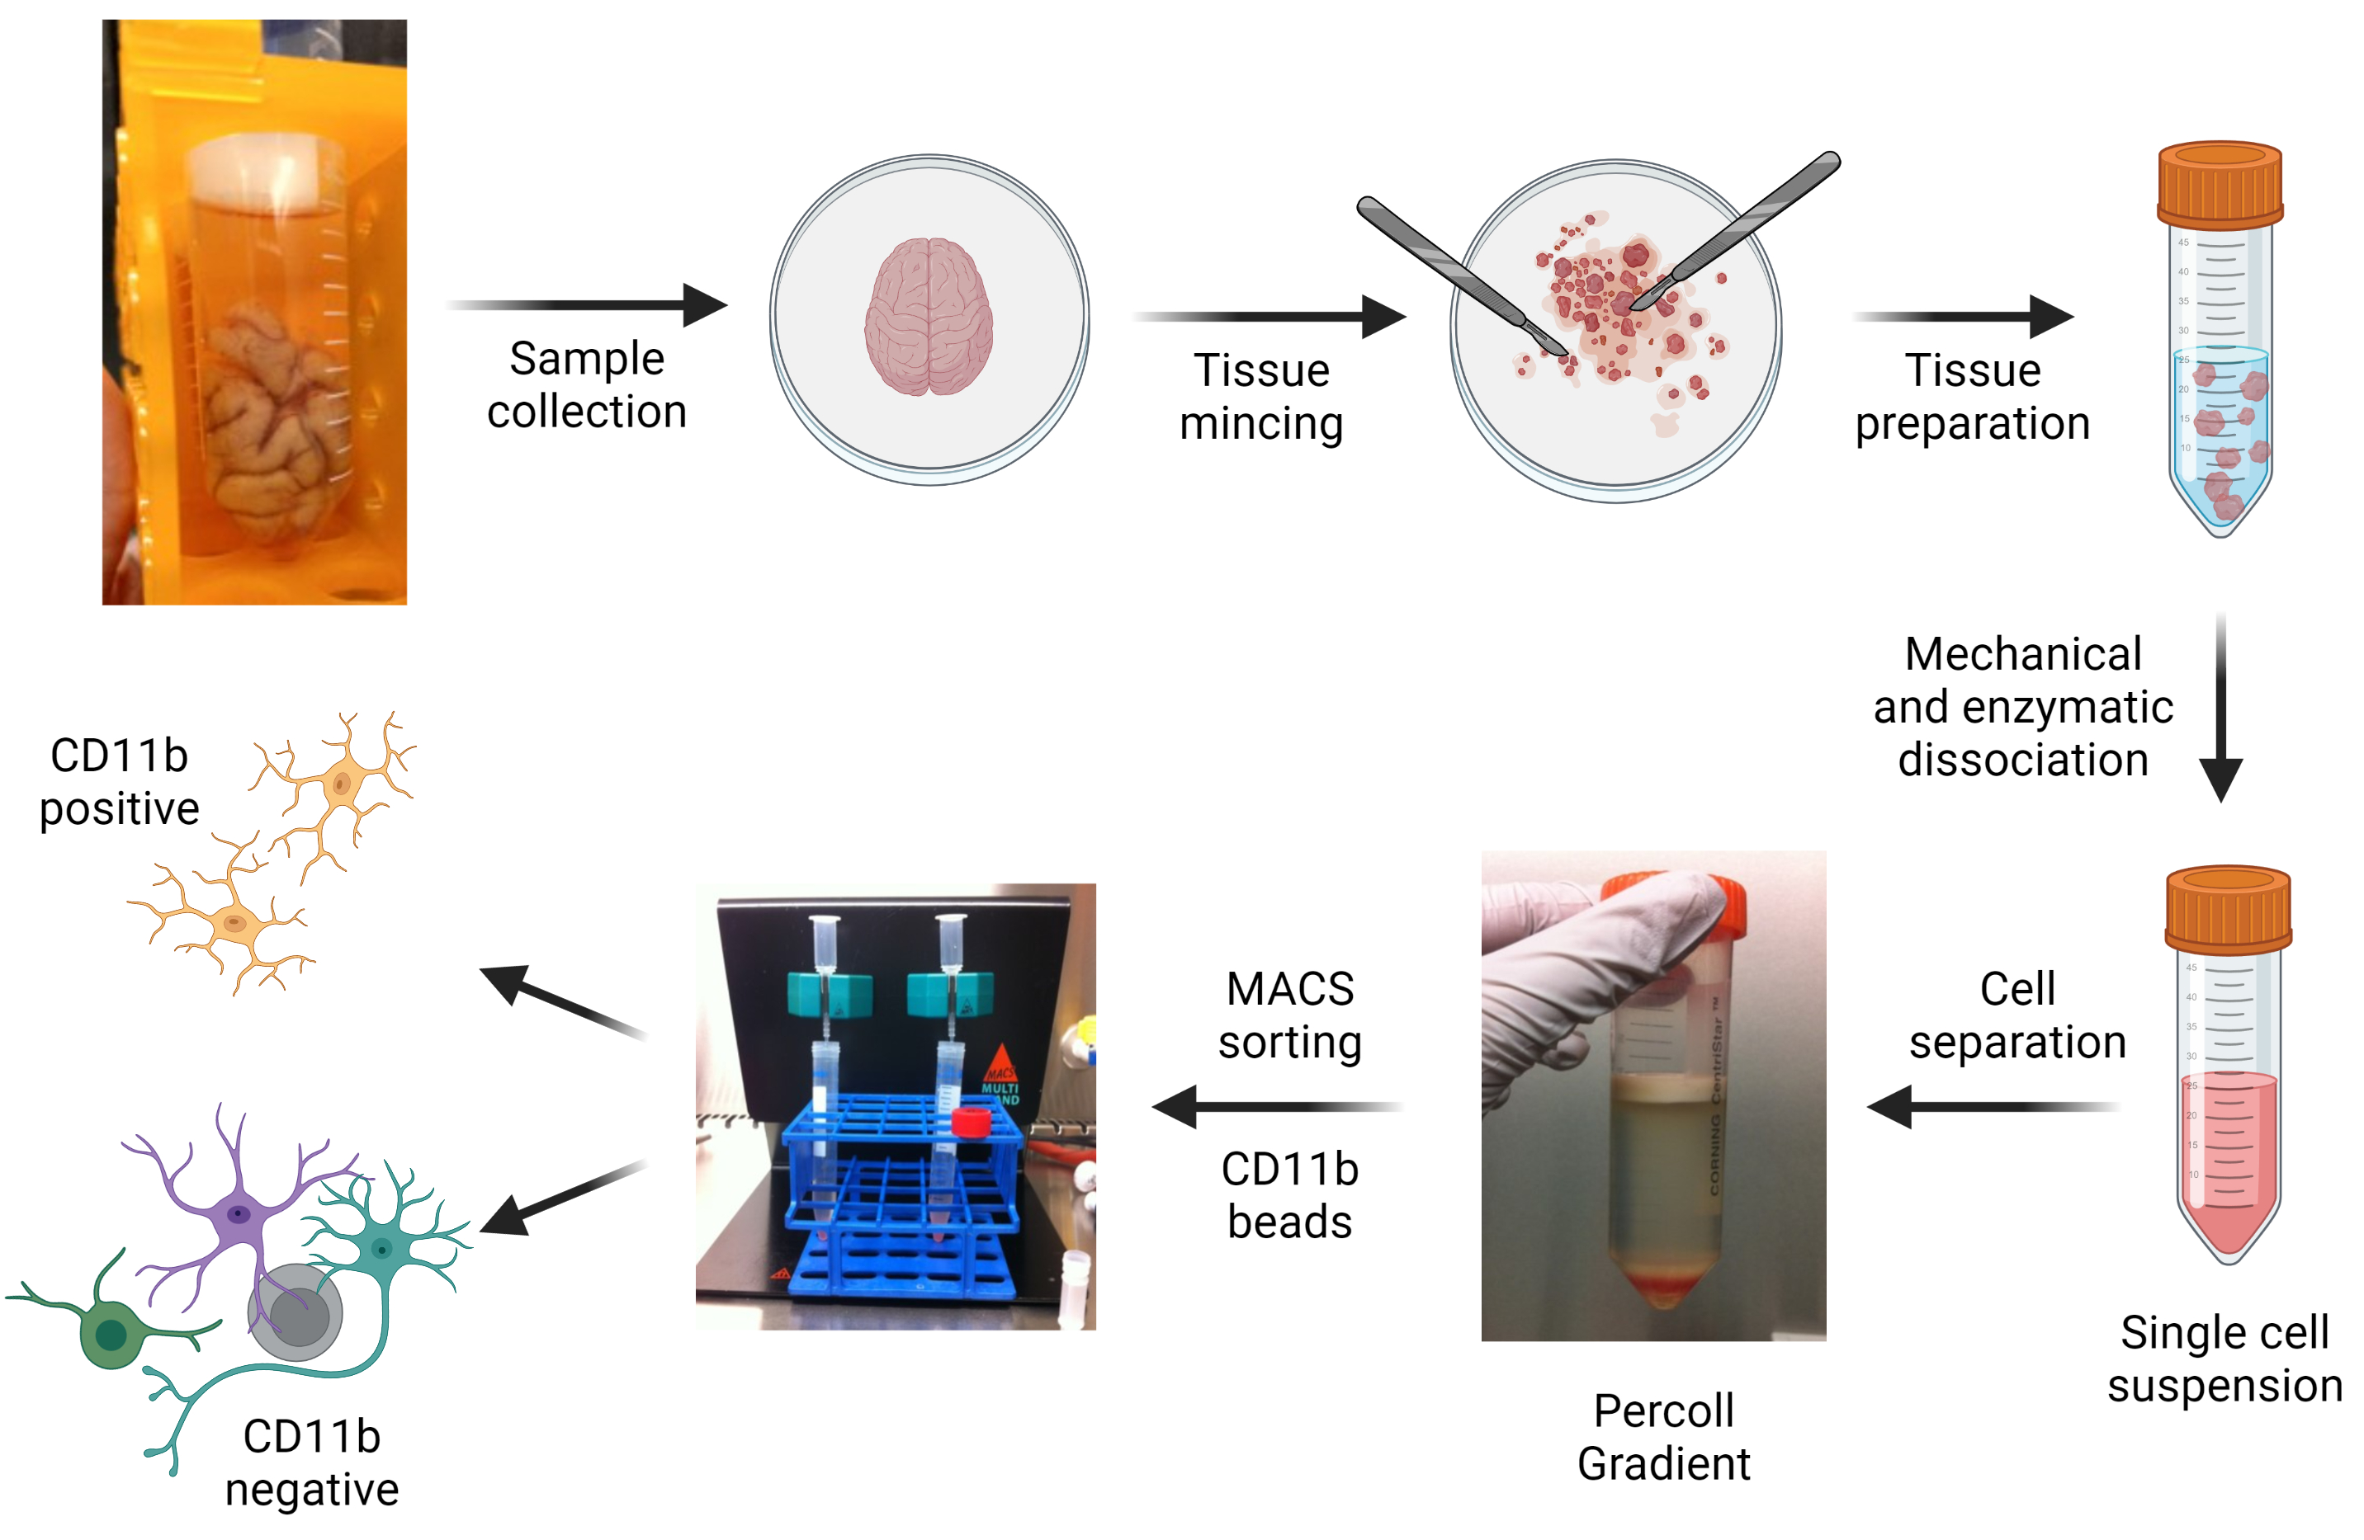
Methods
Tissue mincing & mechanical and enzymatic dissociation
Microglia enrichment; CD11b⁺ isolation
Created with: Biorender.com

Slide 6
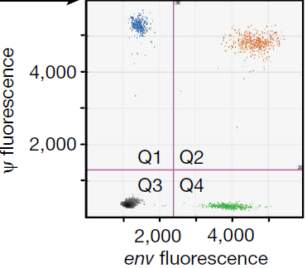
Intact Proviral DNA Assay (IPDA)
Most widely-used PCR detects total proviral DNA (intact & defective)^{1,2}
Digital droplet PCR (ddPCR); sample in +/- 20.000 droplets
IPDA: which droplet contains intact proviral DNA?²
X
X
Psi present and 3’ deletion/hypermutation
Env present and 5’ deletion
Double positive →intact
1. Ho et al. 2013. 2. Bruner et al. 2019

Slide 7
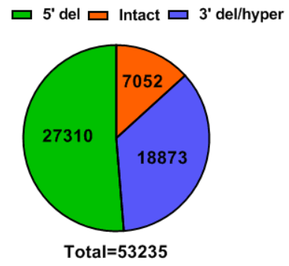
Detection of intact HIV DNA within CNS cells
13% of proviruses were intact
Intact proviral DNA is 2.8 fold higher in microglia-enriched fraction
Occipital lobe harbors most intact proviruses
CD11b pos. CD11b neg.
FRONT
OCC
SVZ

Slide 8
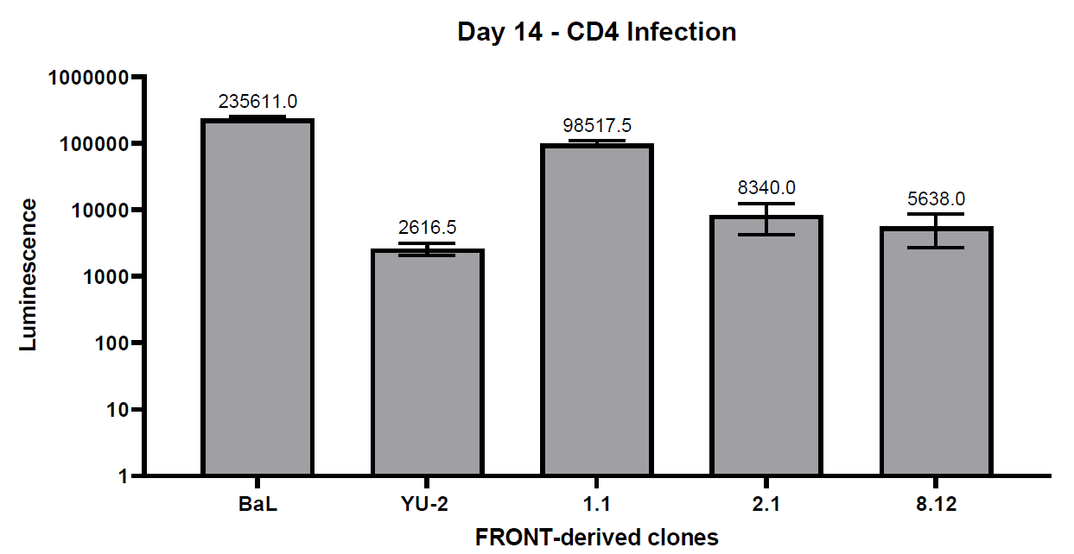
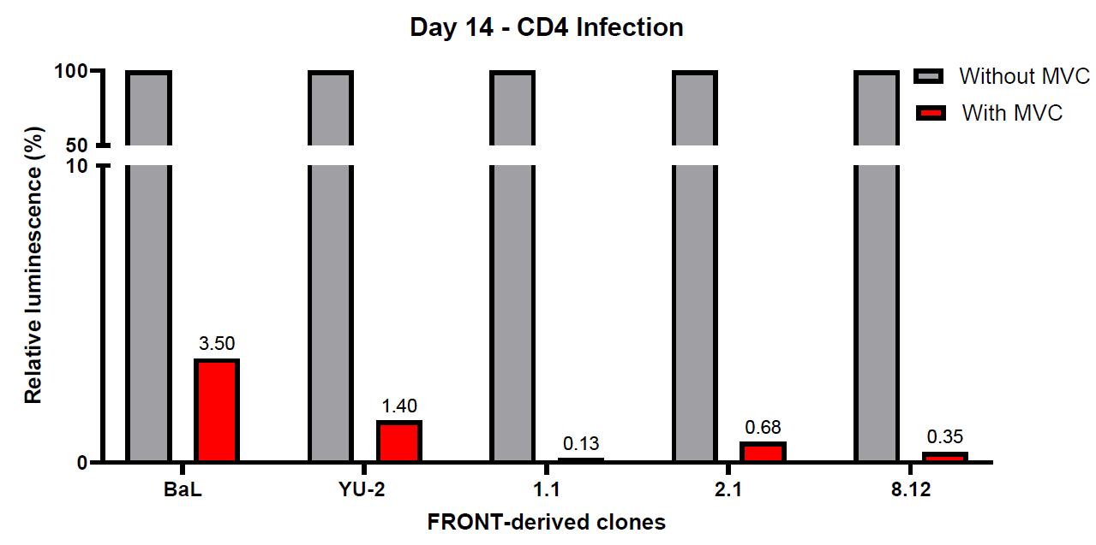
Replication competent virus?
CD11b⁺ fraction of frontal lobe; generation of full-length envelope reporter viruses
Phenotypical characterization in CD4⁺ T cells
Productive infection and replication up to 14 days
Inhibition by Maraviroc (CCR5 receptor)
Notes:
To further characterize the reservoir, we have cloned the full-length envelope and infected CD4 cells with these clones.

Slide 9
Discussion & Future research
Presence of intact HIV proviral DNA in different regions
In microglia, but also in non-myeloid cells
CD4⁺ T cells, astrocytes or residual microglia?
Replication competent and require CCR5 receptor for viral entry
Future characterization of HIV in the CNS
Persistence mechanisms
Impact of HIV-infection on CNS cells

Slide 10
Acknowledgements
Stephanie Gumbs
Pauline Schipper
Lavina Gharu
Ninée Buchholtz
Gijsje Snijders
Frederieke Gigase
Jori Symons
Susan Morgello
Annemarie Wensing
Lot de Witte
Monique Nijhuis
Manhattan HIV Brain Bank
ICD-ICK4HIVCure
Notes:
Supported by …
Collaborations with ..

