Slide 1

Pyrimethamine reverses HIV latency in people with HIV on ART
Results from a randomized controlled clinical trial
Henrieke Prins
22 November, 2022

Slide 2
Disclosure of speaker’s interests
(Potential) conflict of interest | None
Relations that could be relevant for the meeting | None

Slide 3
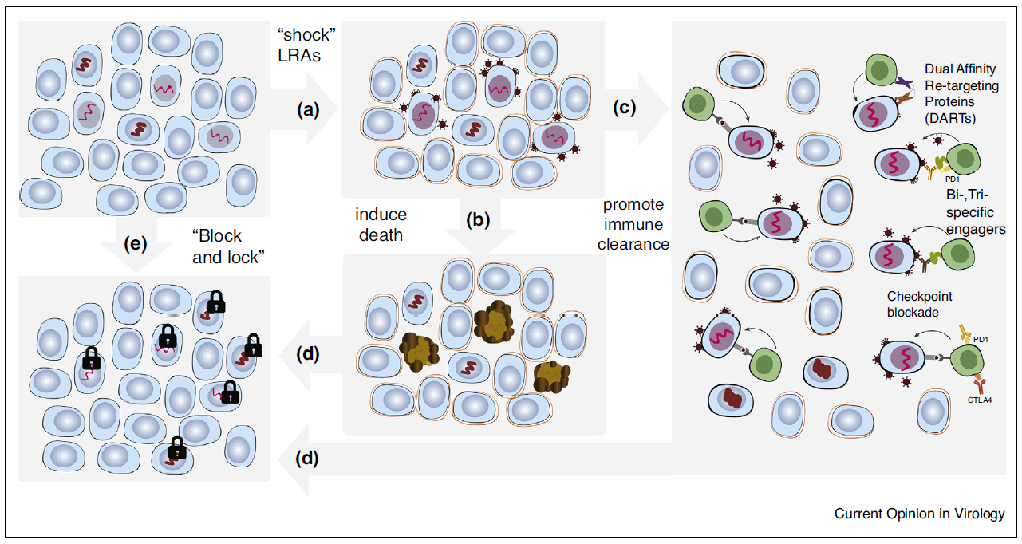
Background: why no cure?
Replication-competent latent HIV reservoir can spark viral rebound when ART is stopped

Slide 4
Background: cure strategies
Stoszko et al. Current Opinion in Virology 2019
Latency reversing agents (LRAs) can reactivate the latent HIV reservoir

Slide 5
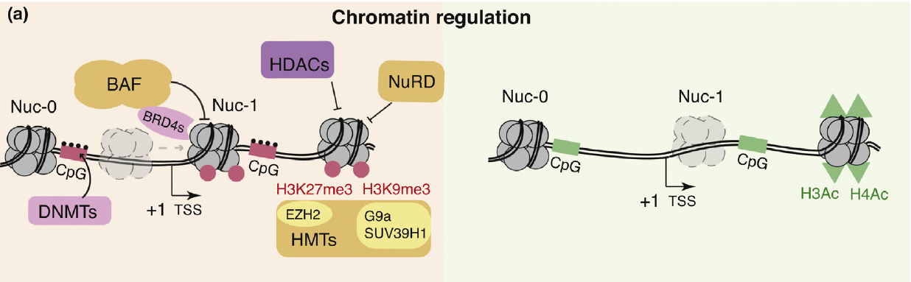
Background: role of BAFi and HDACi
The BAF complex is a key repressor of HIV transcription
  BAF complex inhibitors (BAFis) can act as LRAs
  BAFis enhance the effect of other LRAs ex-vivo (i.e. histone deacetylase inhibitors)
Stoszko et al. Current Opinion in Virology 2019

Slide 6
LRA’s United as Novel Anti-HIV strategy
Investigate the impact of pyrimethamine (BAFi) and valproic acid (HDACi) on the HIV reservoir
Primary endpoint:
Δ in HIV reactivation measured as Δ in cell associated (CA) HIV-RNA after start of treatment
Secondary endpoints:
Δ in reservoir size (Tat/rev Induced Limiting Dilution Assay (TILDA)) after start of treatment
Clinical safety and tolerability of the administered compounds

Slide 7
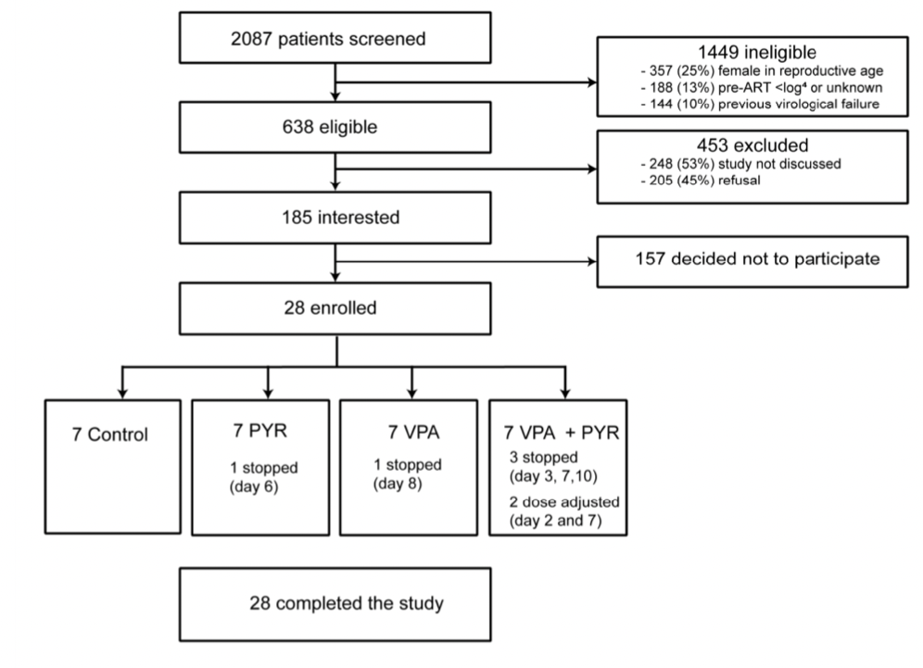
Study flow diagram

Slide 8
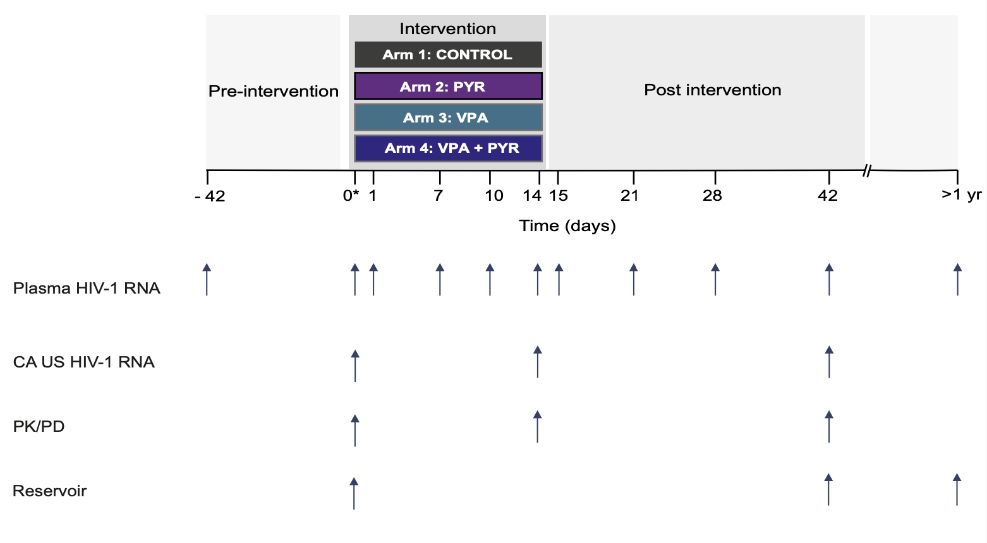
Study design overview

Slide 9
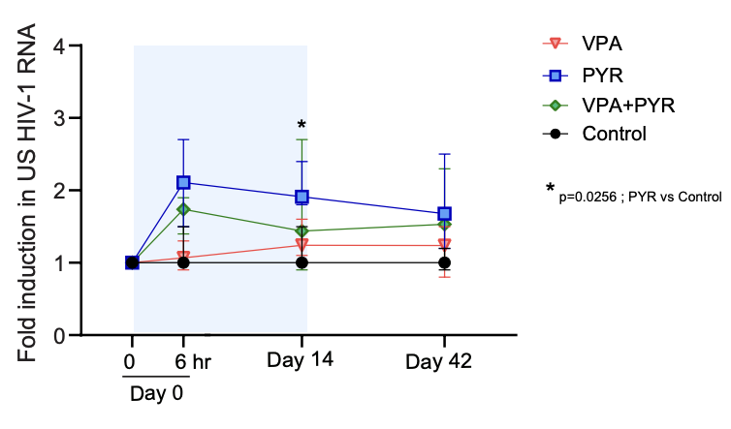
Changes in CA HIV-RNA per arm at four time points during the LUNA study
Pyrimethamine: rapid and sustained increase in CA HIV-RNA in CD4+T-cells
Valproic acid: no increase in CA HIV-RNA, no synergistic effect

Slide 10
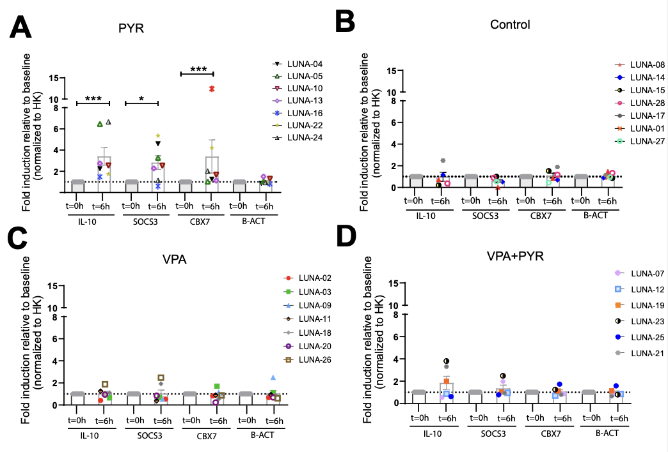
Gene expression profile of BAF complex molecular targets
BAF target gene expression corresponded to pyrimethamine-induced HIV reservoir reactivation

Slide 11
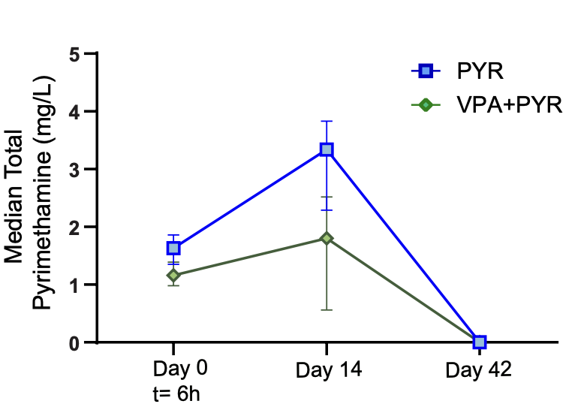
Median total plasma levels in study arms involving pyrimethamine
Pyrimethamine plasma levels corresponded to pyrimethamine-induced HIV reservoir reactivation
No reduction in inducible reservoir size as determined by TILDA (data not shown)
No serious adverse events, but physician-directed treatment adjustments occurred

Slide 12
Conclusion
Pharmacovigilance in HIV cure trials involving combinatorial (LRA) strategies is important
Pyrimethamine reverses HIV latency in vivo, supporting its advancement in clinical studies
Valproic acid is not a clinically useful LRA in HIV cure research
The optimal partner drug for pyrimethamine is to be determined

Slide 13

Acknowledgement
All participants of the LUNA trial
All member of the Erasmus MC HIV Eradication Group (https://eheg.nl)
All lab technicians, phlebotomists, hiv nurse practitioners, outpatient staff members
Erasmus MC Mrace (2016)
Pharmacy Radboudumc
Angela Colbers
David Burger
Biochemistry
Tokameh Mahmoudi
Shringar Rao
Raquel Crespo
Robert-Jan Palstra
Tonmoy Hossein
Infectious diseases
Annelies Verbon
Casper Rokx
Albert Groenendijk
Mariana de Mendonca Melo
Hannelore Bax
Bart Rijnders
Eric van Gorp
Dorine de Vries
Els van Nood
Jan Nouwen
Karin Schurink
Rene van Engen†
Viroscience
David van de Vijver
Charles Boucher†
Rob Gruters
Thibault Mesplede
Jeroen van Kampen
Cynthia Lungu
Ronald Overmars
Georgina Arron
Jeroen IJpelaar
Janet de Wilde
Pharmacy
Birgit Koch
Letao Li
Immunology
Peter Katsikis
Yvonne Muller
Biostatiscis
Grigorios Papageorgiou

Slide 14
Back up

Slide 15
Baseline Characteristics | Overall n =28 | PYR N=7 | VPA N=7 | PYR+VPA N=7 | Control N=7
Male | 28 (100) | 7 (100) | 7 (100) | 7 (100) | 7 (100)
Ethnic origin
-White European | 24 (86) | 4 (43) | 7 (100) | 6 (86) | 7 (100)
-Latin American or Hispanic | 3 (11) | 3 (57) | 0 | 0 | 0
-Black Caribbean | 1 (4) | 0 | 0 | 1 (14) | 0
Age (years) | 54 (47-61) | 53 (48-55) | 51 (54-67) | 51 (45-58) | 55 (51-64)
HIV subtype Bª | 24 (85.7) | 7 (100) | 6 (86) | 6 (86) | 5 (71)
History of AIDS | 8 (29) | 2 (29) | 1 (14) | 3 (43) | 2 (29)
Years from HIV diagnosis until inclusion | 8.5 (7.5-15.4) | 7.7 (7.5-14.5) | 7.8 (7.6-12.8) | 7.6 (5.2-9.4) | 15.6 (10.5-20.2)
Years on cART | 7.5 (5.6-11.7) | 7.3 (6.4-12.0) | 7.6 (6.1-10.8) | 5.6 (4.7-7.4) | 9.8 (8.0-13.0)
Years with HIV-RNA <50 copies per mL | 6.8 (4.9-11.1) | 6.7 (5.1-11.5) | 7.2 (5.4-9.5) | 5.1 (4.5-7.1) | 7.2 (5.2-12.5)
Initiated cART during acute HIV infection | 3 (11) | 2 (29) | 1 (14) | 0 | 0
Pre-cART plasma viral load zenith log₁₀ copies per mL | 4.9 (4.7-5.3) | 5.3 (4.9-5.6) | 4.8 (4.6-5.0) | 4.9 (4.8-5.0) | 4.9 (4.7-5.4)
Pre-cART nadir CD4+ T-cell count per µL | 235 (160-315) | 290 (135-310) | 250 (225-295) | 240 (175-420) | 210 (170-225)
CD4+ T-cell count per µL at inclusion | 665 (530-820) | 610 (490-770) | 750 (560-810) | 630 (475-1005) | 680 (590-740)
cART
-NNRTI based^{b} | 16 (57) | 5 (71) | 4 (57) | 4 (57) | 3 (43)
-INSTI based^{c} | 12 (43) | 2 (29) | 3 (43) | 3 (43) | 4 (57)

Slide 16
No SAEs and no SUSARs
Total number of self-reported AE adverse events and their severity during trial participation per study arm
Three grade 3 AEs (syncope): two related to blood draw
All study-related AEs resolved (n = 91)
Most commonly reported AEs included nausea (n = 12), vomiting (n = 12), vertigo (n = 6), and headache (n = 6)

