Slide 1
Abortive HIV RNA in serum inversely correlates with transcriptional activity of the HIV reservoir in People with HIV
Stefanie Kroeze
Amsterdam UMC location University of Amsterdam
Department of Experimental Immunology
Amsterdam institute for Infection and Immunity
NCHIV 2023
s.kroeze@amsterdamumc.nl

Slide 2
Disclosure of speaker’s interest
None
None

Slide 3
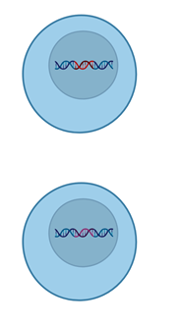
Challenges in detecting and measuring the HIV-reservoir
Active reservoir
Latent reservoir
The HIV-reservoir is heterogeneous!

Slide 4
Current assays
Total HIV-DNA
Integrated HIV DNA
Cell associated HIV DNA
Cell associated HIV RNA
Intact pro-viral DNA assay (IPDA)
Viral out-growth assay (qVOA)
Transcription competent reservoir
Translation competent reservoir
Replication competent reservoir
Depends on cells and labour intensive

Slide 5
Development of PCR-based assay measuring a marker of the HIV-reservoir in plasma and serum
Active reservoir
Latent reservoir
Abortive HIV RNA can be measured in serum and plasma from people living with HIV

Slide 6
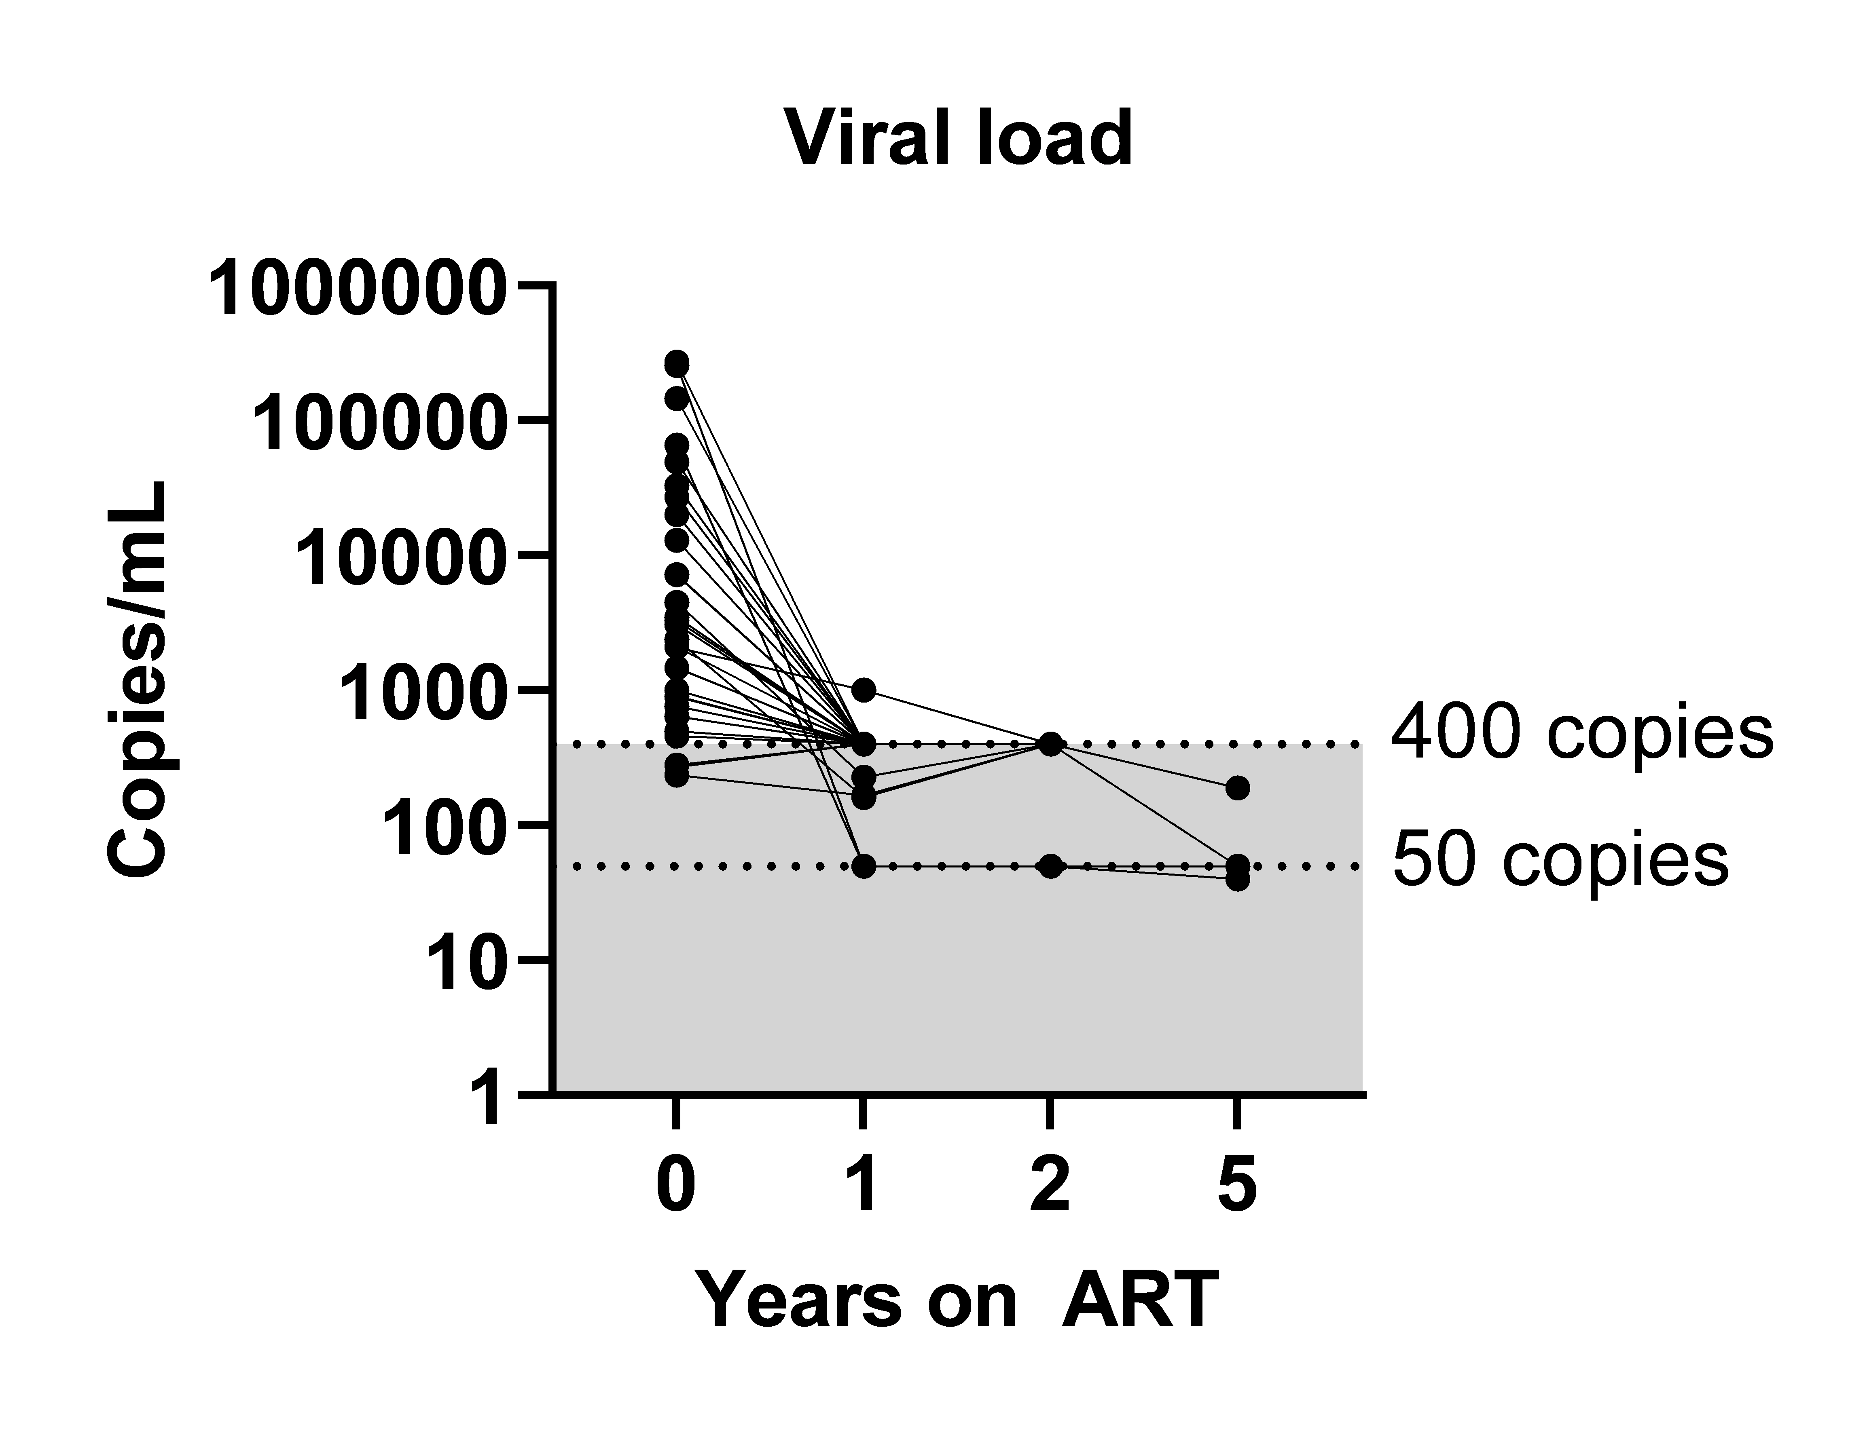
Abortive HIV RNA can be detected in serum during long-term ART
Abortive HIV-RNA in serum up to 5 years of ART

Slide 7
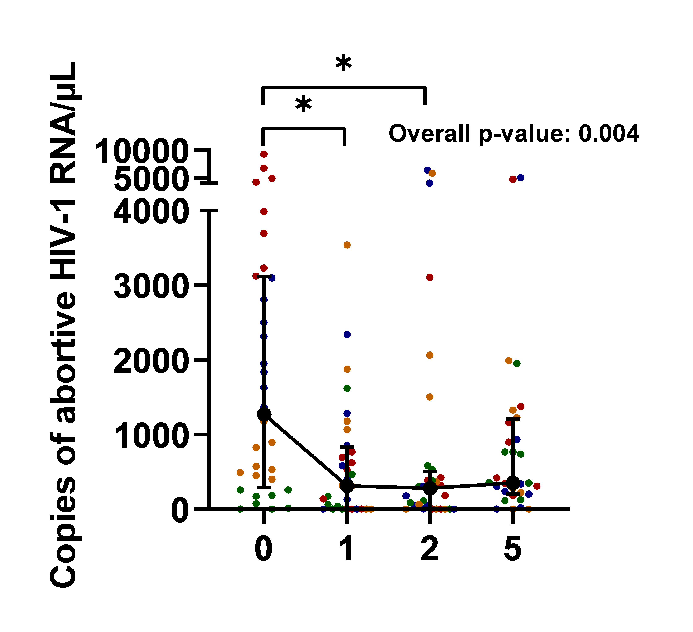
Abortive HIV RNA can be detected in serum during long-term ART
Abortive HIV-RNA in serum up to 5 years of ART

Slide 8
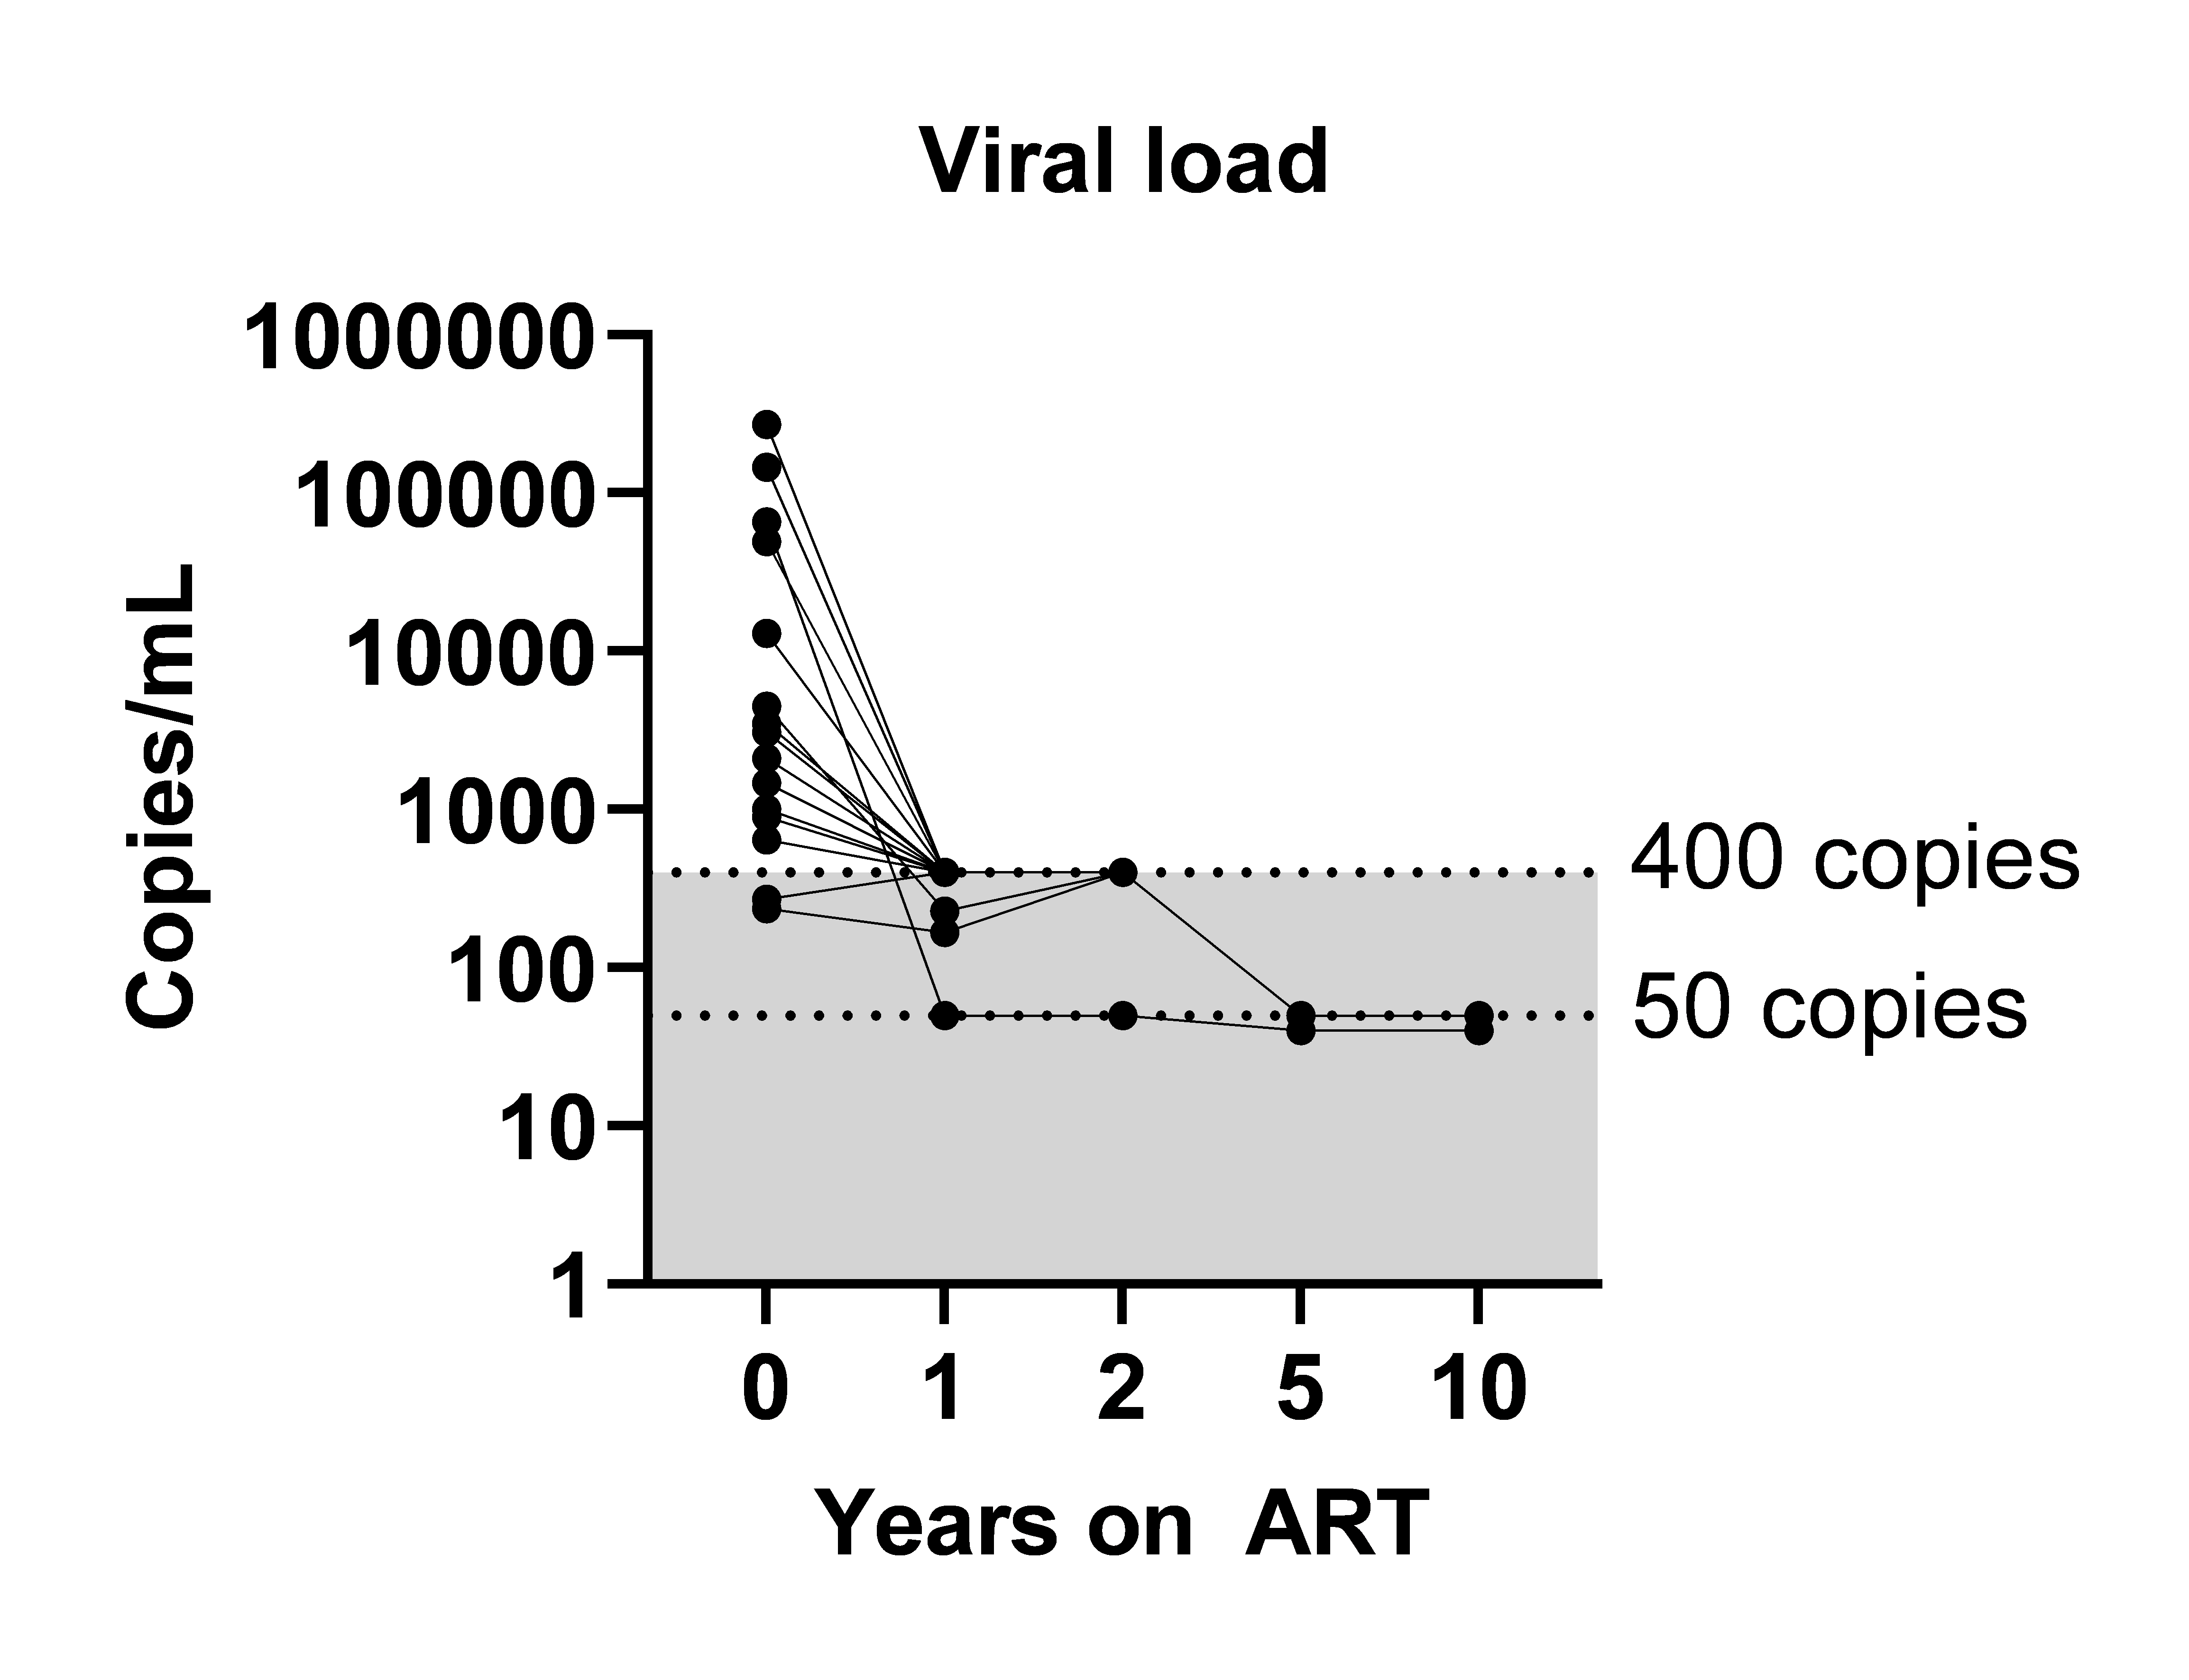
Abortive HIV RNA can be detected in serum during long-term ART
Abortive HIV-RNA in serum up to 10 years of ART

Slide 9
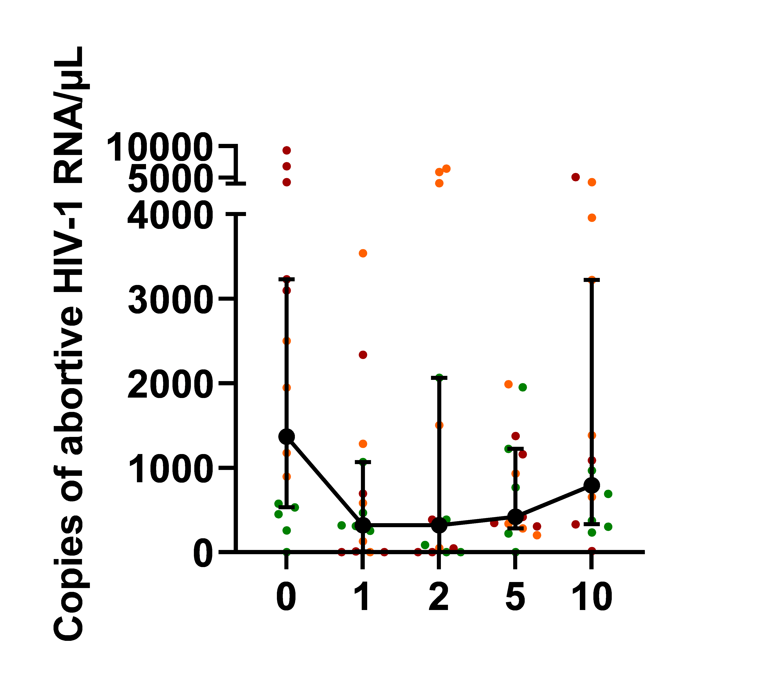
Abortive HIV RNA can be detected in serum during long-term ART
Overall p-value: 0.390
Abortive HIV-RNA in serum up to 10 years of ART

Slide 10
Conclusion - 1
Abortive HIV RNA can be measured in serum during long-term ART
Copies of abortive HIV RNA seem to increased after 10 years of ART

Slide 11
Does abortive HIV-RNA in serum correlate to other reservoir measurements?
Total HIV-DNA
Transcription competent reservoir
Cell associated HIV DNA →
Total HIV-DNA
Cell associated HIV RNA →
Transcriptional active reservoir

Slide 12
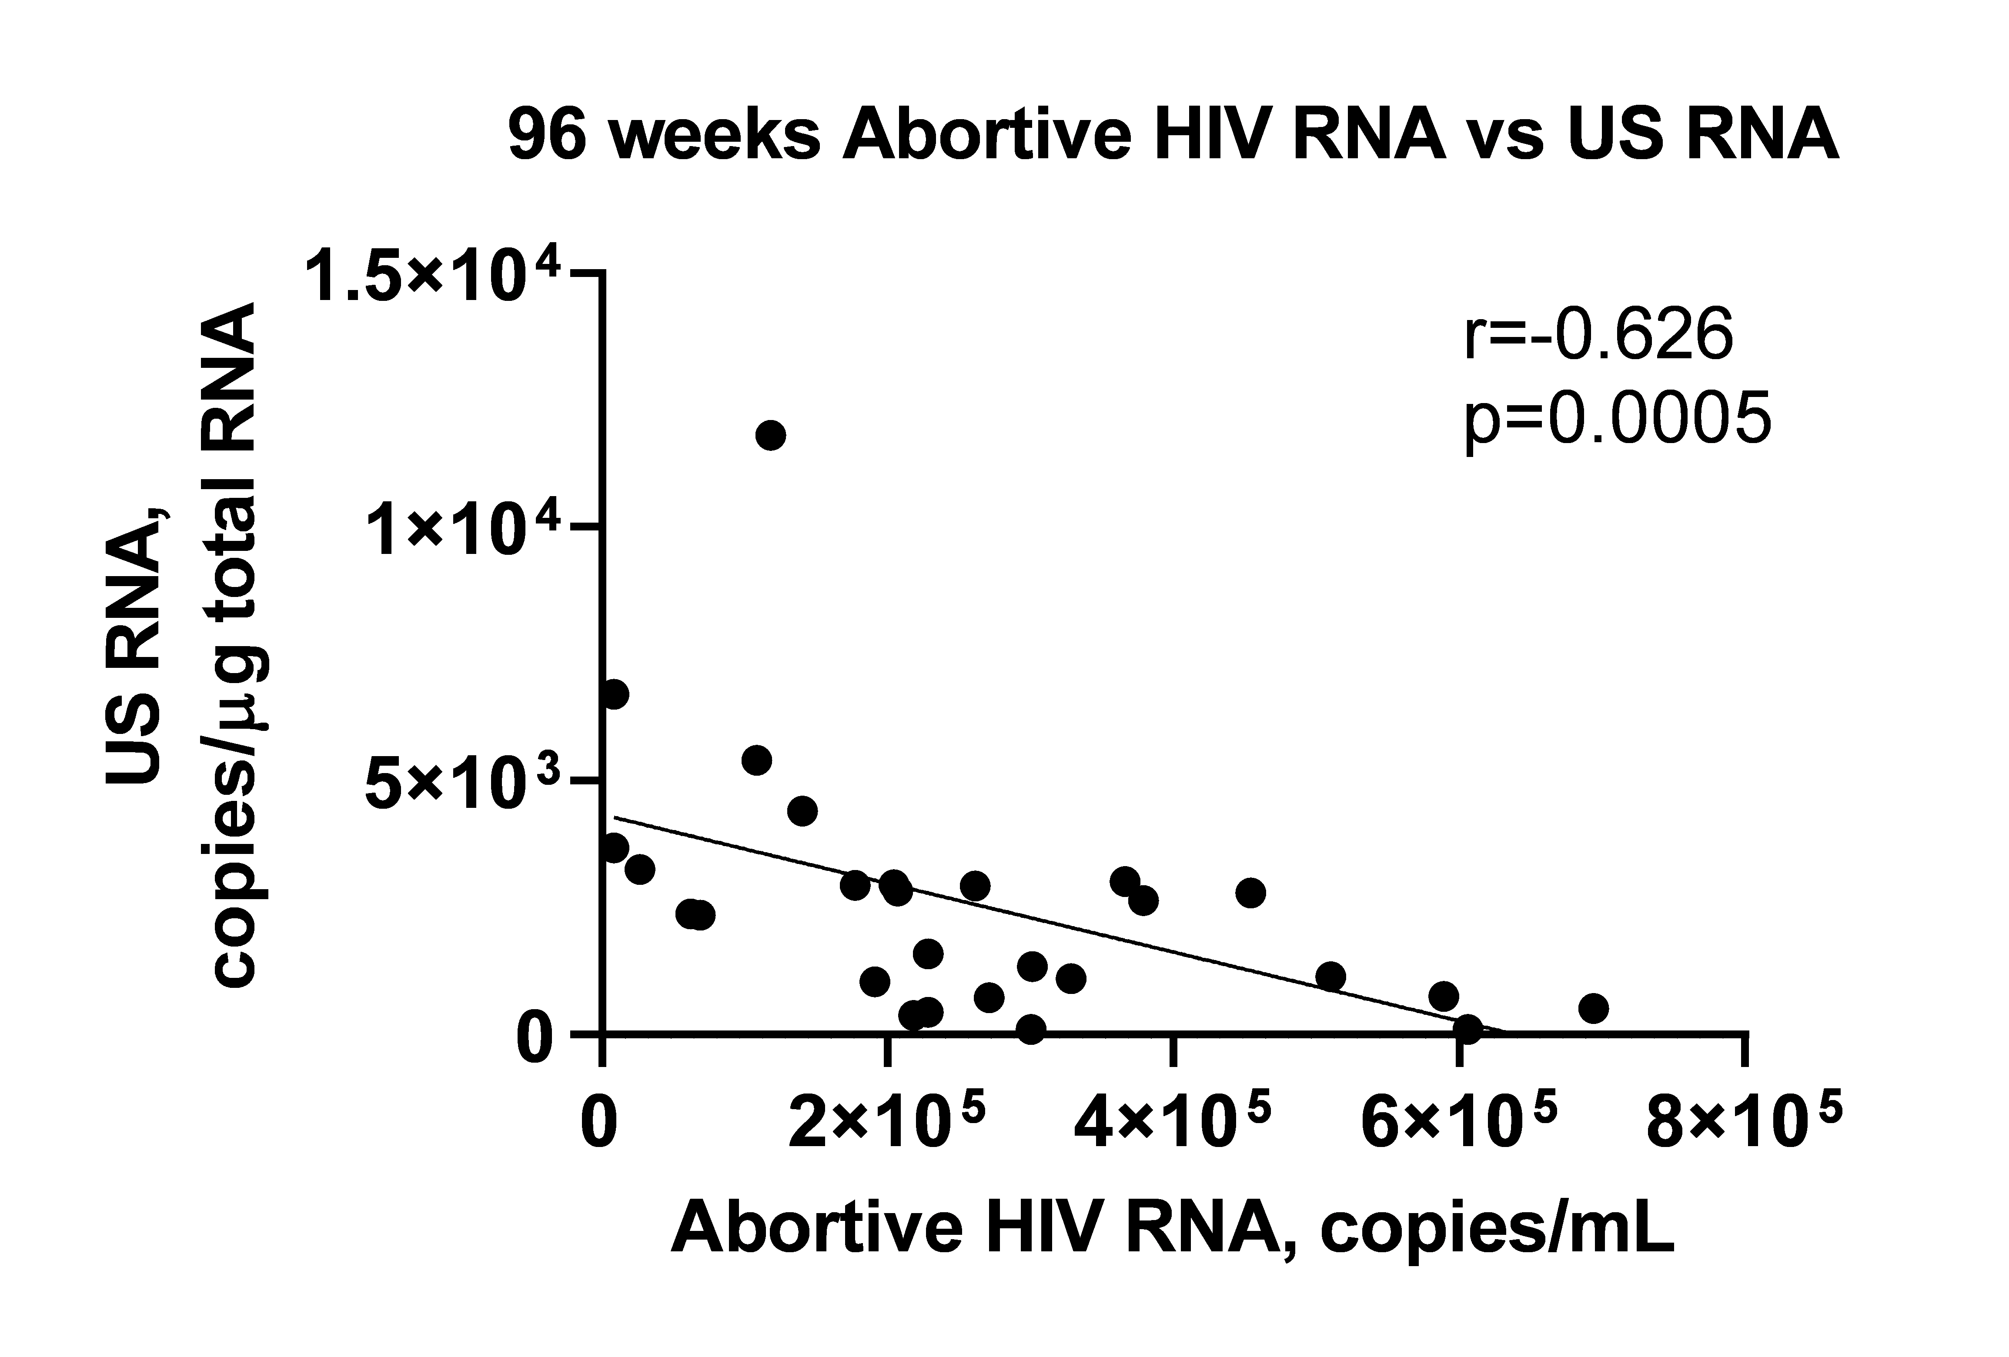
Abortive HIV-1 RNA is inversely correlated with cell associated unspliced RNA
96 weeks of ART
27
US RNA = Unspliced HIV RNA
No correlation was observed between abortive HIV RNA and cell associated HIV DNA

Slide 13
Conclusion - 2
Abortive HIV RNA can be detected in serum during long-term ART
Copies of abortive HIV RNA increased after 10 years of ART
Abortive HIV RNA is inversely correlated with cell associated unspliced RNA

Slide 14
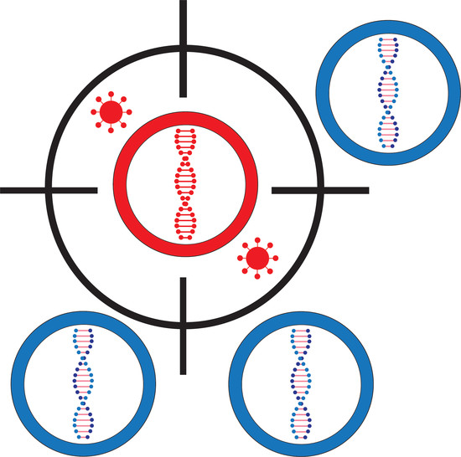
Acknowledgments
Participants Amsterdam Cohort Studies
Amsterdam UMC, Experimental Immunology
Theo Geijtenbeek
Neeltje Kootstra
Carla Ribeiro
Jade Jansen
Shirley Man
Amsterdam UMC, Laboratory of Experimental Virology
Ben Berkhout
Alexander Pasternak
Rogier Sanders
Marit van Gils
Steven de Taeye
Philipp Adams
Angela Schriek
Jeffrey Umotoy
UMC Utrecht, Translational Virology
Monique Nijhuis
Lavina Gharu
Target2Cure
consortium
NCHIV 2023
s.kroeze@amsterdamumc.nl

