Slide 1
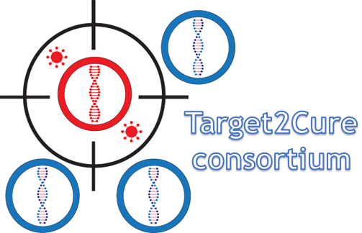

Targeting Host Factors DDX3 and IAP Eliminates the HIV-1 Reservoir in People Living with HIV ex vivo
Jade Jansen
NCHIV - 28 November 2023
Amsterdam UMC location University of Amsterdam
Department of Experimental Immunology
Amsterdam institute for Infection and Immunity
NCHIV 2023
j.jansen2@amsterdamumc.nl

Slide 2
Disclosure of speaker’s interest
None
None

Slide 3


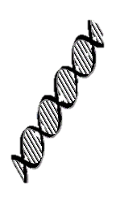



Reactivation and elimination
HIV Latency
Reactivation
Elimination
DNA
HIV
genome
HIV replication
+ART
Reactivation and elimination by targeting host factors DDX3 with DDX3i and IAP with SMAC mimetic (SMACm)
NCHIV 2023
Adapted from Deeks, S., Overbaugh, J., Phillips, A. et al. HIV infection. Nat Rev Dis Primers 1, 15035 (2015)

Slide 4

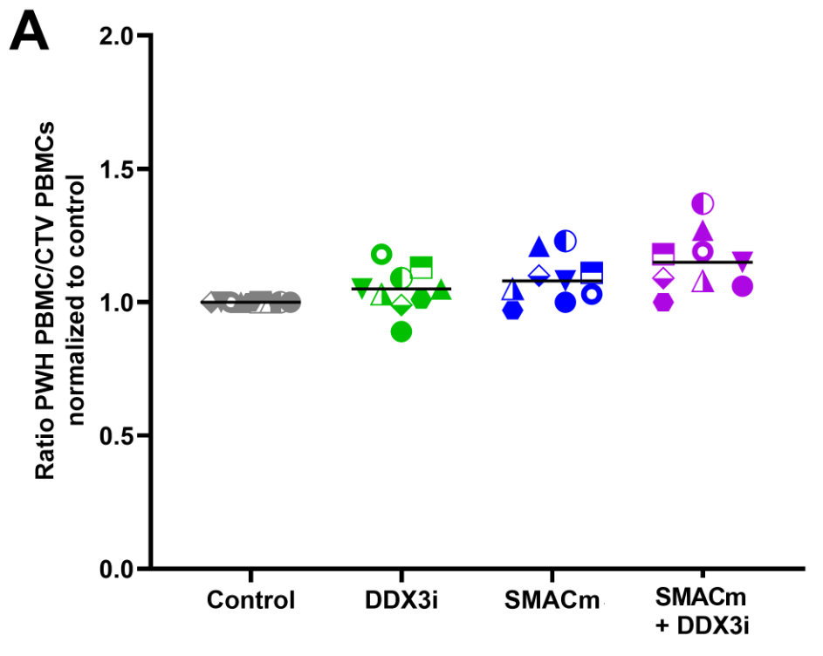
Reservoir reduction in PBMCs of people living with HIV-1 after SMACm/DDX3i treatment
Number of HIV-1 infected cells
Total number of cells
NCHIV 2023
Jansen et al., 2023 Microbiology spectrum

Slide 5
Reservoir reduction in PBMCs of people living with HIV-1 after SMACm/DDX3i treatment
Number of HIV-1 infected cells
Total number of cells
Mechanism?
NCHIV 2023
Jansen et al., 2023 Microbiology spectrum

Slide 6
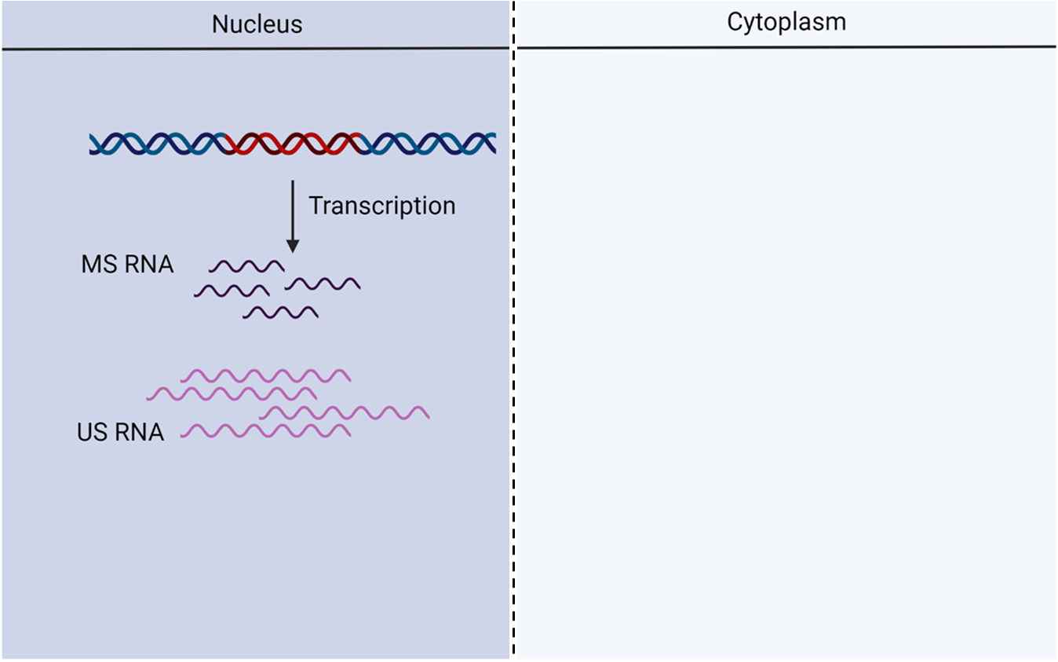
Hypothesis
NCHIV 2023

Slide 7
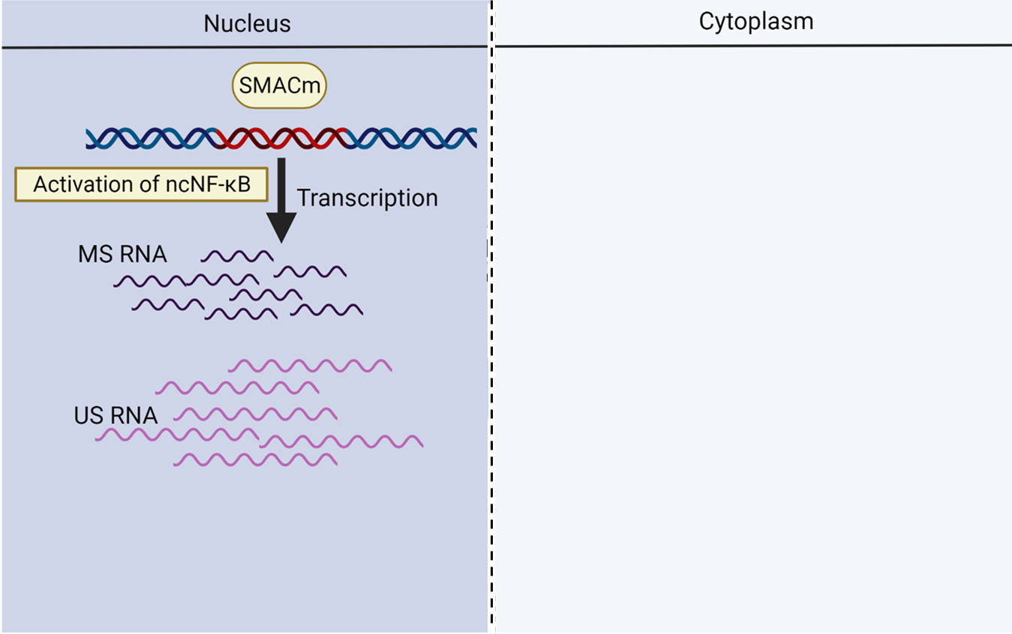
Hypothesis
NCHIV 2023

Slide 8
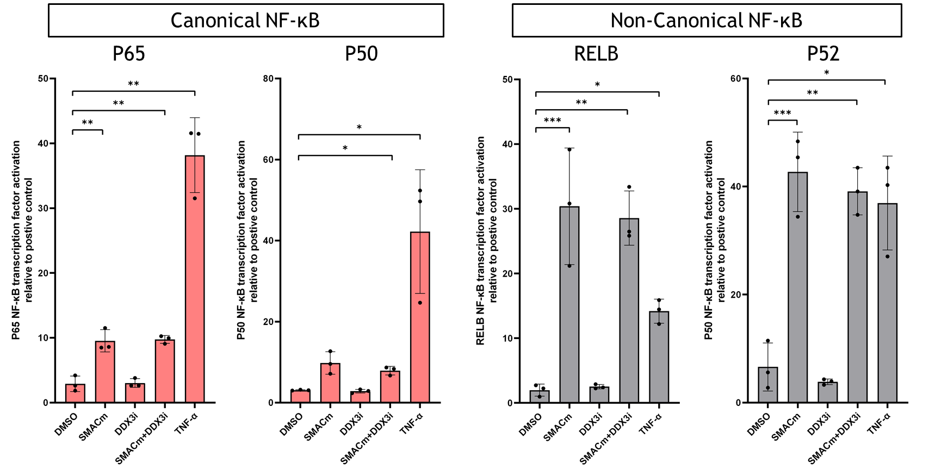
Activation of the ncNF-kB pathway with SMAC mimetic
NCHIV 2023

Slide 9
Activation of the ncNF-kB pathway with SMAC mimetic
NCHIV 2023

Slide 10
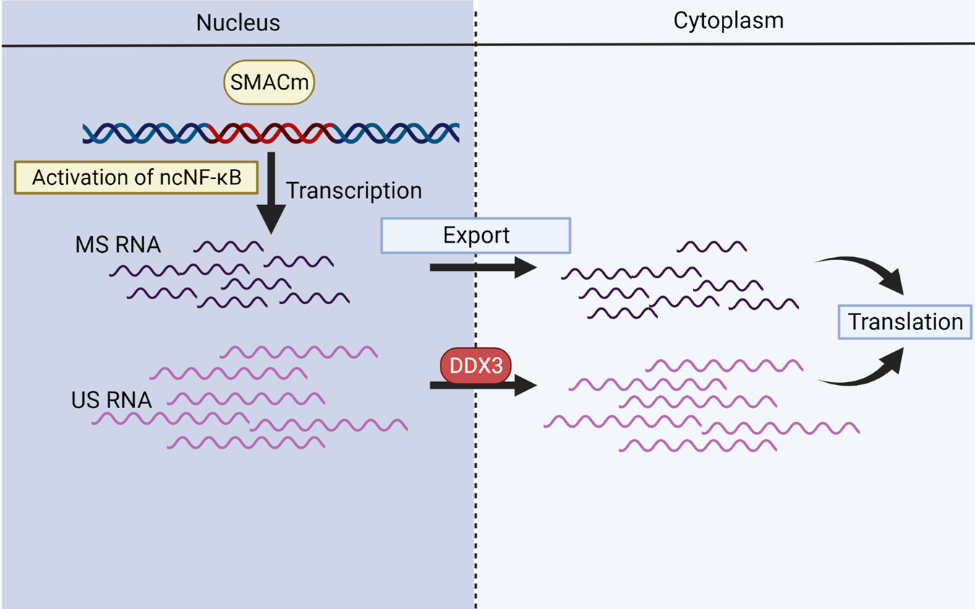
Hypothesis
NCHIV 2023

Slide 11
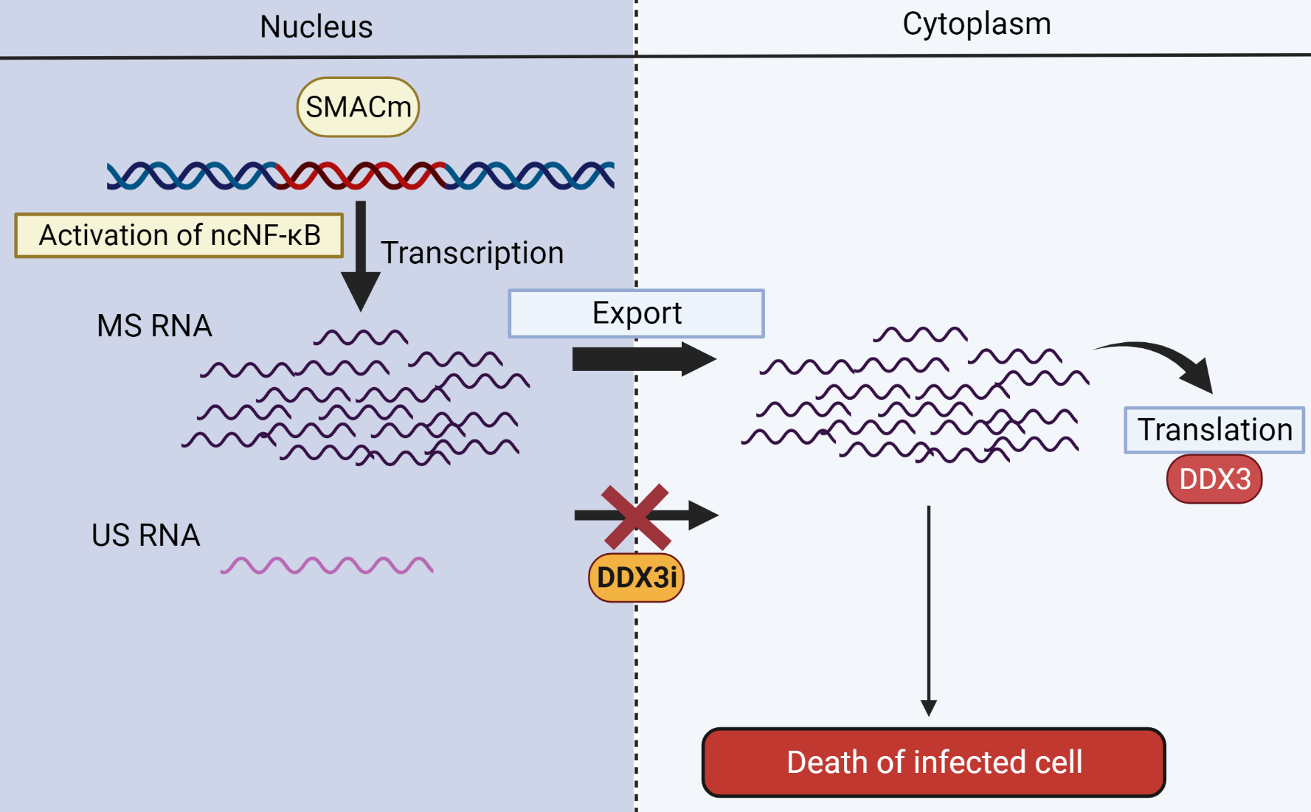
Hypothesis
NCHIV 2023

Slide 12
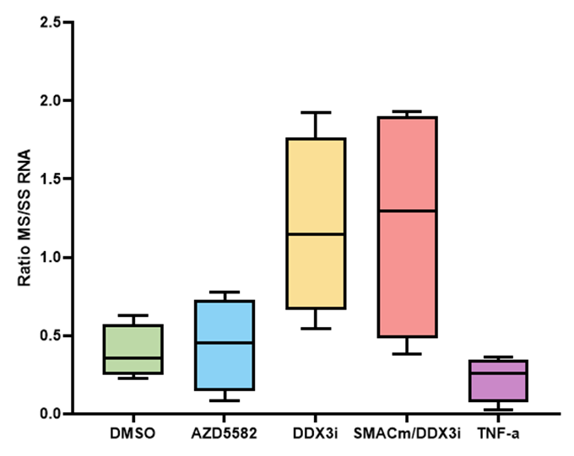
DDX3i treatment alone or with SMACm leads to increased MS RNA and decreased SS RNA levels
NCHIV 2023

Slide 13
Hypothesis
NCHIV 2023

Slide 14
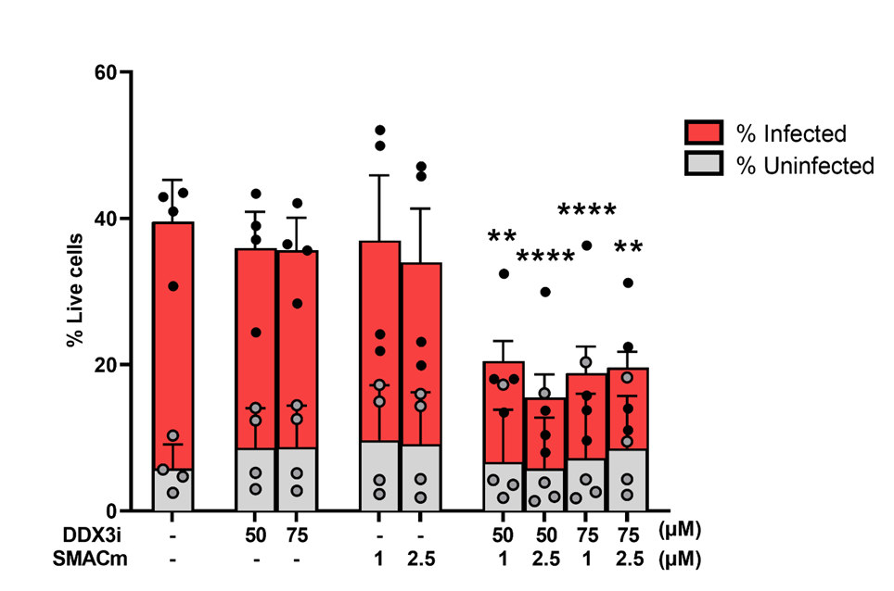
SMACm/DDX3i treatment leads to elimination of HIV-1 infected cells
NCHIV 2023
Jansen et al., 2023 Microbiology spectrum

Slide 15
Conclusion
SMACm alone and in combination with DDX3 inhibitor reduced the HIV-1 reservoir in PBMCs from ART suppressed individuals
Targeting IAP with a SMACm activated the non-canonical NF-κB pathway
DDX3i alone or in combination with SMACm led to increased MS RNA levels but decreased levels of SS RNA
DDX3i in combination with SMACm induces elimination of HIV-1 infected cells
NCHIV 2023

Slide 16





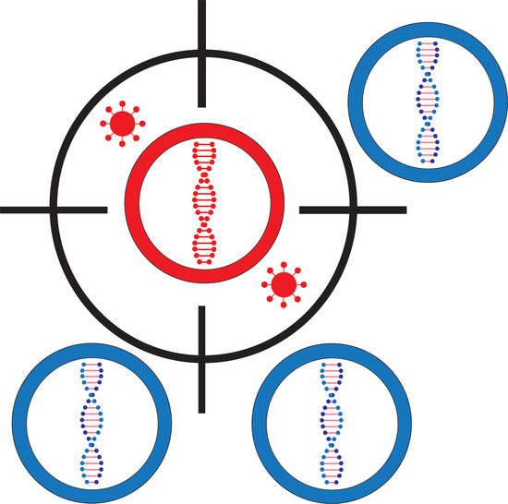



Acknowledgments
Amsterdam UMC
Experimental Immunology
HIV cure group
Theo Geijtenbeek
Neeltje Kootstra
Stefanie Kroeze
Shirley Man
UMC Utrecht
Monique Nijhuis
First Health Pharmaceuticals
Alessia Tarditi
Matteo Andreini
Claudio Zamperini
Jan Willem Bakker
Laboratory of Experimental Virology
Ben Berkhout
Alexander Pasternak
Rogier Sanders
Marit van Gils
Target2Cure
consortium
Participants Amsterdam Cohort Studies
NCHIV 2023
j.jansen2@amsterdamumc.nl

