Slide 1
Immune selection of HIV-1 reservoir cells
Mathias Lichterfeld, M.D., Ph.D.
Professor of Medicine, Harvard Medical School
Member, Ragon Institute of MGH, MIT and Harvard
Senior Staff Physician, Infectious Disease Division, Brigham and Women’s Hospital and Massachusetts General Hospital

Slide 2
Disclosures
Jounce Therapeutics, Inc. - speaker/consultant
Gilead Sciences, Inc. - grantee/speaker/consultant
Novartis - collaborator
Merck – speaker/consultant
United Biopharma – consultant

Slide 3
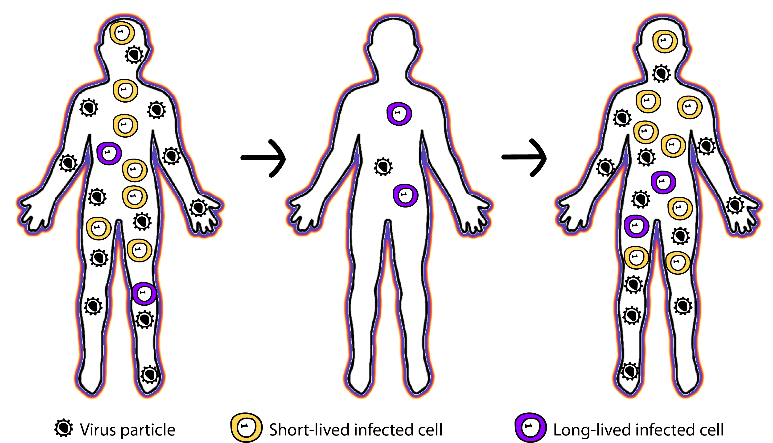
HIV-1 reservoir cells: The Obstacle to Cure
Untreated
Infection
ART
Treatment
Treatment
Interruption
Extremely small numbers of cells (1-10/million CD4 T cells)
Established very early during HIV-1 infection, prior to detectable plasma RNA
Not susceptible to standard ART
Highly durable for decades
Responsible for rebound viremia during treatment interruption
Virus Particle
Productively infected cells
Latently infected cells

Slide 4
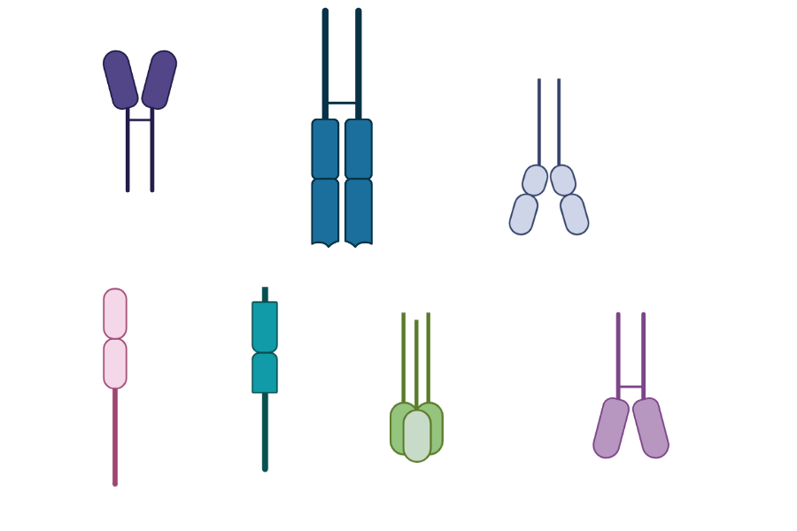
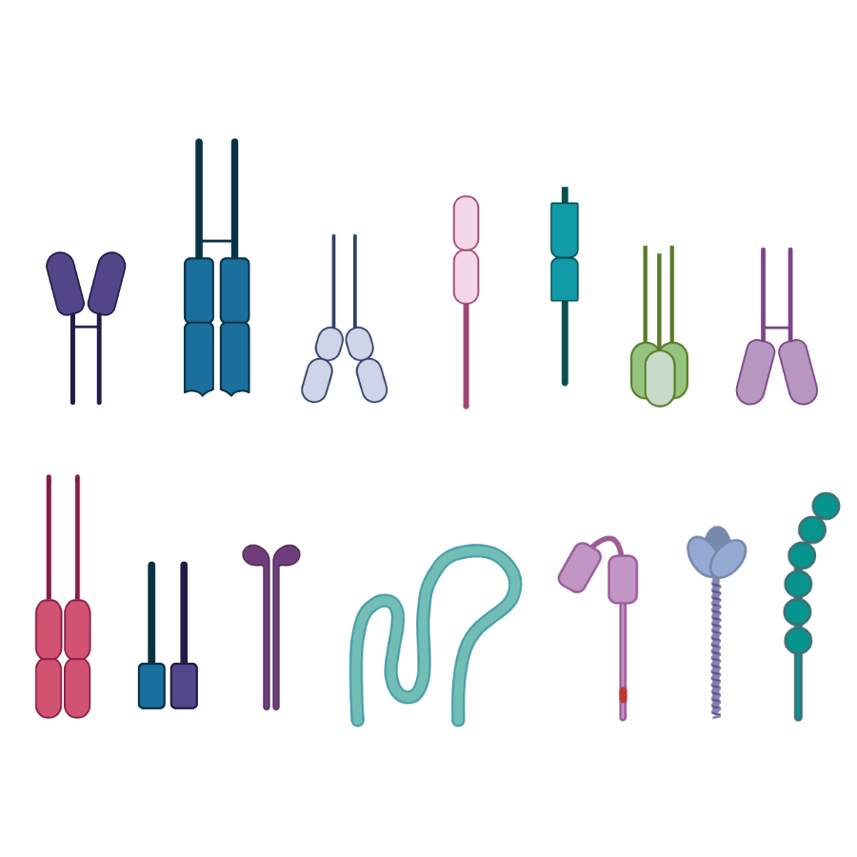
Profiling Individual HIV-1 Reservoir Cells:
Four Generations of Technology
PheP-Seq
FLIP-Seq: near-Full Length Individual Proviral Sequencing
MIP-Seq: Matched Integration site and Proviral Sequencing
PRIP-Seq
FLIP-Seq
MIP-Seq
PRIP-Seq: Parallel HIV RNA, Integration site and Proviral Sequencing
PheP-Seq: Phenotyping and Proviral Sequencing
Single-cell/single-genome
Direct ex vivo analysis
Complementary pieces of information

Slide 5
HIV-1 Elite Controllers (ECs) as a Model for HIV-1 Cure
Intact HIV-1 DNA
Type I Cure:
Virological Cure
the elimination of all HIV-infected cells
the elimination of all replication-competent HIV reservoirs
Type II Cure:
Durable Remission of HIV-1 Infection, Functional Cure
Have detectable intact proviruses
Maintain undetectable viremia in the absence of therapy
Intact proviruses typically integrated into heterochromatin locations
Limit of
detection
Lichterfeld, et al., Trends Immunol. 2022
Lian, et al., Sci Transl Med. 2021
Jiang, et al., Nature. 2020

Slide 6
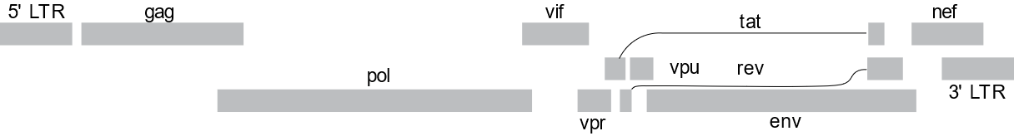
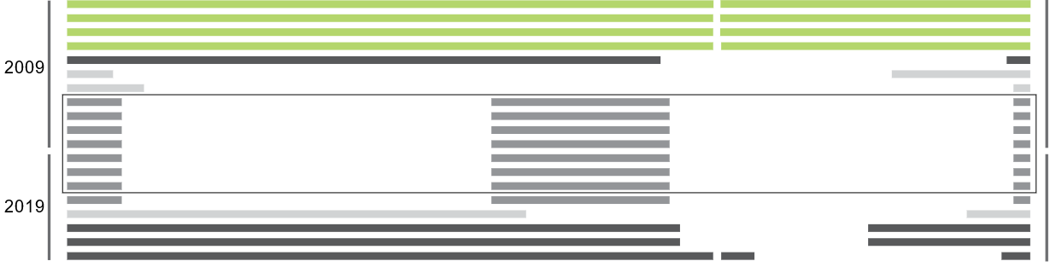
Absence of Intact Proviruses in ECs with Possible Type I (Virological) Cure
2009
560 million
The San Francisco Patient
2019
949 million
2018
37.5 million
The Esperanza Patient
2020
923 million
2019
51.4 million
Turk, et al., Annals of Internal Medicine. 2021
Jiang, et al., Nature. 2020
Steve Deeks, Natalia Laufer, Gabriela Turk, Robert Siliciano, Janet Siliciano

Slide 7
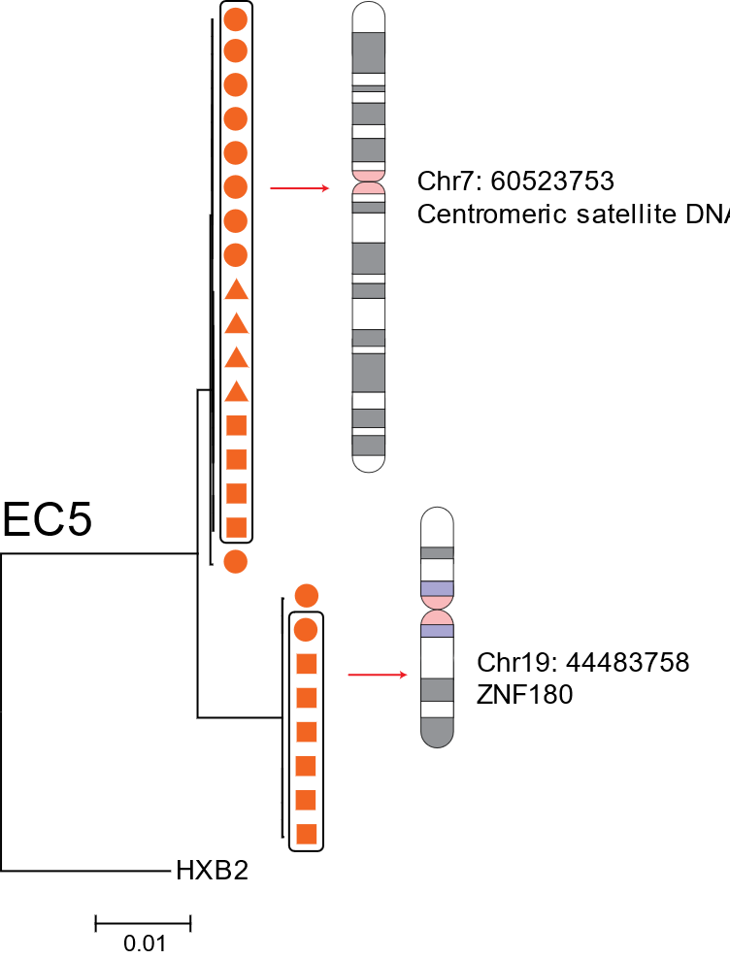
Intact Proviruses in ECs with Type II (Functional) Cure
Accumulate in Heterochromatin Positions
In vitro viral outgrowth assay with PHA/IL2 stimulation
Limit of
detection
diagnosed with HIV for 28 years
Treatment naive
12 years of recorded undetectable VL
FLIP-Seq
MIP-Seq
qVOA
Clonally-expanded intact proviral genomes
Jiang, et al., Nature. 2020

Slide 8


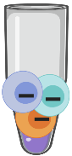
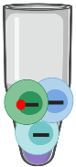


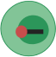

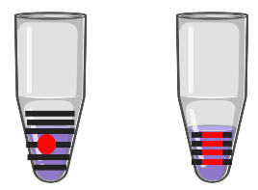
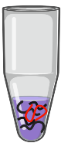

Parallel HIV RNA, Integration Site, and Proviral Sequencing (PRIP-Seq) Assay
Limiting
dilution
Proviral Sequencing
Human
5’-LTR
HIV
3’-LTR
Human
HIV+ cell
HIV- cell
Direct ex vivo
(No stimulation)
Whole Genome Amp.
gDNA
HIV RNA
Human
Chromosome
RNA/gDNA separation
Integration Site Analysis
HIV DNA
Human
5’-LTR
HIV
3’-LTR
Human
HIV RNA
RNA
RT
Amp. cDNA
5’-LTR
HIV
3’-LTR
Human
Einkauf, Osborn, Gao, Sun, Cell. 2022

Slide 9
Integrations into Heterochromatin Positions Are Associated With
HIV Transcriptional Silence in Vivo
PRIP-Seq: Parallel HIV RNA, Integration site and Proviral Sequencing in 701 reservoir cells from 6 PLH on suppressive ART
Einkauf, Osborn, Gao, Sun, Cell. 2022

Slide 10
Immune Selection of Intact Proviruses in Heterochromatin Locations
in People Living with HIV on Suppressive ART?
Participant LT03
2000
2012
2019
HIV copies/ml
Undetectable VL
CD4+ T-cell count
Therapy
Steve Deeks, Michael Peluso
Lian, Cell Host & Microbe. 2023

Slide 11
A Progressive Accumulation of Intact Proviruses in Heterochromatin
With Deep Latency During Long-Term ART
Intact Proviruses
Chr.18
Centromeric
Satellite DNA
Chr. 18: 20148837
Chr. 16: 57007676
NLRC5
Centromeric satellite DNA
Chr. 21: 43915816
AGPAT3
Chr. 9: 92401628
20 years
CENPP/OGN
1y ART
20y ART
Chr. 15: 48747525
CEP152
Chr. 17: 46153160
KANSL1
Chr. 16: 30476673
ITGAL
Chr. 16: 30476673
Intact proviruses only
ITGAL
Chr. 4: 26877038
STIM2
12y ART
Proviruses
Chr. 18: 20148837
Centromeric satellite DNA
Clonal clusters
Lian, et al., Cell Host & Microbe. 2023

Slide 12
A Progressive Accumulation of Intact Proviruses in Heterochromatin
With Deep Latency During Long-Term ART
PRIP-Seq: Parallel HIV RNA, Integration site and Proviral Sequencing
Intact Proviruses
Intact proviruses
Chr. 18: 20148837
Chr. 16: 57007676
NLRC5
Centromeric satellite DNA
Chr. 21: 43915816
AGPAT3
Chr. 9: 92401628
CENPP/OGN
1y ART
20y ART
Chr. 15: 48747525
CEP152
Chr. 17: 46153160
KANSL1
Chr. 16: 30476673
ITGAL
Chr. 16: 30476673
ITGAL
Chr. 4: 26877038
STIM2
20y ART
Proviruses
Chr. 18: 20148837
12y ART
Centromeric satellite DNA
Clonal clusters
Lian, et al., Cell Host & Microbe. 2023

Slide 13
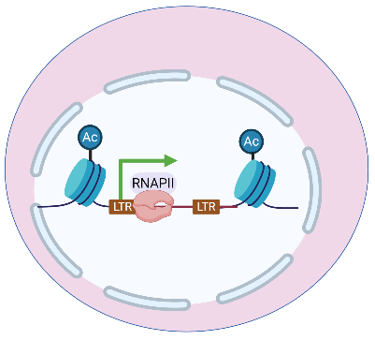
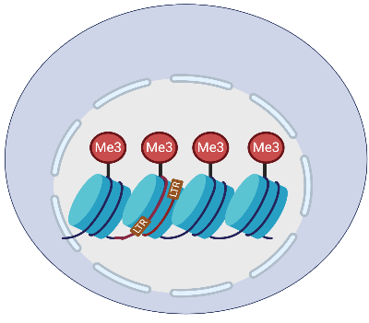
Immune Selection May Lead to an Attenuated Reservoir Profile
in a Subset of People Living with HIV on ART
Post-Treatment Control
HIV-1 Remission
Ongoing Immune Selection during ART
?
Early Infection
“Blocked and Locked”
Autologous
Shock and Kill
Autologous
Shock and Kill
Immune
Responses
Immune
Responses

Slide 14
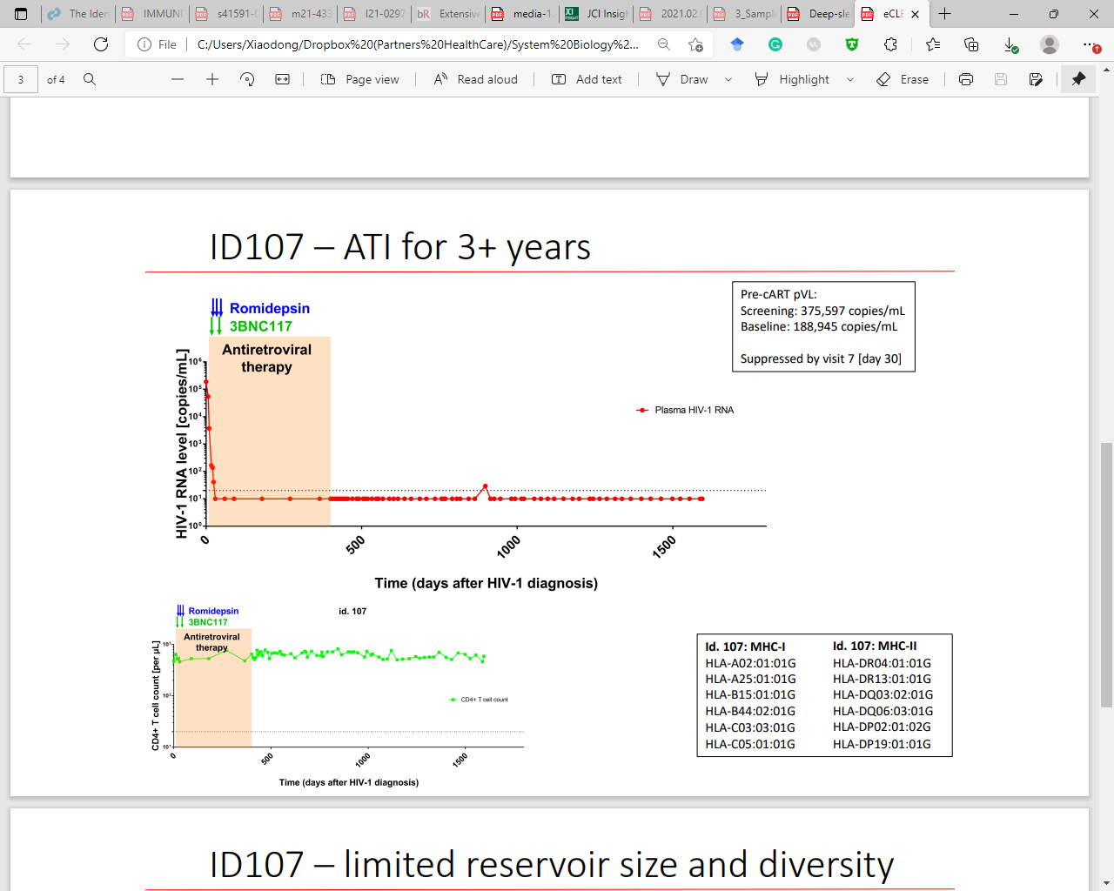
Viral Reservoir Profile in Post-Treatment Controllers (PTCs)
d404
d206 after ATI
d911 after ATI
d1
d206
d372
d666
Positive in in vitro viral outgrowth assay with PHA/IL2 stimulation
(1/30-70 intact proviruses)
Ole Schmeltz Søgaard
Gunst et al., Nat Med. 2022

Slide 15

Accumulation of Intact Proviruses in Heterochromatin Is Associated with PTC
Day 911 after ATI
19.4M PBMC
Chr. X: 96989587 DIAPH2
Chr. 19: 58232787 ZNF544
Chr. 9: 43319381 centromeric
Chr. X: 40692154 MED14
Chr. 4: 49103577
Non-genic, Centromere
Chr. 7: 37230260 ELMO1
Chr. Y: 11286950
Non-genic,
peri-centromere
Chr. 19: 36579961 ZNF529
Day 1:
ART initiation
Chr. 14: 74673138 AREL1
Day 206 after ATI
1.3M PBMC
14.9M PBMC
Chr. 17: 59995276 RNFT1
Chr. 4: 49103577
Non-genic, Centromere
Chr. 19: 14156973 ADGRL1
Chr. 16: 89756643 FANCA
Chr. 17: 59099605 TRIM37
Chr. 22: 27857113 PITPNB
Day 404:
ATI initiation
Chr. 8: 7890581 KZ208915v1
Chr. 15: 65754467 DENND4A
Chr. 12: 67512040 LINC02408
Intact proviruses only
Chr. 5: 24162002
long non-coding RNA
Chr. 18: 12370315 CHRDL2
Intact proviruses
6.8M PBMC
Clonal clusters

Slide 16
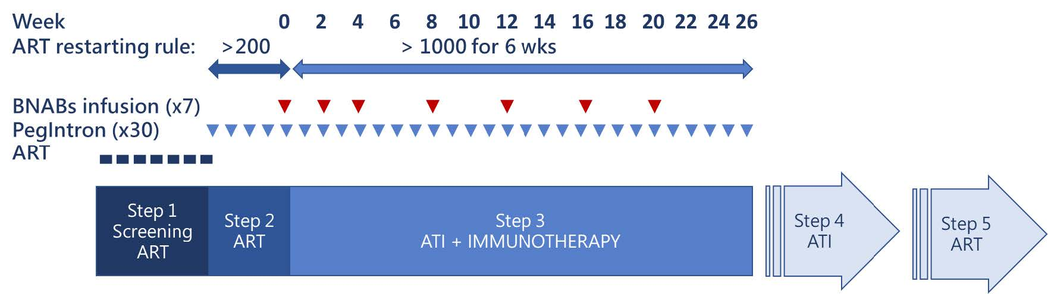
Viral Reservoir Profile in Post-Treatment Controllers (PTCs)
BEAT 2.0 Study:
PLH on suppressive ART
Pegylated-IFN-α2b in combination with two bNAbs (3BNC117 and 10-1074) during ATI (n=14)
Luis Montaner
CROI 2022, Poster 352

Slide 17
Viral Reservoir Profile in Post-Treatment Controllers (PTCs)
on ART
week 28
off ART
week 46
off ART
HIV Viral Load
(copies/ml)
Time after discontinuation of ART (weeks)
Undetectable Viremia
Viral Load
Luis Montaner
CROI 2022, Poster 352

Slide 18
Accumulation of Intact Proviruses in Heterochromatin Is Associated with PTC
Chr.19: 57298842 Non-genic
Chr.22: 12199070 Non-genic LTR*
Rebound driven by:
Minority clones harboring intact proviruses?
Proviruses resistant to autologous neutralizing antibody/CTL?
Tissue reservoirs?
week 46 off ART
on ART
Chr.21: 10714605 Non-genic
Chr.19: 57298842 Non-genic
Chr. 12: 6439597 CD27-AS1 LTR
week 28 off ART
Chr. 1: 143252377 Non-genic (large gene desert)
Chr.12: 12491549 DUSP16
Work in progress
Intact proviruses only
Intact proviruses
Clonal clusters

Slide 19
What Mechanisms Drive Immune Selection of HIV-1 Reservoir Cells?
 | Total | Male | Female
Number of participants | 66 | 34 | 32
Age (years) | 60.5 (43 - 82) | 61.5 (49 - 75) | 56.5 (43- 82)
Ethnicity (white%) | 48.48% | 60.00% | 48.88%
CD4 counts | 722 (250 – 1452) | 712 (365 - 1452) | 727 (250 - 1204)
Viral loads | Undetectable | Undetectable | Undetectable
Time since diagnosis (years) | 23 (16 - 37) | 23 (16 - 37) | 22 (18 - 33)
Known duration of undetectable viremia (years) | 20 (15 – 25) | 20 (15 - 24) | 19 (15 - 25)
HLA-B*57/27 (%) | 10.00% | 12.12% | 7.81%
HLA-B*35/53 (%) | 9.23% | 10.61% | 7.81%
Jeffrey Jacobson, Steve Deeks, Michael Peluso, Phyllis Tien, Eric Rosenberg, Rajesh Gandhi

Slide 20
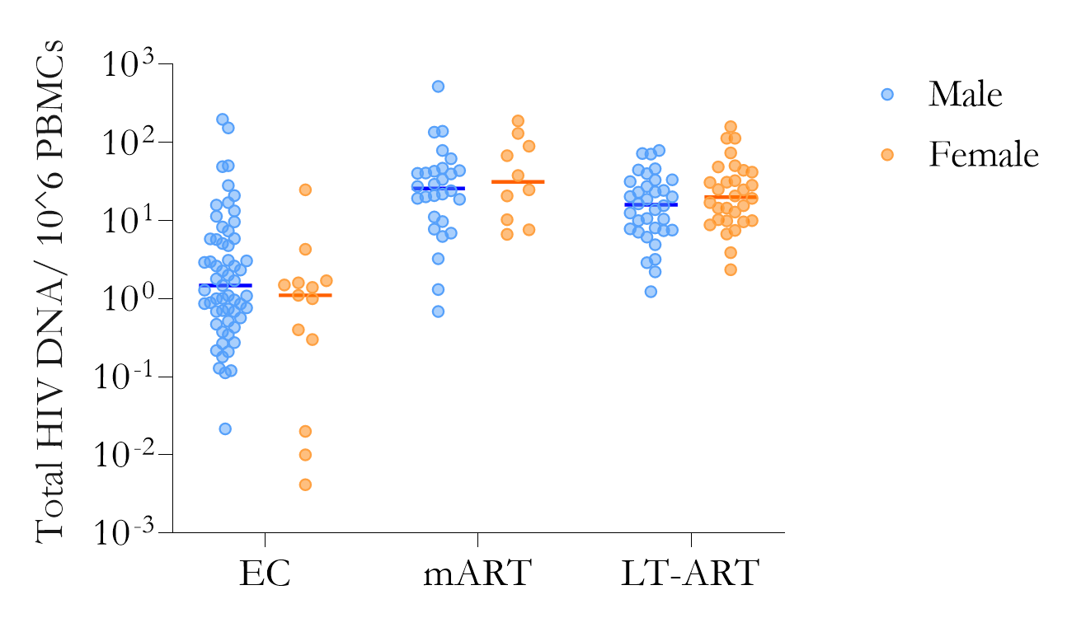
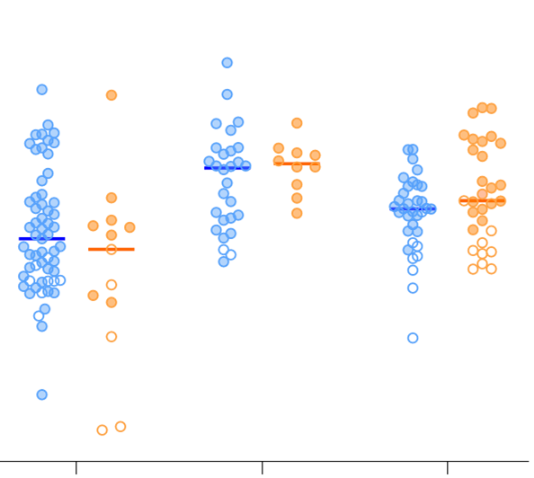
Limited Quantitative Differences in Viral Reservoir Profiles
between Male and Female Participants on ART
Total HIV-1 DNA
Intact Proviruses
**
**
***
**
*
*
Male Female
Male Female
Male Female
Male Female
Male Female
Male Female
EC
Moderate
ART
Long-Term
ART
EC
Moderate
ART
Long-Term
ART
Work in progress
open circles: no intact proviruses detected so far

Slide 21
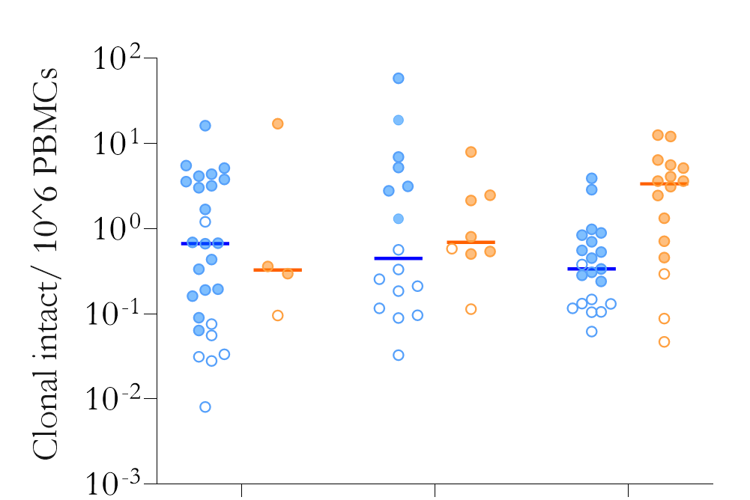
More Clonal Expansion of Reservoir Cells Harboring Intact Proviruses
in Female Participants on Long-Term ART
Clonally Expanded HIV-1 Reservoirs with Intact Proviruses
**
Male Female
Male Female
Male Female
EC
Moderate
ART
Long-Term
ART
open circles: intact proviruses detected are not clonal
*only participants with at least 2 intact proviruses detected are included in this analysis
Work in progress

Slide 22
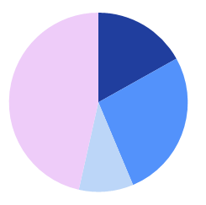
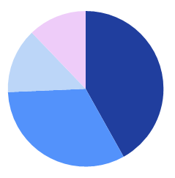
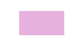
Significant Enrichment of Intact Proviruses in Centromeres
In Female Participants on Long-Term ART
Long-Term ART
Moderate ART
(~8 years ART)
Elite
Controllers
Male
Female
P=0.001
Centromere
ZNF
non-genic
Centromere
Centromere
Intact
Proviruses
non-genic
ZNF
ZNF
ZNF
non-genic
non-genic
n=71
n=74
n=78
n=103
Defective
Proviruses
Centromeric/
(micro-) satellite DNA
Blocked and Locked
ZNF family
Other non-genic
n=57
n=44
Other genic regions

Slide 23
How to Accelerate Immune Selection in PLH on ART?
Post-Treatment
Elite Control
HIV-1 Remission
“Blocked and Locked”
Short-Term ART Treatment (3-5 years) ?
?
Early Infection
Shock and Kill
Therapeutic Vaccines
Immune Modulators
?

Slide 24
The RIVER Study: Research In Viral Eradication of Reservoirs
Participants were treated within the acute infection
confirmed HIV acute infection within a maximum of the past 6 months
started ART within 1 month from confirmed diagnosis
Prime
ChAdV63.HIVconsv
Boost
MVA.HIVconsv
Vorinostat
w0
w1
w8
w10
w12
w16
w18
~w52
~w260
w9
w11
Rand
PR16
PR18
1YR
5YR
8w
4w
6w
  10 participants: 5 V+V+ART, 5 ART only
  PBMCs from Rand, PR18, 1YR follow-up → 5YR planned
Sarah Fidler and John Frater
Fidler et al. Lancet. 2020

Slide 25
Accelerated Selection of Intact Proviruses in Heterochromatin
after Early Treatment Initiation
1 Year Follow-Up
Chr16: 34586997
Non-genic
Chr2: 190923389
GLS
Chr1: 1135785
Non-genic
Chr20: 37019032
RBL1
Chr1: 143207109 Non-genic
(close to micro-satellite DNA)
Chr16: 89726486
ZNF276
Chr4:49144058
Centromeric satellite DNA
Randomization
Chr16:36245659
Centromeric satellite DNA
Chr18: 4513734
Non-genic
Chr16: 46392806
Non-genic
Chr4: 2237143
HAUS3
Intact
n=38
Chr21: 12097745
Centromeric Satellite DNA
Chr6: 13649646
RANBP9
Chr19: 36696070
ZNF567
Chr9:10274951
PTPRD
Chr4:472863
ABCA11P/ZNF721
Chr3:18414276
SATB1
Primary
Endpoint
(18w)
Chr20: 35709998
RBM39
Chr11: 66536028
ZDHHC24
Chr1: 125180758
Centromeric
satellite DNA
Chr12: 122519093
RSRC2
Chr14:17591369
Centromeric satellite DNA
Clonally-expanded intact proviral genomes

Slide 26
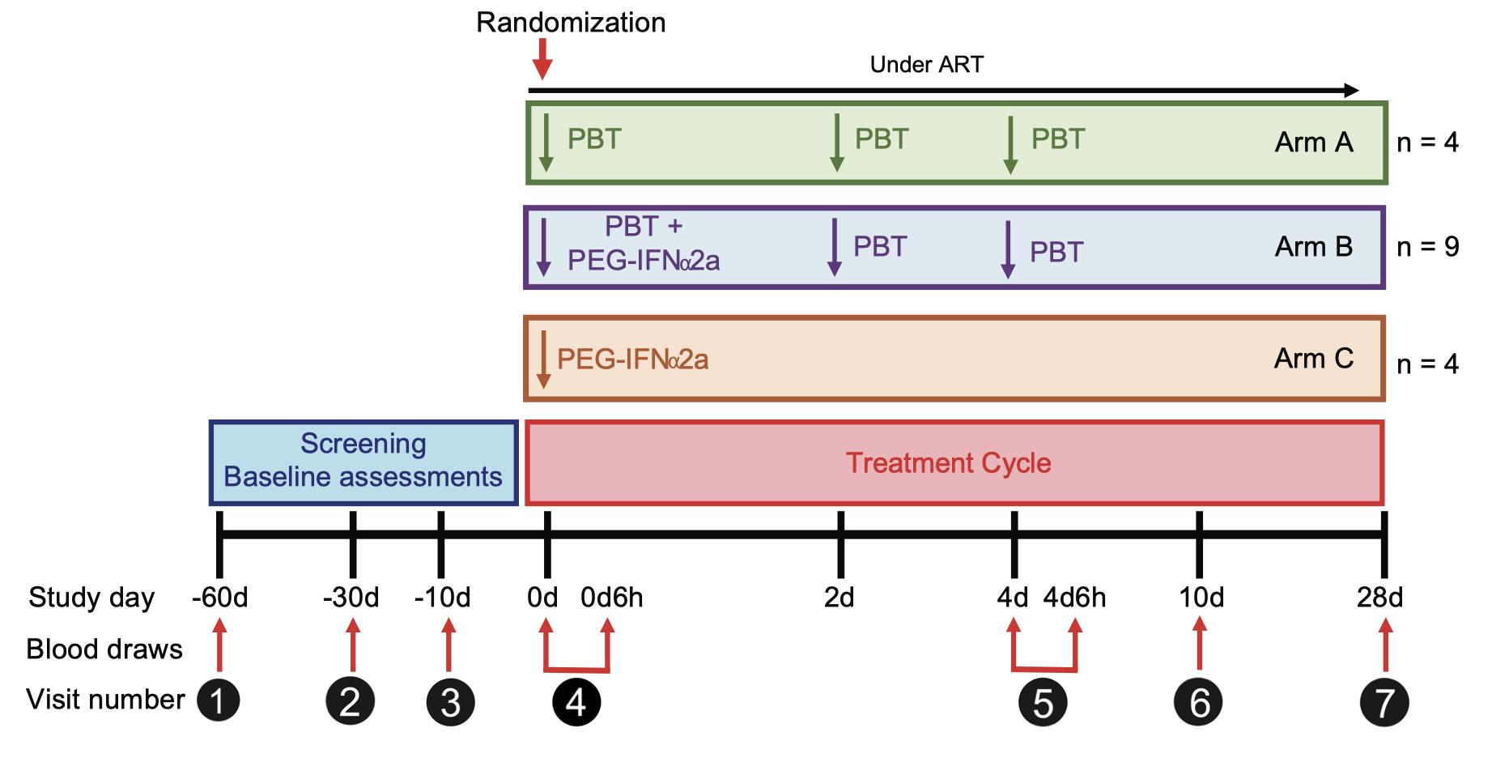
The ACTIVATE Study: Assessment of Combined Treatment
with Immunomodulators and Viral Activating-agents To Eradicate HIV
Mathias Lichterfeld and Daniel Kuritzkes

Slide 27
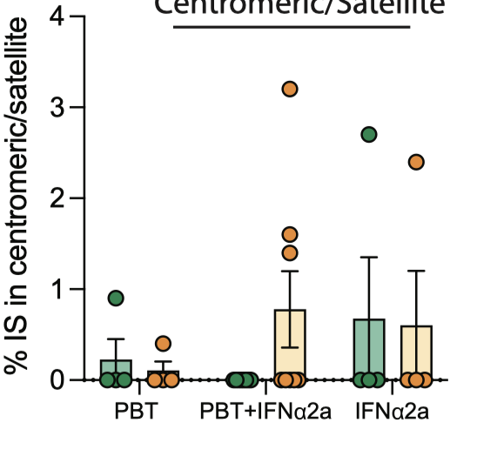
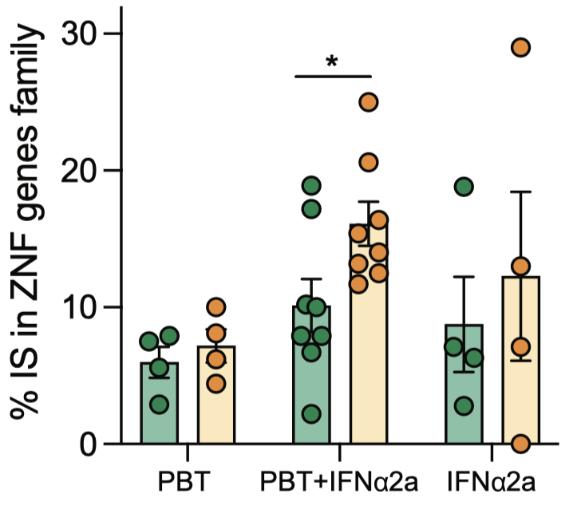
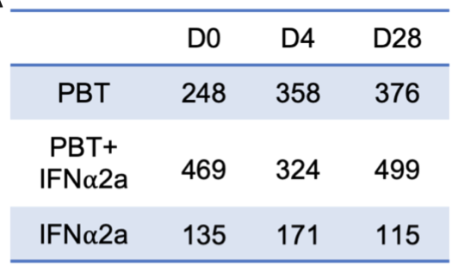
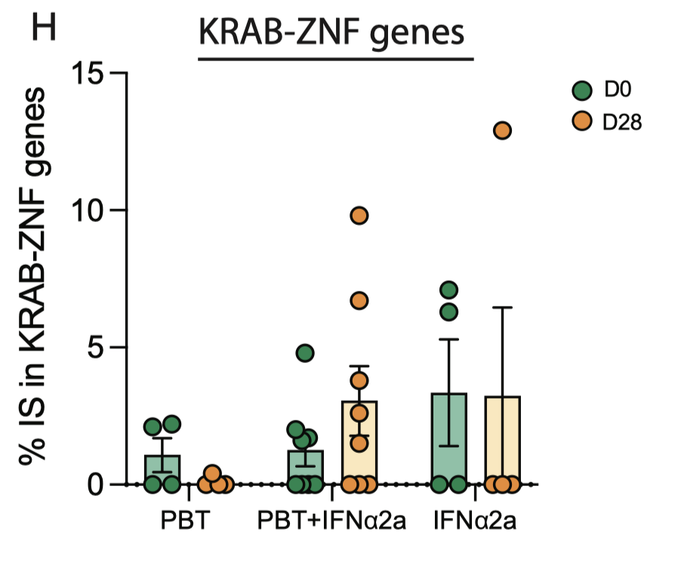
The ACTIVATE Trial: Accumulation of Integration Sites In Heterochromatin
Centromeric Satellite DNA
ZNF Gene Family
total of 2,695 Integration Sites

Slide 28
Conclusions
Progressive selection of intact proviruses in heterochromatin locations
Selection process not very effective, requires >20 years of time
Proviral reservoir landscape dominated by intact proviruses in heterochromatin might be less rebound-competent
Accumulation of intact proviruses in heterochromatin in elite controllers/post-treatment controllers
Can this selection process be accelerated?
Integration sites can be used as biomarkers of immune selection in HIV reservoir cells

Slide 29













Acknowledgements
BWH
WeiWei Sun
Xiaodong Lian
Kevin Einkauf
Marie Armani-Tourret
Tan Toong Seng
Catherine Koofhethile
Benjamin Bone
Aischa Niesar
Ragon Institute
Ce Charlie Gao
Matthew Osborn
Ciputra Hartana
Zachary Manickas Hill
Melanie Lancien
Gregory Gladkov
Isabelle Roseto
Tan Toong Seng
Xu Yu
Main Collaborators:
Tae-Wook Chun, NIAID
Steve Deeks/Michael Peluso, UCSF
Luis Montaner, Wistar
Sarah Fidler/John Frater, Imperial/Oxford
Roger Shapiro, HSPH/BHP
Linos Vandekerckhove, U Ghent
Paolo Palma/Nicola Cotugno, OPBG
Study
Participants
ttps://www.thebody.com/author/amf-ar

