Slide 1
Current and Future Options for Biomedical Prevention of HIV and STIs
Jean-Michel Molina, MD
University of Paris Cité and Department of Infectious Diseases,
St-Louis and Lariboisière Hospitals, Paris, France

Slide 2
Disclosures
Advisory boards: Gilead, Merck and ViiV
Research grants: Gilead, Merck and ViiV for ANRS trials

Slide 3
+ 52% New diagnoses annually relative to 2010 in Eastern Europe and Central Asia The region with the fastest growing epidemic in the world !
Global HIV Epidemic
- 32%
New infections annually relative to 2010
2022
Globally
39 million
People living with HIV
- 52%
Deaths annually relative to 2010
1.3 million
People newly infected
UNAIDS/WHO estimates 2023

Slide 4
Prevention of HIV/AIDS without a Vaccine on the Horizon
Abstain, Be Faithful, Condoms: 70-90% risk reduction of HIV sexual transmission (observational studies)
Circumcision in males: 60% risk reduction of HIV transmission from women to men
Harm reduction in IVDU: opoid substitution therapy, needle/syringes programs
Drugs (Antiretrovirals) for HIV Prevention
Prevention of mother to child transmission
Post-Exposure Prophylaxis (PEP)
Treatment of HIV-infected individuals: Undetectable = Untransmissible (TASP)
Pre-Exposure Prophylaxis (PrEP)

Slide 5
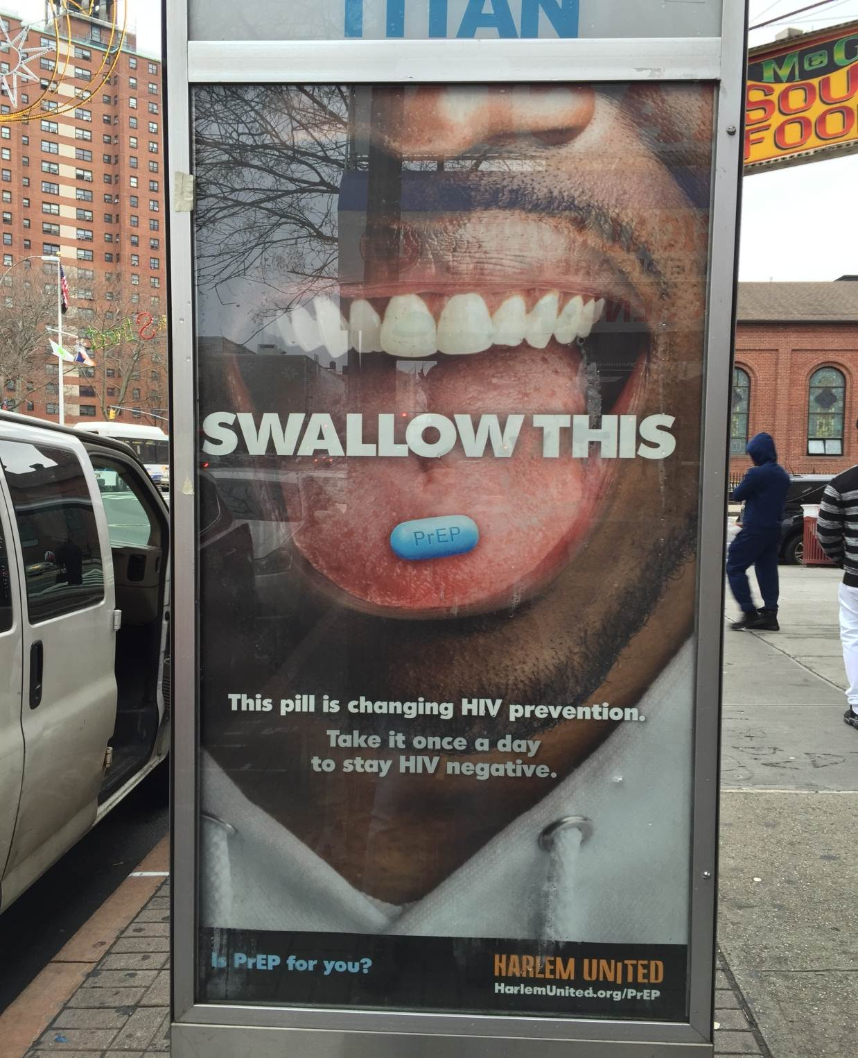
PrEP is Changing HIV Prevention
PrEP is highly effective in preventing HIV-infection in both men and women when adherence is high.
PrEP has become an essential tool in HIV prevention strategies

Slide 6
WHO 2015 Guidelines
Oral PrEP should be offered as an additional prevention choice for people at substantial risk of HIV infection as part of combination prevention approaches
Defining “substantial risk”: Substantial risk of HIV infection is provisionally defined as HIV incidence greater than 3 per 100 person–years in the absence of PrEP. HIV incidence greater than 3 per 100 person–years has been identified among some groups of men who have sex with men, transgender women in many settings and heterosexual men and women who have sexual partners with undiagnosed or untreated HIV infection.
http://www.who.int/hiv/pub/guidelines/earlyrelease-arv/en/
http://www.who.int/hiv/pub/guidelines/earlyrelease-arv/en/ (Accessed October 2015)
Notes:
PrEP is an effective prevention method to reduce the risk of HIV acquisition and has been recommended by WHO since 2015 as an additional prevention choice for pepole at substantial risk of HIV. Maximising prevention of HIV transmission requires a multimodal approach: testing and immediate or early HIV treatment, to eliminate sexual transmission, condoms, testing and treatment for STIs, male circumcision, and harm reduction intervention such as opioid substitution therapy, needle exchanges services, should be used when available.

Slide 7
EACS Guidelines — PrEP
EACS Guidelines on PrEP
PrEP should be used in adults at high risk of acquiring HIV infection when condoms are not used consistently
PrEP is recommended in HIV-negative MSM and transgender individuals when condoms are not used consistently with casual partners or with HIV-positive partners who are not on treatment.
A recent STI, use of PEP or chemsex may be markers of increased risk for HIV acquisition.
PrEP may be considered in HIV-negative heterosexual women and men who are inconsistent in their use of condoms and have multiple sexual partners where some of whom are likely to have HIV and not being on treatment
Oral PrEP with TDF/FTC daily or on demand for MSM
PrEP provides a high level of protection against HIV acquisition but does not protect against other STIs.
EACS. Guidelines, version 8, 2015
(www.eacsociety.org/guidelines/eacs-guidelines/eacs-guidelines.html)

Slide 8
PrEP with Daily or On Demand TDF/FTC among MSM
Global HIV Incidence: 0.11/100 PY (95% CI: 0.04-0.23) (6 cases)
Mean Follow-up of 22.1 months and 5633 Person-Years
Treatment | Follow-Up Pts-years | HIV Incidence per 100 Pts-years (95% CI) | IRR (95%CI)
TDF/FTC Daily | 2583.25 | 0.12 ( 0.02 – 0.34 ) | 0.99 (0.13-7.38)
TDF/FTC On Demand | 2553.68 | 0.12 ( 0.02 – 0.34 )
Molina JM et al Lancet HIV 2022
Notes:
8
8

Slide 9
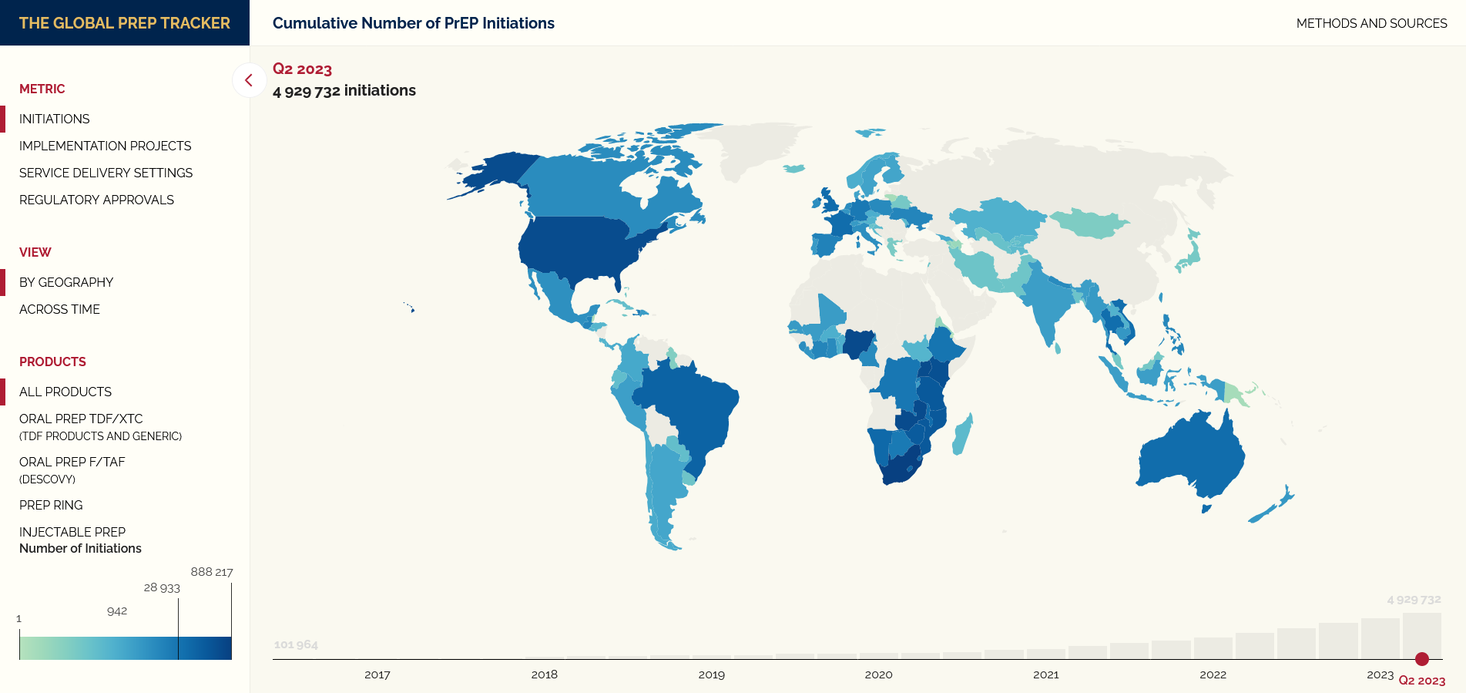
PrEP Initiations by Country, 2023

Slide 10
Status of formal PrEP implementation in Europe as of October, 2023
N=27
N=25
N=16
N=18
N=12
N=12
N=21
Source: ECDC Dublin Declaration monitoring 2023. Validated unpublished data. Preliminary analysis.

Slide 11
Number of People Receiving PrEP in Europe in 2022
Source: ECDC Dublin Declaration monitoring 2023. Validated unpublished data. Preliminary analysis.

Slide 12
Barriers to PrEP Implementation in Europe
Source: ECDC Dublin Declaration Monitoring 2023.

Slide 13
Real-World PrEP Effectiveness in Men at high risk of HIV-infection in France* (2016-2020)
 | Cases | Controls | Adjsuted OR (95% CI) | PrEP Effectiveness (95% CI)
PrEP non consumers | 183 (71%) | 622 (51%) | Ref | Ref
PrEP consumers
All | 73 (29%) | 591 (49%) | 0.40 (0.29-0.54) | 60% (46, 71)
< 50% follow-up | 57 (22%) | 239 (20%) | 0,82 (0.57-1.18) | 18% (-18; 43)
50-74% follow-up | 11 (4%) | 117 (10%) | 0.31 (0.16-0.59) | 69% (41, 84)
> 75% follow-up | 5 (2%) | 235 (19%) | 0.07 (0,03-0.16) | 93% (84, 97)
Excluding Periods of PrEP Discontinuation | 21 (10%) | 417 (43%) | 0.14 ( 0,08-0.22) | 86% (78, 92)
Median Follow-up in Open-Label Phase 18.4 months (17.5-19.1)
*Men,18-65 y, living in mainland France using PrEP or with > 4 HIV tests with 1 STI: Using the SNDS 46706 individuals: 256 cases with HIV and 5 matched controls per case (age, socioeconomic status, place of residence, calendar year, follow-up)
Jourdain H et al. Lancet Public Health 2022
Notes:
13
13

Slide 14
HIV Incidence Rates Among Women on Oral TDF/FTC with Adherence Data (n = 2955)
Consistently Daily (7/wk) | 0 / 498
Consistently High (4-6) | 1 / 658
High, but Declining (2-3) | 6 / 1166
Consistently Low (< 2) | 5 / 632
HIV Diagnoses / n
HIV Incidence per 100 PY (95% CI)
0
0.13 (0.02-0.92)
0.49 (0.22-1.08)
1.27 (0.53-3.04)
Even with low incidence overall, higher patterns of adherence were directly associated with lower risk of HIV acquisition
Calculated by Poisson regression.
Marrazzo J et al. CROI 2023

Slide 15
Limitations of Oral PrEP
Stigma associated with pill intake
Gastro-intestinal AEs (nausea, diarrhea)
Adherence to pills: daily or on demand regimen

Slide 16
Long-Acting Agents for PrEP

Slide 17
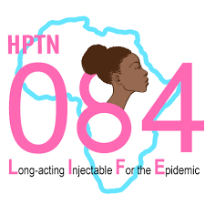
PrEP with LA Injectable Cabotegravir Highly Effective for Women
38 HIV infections in 3223 women, median age 26 years
Botswana, Eswatini, Kenya, Malawi, Uganda, Zimbabwe
HIV Incidence
1.86
^{36 infections}
Hazard Ratio (95% CI)
Favors CAB
Favors TDF/FTC
Non-Inferiority
Superiority
HIV Incidence Rate/100 PY
0.11
Noninferiority
0.01
0.31
4 Infections
CAB
n=1614
TDF/FTC
n=1610
0.75
1.23
NI margin
CI, confidence interval
Delany-Moretllwe S. et al. Lancet 2022; Eshleman S J Infect Dis 2022

Slide 18
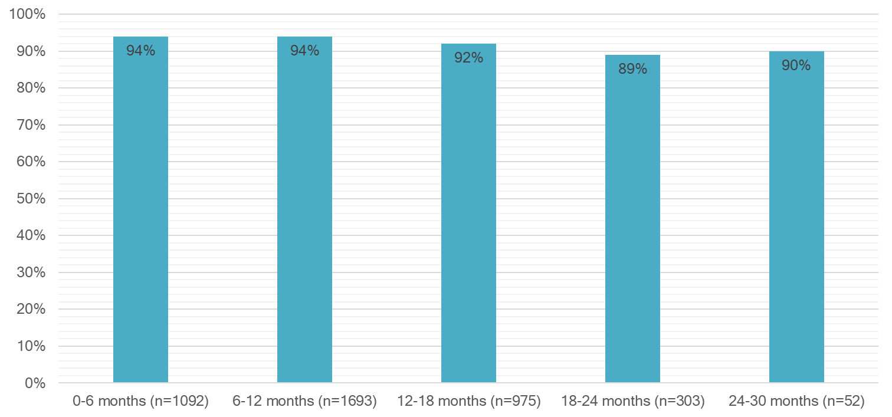
Adherence to Pill and Injections
TFV Plasma Concentrations
Cabotegravir Injections Coverage
Adherence Subset
N=375
62% detectable
46% < 40 ng/ml
No discontinuation due to injection site reaction
Similar pregnancy outcomes
Delany-Moretllwe S. et al. Lancet 2022

Slide 19
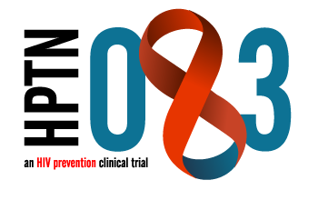
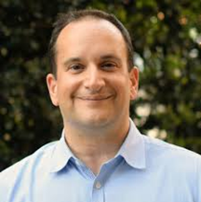
PrEP with LA Injectable Cabotegravir Highly Effective for MSM and TGW
52 HIV infections in 6389 PY of follow-up
1.4 years median per-participant follow-up
HIV Incidence
Hazard Ratio (95% CI)
39 Infections
Favors CAB
Favors TDF/FTC
Superiority
Non-Inferiority
HIV Incidence Rate/100 PY
0.34
Noninferiority
13 Infections
0.18
0.62
CAB
n=2244
TDF/FTC
n=2250
0.75
1.23
NI margin
CI, confidence interval
Landovitz RJ et al. NEJM 2021

Slide 20
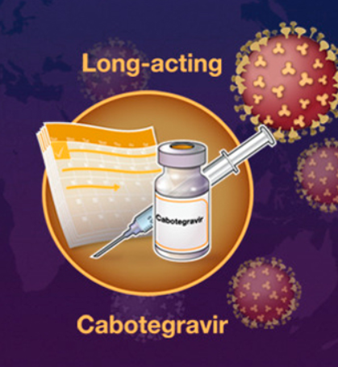
Cabotegravir for PrEP in Europe
Marketing authorization on September 15, 2023
For preventing sexually transmitted HIV-1 infection in adults and adolescents at high risk of being infected.
It should be used in combination with safer sex practices, such as using condoms.
Oral lead-in is optional

Slide 21
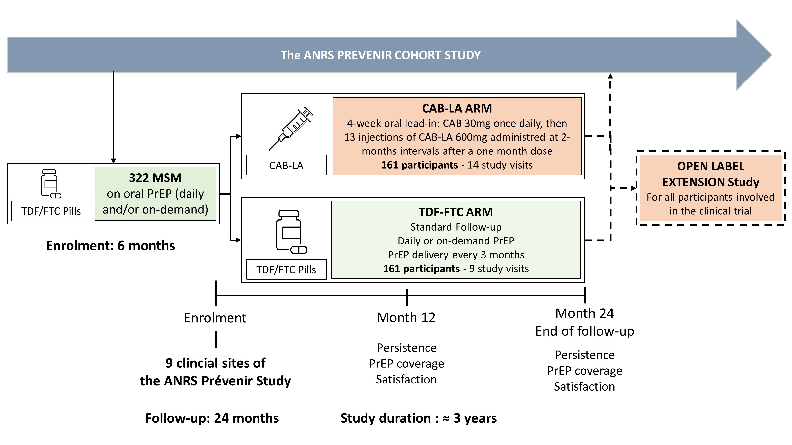
CABOPrEP – Study Design
CAB-LA Group
CAB Oral
4-week

Slide 22
Limitations of Cabotegravir LA for the Prevention of HIV
Burden of bimonthly injections
Injections cannot be self-administered
Unknown time to protection and forgiveness
Injection site reactions
Emergence of INSTI-R with potential cross-resistance to DTG
Breakthrough infections despite correct use with delayed diagnosis
Cost of drug and implementation

Slide 23
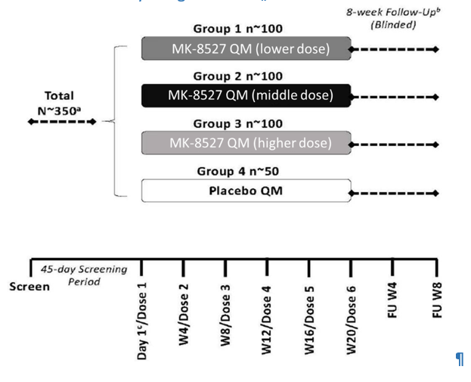
MK-8527 P007: Study Schema (NCT 06045507)
Phase 2a, double-blind placebo-controlled study to assess the safety, tolerability and PK of oral MK-8527 taken once monthly in participants at low risk for HIV infection
FU W=follow-up week; N=total number of participants in the study; n=number of participants in each treatment group; PBMC=peripheral blood mononuclear cells; QM=once monthly.
ª A subset of ~20 participants per study intervention group will be included in the PBMC Subset; these participants will have additional in-clinic visits
^{b} Participants who discontinue study intervention early will be asked to complete the blinded follow-up visits.
^{c} Randomization to study intervention will occur at Day 1 and will be stratified by sex (female, male) and region (Africa, non-Africa).

Slide 24
Randomized Open-Label Evaluation of Persistence and Acceptability of LEN in France and the UK
Week 0
26
52*
People who would benefit from PrEP (as defined by national guidelines)
but not currently on PrEP
LEN SC injection Q6M
n=175
LEN SC injection Q6M
Primary endpoint is 52-week persistence on LEN or F/TDF
F/TDF po qd
n=87
*If LEN is safe and effective in
PURPOSE 1 and 2,
all participants will be offered LEN
at W52
Internal active control
Primary endpoint of persistence, defined as sustained and consistent use of LEN vs F/TDF
Inclusion criteria focused on those who are not currently benefiting from PrEP
~5 sites each in France and the UK

Slide 25
Population Impact of PrEP The Situation in France Today
Oral PrEP with TDF/FTC fully subsidized since 01/2016
Generic TDF/FTC available since 07/2017
Condoms subsidized since 12/2018
GP can prescribe PrEP since 06/2021

Slide 26
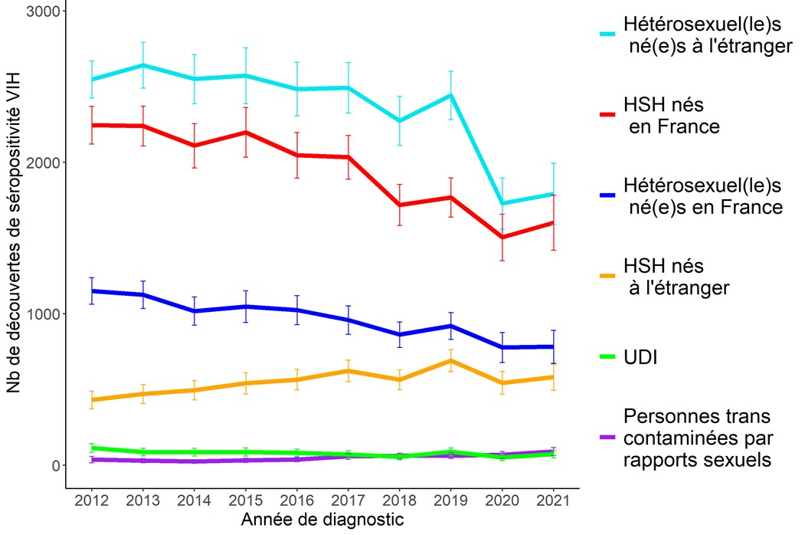
New HIV Diagnoses in France (2012- 2021)
Decline by 20% between 2016 and 2021 (5,000 cases in 2021)
PrEP
Heterosexuals born abroad (36%)
MSM born in France (32%)
Heterosexuals born France (15%)
MSM born abroad (12%)
IVDU (1%)
Transgender (2%)
Only 24% of Recent HIV-Infections
Public Health France November 2022

Slide 27
Recent HIV Infections and Missed Opportunities for PrEP in France
Multicenter study in people diagnosed with recent HIV-infection (4/2019 - 11/2020)
185/224 eligibile patients completed the questionnaire:
- 177 men: 163 MSM + 2 TGW (89%), 10 men (5%), 2 IVDU and 8 women (4%)
Median age of 33 years, and 71% born in metropolitan France
91% were eligible for PrEP but only 11% used PrEP (3.8% at diagnosis)
140 (75.7%) have heard about PrEP but 120 did not use PrEP :
- HIV infection diagnosed at PrEP initiation (33%)
- Fear of side effects (33%)
- Low perceived risk of HIV-infection (28%)
- Not being offered (24%) or not knowing where to get it (20%)
- Fear of stigma (8%)
Lions et al HIV Med 2022

Slide 28
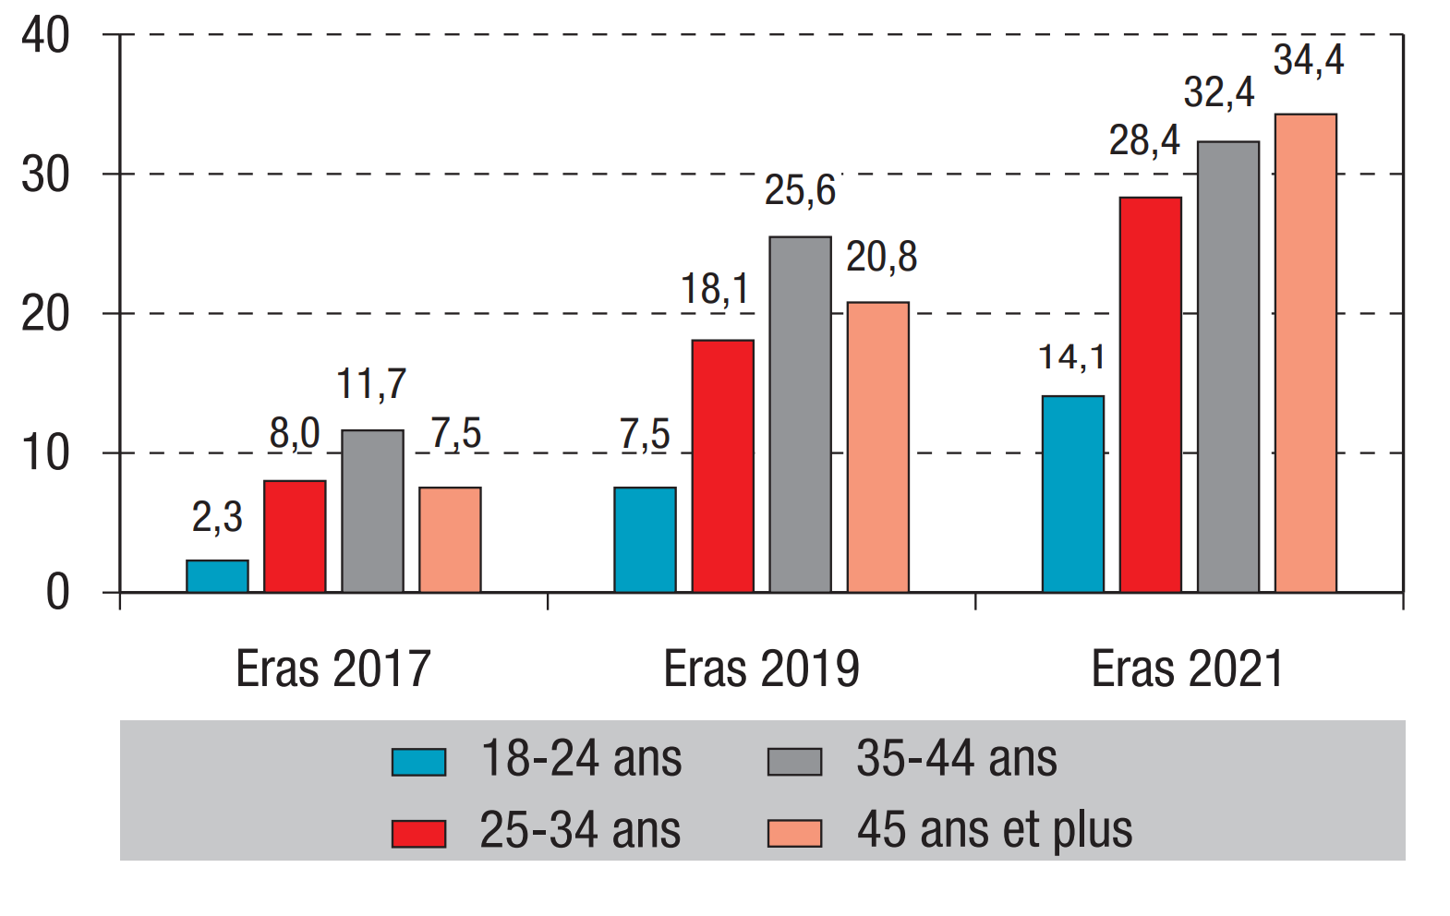
PrEP Use by HIV Negative MSM at Last Anal Sexual Intercourse with a Casual Partner in France
N= 4078
N= 5168
N= 3259
18-24 y
25-34 y
35-44 y
45+ y
Velter A et al BEH November 2022

Slide 29
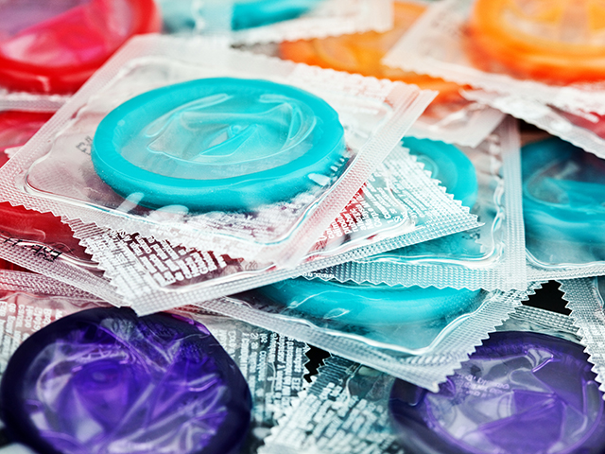

Slide 30
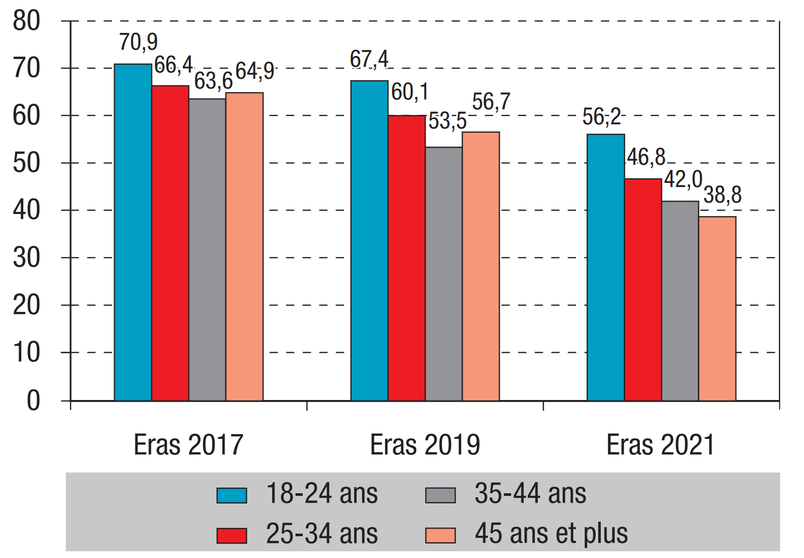
Condom Use by HIV Negative MSM at Last Anal Sexual Intercourse with a Casual Partner in France
N= 4078
N= 5168
N= 3259
18-24 y
25-34 y
35-44 y
45+ y
Velter A et al BEH November 2022

Slide 31
Preventive Tools used by HIV Negative MSM at Last Anal Sexual Intercourse with a Casual Partner (Paris)
Up to 20% of MSM do not use Preventive Tools
This Proportion did not Decreased over Time
PEP
Treatment as Prevention
Condoms Only
No Protection
Annie Velter, Personnal communication 09/2023

Slide 32
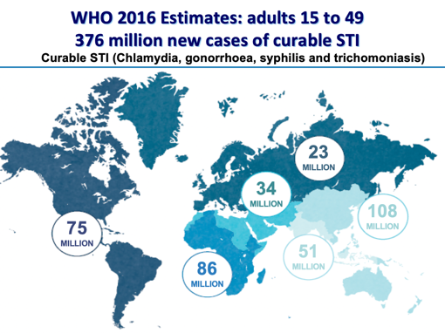
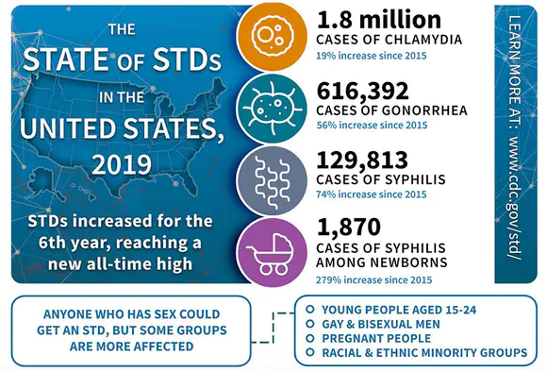
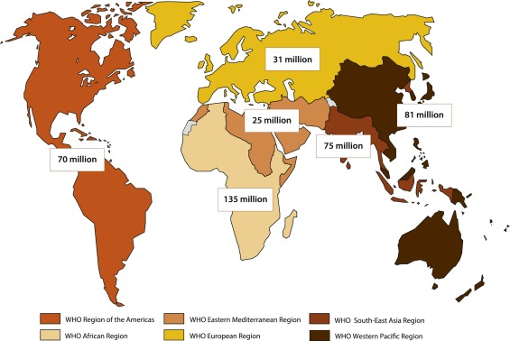
Dramatic Increases in Bacterial STI Incidence
in an Era of Effective HIV Treatment and Prevention
WHO estimates more than 374 million new curable STIs each year
23 million
36 million
86 million
60 million
74 million
96 million
28% ↑
Gonorrhea: threat of increasing incidence of antimicrobial resistance
Syphilis: spread into heterosexual networks with congenital syphilis
Reappearance of classics: LGV proctitis in MSM
WHO global progress report on HIV, viral hepatitis and sexually transmitted infections 2021; https://www.cdc.gov/std;
Pathela Sex Transm Dis 2019; WHO; Oliver Clin Infect Dis 2018; Braun DL CID 2018, Marrazzo JM. CROI 2019 Seattle USA
Notes:
I will add relevant abstracts being presented

Slide 33
Predicting Factors of STIs in PrEP Users
PrEPX: Multi-site, open-label PrEP study in Australia
4275 participants (98.5% MSM) enrolled (July 2016–April 2018)
STI incidence of 91.9 /100 PY and 2058 patients in a multi-variate analysis
Predicting factors of STIs | aOR | 95% CI | p-value
Age (5 years increase) | 0.94 | 0.90–0.97 | < 0.001
No. of anal sex partners in last 6 months (< 5 vs. >10) | 1.91 | 1.48–2.46 | < 0.001
Group sex (monthly vs none) | 1.45 | 1.15–1.83 | 0.002
Condom use (never vs always) | 1.31 | 0.88–1.97 | 0.18
PY, Person years; aOR, Adjusted odds ratio
Traeger MW et al. JAMA. 2019;321:1380-1390.
Notes:
33

Slide 34
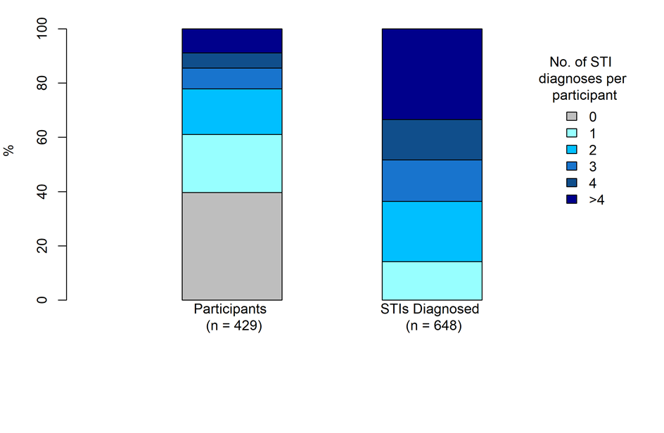
Reccurent STIs in the ANRS Ipergay PrEP Trial
% of Participants
Median FU of 23 months
STI testing every 6 months
60% with incident STIs
Recurrent STIs associated with
STIs at baseline,
> 8 partners in prior 2 months
GHB use
39% of participants accounted for 86% of all STIs
Zeggagh J. et al. AIDS 2022
Notes:
34

Slide 35
Doxycycline PEP in MSM
Randomized open-label trial
On Demand PEP with doxycycline
(200 mg, within 24-72h after sex)
N=116
HIV-negative MSM on PrEP
Enrolled in the ANRS IPERGAY open-label extension study
No contra-indication to Doxy
No PEP
N=116
* < 6 pills/week to limit antibiotic exposure: use of a median of 6.8 pills/month per patient
Visits at baseline and every two months with serologic assays for HIV and syphilis and PCR assays for CT and NG in urine samples, anal and throat swabs
PCR, Polymerase chain reaction; CT, chlamydia trachomatis; NG, Neisseria gonorrhoeae
Molina JM et al. Lancet Inf Dis. 2018;18:308-317
Notes:
35

Slide 36
Why Testing Doxycycline for PEP ?
No known resistance to doxycycline in C. trachomatis and T. pallidum
Doxycycline PEP successfully used for prevention of Lyme disease and Leptospirosis (Nadelman, NEJM 2001; Takafuji, NEJM 1984)
Limited use of doxycycline in France for the treatment of bacterial infections, mostly used for acnea and malaria prophylaxis
N. gonorrhoeae in France already resistant to tetracycline (65% in 2020-21, 20-30% high level with tetM acquisition)

Slide 37
Incidence of First Episode of STIs
0.5
No PEP
0.4
Log-rank test p=0.007
0.3
Cumulative probability of first STI
0.2
PEP
0.1
0
0
2
4
6
8
10
months
No at risk : No PEP
PEP
116
116
110
112
91
105
76
93
50
69
6
18
Median follow-up of 8.7 months (IQR: 7.8-9.7): 73 subjects infected
45 in No PEP arm (incidence: 69.7 per 100 PY), 28 in PEP arm (incidence: 37.7 per 100 PY)
Hazard Ratio: 0.53 (95% CI: 0.33-0.85, p=0.008)
Molina JM et al. Lancet Inf Dis. 2018;18:308-317
Notes:
37
37

Slide 38
Incidence of First Episode of Chlamydia
0.5
0.4
Log-rank test p=0.003
0.3
Cumulative probability of first STI
No PEP
0.2
0.1
PEP
0
0
2
4
6
8
10
months
No at risk : No PEP
PEP
116
116
112
114
102
111
93
105
68
84
9
22
Median follow-up of 8.7 months (IQR: 7.8–9.7): 28 subjects infected
21 in no PEP arm (incidence: 28.6/100 PY), 7 in PEP arm (incidence: 8.7/100 PY)
Hazard Ratio: 0.30 (95% CI: 0.13-0.70, p=0.006)
Molina JM et al. Lancet Inf Dis. 2018;18:308-317
Notes:
38
38

Slide 39
Incidence of First Episode of Syphilis
0.5
0.4
Log-rank test p=0.04
0.3
Cumulative probability of first STI
0.2
No PEP
0.1
PEP
0
0
2
4
6
8
10
months
No at risk : No PEP
PEP
116
116
114
116
110
115
102
107
74
83
7
21
Median follow-up of 8.7 months (IQR: 7.8-9.7): 13 subjects infected
10 in no PEP arm (incidence: 12.9 / 100 PY), 3 in PEP arm (incidence: 3.7/100 PY)
Hazard Ratio: 0.27 (95% CI: 0.07–0.98, p<0.05)
Molina JM et al. Lancet Inf Dis. 2018;18:308-317
Notes:
39
39

Slide 40
Co-Chairs Choice
Doxycycline post-exposure prophylaxis for prevention of STIs among MSM and TGW who are living with HIV or on PrEP
Annie Luetkemeyer, Julie Dombrowski, Stephanie Cohen, Deborah Donnell, Cole Grabow, Clare Brown, Cheryl Malinski, Rodney Perkins, Melody Nasser, Carolina Lopez, Susan Buchbinder, Hyman Scott, Edwin Charlebois, Diane Havlir, Olusegun Soge, Connie Celum on behalf of the DoxyPEP Study Team

Slide 41
Intervention: Open label doxycycline 200mg taken as PEP within 72 hours after condomless sexual contact Maximum of 200 mg every 24 hours
Doxy PEP
Inclusion criteria:
Male sex at birth
Living with HIV or on PrEP
≥ 1 STI in past 12 months
Condomless sex with ≥ 1 male
partner in past 12 months
STI Testing: Quarterly 3 site GC/CT testing + RPR, GC culture before treatment
Sites: San Francisco & Seattle HIV
& STI clinics
MSM & TGW
living with HIV
(planned n = 390)
No PEP
Month
STI testing
0
3
6
9
12
2:1 randomization
Doxy PEP
MSM & TGW
on HIV PrEP
(planned n = 390)
No PEP
Month
STI testing
0
3
6
9
12
Detect a 50% reduction of STIs/quarter with doxyPEP
Stopping boundaries for effectiveness: α < 0.025 for both cohorts
DSMB recommended early discontinuation in May 2022 at first interim analysis

Slide 42
Primary Endpoint: STI incidence per quarter (501 pts enrolled)
31.9% (82/257)
30.5% (39/129)
Reduction in STI incidence/quarter
risk reduction (95% CI)
PrEP | 0.34 (0.24 - 0.46)
Living with HIV | 0.38 (0.24 - 0.60)
Total | 0.35 (0.27 - 0.46)
10.7% (61/570)
11.8% (36/305)
all p< 0.0001
Luetkemeyer et al NEJM 2023

Slide 43
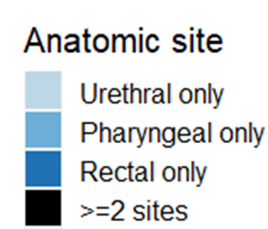
Individual STI incidence by study arm & cohort
Gonorrhea
Chlamydia
Reduction in each STI per quarter
risk reduction (95% CI)
 | PrEP | PLWH
GC | 0.45 (0.32 - 0.65) p<0.0001 | 0.43 (0.26 - 0.71) p=0.001
CT | 0.12 (0.05 - 0.25) p<0.0001 | 0.26 (0.12 - 0.57) p=0.0007
Syphilis | 0.13 (0.03 - 0.59) p=0.0084 | 0.23 (0.04 - 1.29) p=0.095
Syphilis
Luetkemeyer et al NEJM 2023

Slide 44
Tetracycline resistance (TCN-R) in incident GC with culture data
(1)
(3)
TCN-R similar in incident GC at baseline and on doxy-PEP
Increased TCN-R in doxy- PEP vs. standard of care suggests doxy-PEP may be less protective against GC strains with existing TCN-R
Limited by low number of GC samples with MIC results (56/320)
(2)
(2)
(4)
(17)
(13)
(16)

Slide 45
ANRS DOXYVAC Study Design
Multicenter, 2 x 2 factorial randomized, open-label, superiority, phase III trial (NCT04597424)
4CMenB Vaccine
2 injections (M0 and M2)
DoxyPEP 200 mg
24-72h post sex
MSM on PrEP > 6 months
Enrolled in ANRS Prevenir
Bacterial STI in prior 12 months
No STI symptoms
(N = 720)
1:1
No Vaccine
Up to 96 wks follow-up
2:1
No PEP
4CMenB Vaccine
2 injections (M0 and M2)
1:1
No Vaccine
Primary efficacy end-points: impact of DoxyPEP on time to a first episode of syphilis or chlamydia and impact of the 4CMenB vaccine on time to a first episode of N. gonorrhoeae infection.
Sample size: based on vaccine effectiveness assuming no impact of Doxy on GC: 720 subjects needed for an HR: 0.70 (Estimated probability of a first GC episode over 18 months: 52%, power 85%, 18% lost to FU).
Quaterly visits with PCR tests (Roche dual target Cobas°) for GC/CT/MG (3 sites) and serology for TP
Doxycycline monohydrate purchased from Arrow and 4CMenB vaccine purchased from GSK
Molina JM, CROI 2023

Slide 46
Doxycycline PEP
Time to First CT or Syphilis Infection
No interaction between Doxy PEP
and 4CMenB vaccine (p=0.99)
Median follow-up: 9 months
(IQR: 6 to 12) in 501 participants
49 subjects infected
36 in No PEP arm
(incidence: 35.4/100 PY),
13 in Doxy PEP arm
(incidence: 5.6/100 PY)
Adjusted Hazard Ratio:
0.16 (95% CI: 0.08-0.30, p<0.0001)
Molina et al CROI 2023
Notes:
46
46

Slide 47
Doxy-PEP Use vs STIs Averted in a US Sexual Health Clinic
Prescribe doxy-PEP to:
Prescribe doxy-PEP following:
27
Confidential. Please do not distribute.
Traeger M, CID 2023
Notes:
Cohort of 10,562 persons, 94% MSM at Fenway 54% on PrEP, 14% HIV, 37,4% STI incidence

Slide 48
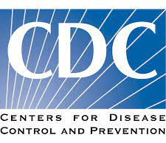
DoxyPEP for Bacterial STIs What the Guidelines Say ?
IAS-USA 2022: on a case by case basis in MSM and TGW
EACS 2023: on a case by case basis in MSM with repeated STIs
US CDC 2023: recommended for consideration for MSM and TGW with at least one bacterial STI in last 12 months

Slide 49
How to Use Doxy PEP
MSM and TGW living with or without HIV
Sex with casual partners without regular use of condoms
>1-2 STIs in last 12 months
Tested negative for GC, CT, and syphilis < 7 days before starting PEP
No tetracycline allergy and no concomitant treatment with retinoïds or anticonvulsivant
Doxy PEP prescription:
200 mg monohydrate > hyclate Doxy with food and water > 1 h before bedtime
24h and no later than 72h following condomless sex
Monitoring of Doxy PEP:
Testing for STIs every 3 months
Assess safety of Doxy PEP
Perfom test of cure, especially if STI treatment with doxycycline is used
Monitoring for AMR in case of breakthrough infection (phenotypic and genotypic resistance)
Notes:
49

Slide 50
DoxyPEP for STIs Summary
Short-term benefits of Doxycycline PEP among MSM
Strong reduction of syphilis and chlamydia incidence
Impact on gonorrhoea likely to be limited
Well tolerated with high acceptability and adherence
Long-term uncertainties: Continue research
Selection and clonal dissemination of more resistant STIs
Impact on the microbiome
Time for cautious DoxyPEP implementation?
Identify and monitor the population who will benefit the most
Notes:
50

Slide 51
Prevention Choices for HIV and STIs among Young MSM
Ongoing, observational cohort of young black MSM in Atlanta, Emory University, GA
OPTIONS: daily, oral PrEP, 2-1-1 oral PrEP, Doxy PEP
CAB-LA not offered through study
Participants can start, stop, change prevention choice at any time
Navigation, mHealth study app, and peer counselor motivational interviewing support
Selected Prevention Option at Enrollment | N= 140
1. Daily PrEP | 23; 16%
2. 2-1-1 PrEP | 8; 6%
3. STI PEP | 13; 9%
4. Daily PrEP and STI PEP | 72; 50%
5. 2-1-1 PrEP and STI PEP | 21; 15%
6. Sexual health app only | 3; 2%
89% HIV PrEP
76% STIs PEP
55% PrEP + PEP
CF Kelley and Sullivan CROI 2023

Slide 52
Summary
High incidence of HIV and STIs in key populations.
HIV PrEP and STI PEP are highly effective biomedical tools.
PrEP, PEP and Condoms should be used in combination against HIV and STIs.
Awareness campaigns for condoms and biomedical prevention of HIV and STIs are clearly insufficient.
The goal is to increase the level of protection against HIV and STIs to reduce their incidence.
All stakeholders need to be involved, especially the community.

Slide 53
Acknowledgments
Connie Celum
Sinead Delany
Colleen Kelley
Raphael Landovitz
Annie Lutkemeyer
Teymur Noori
Annie Velter
@jmmolinaparis
Notes:
53
53

