Slide 1
Sex-based differences in autologous neutralising antibody responses induced by a native-like HIV-1 envelope trimer vaccine Emma Reiss on behalf of the ACTHIVE-001 team 28-11-2023 e.i.reiss@amsterdamumc.nl
Image credit: David Goodsell
Depiction of germline-targeting Env trimers (pink) or boosting immunogens (pink with dark pink) binding to B cell receptors (green)

Slide 2
Disclosure of speaker’s interest
(Potential) conflict of interest | None

Slide 3
Immunogen
Trial design
Safety
Serum binding
Serum neutralisation
Sex differences
Sequential immunisation to promote broadly neutralising antibody development
Requires multiple immunogens
Antibody (Ab) breath
Prime
‘Shape’
‘Polish’
Germline
Ab lineage
Broadly neutralising
antibodies (bNAbs)
Env variants
Germline
Adapted from Gruell H & Klein F, Nature Med, 2014
https://doi.org/10.1038/nm.3567

Slide 4
Immunogen
Trial design
Safety
Serum binding
Serum neutralisation
Sex differences
Boosting HIV-1 Env immunogens
Used to shape or polish the B cell response towards bNAb formation
Immunogens that are currently under investigation in clinical trials:
Clade A BG505 SOSIP.664 (IAVI-C107 and IAVI-C110 studies)
Preceeded by BG505 SOSIP.GT1.1 prime (C101)
Sponsor-initiated, multicentre: Amsterdam UMC (C110), Rockefeller University, George Washington University (C107)
Readily available (prior use in IAVI W001)
Consensus sequence Env ConM SOSIP.v7 (ACTHIVE-001)
Monocenter, PI-initiated at Amsterdam UMC, location AMC
Not preceeded by (germline-targeting) priming immunisation in this study
Both BG505 SOSIP.664 and ConM SOSIP.v7 are capable of boosting the antibody response induced by BG505 SOSIP.GT1.1 in non-human primates (Caniels TG, et al, in review)

Slide 5
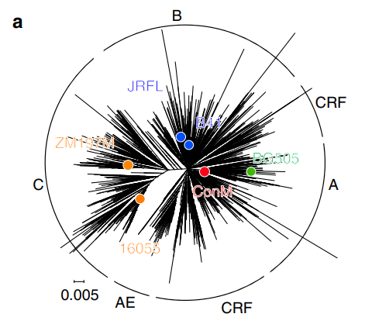
Immunogen
Trial design
Safety
Serum binding
Serum neutralisation
Sex differences
ConM SOSIP.v7 gp140
A stabilised native-like Env trimer based on HIV-1 Major (M) group (> 90% infections worldwide)
Artificial group M consensus sequence; most common amino acid on each position in genetic code
Contains less strain-specific antibody targets
Intended to increase neutralising antibody breadth
Potent autologous ConM-specific neutralisation in animals, modest cross-neutralisation
Sliepen K., et al. Nat. Comm, 2019
https://doi.org/10.1038/s41467-019-10262-5

Slide 6
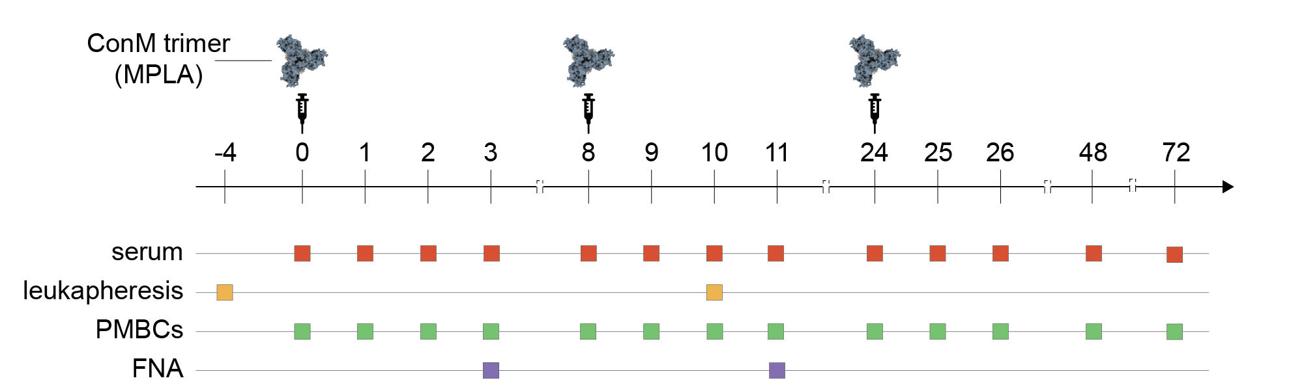
Immunogen
Trial design
Safety
Serum binding
Serum neutralisation
Sex differences
ACTHIVE-001 trial overview
ConM trimer
(MPLA)
*MPLA = Monophosphoryl lipid A
TLR4 agonist
Randomised, open-label, uncontrolled phase 1 clinical trial
Monocenter (Amsterdam UMC)
Principal Investigator: dr. G.J. de Bree
24 HIV-negative adult women and men, aged 18 – 50 years
Large overlap with other (pre)clinical studies (e.g. IAVI-C101)
 | Total N = 24
Sex at birth, n (%)
Female | 14 (58%)
Male | 10 (42%)
Age, years
Median, (range) | 29 (19 - 49)
BMI, kg/m²
Median, (range) | 22.3 (17.1 - 29.0)

Slide 7
Immunogen
Trial design
Safety
Serum binding
Serum neutralisation
Sex differences
The adjuvanted ConM SOSIP.v7 vaccine is well tolerated and has an acceptable safety profile
Adverse events post any vaccine dose | n (%)
All adverse events | 294 (100)
All Grade 1 (mild) adverse events | 248 (84.4)
All Grade 2 (moderate) adverse events | 38 (12.9)
All Grade 3 (severe) adverse events | 8 (2.7)
Adverse reactions post any vaccine dose | n (%)
All adverse reactions | 194 (100)
All Grade 1 (mild) adverse reactions | 159 (82.0)
All Grade 2 (moderate) adverse reactions | 29 (14.9)
All Grade 3 (severe) adverse reactions | 6 (3.1)
 | Vaccination
 | #1 (N = 24) n (%) | #2 (N = 23) n (%) | #3 (N = 23) n (%)
Local ARs
Site tenderness | 16 (66.7) | 16 (69.6) | 15 (65.2)
Site erythema | 4 (16.7) | 7 (30.3) | 7 (30.4)
3. Site pain | 4 (16.7) | 3 (13.0) | 5 (21.7)
Systemic ARs
Headache | 6 (25.0) | 7 (30.4) | 6 (26.1)
Malaise | 7 (29.2) | 5 (21.7) | 5 (21.7)
Fatigue | 5 (20.8) | 4 (17.4) | 4 (17.4)
No serious adverse events (SAEs) or suspected unexpected serious adverse reactions (SUSARs) were reported.
66% of adverse events (AEs) were considered at least possibly related to the vaccine (adverse reactions (AR)).
All participants reported at least one adverse reaction
22/24 (91.7%) reported ≥ 1 local AR
22/24 (91.7%) reported ≥ 1 systemic AR
No significant differences between vaccination # or sexes
Less reactogenicity than BNT162b2 and mRNA-1273 Covid-19 vaccines (NEJM, December 2020)

Slide 8
Immunogen
Trial design
Safety
Serum binding
Serum neutralisation
Sex differences
ConM-specific binding and neutralising antibodies were detected in nearly all participant sera
ConM-specific binding antibodies
ConM-specific neutralising antibodies
100%
100%
96%
100%
74%
65%
Modest binding to heterologous Env proteins, but no neutralisation breadth (data not shown).
Binding Antibody Multiplex Assay (BAMA) and serum neutralisation data generated by Duke Human Vaccine Institute (Tomaras and Montefiori laboratories, respectively)

Slide 9
Immunogen
Trial design
Safety
Serum binding
Serum neutralisation
Sex differences
Sex-based differences in ConM-specific binding and neutralising antibodies were observed
ConM-specific binding per sex
ConM-specific neutralisation per sex
Female participants generated a greater binding response compared to males, although not always statistically significant.
Female participants generated a significantly greater neutralising response compared to males, which persists over time.
Binding Antibody Multiplex Assay (BAMA) and serum neutralisation data generated by Duke Human Vaccine Institute (Tomaras and Montefiori laboratories, respectively)

Slide 10
Conclusion
The adjuvanted ConM SOSIP.v7 gp140 vaccine has an acceptable safety profile
Strong ConM-specific neutralising responses after three vaccinations (96%)
Quantitative and qualitative differences between the female and male antibody response:
ConM-specific IgG, IgG1 and IgG4 (not shown) and ConM neutralisation
Additional antibody-mediated effector functions (e.g. ADCP, ADCC) (not shown)
Potential role for TLR4 stimulatory adjuvant (MPLA)
We have not come across a similar impact of sex (i.e. 6.3-fold difference) on neutralising antibody responses in human (HIV) vaccinology studies
Image credit: David Goodsell
Depiction of germline-targeting Env trimers (pink) or boosting immunogens (pink with dark pink) binding to B cell receptors (green)

Slide 11
So what have we learned?
It is highly unlikely that a solitary immunogen will be capable of inducing broadly neutralising HIV-1 antibodies (bNAbs)
Sequential immunisation strategies are being studied (e.g. C110 and C107)
GT1.1 is capable of inducing desirable VRC01-class antibodies
ConM SOSIP.v7 more suited as a boosting than priming immunogen
Both protein and mRNA designs should be considered
Sex-based differences should be taken into consideration when assessing HIV-1 vaccine candidates and adjuvants
Described for some antiviral vaccines, yet underlying mechanisms not fully understood
Preclinical and clinical studies should include both sexes
Different people at risk could benefit from different antigen/adjuvant combinations
Prime
‘Shape’
‘Polish’
Germline
Image credit: David Goodsell
Depiction of germline-targeting Env trimers (pink) or boosting immunogens (pink with dark pink) binding to B cell receptors (green)

Slide 12
Acknowledgements
Amsterdam UMC (MMI)
Rogier Sanders
Judith Burger
Mathieu Claireaux
Marit van Gils
Laura Graus
Marloes Grobben
Menno de Jong
Guistiniano Kerster
Marius Liesdek
Wouter Olijhoek
Colin Russell
Ronald van Leersum
Karlijn van der Straten
Ruben Walen
Amsterdam UMC (Pharmacy)
Marleen Kemper
Azra Beganovic
Jantine Colen
Duke University/CAVIMC
David Montefiori
Georgia Tomaras
Nicole Yates
Sheetal Sawant
Hongmei Gao
Kelli Greene
Scripps Research
Andrew Ward
Gabriel Ozorowski
Gyunghee Jo
Wilma Lee
Ryan Lin
Jon Torres
Andy Tran
Ospedale San Raffaele (OSR)
Gabriella Scarlatti
Monica Tolazzi
Cimi-Paris / INSERM
Behazine Combadière
Olivia Bonduelle
Amsterdam UMC (ECRU)
Maarten Soeters
Dulci Burleson-Pocorni
Monique Kooijman
Jane Mensink
Miranda Poffijn
Twink Smidt
BMGF
Susan Barnett
Pervin Anklesaria
Polymun GmbH
Dietmar Katinger
Thomas Hemetsberger
Philipp Mundsperger
Markus Simmerstatter
Gabriela Stiegler
Veronika Triebel
Richard Vasicek
Imperial College (ICL)
Robin Shattock
Hannah Cheeseman
Abbey Evans
Leon McFarlane
Karolinska Institutet
Gunilla Karlsson-Hedestam
Martin Corcoran
Amsterdam UMC (RAD)
Rob Hurks
Researchbureau Radiology
Amsterdam UMC (INT)
Godelieve de Bree
Michelle Klouwens
Jan Prins
Maarten Soeters
Annelou van der Veen
Amsterdam UMC (Dianet)
Liffert Vogt
Anita van Noort
Wilma Kool
Amsterdam UMC (LVIP)
Neeltje Kootstra
Agnes Harskamp
& our gratitude to all ACTHIVE-001 participants

