Slide 1
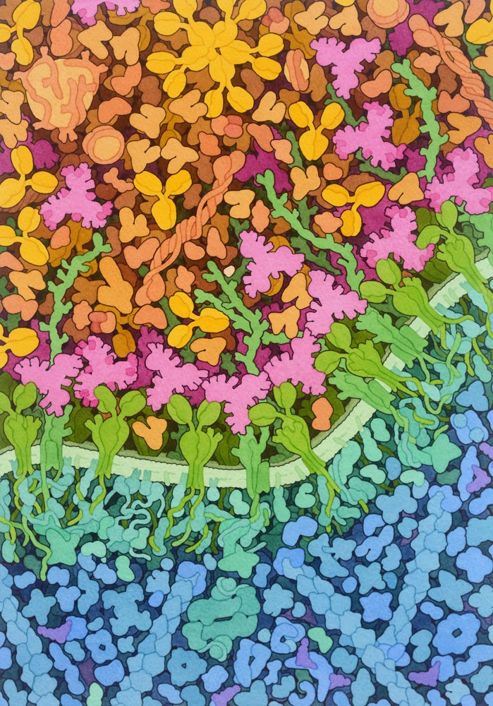

Membrane-bound germline-targeting HIV-1 Env immunogens for mRNA vaccination
Iván del Moral Sánchez
Amsterdam UMC, University of Amsterdam, Netherlands
28th November 2023
Image credit: David Goodsell
Depiction of germline-targeting Env trimers (pink) or boosting immunogens (pink with dark pink) binding to B cell receptors (green)

Slide 2
Disclosure of interests
The speaker has no conflicts of interest to disclose.

Slide 3
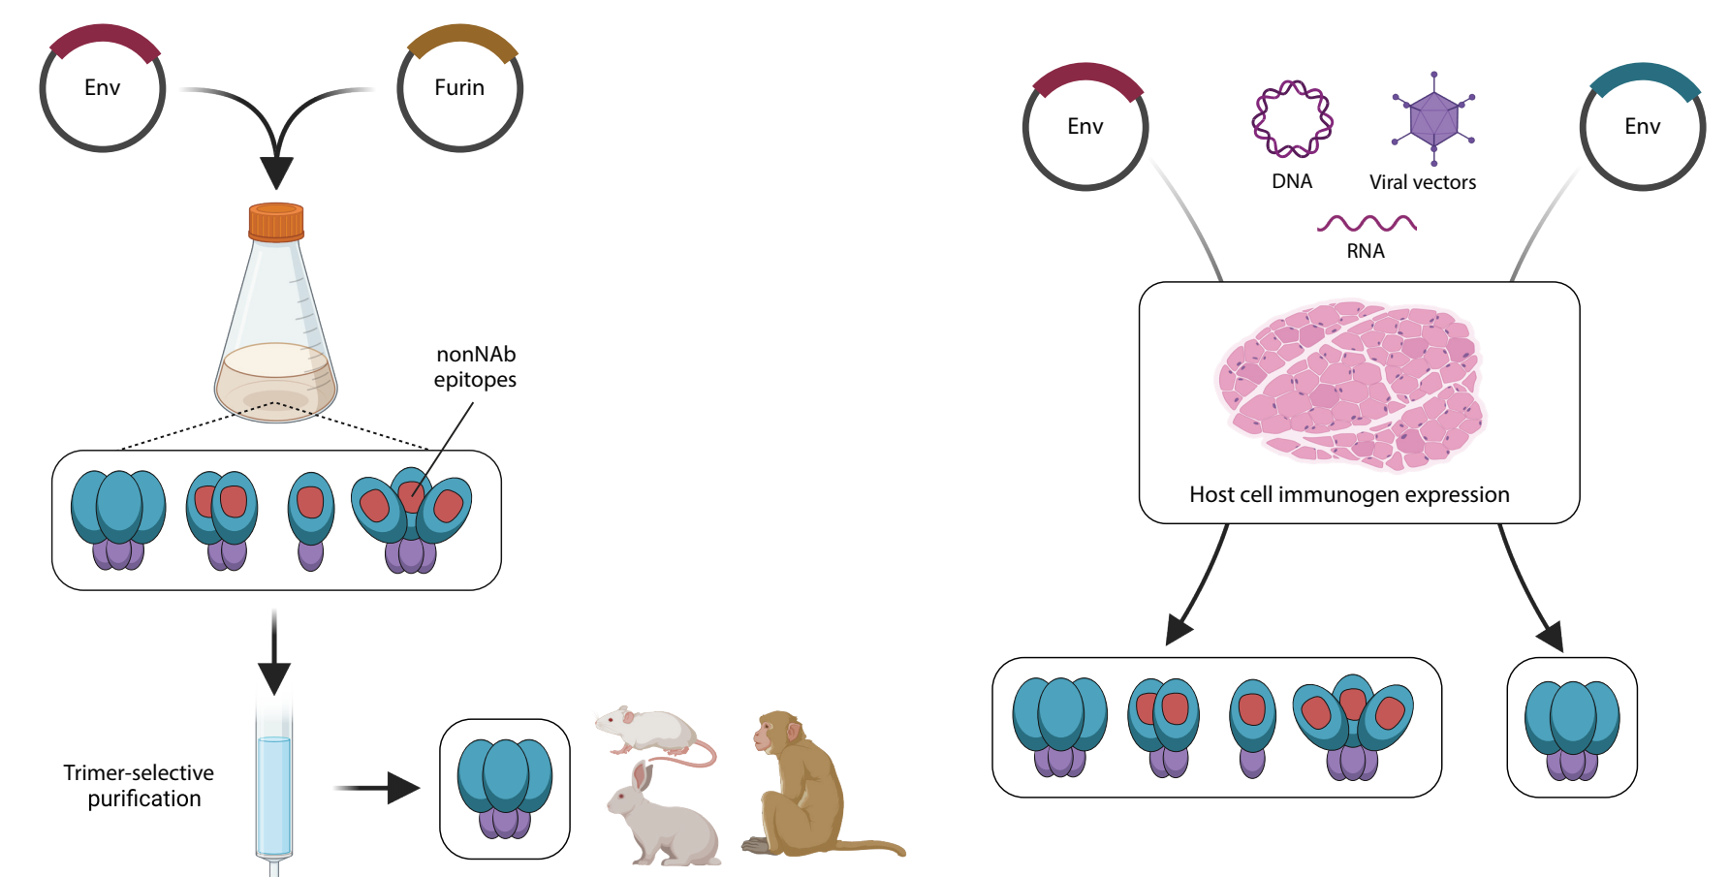
Native-like Env constructs for nucleic acid vaccination
Protein vaccination

Slide 4
Native-like Env constructs for nucleic acid vaccination
Protein vaccination
Nucleic acid vaccination

Slide 5
Native-like Env constructs for nucleic acid vaccination
Protein vaccination
Nucleic acid vaccination

Slide 6
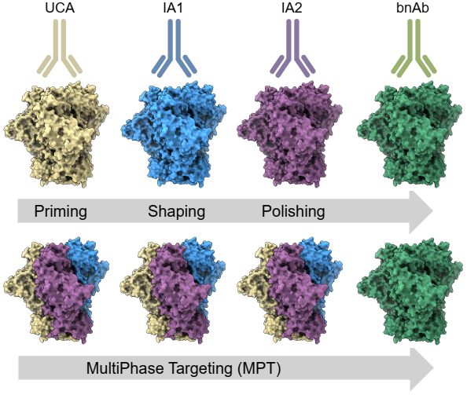
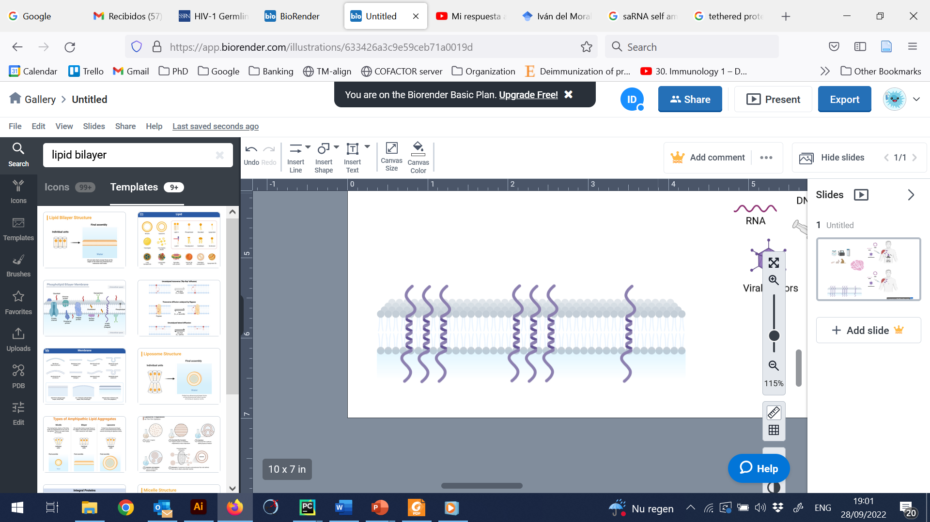
Presentation cell membranes improves the conformation and immunogenicity of Env
Membrane-bound Env
Soluble Env
Env
The transmembrane domain improves the conformation of Env trimers
Env
Transmembrane domain

Slide 7
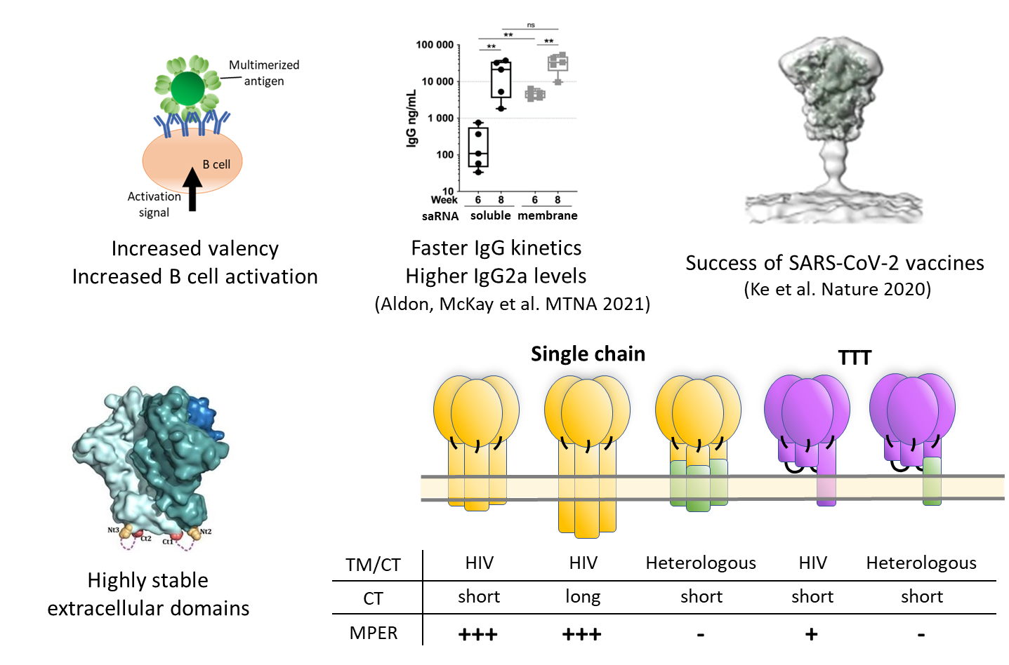
Presentation cell membranes improves the conformation and immunogenicity of Env
Membrane-bound Env
Soluble Env
Env
The transmembrane domain improves the conformation of Env trimers
Env
Transmembrane domain
Increased valency → Increased B cell activation

Slide 8
Presentation cell membranes improves the conformation and immunogenicity of Env
Membrane-bound Env
Soluble Env
Env
The transmembrane domain improves the conformation of Env trimers
Env
Transmembrane domain
Increased valency → Increased B cell activation
Success in SARS-CoV-2 vaccines

Slide 9
Membrane-bound GT1.1 show high surface expression and favorable antigenicity
GR1
GR2
GR6
GR14
GR16
Negative control Env
GT1.1 variants stabilized with different
design platforms
Different transmembrane domains
Negative control
GT1.1
HIV-1
Heterologous

Slide 10
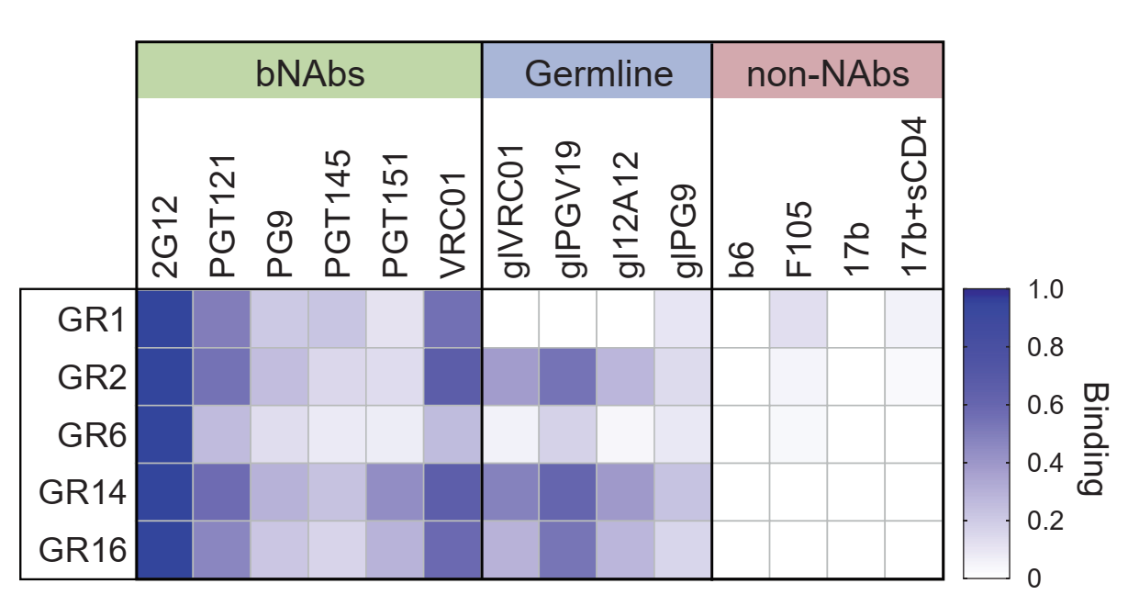
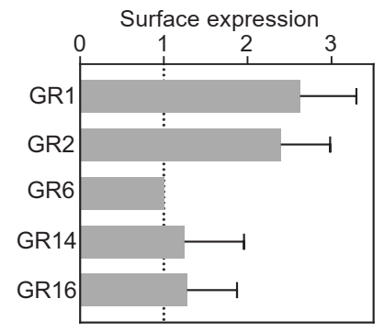
Membrane-bound GT1.1 show high surface expression and favorable antigenicity
GR1
GR2
GR6
GR14
GR16
Negative control Env
GT1.1 variants stabilized with different
design platforms
Different transmembrane domains
Negative control
GT1.1
HIV-1
Heterologous
High expression on the surface of cells
Binding to target precursors of broadly neutralizing antibodies

Slide 11
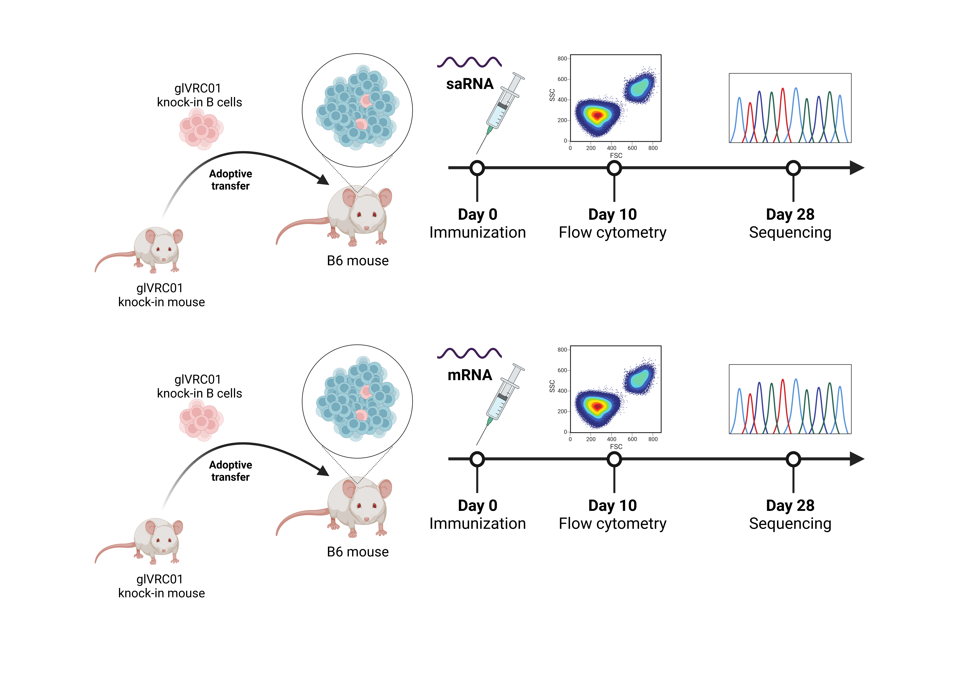
Jahyun Koo, Edward Lamperti, Facundo Batista, Paul McKay, Robin Shattock
Membrane-bound GT1.1 are superior to soluble GT1.1 immunogens
Soluble GT1.1
GR1
GR2
GR6
GR14
GR16
Negative control
GT1.1
HIV-1
Heterologous

Slide 12
Jahyun Koo, Edward Lamperti, Facundo Batista, Paul McKay, Robin Shattock
Membrane-bound GT1.1 are superior to soluble GT1.1 immunogens
Soluble GT1.1
GR1
GR2
GR6
GR14
GR16
Negative control
GT1.1
HIV-1
Heterologous

Slide 13
Jahyun Koo, Edward Lamperti, Facundo Batista, Paul McKay, Robin Shattock
Membrane-bound GT1.1 are superior to soluble GT1.1 immunogens
Soluble GT1.1
GR1
GR2
GR6
GR14
GR16
Negative control
GT1.1
HIV-1
Heterologous

Slide 14
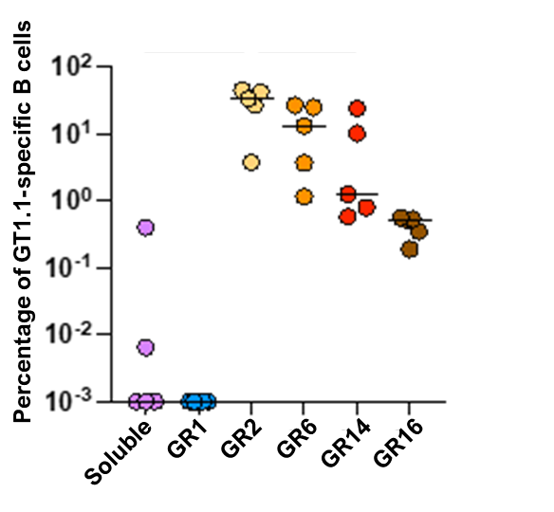
Jahyun Koo, Edward Lamperti, Facundo Batista, Paul McKay, Robin Shattock
Membrane-bound GT1.1 are superior to soluble GT1.1 immunogens
Soluble GT1.1
GR1
GR2
GR6
GR14
GR16
Negative control
GT1.1
HIV-1
Heterologous
Membrane-bound, but not soluble, GT1.1 immunogens induce strong antigen-specific responses in high-bar mouse models.

Slide 15
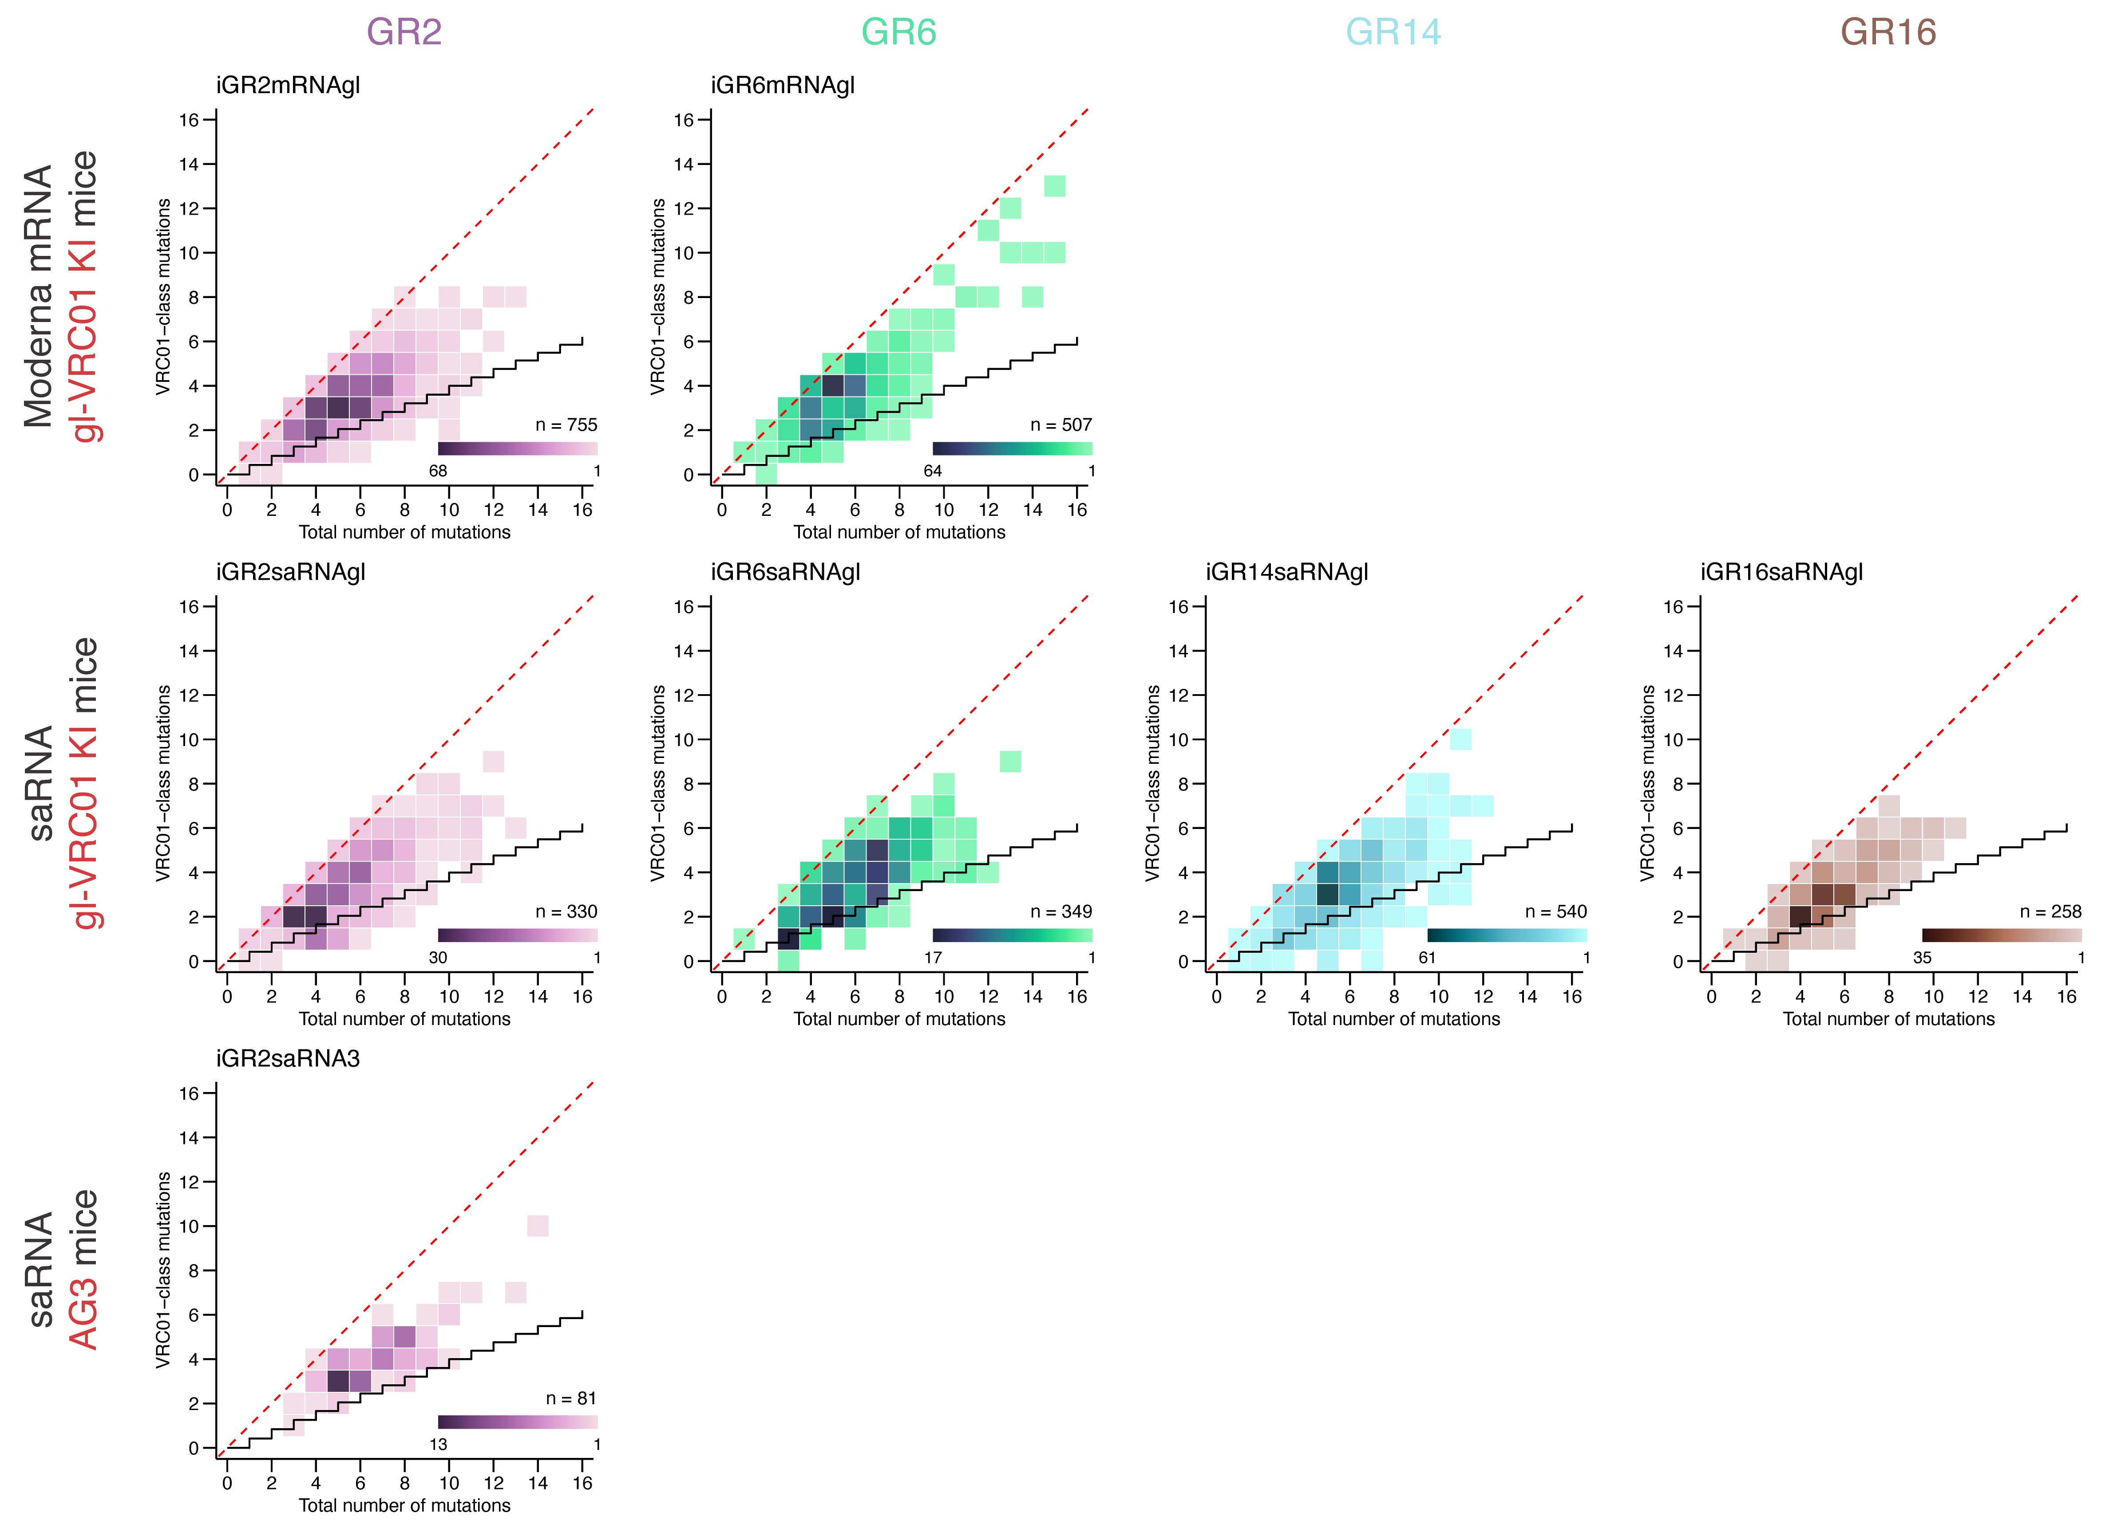
Jahyun Koo, Edward Lamperti, Facundo Batista, Paul McKay, Robin Shattock
Membrane-bound GT1.1 are superior to soluble GT1.1 immunogens
Soluble GT1.1
GR1
GR2
GR6
GR14
GR16
Negative control
GT1.1
HIV-1
Heterologous
Membrane-bound, but not soluble, GT1.1 immunogens induce strong antigen-specific responses in high-bar mouse models.
GR2 GR6 GR14 GR16
Membrane-bound GT1.1 induce VRC01-like mutations

Slide 16
Jahyun Koo, Edward Lamperti, Facundo Batista, Sunny Himansu
GT1.1 mRNAs induce potent GT1.1-specific antibody responses in high-bar mouse models
GR1
GR2
GR6
Negative control
GT1.1

Slide 17
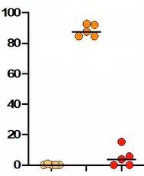
Jahyun Koo, Edward Lamperti, Facundo Batista, Sunny Himansu
GT1.1 mRNAs induce potent GT1.1-specific antibody responses in high-bar mouse models
GR1
GR2
GR6
Negative control
GT1.1
GR2 GR6
Percentage of GT1.1-specific B cells
GR1
GR2
GR6

Slide 18


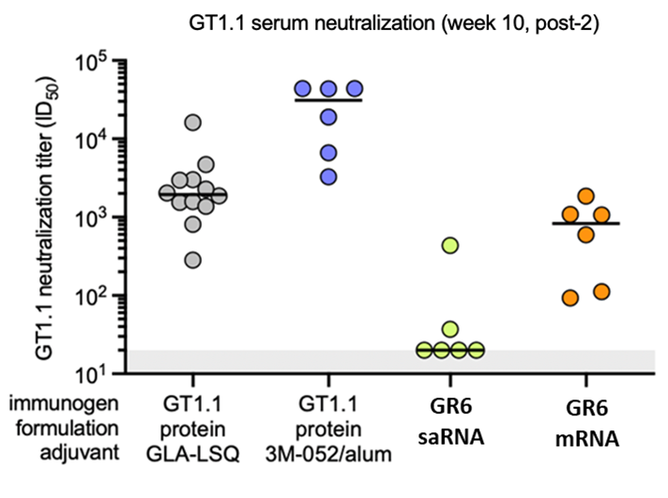
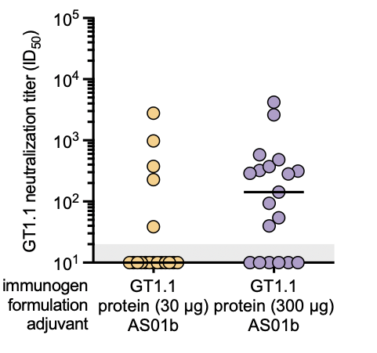
Francois Villinger, Sunny Himansu
GT1.1 mRNA induces potent GT1.1-specific antibody responses in non-human primates
GT1.1 neutralization in NHPs
(week 10, post-2)
GT1.1 neutralization in C101 participants
(week 26, post-3)
GT1.1 mRNA induces neutralizing responses comparable to those elicited by GT1.1 protein in NHPs and humans

Slide 19
Conclusions
Membrane-bound GT1.1 show high surface expression and favorable antigenic profiles.
Membrane-bound, but not soluble, GT1.1 immunogens induce strong B cell responses in high-bar mice models for VRC01-class precursors.
The activated B cells acquire VRC01-like mutations
GT1.1 mRNA induces potent GT1.1-specific antibody responses in non-human primates
These results justify evaluating GT1.1 mRNAs in human clinical trials.

Slide 20










Acknowledgments
Jayhun Koo
Edward Lamperti
Facundo Batista
Thomas Ketas
John P. Moore
Sunny Himansu
Yoann Aldon
Tom Caniels
Ronald Derking
Jonne Snitselaar
Jelle van Schooten
Marit van Gils
Kwinten Sliepen
Rogier Sanders
Paul McKay
Robin Shattock
David C. Montefiori
Ming Tian
Sai Luo
Frederick Alt
Francois J. Villinger

