Slide 1


Germline-targeting vaccine candidate BG505 SOSIP GT1.1 expands B cells with broadly neutralizing antibody signatures in humans
Tom Caniels
Amsterdam UMC
28-11-2023
NCHIV
@tomcaniels | t.g.caniels@amsterdamumc.nl
Image credit: David Goodsell
Depiction of germline-targeting Env trimers (pink) or boosting immunogens (pink with dark pink) binding to B cell receptors (green)

Slide 2
Disclosure of speaker’s interests
(Potential) conflict of interest | None

Slide 3
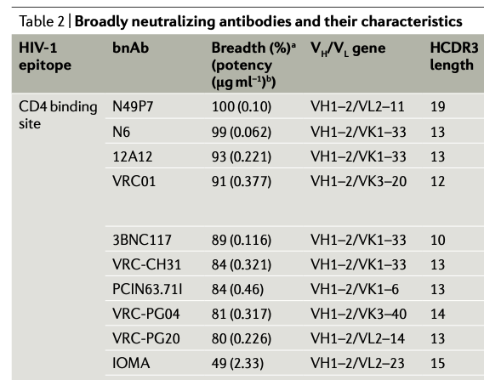
CD4 binding site (CD4bs) broadly neutralizing antibodies are extremely similar
The most broad and most potent broadly neutralizing antibodies that target the CD4 binding site are genetically extremely similar:
All use heavy chain variable gene (IGHV)1-2
All have a shorter-than-average 5 amino acid light chain CDR3
Haynes 2023 Nat. Rev. Immunol.

Slide 4
CD4 binding site (CD4bs) broadly neutralizing antibodies are extremely similar
The most broad and most potent broadly neutralizing antibodies that target the CD4 binding site are genetically extremely similar:
All use heavy chain variable gene (IGHV)1-2
All have a shorter-than-average 5 amino acid light chain CDR3
These CD4bs broadly neutralizing antibodies are called “VRC01-class” of broadly neutralizing antibodies
VRC01-class antibodies are considered a major goal for a preventative HIV vaccine
Haynes 2023 Nat. Rev. Immunol.
Kong et al. 2013 Immunity

Slide 5

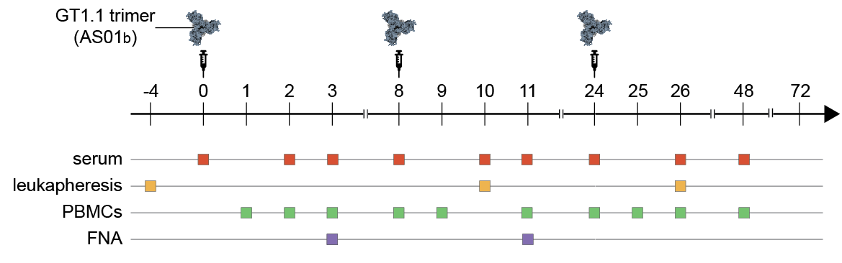
Exploring germline-targeting of VRC01-class B cells in a human clinical trial
Evaluate whether GT1.1 can activate VRC01-class B cells (frequency: 1 in ~500.000 B cells)
Evaluate whether B cells elicited by GT1.1 resemble VRC01-class broadly neutralizing antibodies

Slide 6
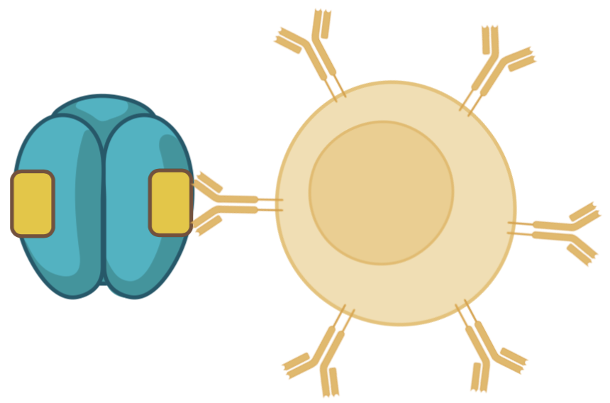
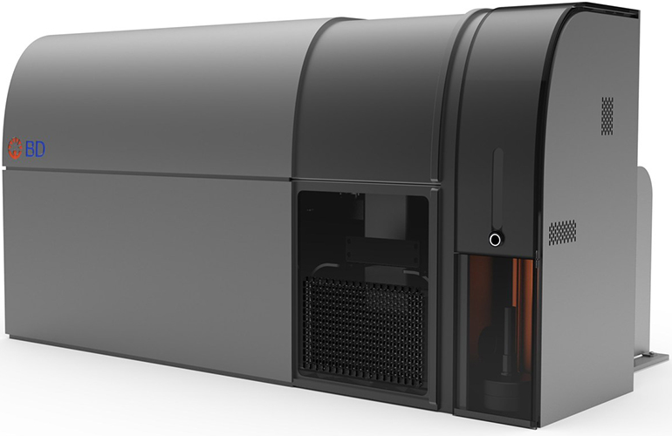
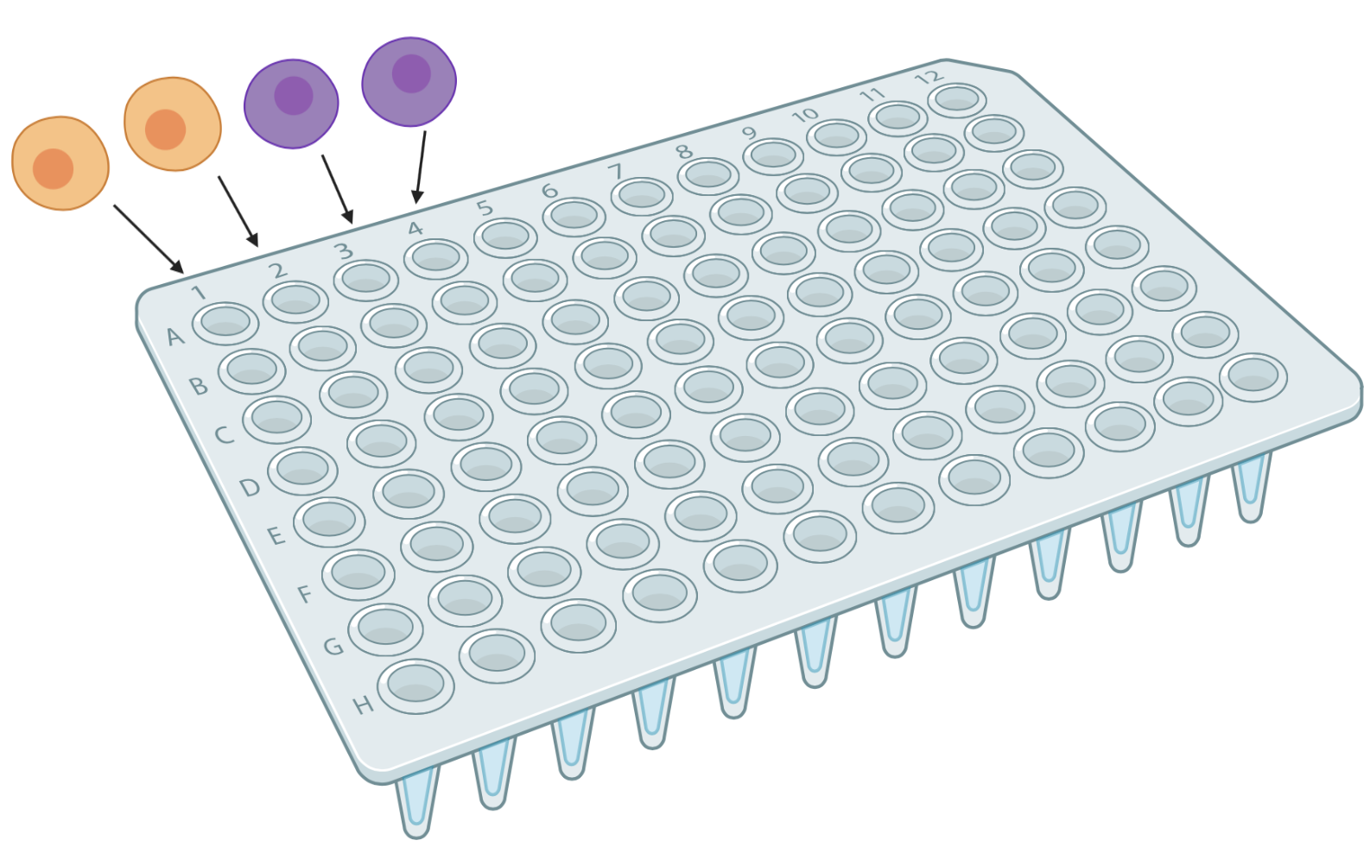
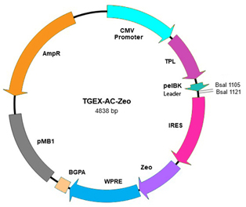
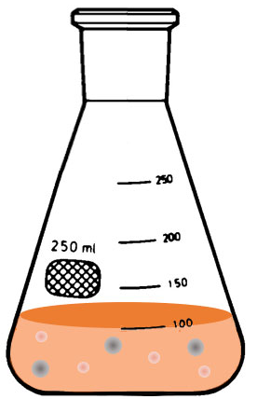
Exploring germline-targeting of VRC01-class B cells in a human clinical trial
Evaluate whether GT1.1 can activate VRC01-class B cells (frequency: 1 in ~500.000 B cells)
Evaluate whether B cells elicited by GT1.1 resemble VRC01-class broadly neutralizing antibodies
measure
GT1.1-specific
memory B cells
clone in Ab
expression vector
produce Ab
characterize Ab
properties
sort epitope-specific B cells
sequence B cell receptor genes

Slide 7
Madhu Prabhakaran & VRC team
GT1.1 induces strong epitope-specific memory B cell responses
GT1.1 induces a strong antigen-specific memory B cell response
GT1.1-specific memory B cells account for up to 10% of the memory B cell repertoire
CD4bs-specific and apex-specific B cells are substantially boosted by the third immunization, while off-target B cells are not
CD4bs-specific memory B cells account for ~0.1% of all memory B cells at week 26
At week 10, VRC01-class B cells (IGHV1-2 with 5aa CDRL3) measured in:
  5/9 low dose individuals
  6/10 high dose individuals
At week 26, 6/7 high dose individuals have a VRC01-class B cell response
antigen+
epitope+ (CD4bs+)
epitope+ (Apex+)
off-target

Slide 8
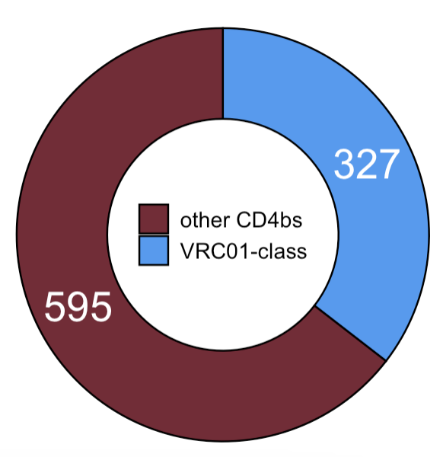
Madhu Prabhakaran & VRC team
GT1.1 induces CD4 binding site-specific, VRC01-class memory B cell responses
GT1.1 induces a strong antigen-specific memory B cell response
GT1.1-specific memory B cells account for up to 10% of the memory B cell repertoire
CD4bs-specific and apex-specific B cells are substantially boosted by the third immunization, while off-target B cells are not
CD4bs-specific memory B cells account for ~0.1% of all memory B cells at week 26
At week 10, VRC01-class B cells (IGHV1-2 with 5aa CDRL3) measured in:
  5/9 low dose individuals
  6/10 high dose individuals
At week 26, 6/7 high dose individuals have a VRC01-class B cell response
antigen+
epitope+ (CD4bs+)
sequence B cell receptor genes
~35% of CD4bs-specific B cells
are VRC01-class

Slide 9
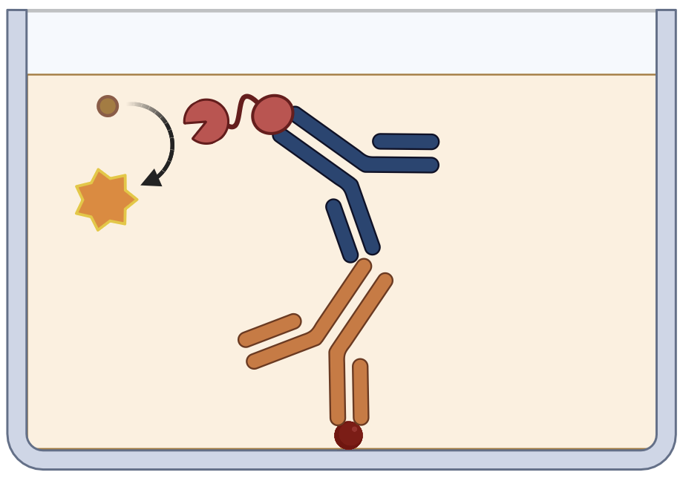
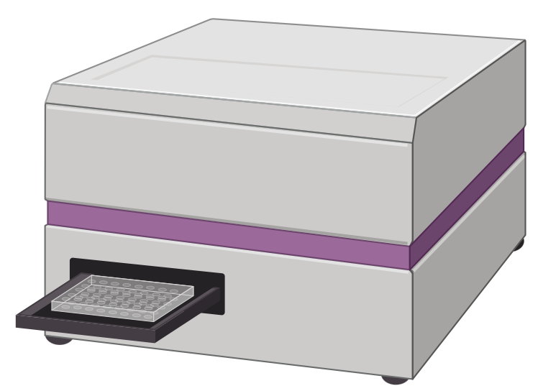
ELISA
Enzyme-linked immunosorbent assay (ELISA) to assess phenotypic similarities to VRC01-class antibodies
Enzyme-linked
immunosorbent
assay (ELISA)
clone in Ab
expression vector
produce Ab
characterize Ab
properties
sequence B cell receptor genes

Slide 10
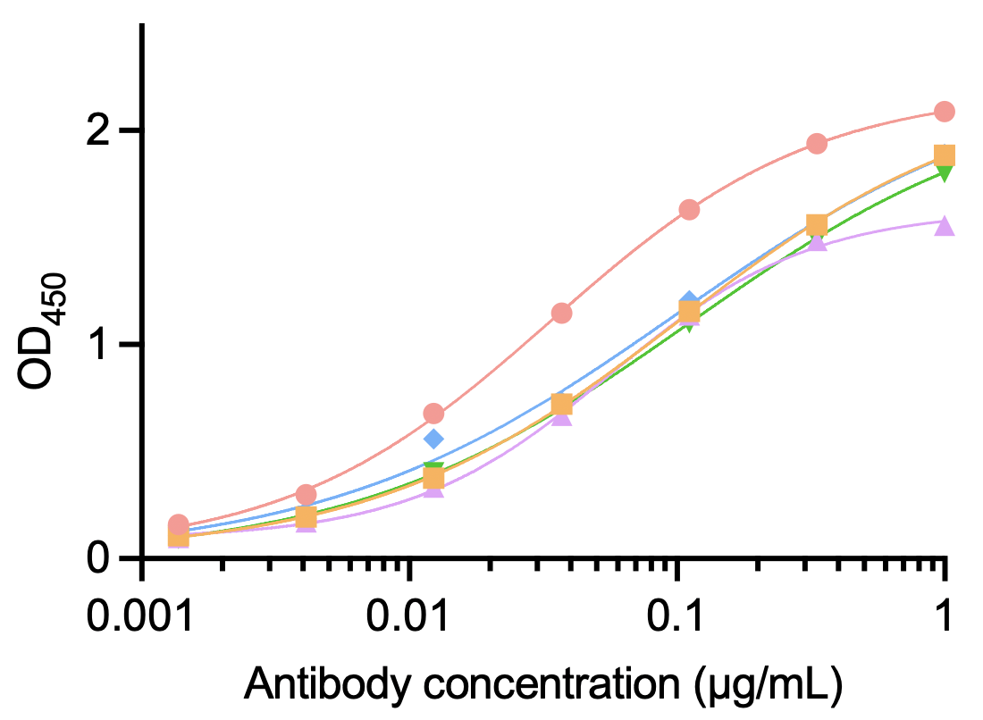
ELISA
GT1.1-elicited VRC01-class antibodies are CD4bs-specific and can recognize circulating Envs
Enzyme-linked
immunosorbent
assay (ELISA)
clone in Ab
expression vector
produce Ab
characterize Ab
properties
sequence B cell receptor genes
ELISA to measure antibody affinity
VRC01-class antibodies from vaccinated participants are indeed CD4bs-specific
VRC01-class antibodies from vaccinated participants occasionally bind to circulating, native Env trimers
How exactly do they bind?
147_1C01
147_1B06
shaping immunogens
polishing immunogens

Slide 11
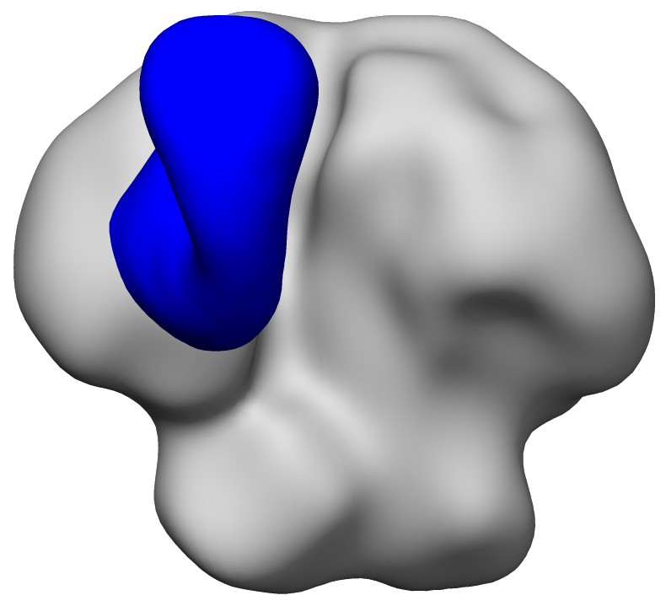
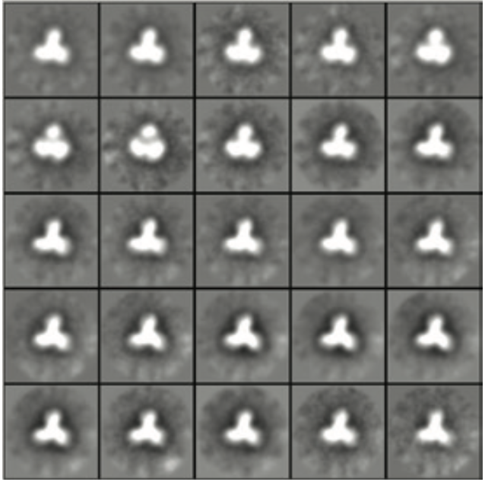
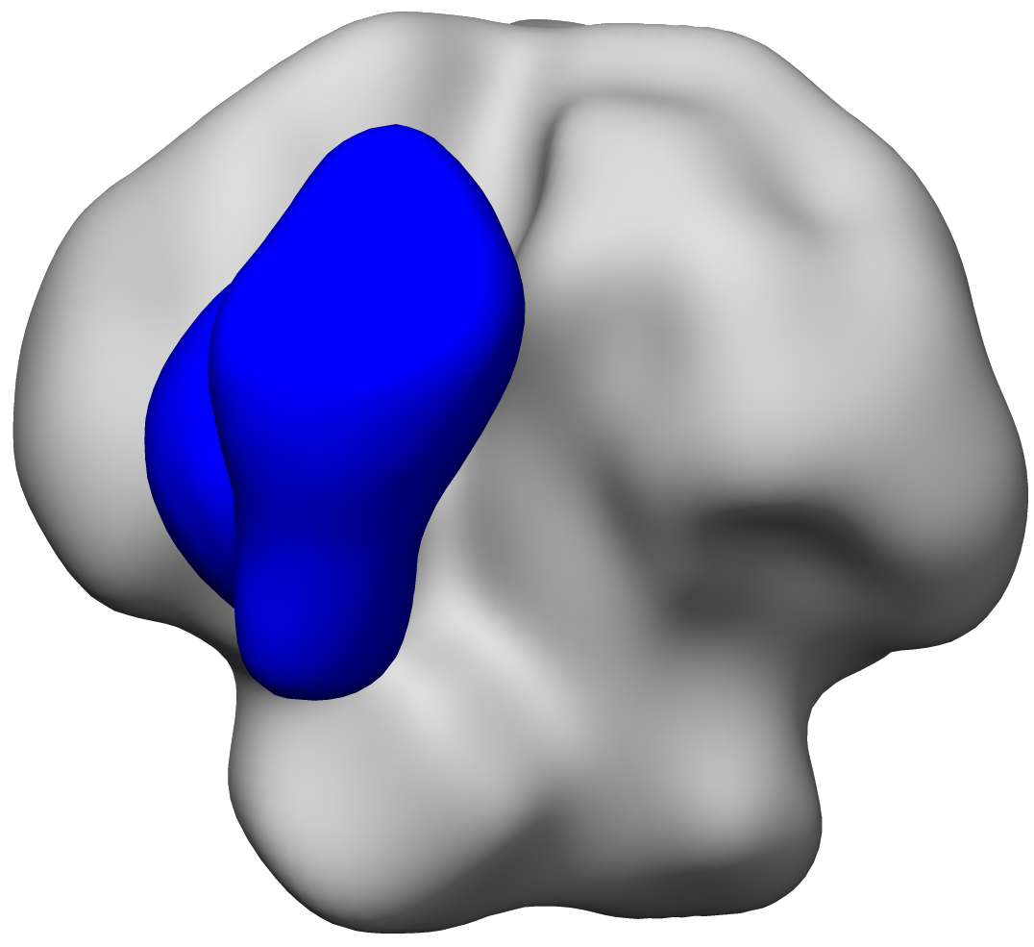
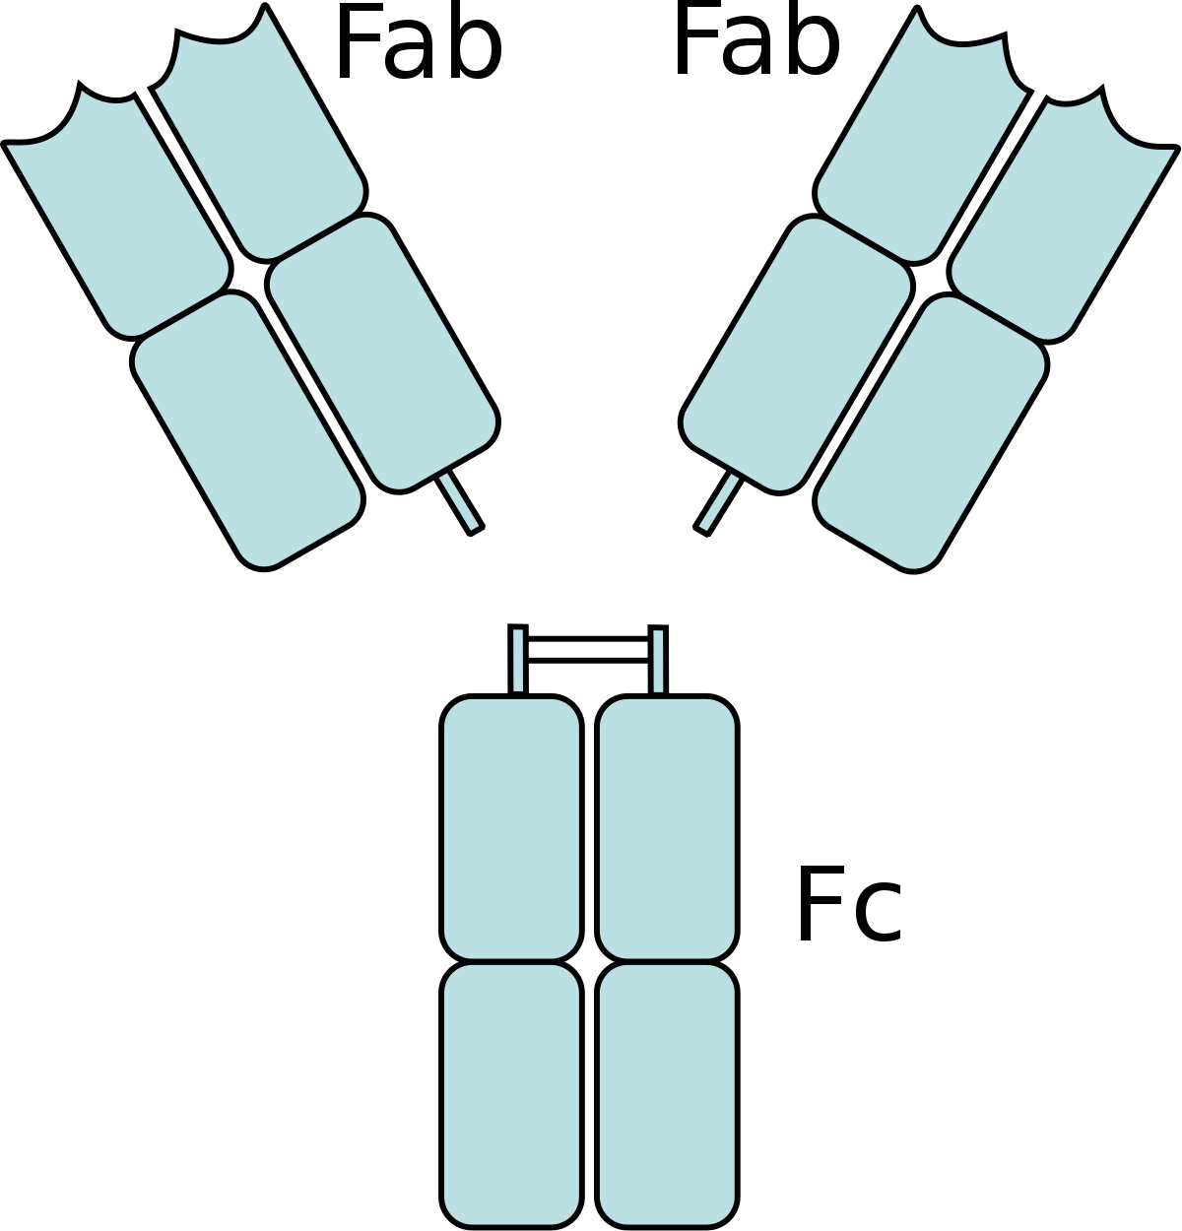
Shiyu Zhang, Gabriel Ozorowski, Andrew Ward & Sashank Agrawal, Ian Wilson
GT1.1-elicited VRC01-class antibodies are extremely similar to VRC01-class bNAbs
To compare similarities/resemblance to VRC01, epitope determination using cryo-electron microscopy
VRC01-class antibodies from vaccinated humans are similar to VRC01
147_1B06
147_1C01

Slide 12
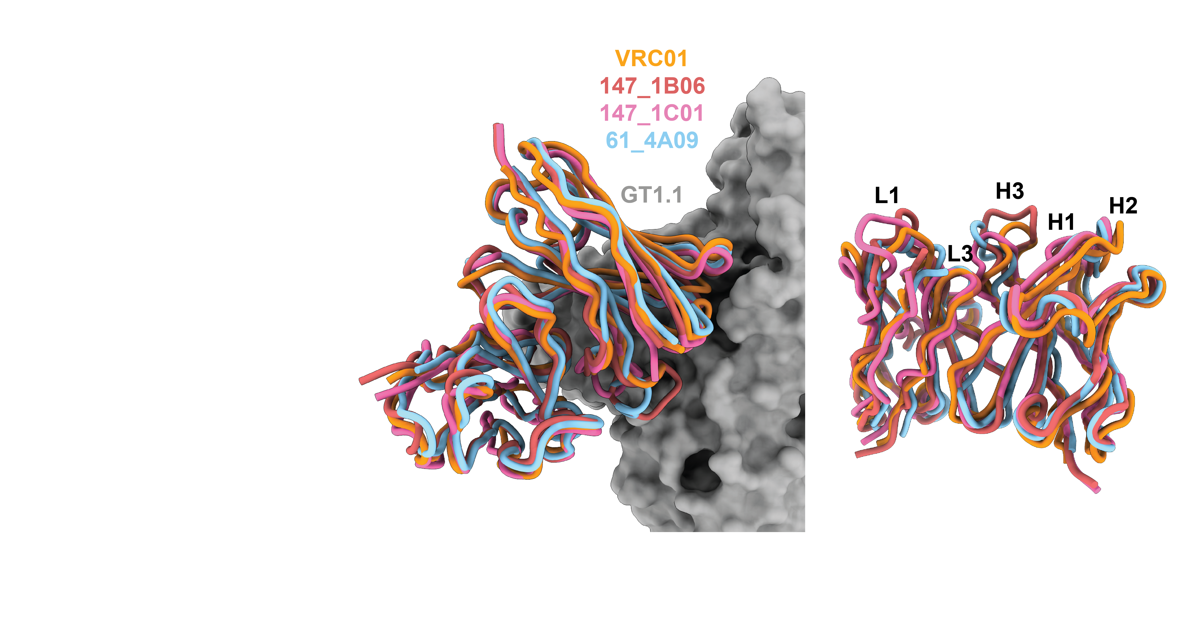
Shiyu Zhang, Gabriel Ozorowski, Andrew Ward & Sashank Agrawal, Ian Wilson
GT1.1-elicited VRC01-class antibodies are extremely similar to VRC01-class bNAbs
To compare similarities/resemblance to VRC01, epitope determination using cryo-electron microscopy
In terms of epitope, angle of attack, and orientation, antibodies are virtually indistinguishable from broadly neutralizing VRC01
147_1B06
147_1C01

Slide 13
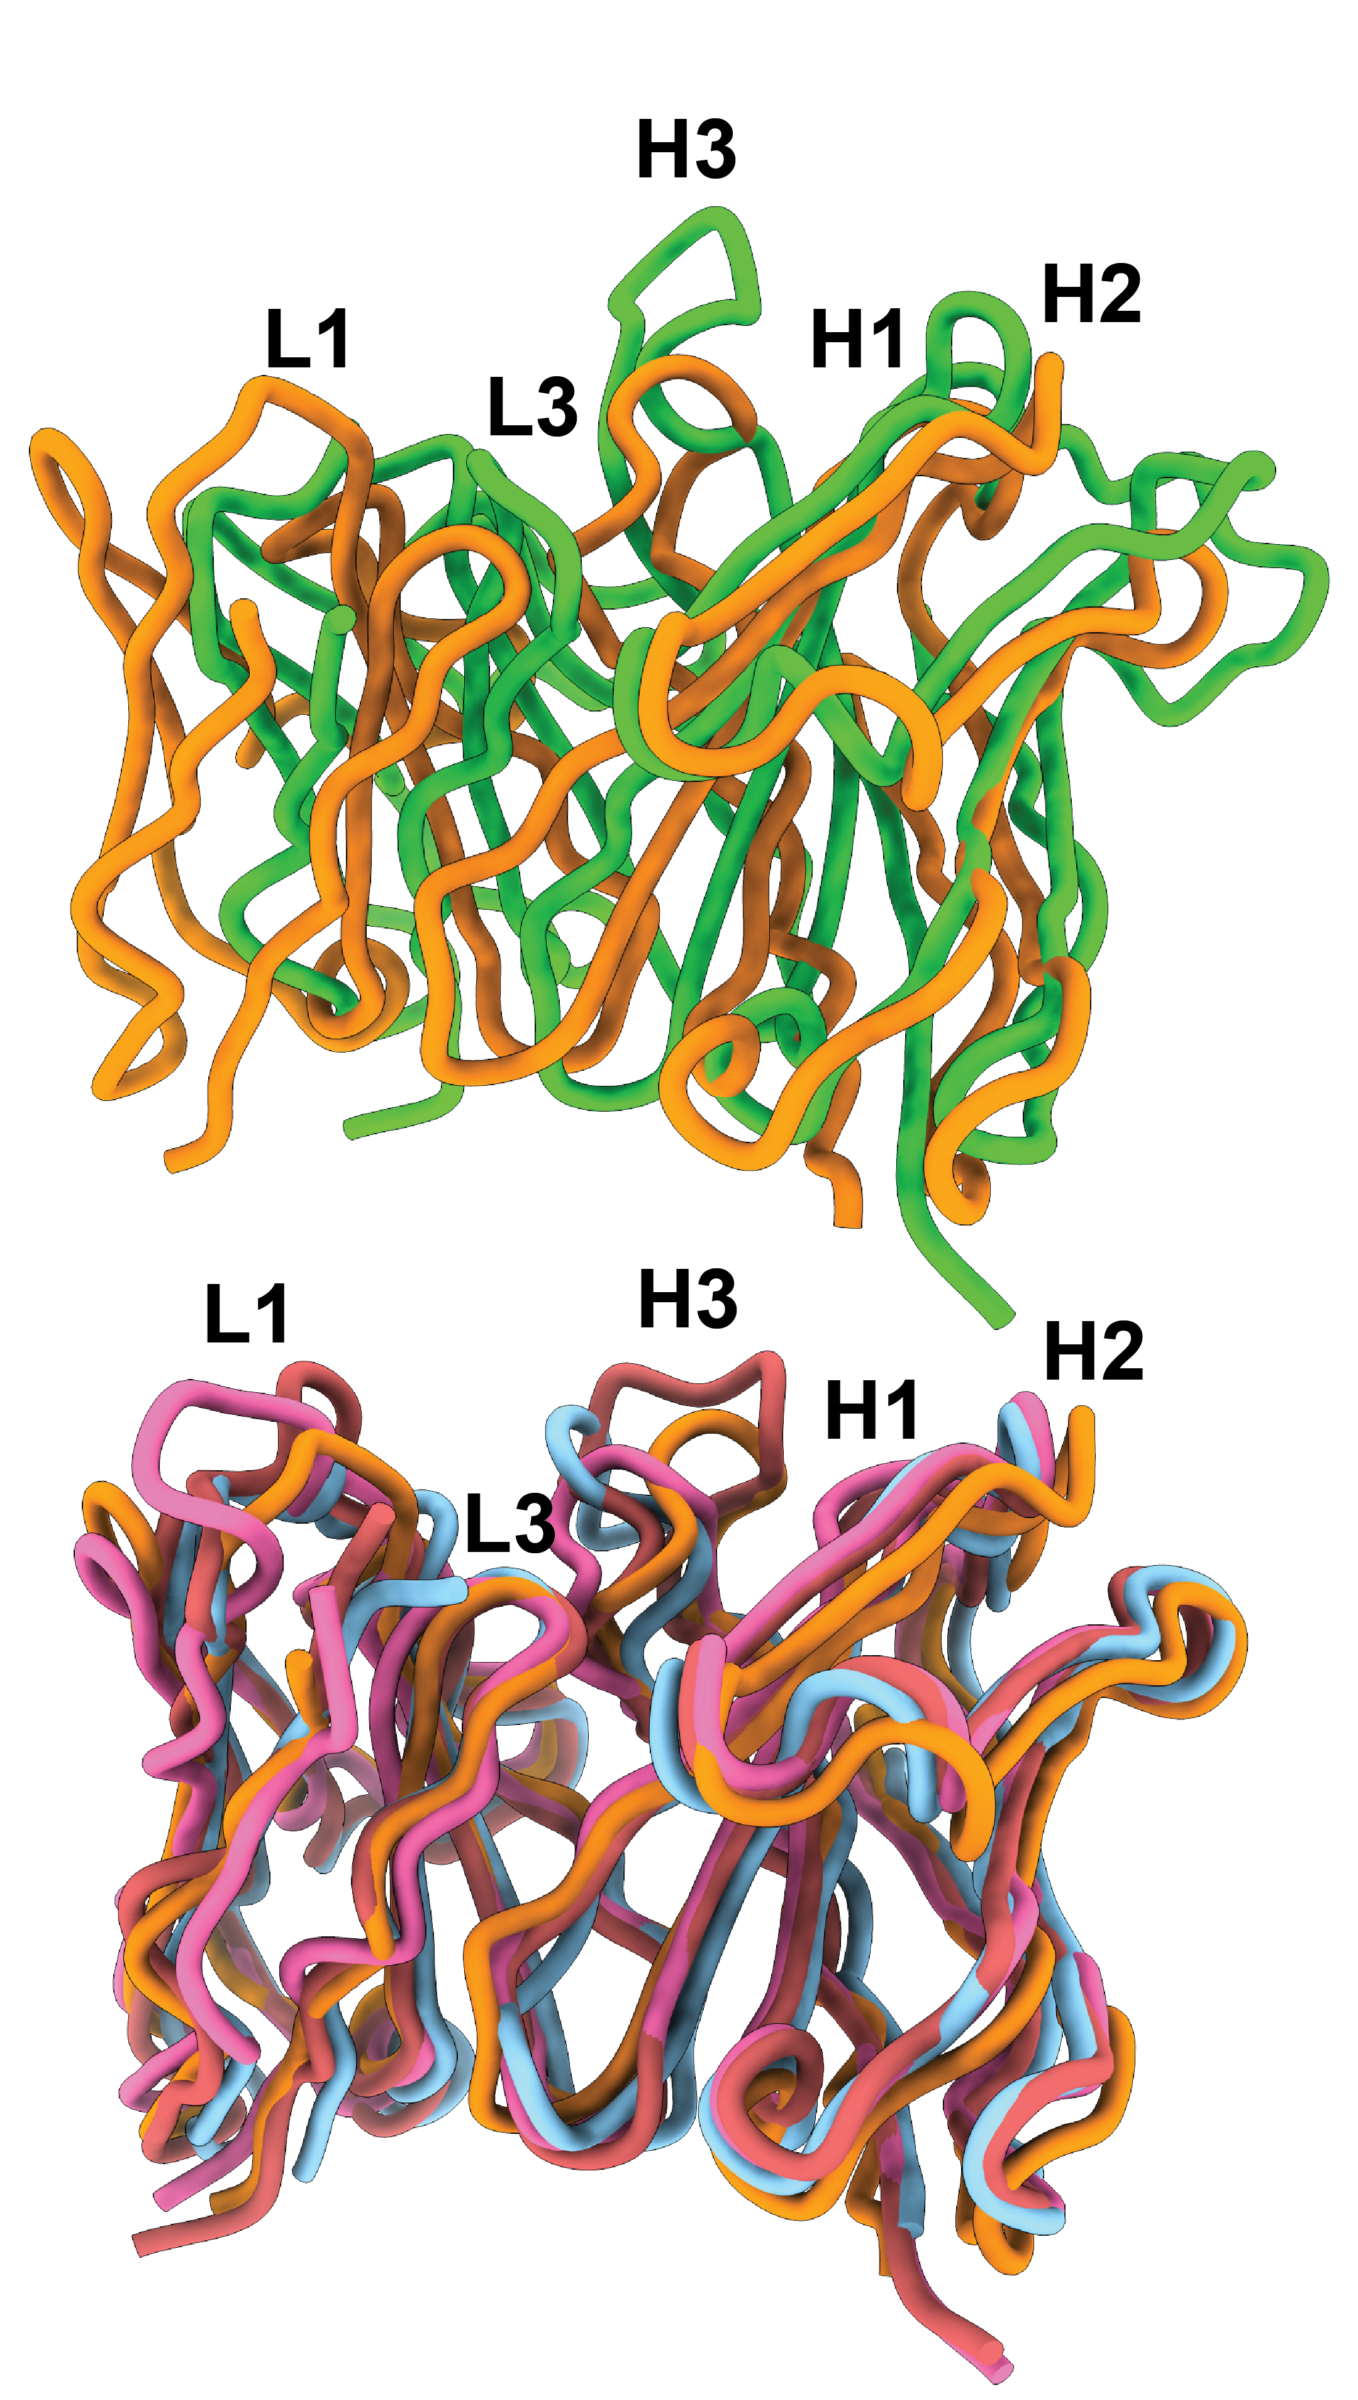
Shiyu Zhang, Gabriel Ozorowski, Andrew Ward & Sashank Agrawal, Ian Wilson
GT1.1-elicited VRC01-class antibodies are extremely similar to VRC01-class bNAbs
To compare similarities/resemblance to VRC01, epitope determination using cryo-electron microscopy
In terms of epitope, angle of attack, and orientation, antibodies are virtually indistinguishable from broadly neutralizing VRC01
Another CD4bs broadly neutralizing antibody, 1-18, is quite dissimilar to VRC01 in terms of antibody orientation
VRC01
1-18
other bNAb

Slide 14
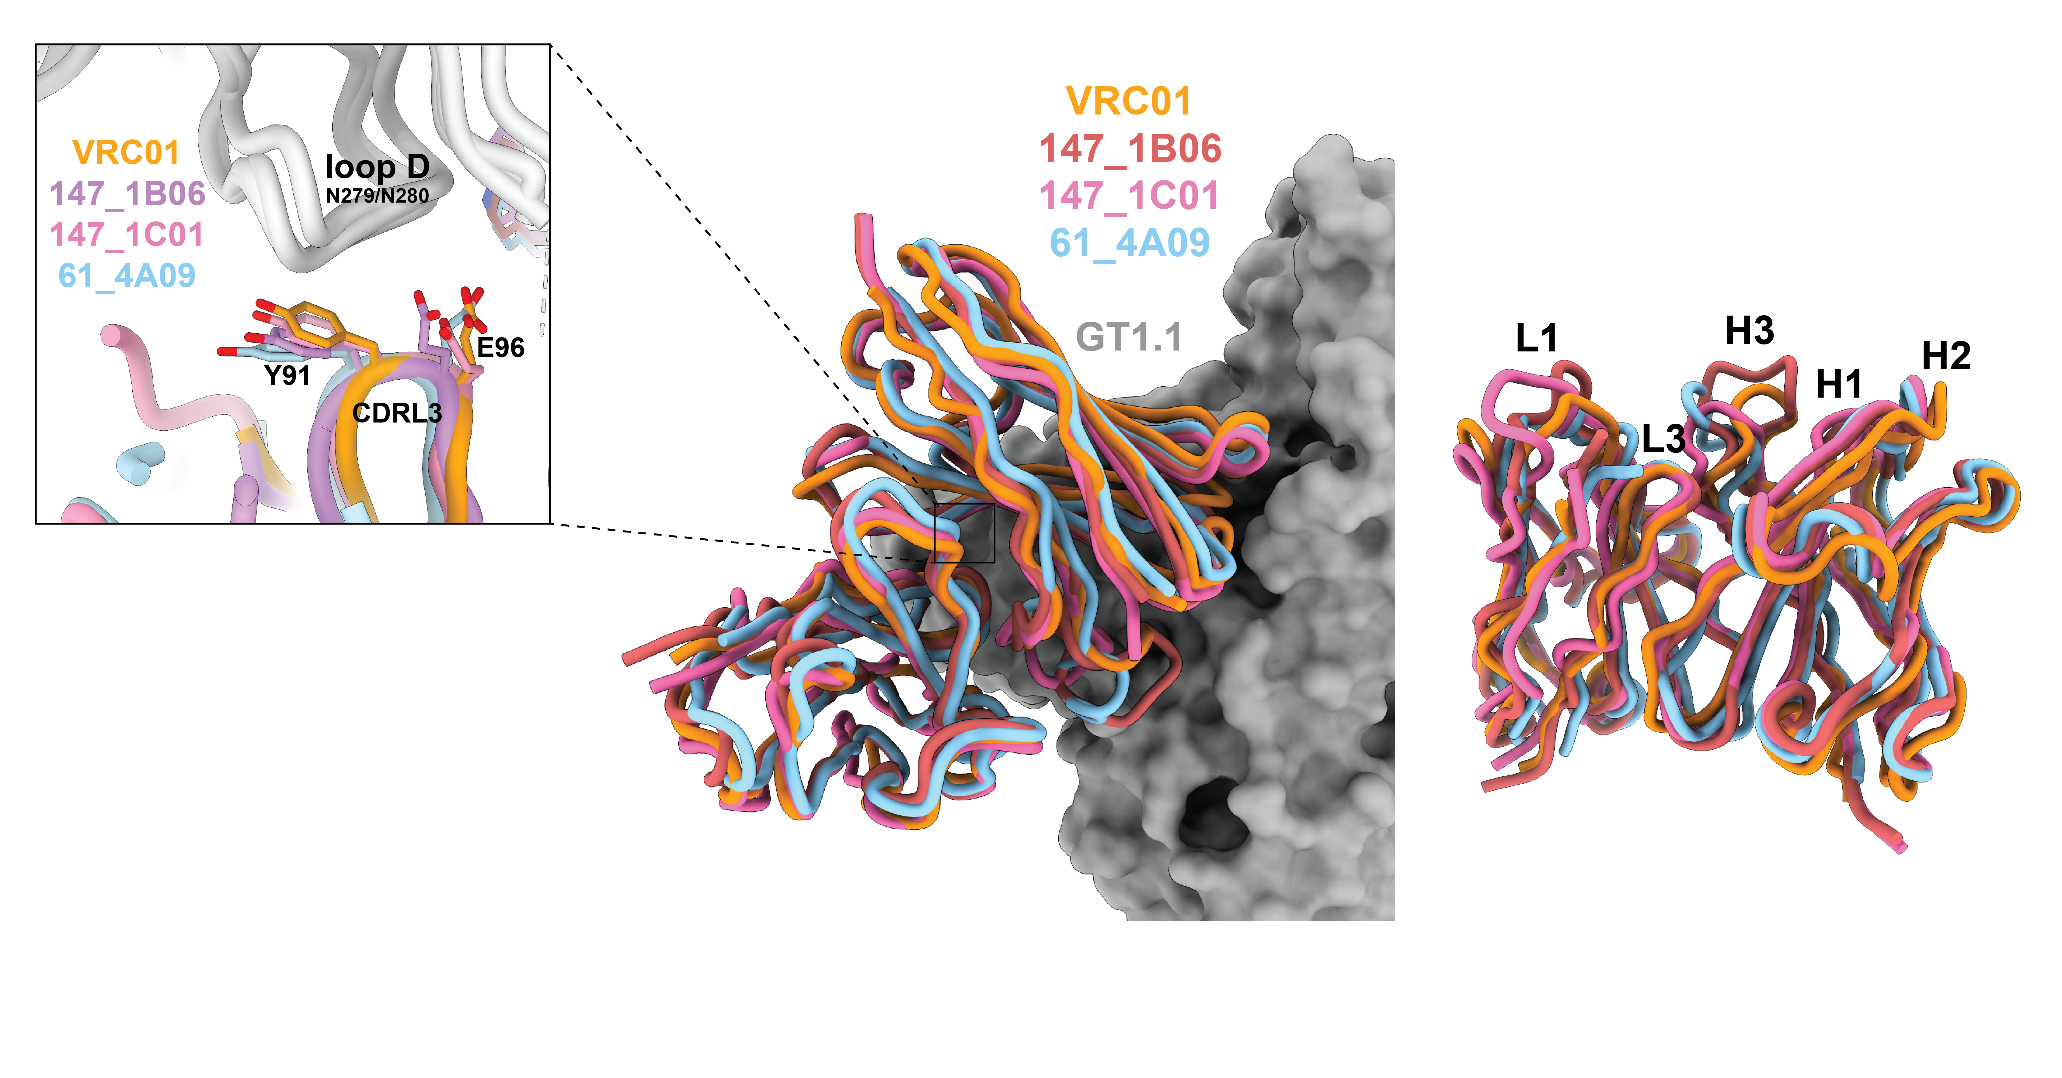
Shiyu Zhang, Gabriel Ozorowski, Andrew Ward & Sashank Agrawal, Ian Wilson
C101-derived VRC01-class MAbs reveal highly similar mode of targeting to VRC01
GT1.1 induces VRC01-class antibodies that closely resemble the intended
broadly neutralizing antibody, VRC01
The contacts between antibody and antigen are extremely similar to those of VRC01 and are made with conserved residues on HIV Env

Slide 15

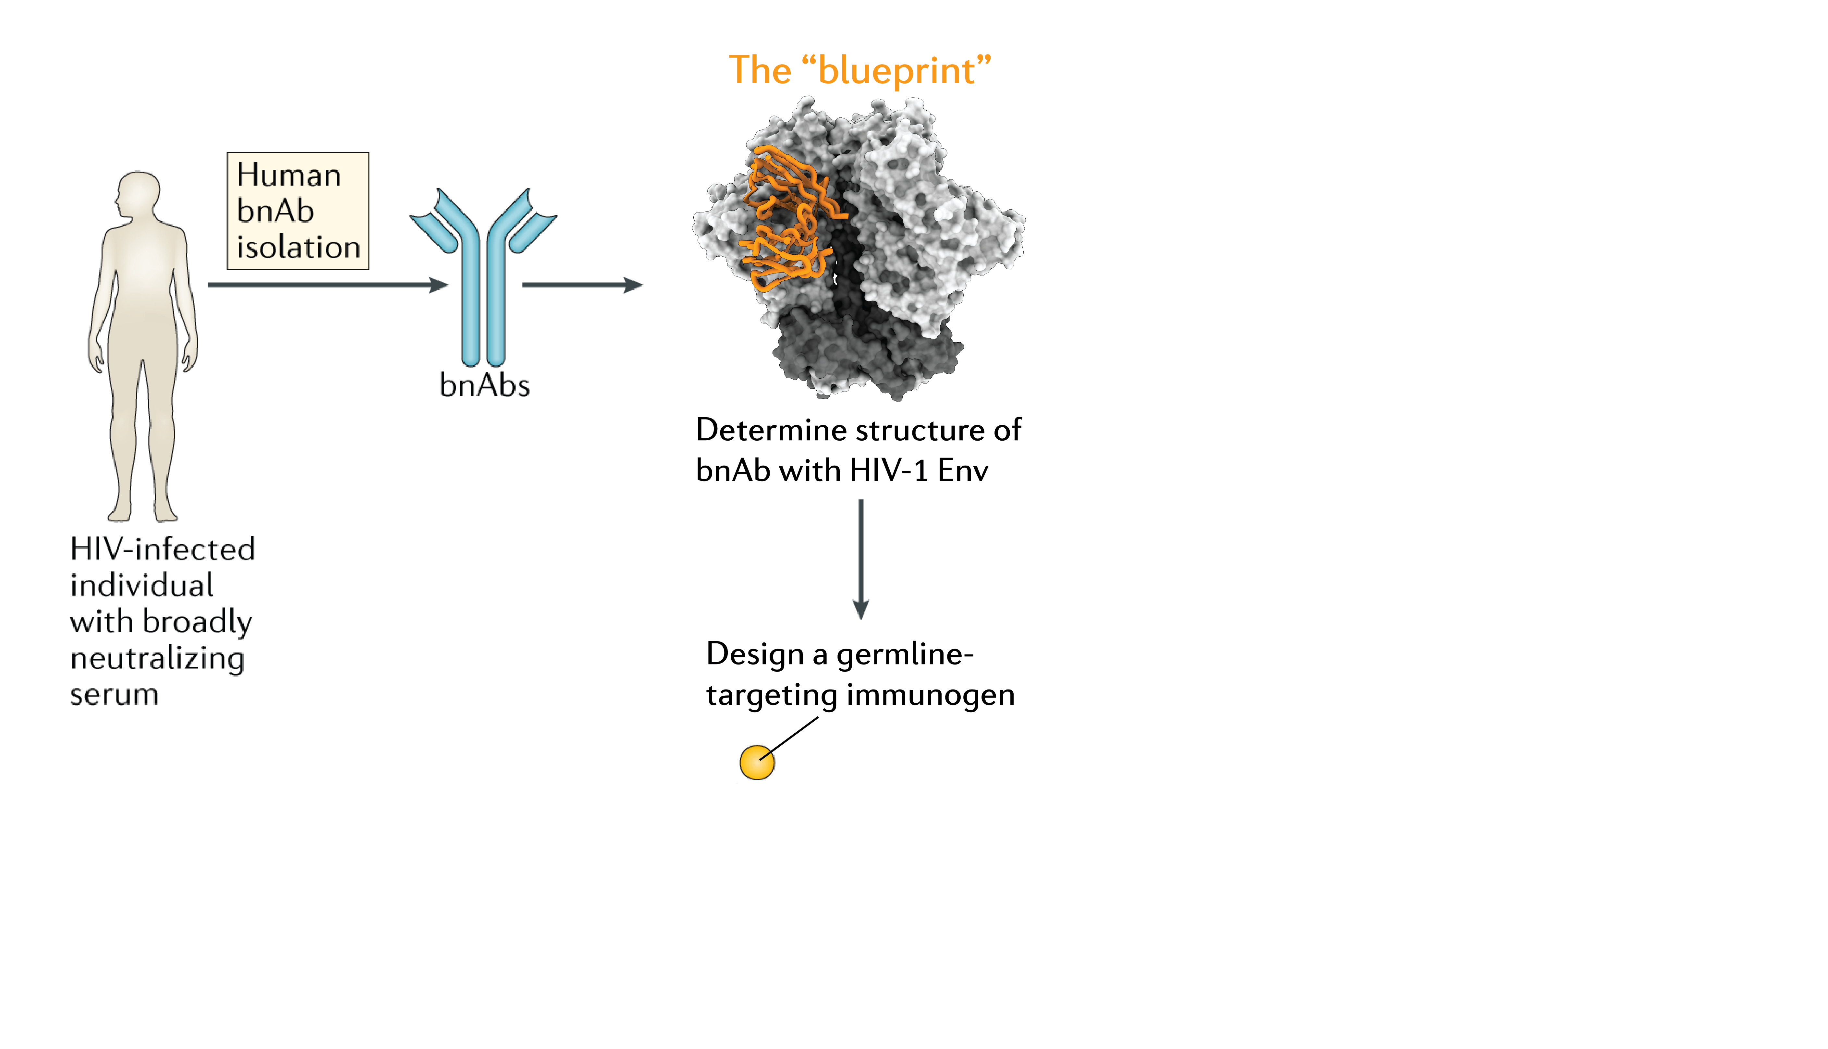

Broadly neutralizing
antibodies such as
VRC01

Slide 16

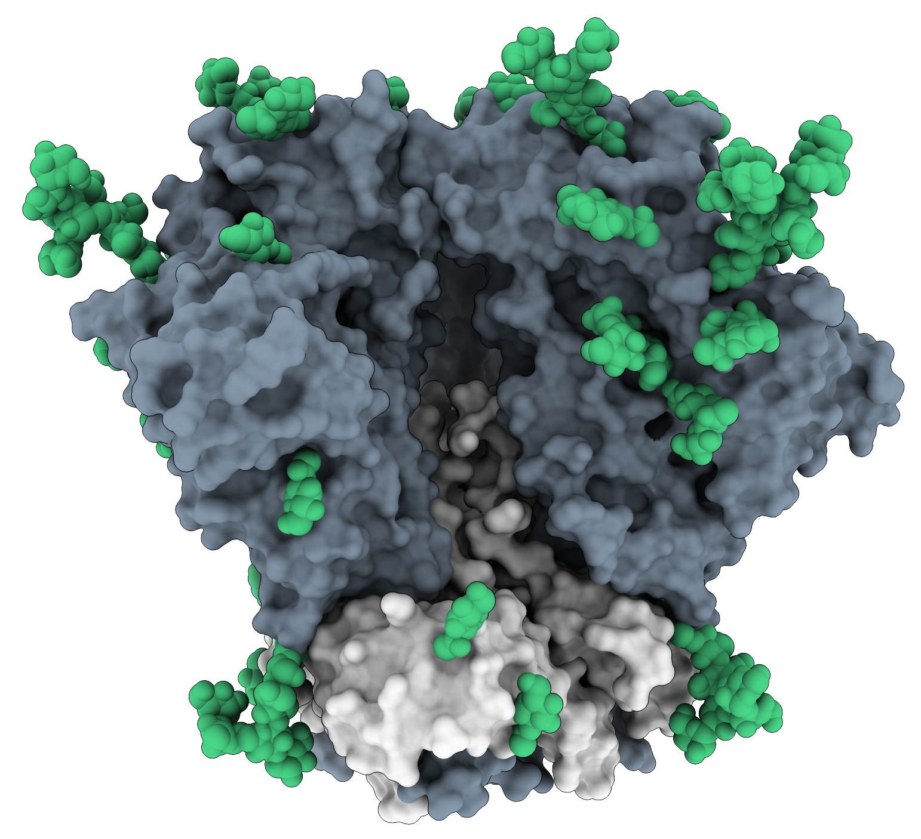
Broadly neutralizing
antibodies such as
VRC01
Design GT1.1 to engage
VRC01-class B cells
VRC01-class B cells are present at a frequency of
~1 in 500.000 B cells

Slide 17
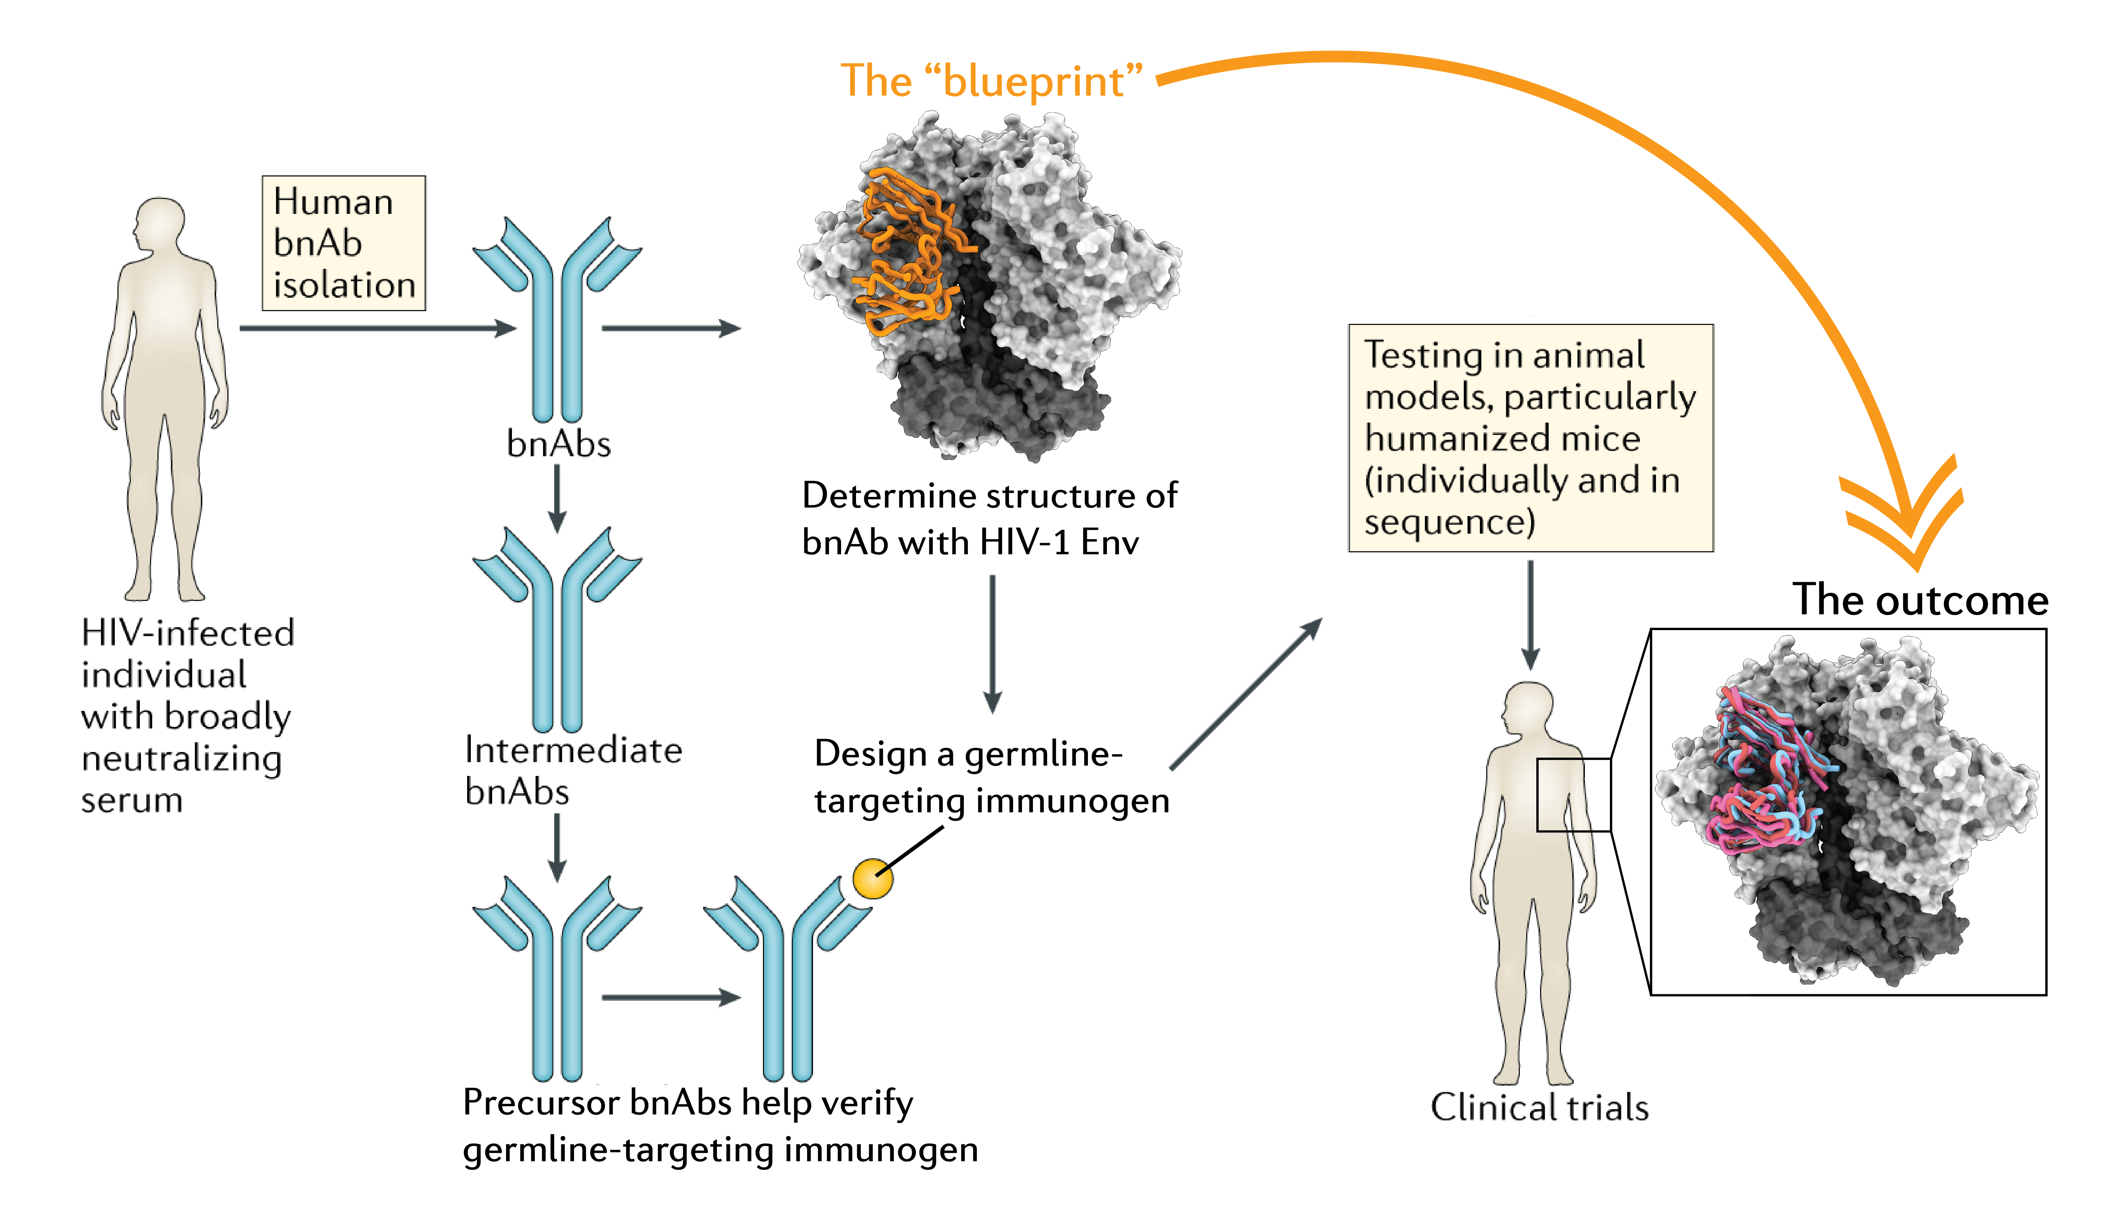
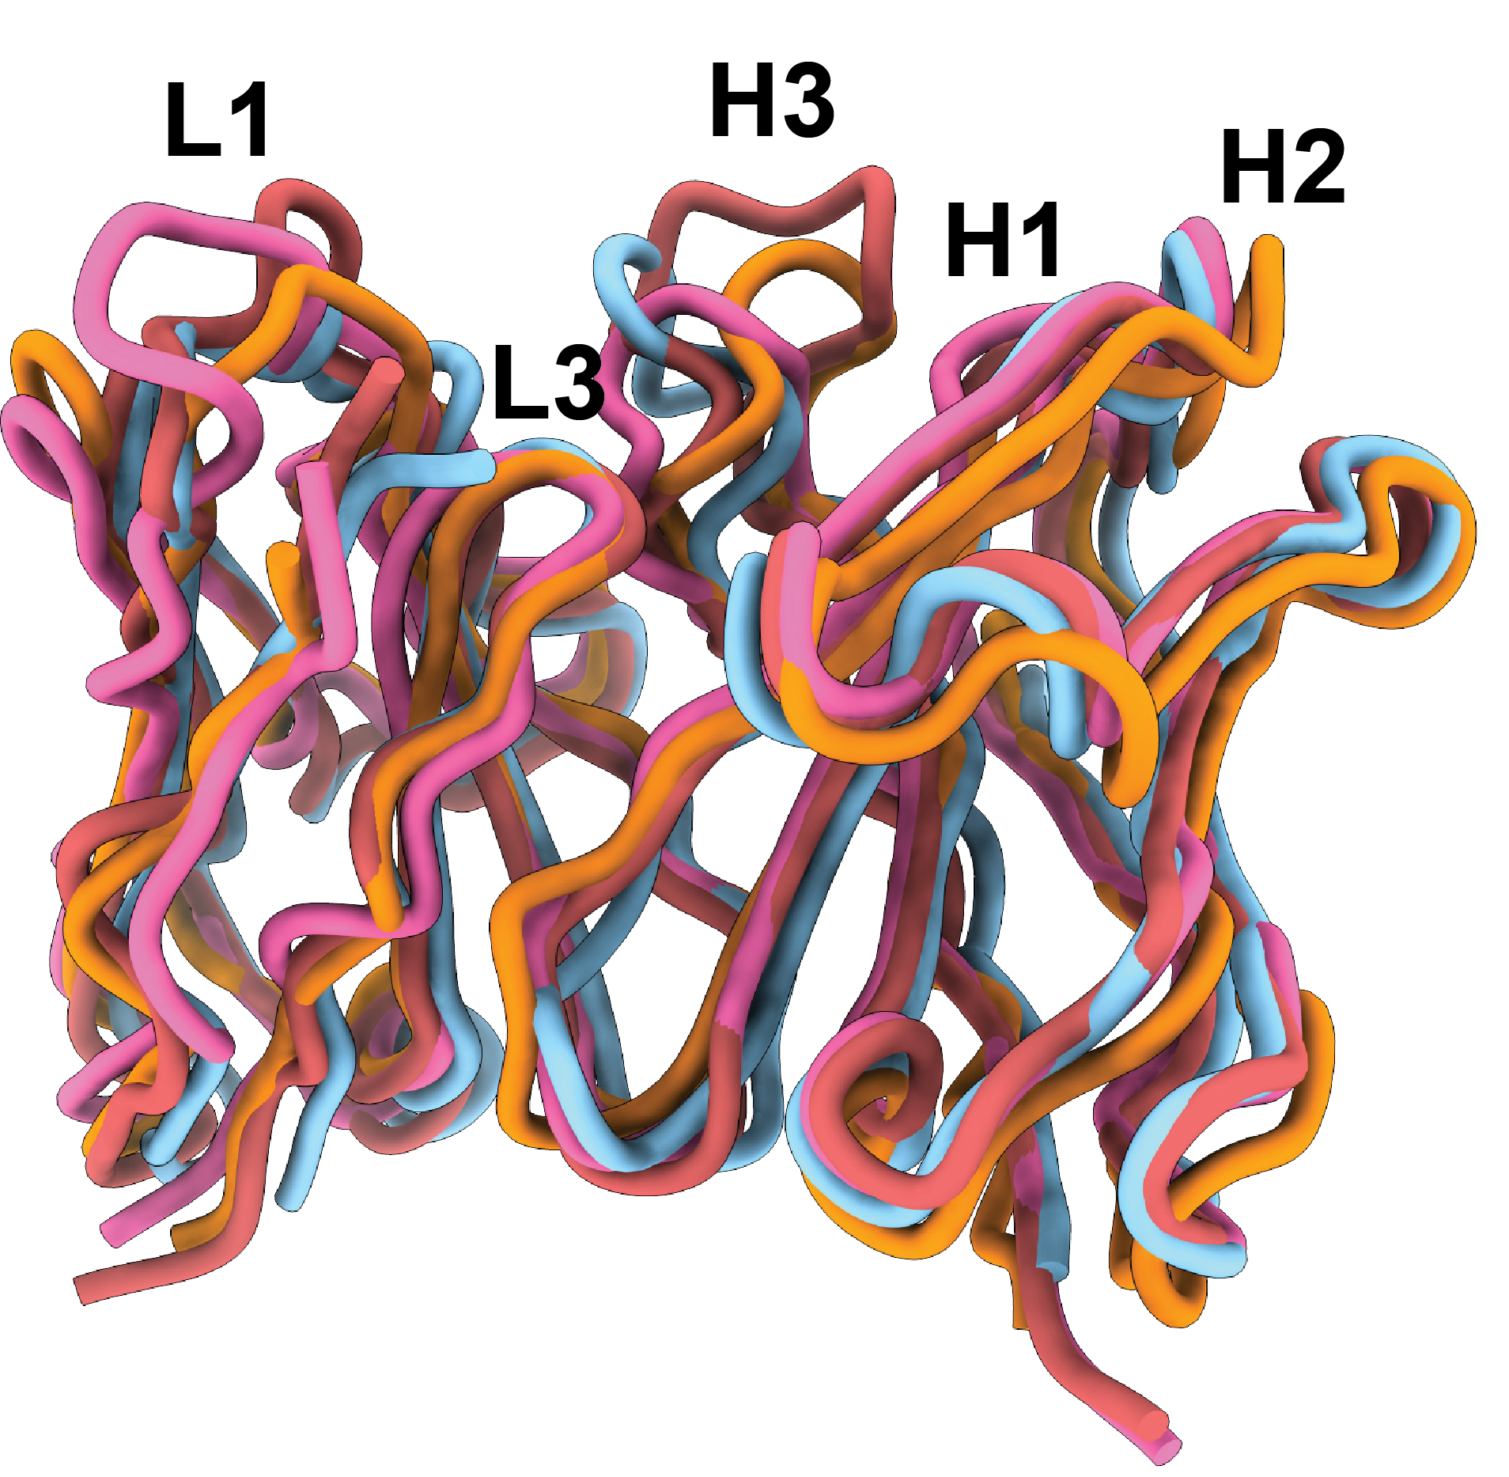
Design GT1.1 to engage
VRC01-class B cells
VRC01-class B cells are present at a frequency of
~1 in 500.000 B cells

Slide 18
Discussion
Vaccination with GT1.1 leads to strong CD4 binding site-directed memory B cells
~35% of CD4bs-directed memory B cells are of the VRC01-class, a well-known and reproducibly elicited class of broadly neutralizing antibodies
GT1.1-elicited VRC01-class antibodies can occasionally bind to fully glycosylated, circulating Envs
GT1.1-elicited antibodies are virtually indistinguishable from broadly neutralizing antibody VRC01 at a structural level
Current and future challenges
Next-step immunogens to drive maturation of B cells into broadly reactive B cells
Present GT1.1 as a membrane-bound immunogen through mRNA vaccination
Image credit: David Goodsell
Depiction of germline-targeting Env trimers (pink) or boosting immunogens (pink with dark pink) binding to B cell receptors (green)

Slide 19











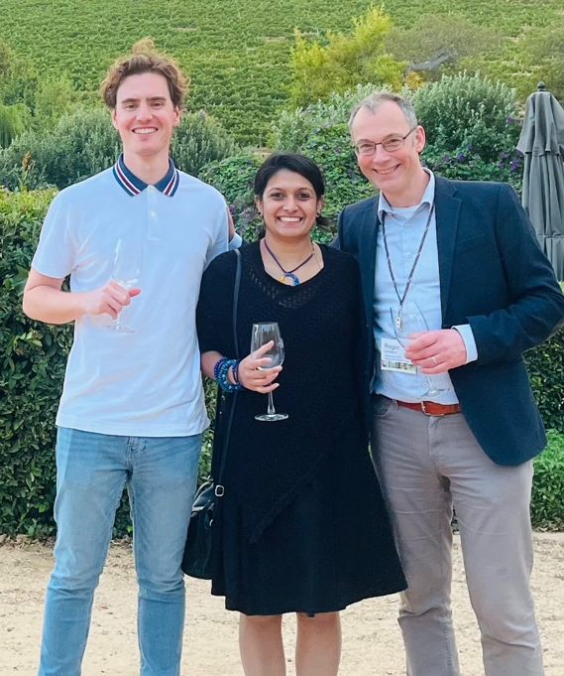
Acknowledgments
Our gratitude to all C101 participants!
Amsterdam UMC (lab)
Rogier Sanders
Tom Caniels
Ronald Derking
Tom Bijl
Jonne Snitselaar
Joey Bouhuijs
Isabel Baken
María Ríos Carrasco
Marit van Gils
Mathieu Claireaux
Amsterdam UMC (clinic)
Godelieve de Bree
Karlijn van der Straten
Emma Reiss
Marinus Liesdek
Annelou van der Veen
Michelle Klouwens
Ronald Leersum
Neeltje Kootstra
Agnes Harskamp
Rob Hurks
Liffert Vogt
Anita van Noort
Monique Kooijman
Azra Beganovic
Stefanie Krens
Nienke van Rein
VRC / CCVIMC
Richard Koup
Adrian McDermott
Sarah Andrews
David Leggat
Madhu Prabhakaran
Jennifer Bohl
Abhinaya Srikanth
Weiwei Wu
Jalen Jean-Baptiste
Flavio Matassoli
Supra Gajjala
Rhianna Bronson
Rory Malek
Supra Gajjala
Bill & Melinda Gates
Foundation
Pervin Anklesaria
Susan Barnett
Carlos Diazgranados
Nina Russell
Emilio Emini
GSK
François Roman
Marguerite Koutsoukos
Cécile Carton
Jasper Solomon
Rockefeller Univ.
Marina Caskey
Katrina Millard
Martina Turroja
Melissa La Mar
Leah Todd
Irina Shimeliovich
Bennett Chirco
Juan Dizon
George Washington
David J. Diemert
Jeffrey Bethony
Aimee Desrosiers
Elissa Malkin
Larissa Scholte
Guacyara Erwin
Lara Hoeweler
Rafaela Thur
Anna Peterson
Etelvina Guerra
Hanna-Grace Rabanes
Laura Vasquez
Nadia Khati
Cornell Univ.
John Moore
Al Cupo
FNIH/CCVIMC
David Brown
Rebeca Salmeron
Duke University
David Montefiori
Georgia Tomaras
Nicole Yates
Sheetal Sawant
Miroslawa Bilska
Marcella Sarzotti-Kelsoe
Hongmei Gao
Kelli Greene
VISC
Ollivier Hyrien
Drienna Holman
Solmaz Shotorbani
Mike Duff
Yung-Wen Liu
Bhavesh Borate
Keith Curtis
Marie Vendettuoli
Valeria Duran
Kellie MacPhee
Scripps Research
Andrew Ward
Ian Wilson
Gabriel Ozorowski
Wilma Lee
Jeffrey Copps
Leigh Sewall
Sara Richey
Hannah Turner
Shiyu Zhang
Sashank Agrawal
IAVI PDC
Angela Lombardo
Sangeetha Sagar
Dagna Laufer
Preveen Ramamoorthy
Vince Philiponis
Devin Hunt
Yelena Sigal
Francesco Sanchez
Heather Siefers
Jennifer Santos
Allison Kennedy
Letetia Mason
Kaylin Terhune
Stella Marincheva
Polina Kishinevskaya
Ricardo Yglesias
Melissa Schroeter
Dani Vooijs
Harriet Park
Eddy Sayeed
Kristen Syvertsen
Jane Halpern
Anna Schoenfelder
Min Ding
Lian Smink-van Ruitenbeek
Priyanka Agarwal
Venkateswarlu Yanamandra
Kofoworola Bombata
Madhu Prabhakaran (VRC)
Prof. dr. Rogier Sanders (AUMC)

