Slide 2
Implementing HIV teams sustainably improves HIV testing rates in patients with HIV indicator conditions: a multicenter study
C.C.E. Jordans, J.L.J. Hanssen, K. Osbak, M. Vriesde, J.A.E. van Beek, N. van Holten, W. Dorama, K. Vliegenthart-Jongbloed, J. van Kampen, A. Verbon, A.H.E. Roukens, C. Rokx
Klaske Vliegenthart k.vliegenthart-jongbloed@erasmusmc.nl
www.awarehiv.com
Notes:
Good afternoon and thanks to the organising committee for the opportunity to present my data on the effect of implementing HIV teams on HIV indicator condition-guided testing

Slide 3
Disclosure
This work was supported by the Dutch Federation Medical Specialist (SKMS)
Gilead Sciences will support the follow up project, and thus my PhD trajectory in #aware.hiv Europe
Notes:
These are my disclosures

Slide 4
HIV in the Netherlands
1,390 people remain undiagnosed
24,400 people in the Netherlands live with HIV
23,010
1,390
SHM, HIV monitoring report, 2023

Slide 5
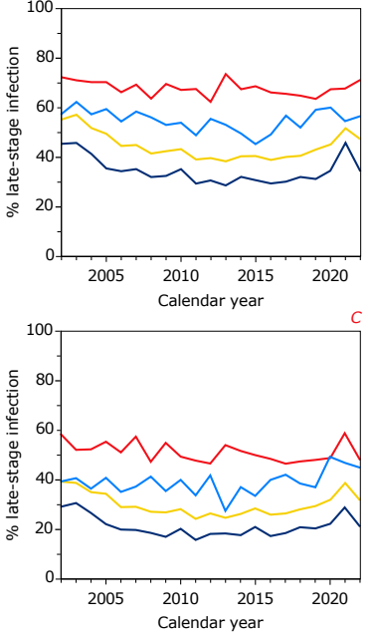
Late diagnosis
Late-stage HIV infection (47%) (CD4+ T-cell count < 350 cells/mm³ / AIDS)
Advanced-stage HIV infection (32%) (CD4+ T-cell count < 200 cells/mm³ / AIDS)
SHM, HIV monitoring report, 2023
Notes:
In 2021 Late stage 57% and advanced stage 41%

Slide 6
Missed opportunities
Less than 5 years before diagnosis:
77% visited an OPD specialist 37% was admitted in the hospital 31% presented with an HIV indicator condition in the hospital
Schouten et al. NTVG 2013

Slide 7
Methods
Multicenter prospective implementation project (Erasmus MC and LUMC)
Newly registered diagnoses
≥18 years
1st January, 2020 until 31st December, 2022
Exclusion of people already diagnosed with HIV
Automated ICD-10 codes and standardized health insurance codes
to flag potential HIV indicator conditions

Slide 8
HIV team intervention
Start Erasmus MC: August 2020
Start LUMC: October 2022 (external validation)
Proactive HIV testing recommendations to treating physicians
Department-specific educational sessions

Slide 9
Outcomes
HIV testing rates
overall,
over time,
by medical specialty
per hospital (external validation)
HIV positivity rate
Reasons to withhold HIV testing

Slide 10
Implementation periods

Slide 11
Overall HIV testing rate
69.7% (1,804/2,588)
Both hospitals comparable (68.1% versus 75.1%)
Newly registered diagnoses 270,000
Flagged diagnoses 23,000
HIV indicator conditions 2,588

Slide 12
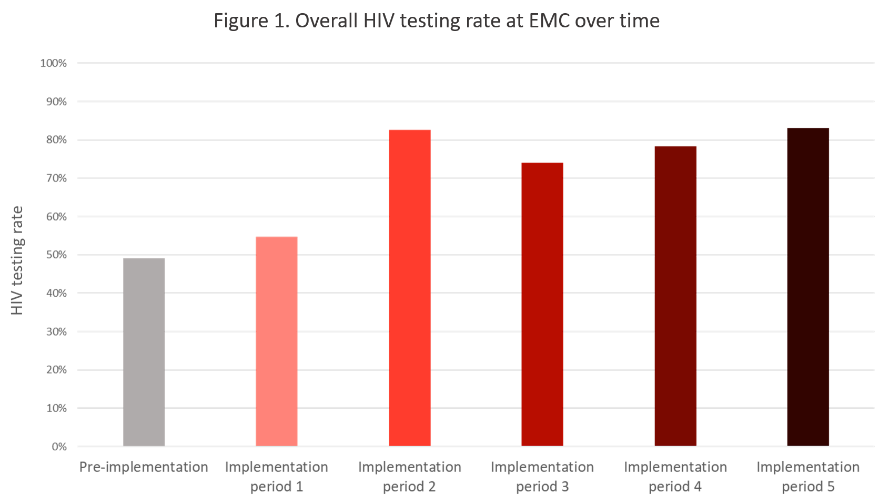
HIV testing rate
Testing rate:
49.1% 75.1%
HIV positivity rate:
0.4% (1/265) 0.6% (9/1,539)

Slide 13
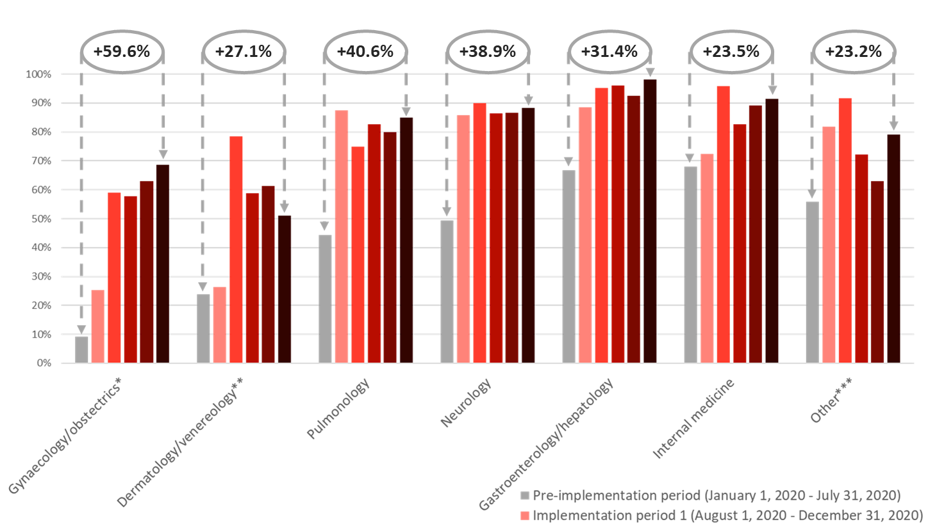
HIV testing rate per specialty

Slide 14
Reasons not to test

Slide 15
Conclusion
Implementing HIV teams in hospitals sustainably increased HIV indicator condition-guided testing and can be successfully expanded across hospitals
The results of this study support the further roll-out of HIV teams in other hospitals and different settings

Slide 16
What’s next?
EUROPE

Slide 17
CALL FOR SITES!
Tristan
Barber
Klaske Vliegenthart
Christoph Spinner
20 hospitals
10 countries
Stepped wedge approach
HIV team implementation
Expected start: Q1 2024
Randomization: 2025
Agata Skrzat-Klapaczyńska
WEST
Marta Vasylyev
Oana Săndulescu
Jose Bernardino
Christina Psomas
Silvia
Nozza
EAST
SOUTH

Slide 18
k.vliegenthart-jongbloed@erasmusmc.nl
www.awarehiv.com

