Slide 1

Exploring and comparing biomarker profiles and comorbidity burden in people with and without HIV
A Latent Profile Analysis of the AGEhIV Cohort Study
Manon C. Vanbellinghen, Anders Boyd, Neeltje Kootstra, Maarten F. Schim van der Loeff, Marc van der Valk, Peter Reiss
On behalf of the
Notes:
I would like to thank the organizing committee for the opportunity to present these data from the AGEhIV Cohort Study on biomarker profiles in people with and without HIV .

Slide 2
Disclosures
No conflicts of interest to declare

Slide 3
Background
People with HIV (PWH) experience a higher burden of ageing-associated comorbidities¹
Partly associated with ongoing inflammation and immune dysfunction²
The specific pathways by which these immunological changes drive comorbidities are not well defined
Clustering can be used on multiple biomarkers to identify profiles in PWH³
The group of Paddy Mallon has previously described inflammatory profiles in PWH, cross-sectionally associated with different CVD risk scores⁴
Notes:
By applying clustering techniques to multiple biomarkers, as demonstrated by Paddy Mallon's research group in Dublin, we can unveil distinct inflammatory profiles in PWH, offering valuable insights into the pathways driving increased comorbidity risks.

Slide 4
Aims
  Identify biomarker profiles in PWH and controls from the AGE_{h}IV Cohort Study
  Explore the association between biomarker profiles and ageing-associated comorbidities over time

Slide 5
Methods
Biomarker data from 94 PWH and 95 age-matched controls enrolled in AGE_{h}IV between November 2010 and December 2011
Clinical outcomes from baseline and 4 follow-up visits, from November 2010 to December 2020

Slide 6
Statistical analysis
Latent profile analysis to identify biomarker profiles
Factors associated with profile membership: multivariable logistic regression
Association profile membership and comorbidity burden: Poisson mixed-effects model

Slide 7
Results
Data are n (%) or
median (IQR)
Notes:
Hepatitis C = Hepatitis C RNA positive
Hepatitis B = surface antigen and/or Hepatitis B DNA positive
Data are n (%) or median (IQR)

Slide 8
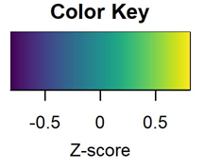
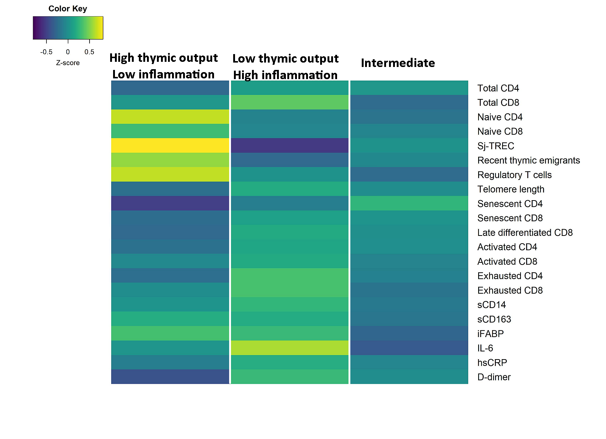
Results: biomarker profiles

Slide 9




Results: biomarker profiles
Innate immune activation
Systemic inflammation

Slide 10

Results: biomarker profiles
Innate immune activation
Systemic inflammation

Slide 11
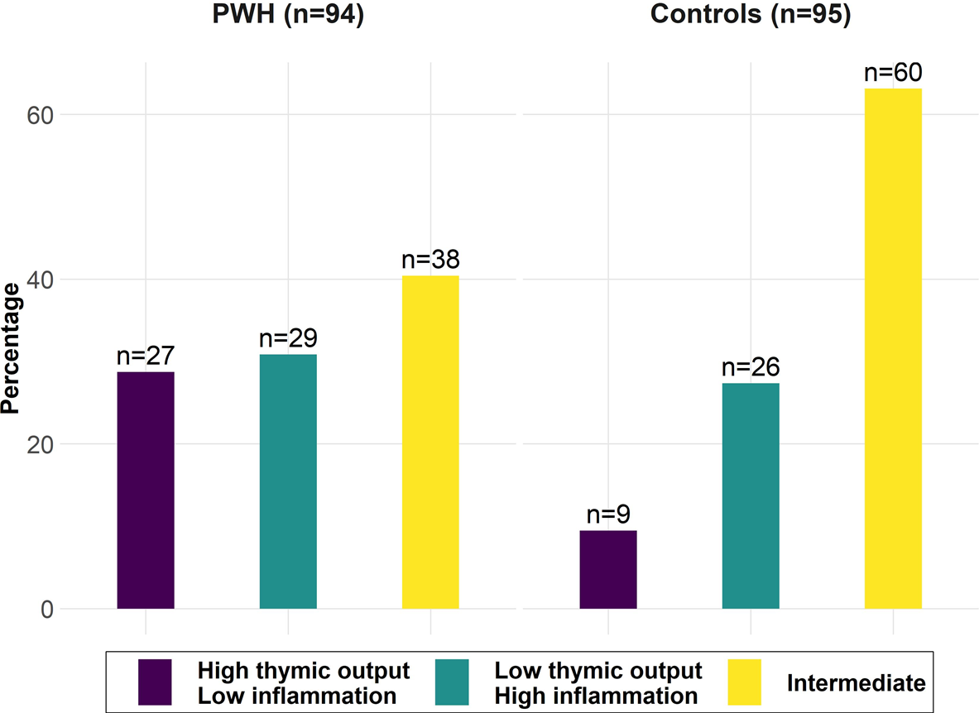
Results: prevalence of biomarker profiles in PWH and controls

Slide 12
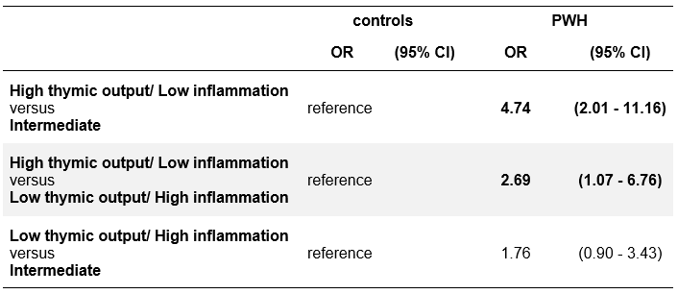
Results: Factors associated with profile membership multivariable logistic regression
Covariates: HIV, CMV and CMV antibody titer, sex at birth, active smoking, obesity, and age
Notes:
Individuals in the High thymic output/ Low inflammation profile had a significantly higher odds of having HIV compared to both the HI/LT profile (OR=3.09, 95%CI=1.11-8.60, p=0.031) and the intermediate profile (OR=4.98, 95%CI=1.93-12.83, p=0.001)

Slide 13
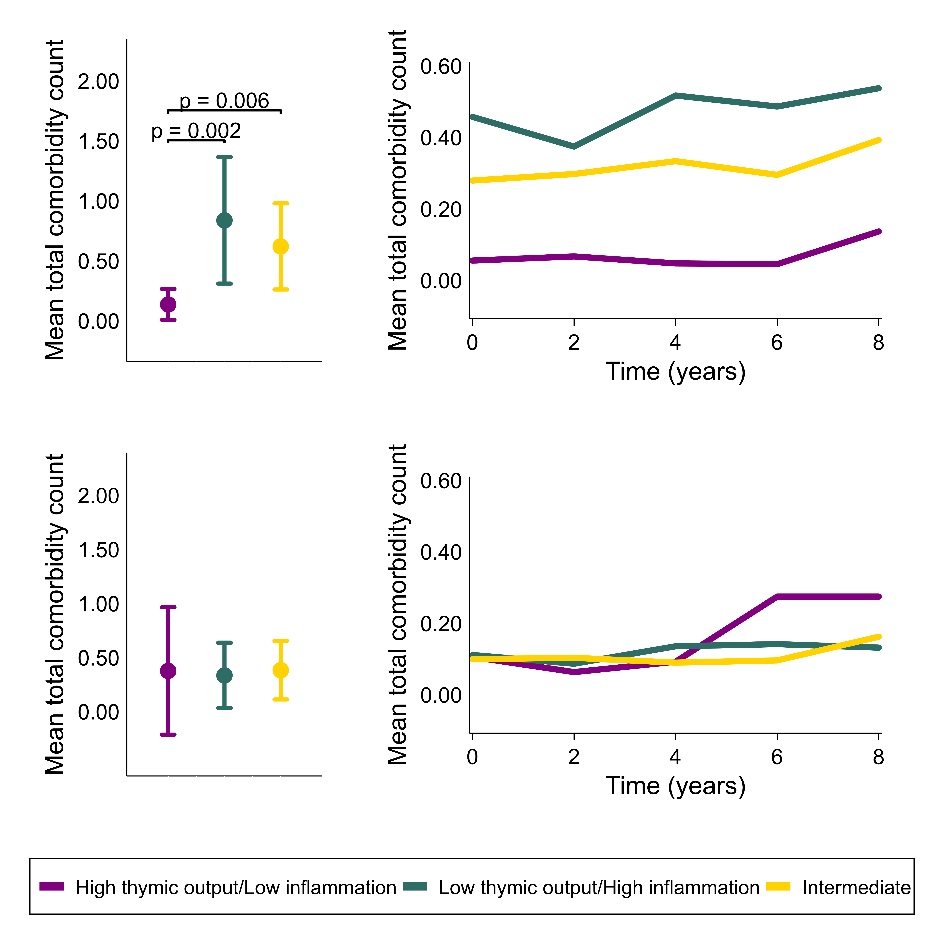
Results: association between profile membership and ageing-associated comorbidities
PWH

Slide 14
Results: association between profile membership and ageing-associated comorbidities
PWH

Slide 15
Results: association between profile membership and ageing-associated comorbidities
PWH
Controls

Slide 16
Conclusions
Three biomarker profiles were identified, the prevalence of which differed in PWH and controls
The High thymic output/Low inflammation profile was associated with having HIV, and with a lower comorbidity burden over time in PWH, but not in controls
These findings suggest that greater thymic function may help mitigate chronic inflammation in a subset of PWH on ART as they age, thereby reducing their risk of ageing-associated comorbidities
Notes:
Only and strong association with HIV

Slide 17

AGE_{h}IV Cohort Study Group
Scientific oversight and coordination: P. Reiss (principal investigator), F.W.N.M. Wit, M. van der Valk, A. Boyd, M.L. Verburgh, I.A.J. van der Wulp, MC. Vanbellinghen, C.J. van Eeden (Amsterdam University Medical Centers (Amsterdam UMC), University of Amsterdam, Department of Global Health and Amsterdam Institute for Global Health and Development (AIGHD)). M.F. Schim van der Loeff (co-principal investigator), J.C.D. Koole, L. del Grande, I. Agard (Public Health Service of Amsterdam, Department of Infectious Diseases). Statistical support: A. Boyd, F.W.N.M. Wit (HIV Monitoring Foundation). Data management: S. Zaheri, M.M.J. Hillebregt, Y.M.C. Ruijs, D.P. Benschop, A. el Berkaoui (HIV Monitoring Foundation). Project management and administrative support: L. Dol, G. Rongen (AIGHD). | Central laboratory support: N.A. Kootstra, A.M. Harskamp-Holwerda, I. Maurer, M.M. Mangas Ruiz, B.D.N. Boeser-Nunnink, O.S. Starozhitskaya (Amsterdam UMC, Laboratory for Viral Immune Pathogenesis and Department of Experimental Immunology). L. van der Hoek, M. Bakker, M.J. van Gils (Amsterdam UMC, Department of Medical Microbiology and Infection Prevention, Laboratory of Experimental Virology). Financial support: The Netherlands Organisation for Health Research and Development (ZonMW) [grant nr. 300020007] Stichting AIDS Fonds [grant nr. 2009063] Additional unrestricted scientific grants for parent study from: Gilead Sciences; ViiV Healthcare; Merck Sharp & Dohme Corp; Janssen Pharmaceuticals N.V. | Participating HIV physicians and nurses: S.E. Geerlings, A. Goorhuis, J.W.R. Hovius, F.J.B. Nellen, J.M. Prins, T. van der Poll, M. van der Valk, W.J. Wiersinga, M. van Vugt, G. de Bree, B. A. Lemkes, V. Spoorenberg, F.W.N.M. Wit; J. van Eden, F.J.J. Pijnappel, A. Weijsenfeld, S. Smalhout, I.J. Hylkema - van den Bout, C. Bruins, M.E. Spelbrink (Amsterdam UMC, Division of Infectious Diseases). Other collaborators: P.G. Postema (Amsterdam UMC, Department of Cardiology); P.H.L.T. Bisschop (Amsterdam UMC, Division of Endocrinology and Metabolism); E. Dekker (Amsterdam UMC, Department of Gastroenterology); N. van der Velde, R. Franssen (Amsterdam UMC, Division of Geriatric Medicine); J.M.R. Willemsen, L. Vogt (Amsterdam UMC, Division of Nephrology); P. Portegies, G.J. Geurtsen (Amsterdam UMC, Department of Neurology); I. Visser, A. Schadé (Amsterdam UMC, Department of Psychiatry); P.T. Nieuwkerk (Amsterdam UMC, Department of Medical Psychology); R.P. van Steenwijk, R.E. Jonkers (Amsterdam UMC, Department of Pulmonary medicine); C.B.L.M. Majoie, M.W.A. Caan (Amsterdam UMC, Department of Radiology); B.J.H. van den Born, E.S.G. Stroes, (Amsterdam UMC, Division of Vascular Medicine); S. van Oorspronk (HIV Vereniging Nederland).
And many thanks to all study participants!
Notes:
Participants first
Team
Funding

