Slide 1

Engaging the “Social” in HIV Research:
Science & Community
Judith D. Auerbach, PhD
Center for AIDS Prevention Studies, Division of Prevention Science
School of Medicine, University of California San Francisco
Netherlands Conference on HIV Pathogenesis, Epidemiology, Prevention and Treatment
November 28, 2023
Amsterdam

Slide 2
Disclosure of Speaker’s Interests
I have no conflicts of interest to declare.

Slide 3
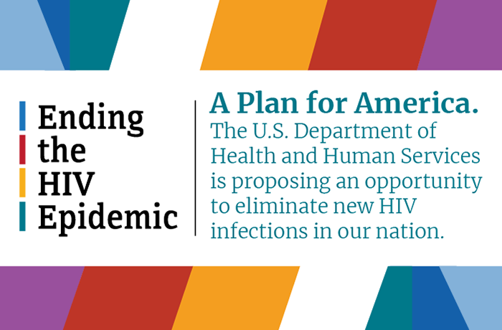
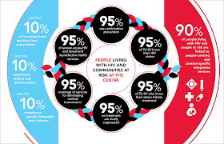
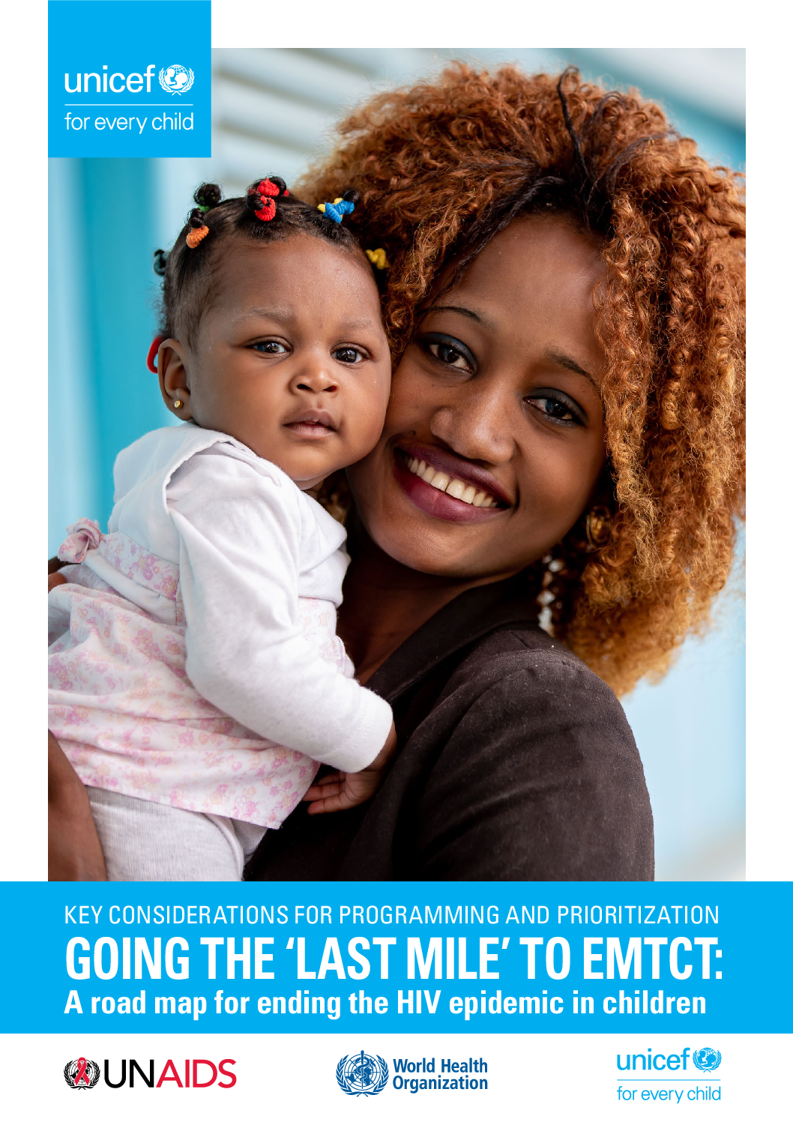
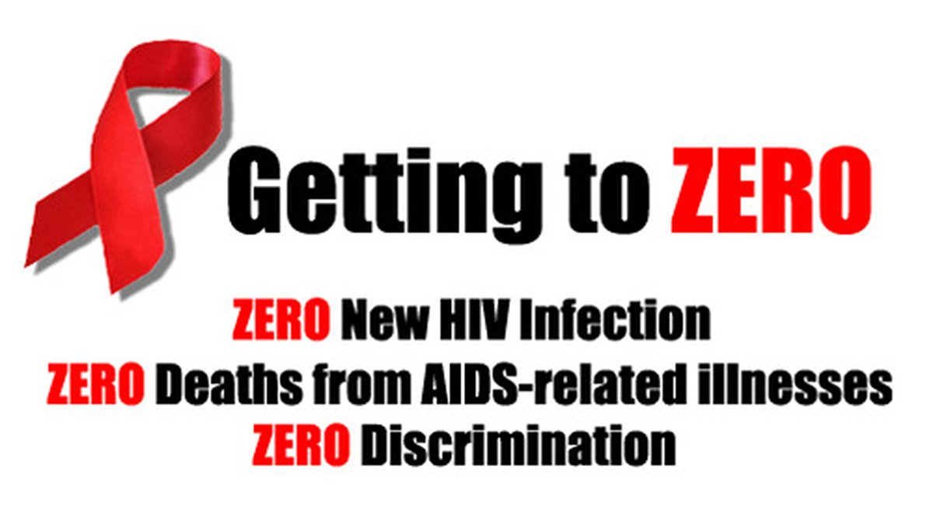
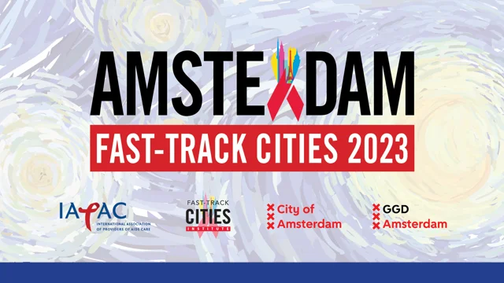
Introduction
Notes:
Introduction
Meeting global HIV goals of eventually ending the HIV pandemic—whether framed as reaching the 95-95-95 targets; “ending the HIV epidemic,” going “the last mile”; or “getting to zero”-- requires focusing on social and structural factors.
There are many efficacious biomedical technologies already in play for HIV treatment and prevention; but these will only be effective—meaning have population-level impact-- if used correctly and consistently by people who need and would benefit from them.
This requires that people are aware and knowledgeable about prevention and treatment options; are motivated to use them; have relatively easy access to them; and use them as prescribed.
While individual behavioral actions are fundamental, they can only be optimized if social (including political, cultural, and economic) and structural arrangement (including clinical and community health service systems, social support and protection programs, finance and payment systems, etc.) exist to facilitate them—because, simply, people do not live as isolated, autonomous actors independent of social and physical environments. Rather they are embedded in communities and other complex social and structural arrangements that themselves operate to confer risk or protection from HIV and its outcomes for any individual.
Better understanding and addressing these arrangements increasingly is recognized by the broad HIV response community as necessary for achieving global health goals, as they acknowledge the continued disparate and unequal ways in which ongoing HIV transmission, engagement with care, and lack of viral suppression are distributed.
This requires the greater integration of behavioral and social science with basic biomedical, clinical, and epidemiological research.
It also requires meaningful engagement—and sometimes leadership—of communities for whom the research is intended to be beneficial.
Focus of my talk is: How does this integration happen and what might it look like?

Slide 4
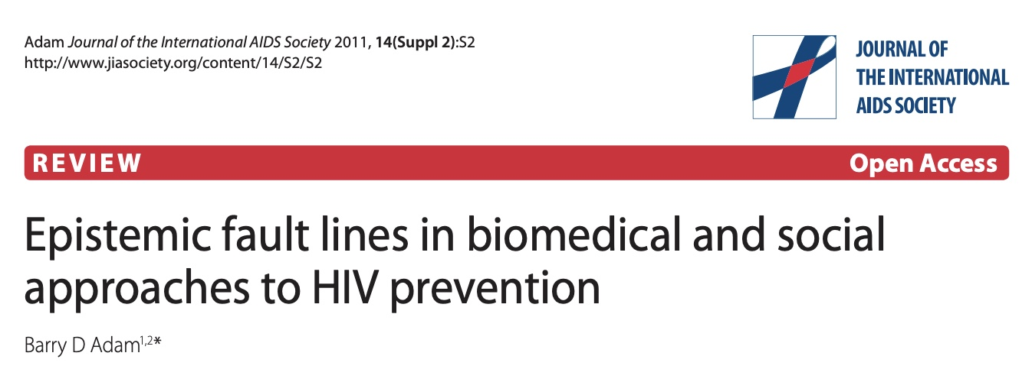
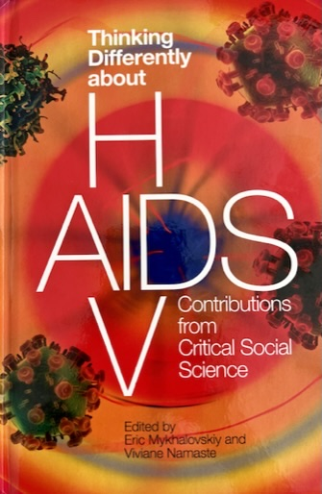

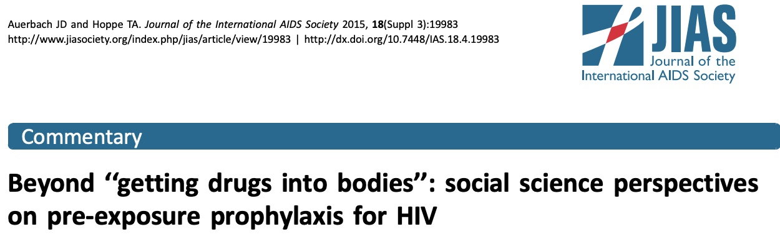
Why the Lack of Integration?
Disciplinary hierarchy
Epistemic fault-lines
Notes:
Must begin with asking why it hasn’t yet occurred.
Fundamentally, the issue is one of knowledge– what kinds of knowledge are used to aid in the prevention and treatment of HIV.
Historically and to this day, HIV research has been dominated by the knowledge gleaned from biomedicine and epidemiology—with a focus on the development and deployment of biomedical tools and technologies—chiefly ART-- without acknowledgement of the ways these themselves are “suffused with social, political, and cultural relations and occasion new forms of self-governance, stratification, and inequality that are worthy of social science inquiry.” (Eric Mykhalovskiy and Viviane Namaste).
Biomedicine and critical social science ask different questions, employ different methodologies, and apply their knowledge in different ways. These produce the “epistemic fault lines” described by Barry Adam in this seminal article.
The operation of science is organized and institutionalized—by state, civil society, and corporate actors-- in ways that valorize the biomedical and marginalize the behavioral and social in infectious diseases and public health more generally.
This elevates “narrowly applied forms of research that treat HIV/AIDS as something to be addressed within the established terms of state, managerial, pharmaceutical, and biomedical discourses and technologies. The resulting agenda for research gives little value or significance to the styles of social science research that critique oppressive relations, attend to problems of inequity and injustice, locate HIV/AIDS in its social, economic, and political context and emphasize remedial responses that connect biological, social, and cultural processes.” *(M & N p.9)

Slide 5
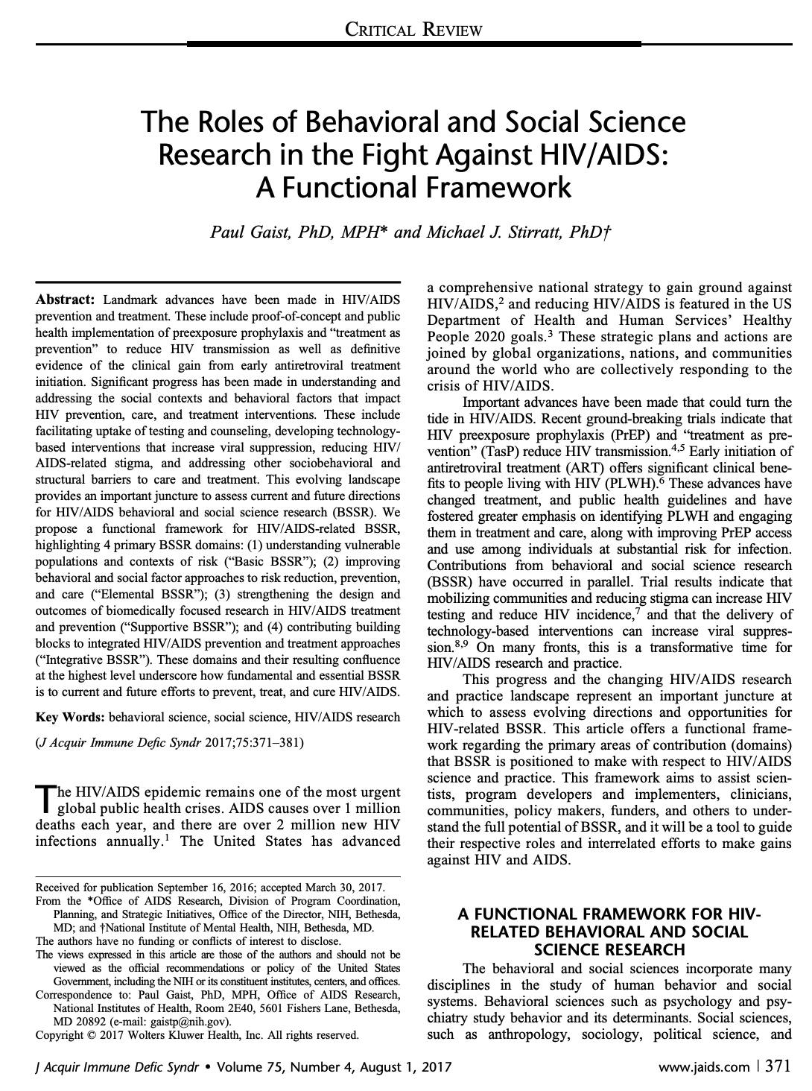
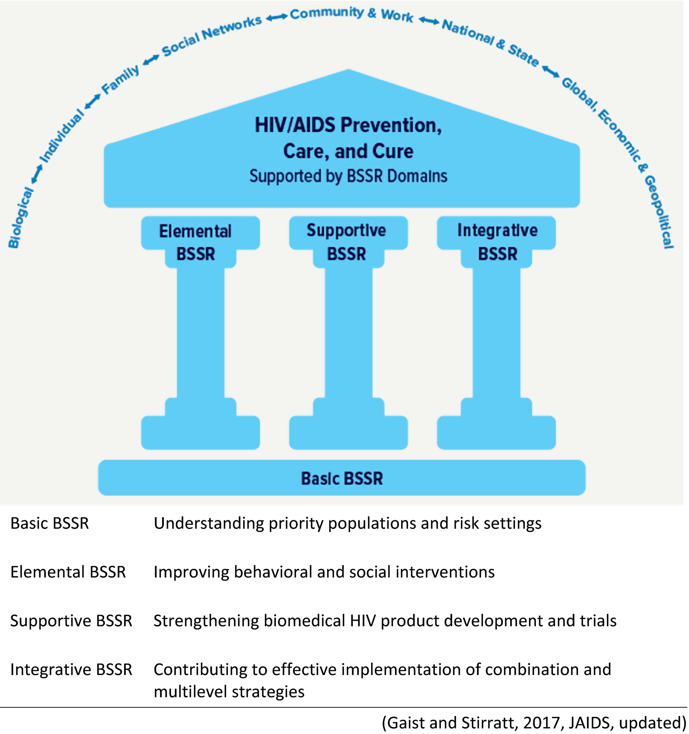
Behavioral and Social Sciences Research Functional Framework (Gaist & Stirratt 2017)
Notes:
How can we bridge this divide and engage in more integrative research?
Begin with a framework developed by Gaist & Stirratt for this purpose.
Some definition:
BSSR encompasses a range of disciplines that study human behavior and social relations:
Behavioral sciences: psychology, study behaviors and decision processes at the individual level
Social sciences: anthropology, sociology, political science, economics, demography:
Interested in the structure and dynamics of relationships among individuals and groups within a society—that is, how people organize themselves in formal and informal ways that affect and are affected by what happens at the individual level.

Slide 6
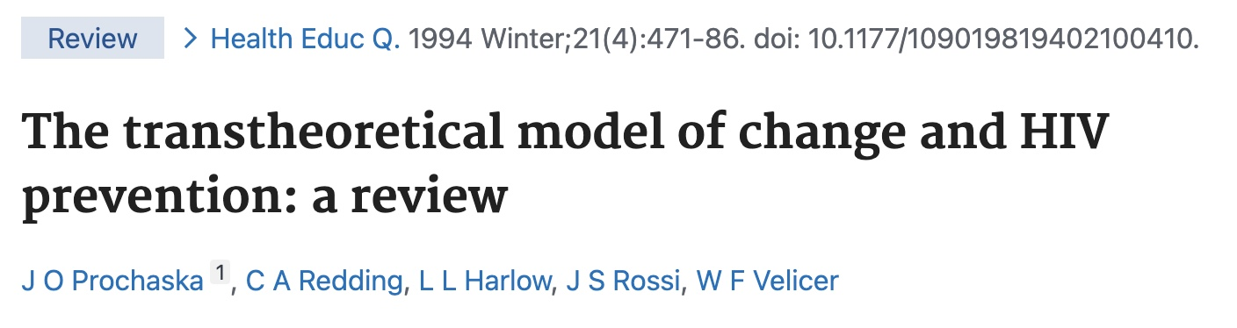
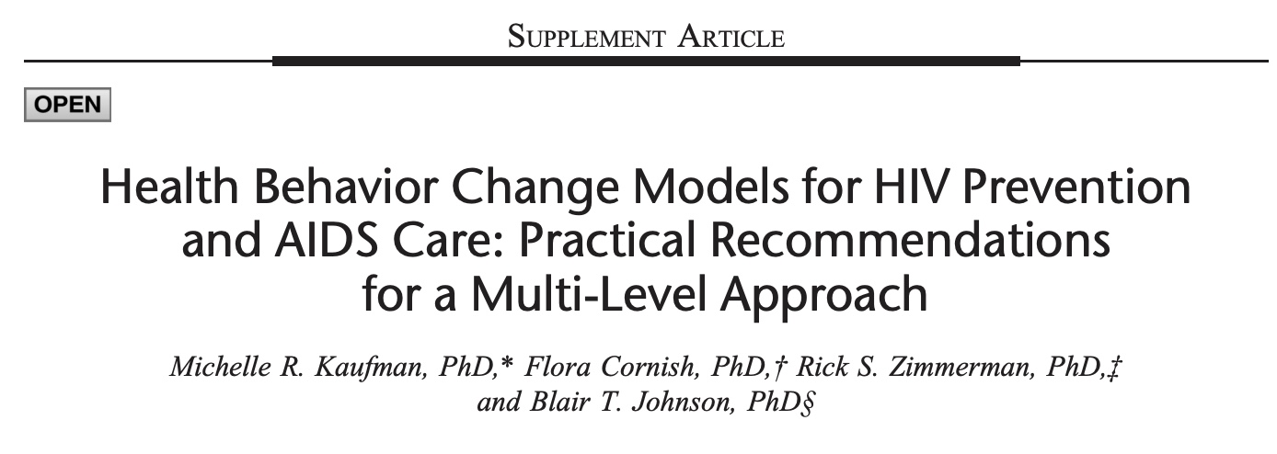
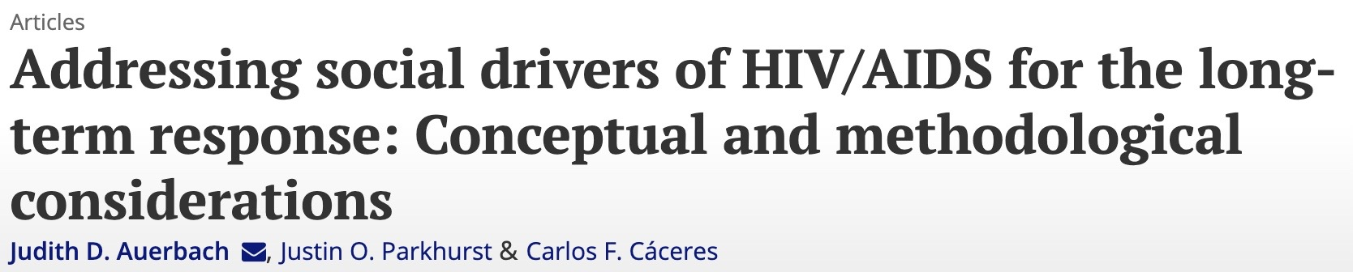
Basic BSSR
Understanding the fundamental mechanisms and patterns by which individual, relational, communal, and social (including cultural, political, economic) factors influence people’s health and well-being.
Behavioral: focused on individual’s risk assessment and reduction; intention- motivation-action trajectory; other psychological dynamics.
Social: focused on social processes & arrangements, reflective of norms, networks, institutions that operate around and in concert with individuals’ behaviors and practices.
  Social determinants/drivers of health
JAIDS, 66(Suppl.3), 2014
Global Public Health, 6(Suppl.3), 2011
Notes:
The foundation of the Gaist & Stirratt framework is basic BSSR.
Basic BSSR seeks to understand the mechanisms of these social processes and then chart the causal pathway between them and HIV-related outcomes.
In this way, it is similar to basic biology, virology, and immunology that seek to understand the fundamental mechanisms and pathways of HIV (the virus) as it operates at a genetic, molecular, and cellular level to affect individual health outcomes.

Slide 7
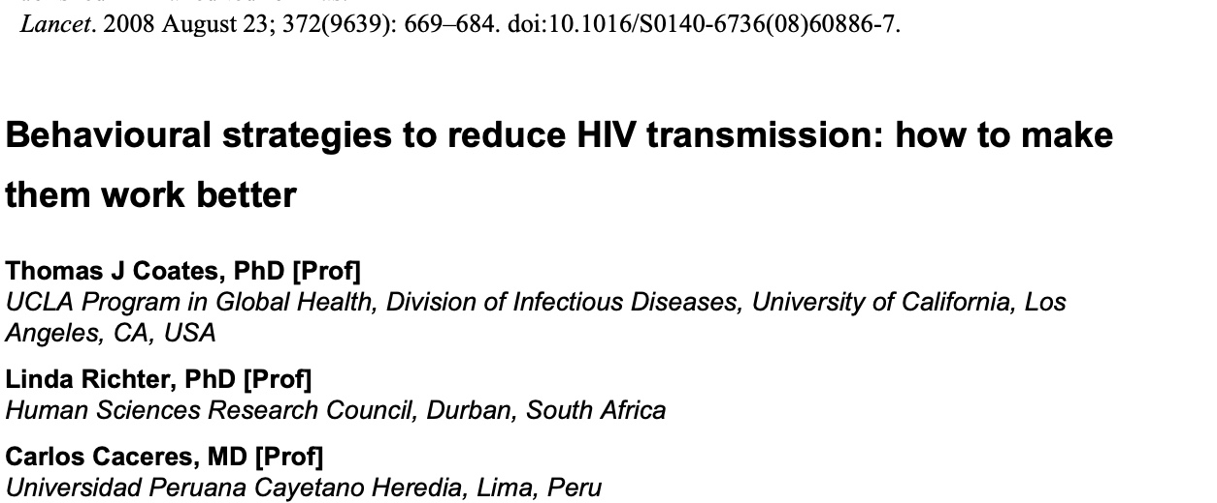
Elemental BSSR
Development and testing of behavioral and social interventions for HIV prevention, treatment, care, and cure.
Behavioral interventions:
  Historically, the dominant focus of SBS.
  Based on behavioral change theories and aimed at increasing HIV testing, increasing condom use, decreasing number of sex partners, decreasing sharing of drug injection equipment, taking up PEP, PrEP, ART, etc.
Social interventions:
  Less well developed because of complexity of social life (inability to control in an RCT framework)
  Based on social theories and aimed at changing social/structural arrangements to reduce vulnerabilities to HIV among marginalized populations, increase access to care, decrease stigma, etc.
Structural approaches to HIV prevention.
Gupta GR, Parkhurst JO, Ogden JA, Aggleton P, Mahal A. Lancet 2008; 372: 764–75
Transforming social structures and environments to help in HIV prevention.
Auerbach J. Health Affairs 2009 Nov-Dec;28(6):1655-65.
Notes:
This basic understanding informs the theoretical basis for behavioral and social intervention design and implementation.

Slide 8
Supportive BSSR
Supporting and strengthening the development and clinical testing of biomedical approaches to HIV prevention, treatment, and cure.
Assist with uptake and use of efficacious HIV prevention, treatment, and cure technologies by different populations.
Trials 22, 882(2021)
Notes:
In addition to behavioral and social interventions themselves, BSSR can inform the planning, implementation, data collection, analysis, and interpretation phases of clinical trial testing biomedical interventions, including products for HIV prevention, treatment, and cure.
Informs trial design, recruitment, retention, adherence, measurement, ethics, cultural appropriateness, community engagement, etc.
SBS facilitates selection of the most acceptable products and identification of adherence support approaches to ensure proper proof-of-concept testing

Slide 9
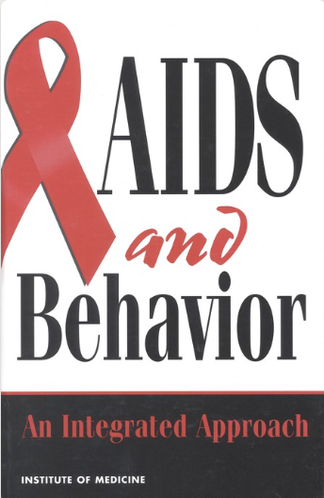
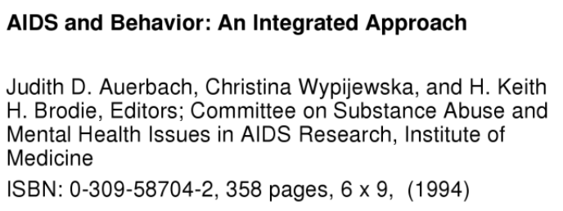
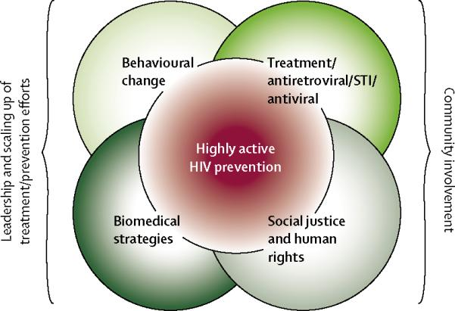

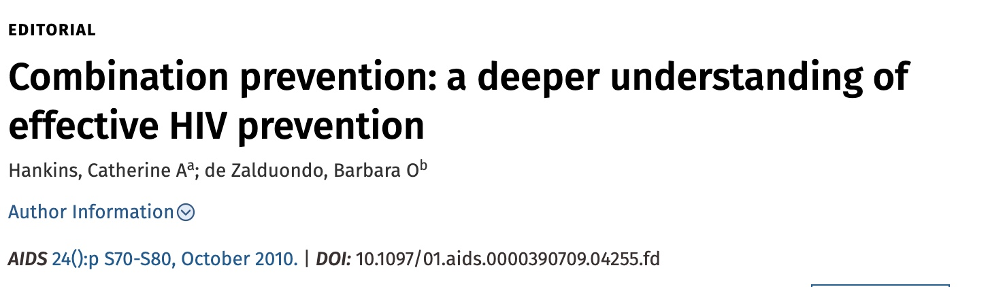
Integrative BSSR
Joins behavioral, social, and biomedical science in an integrative approach, framework, or intervention.
Also called “combination” prevention, treatment.
Recognizes that HIV is a virus, transmitted in human relationships that take place in social context.
  All aspects of this phenomenon should be considered simultaneously for greater population effect.
Notes:
Integrative research aims to link biomedical, behavioral, and social science more intentionally.
It also leads to efforts to include and engage communities as the ultimate users of the outcomes of research.

Slide 10
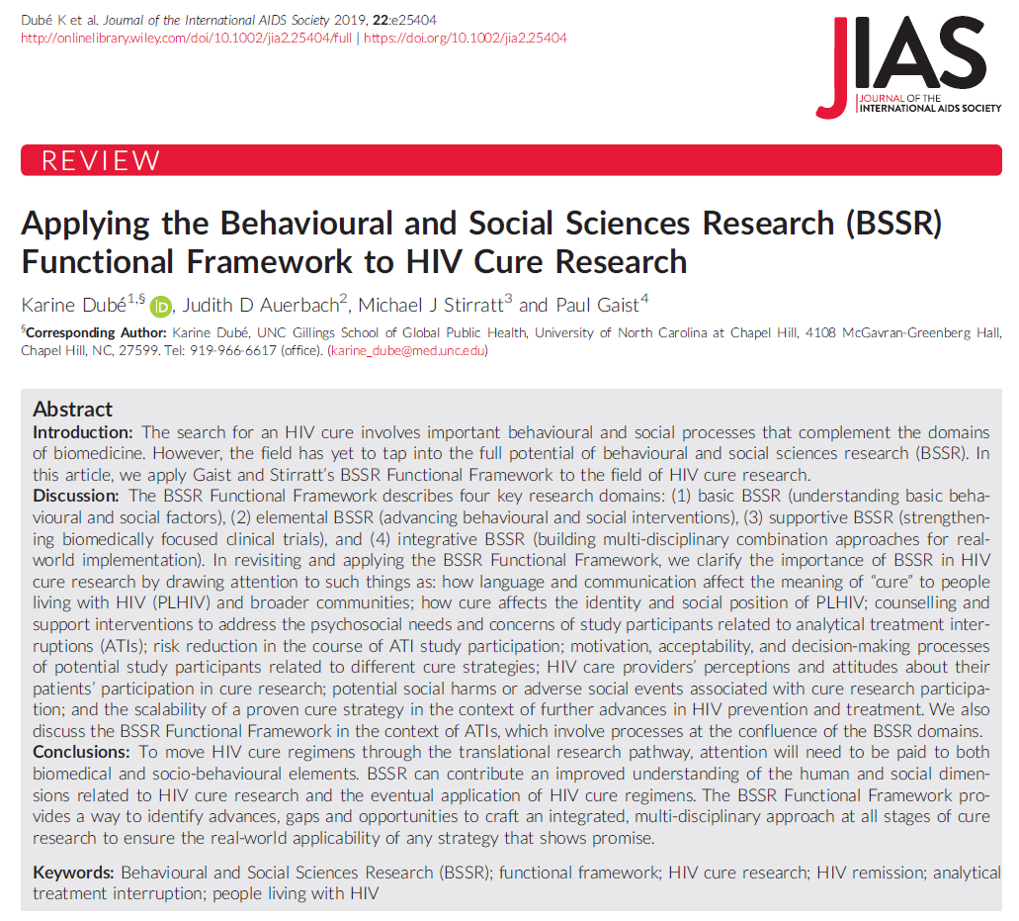
Application of Functional Framework to HIV Cure Research
Notes:
Show how this framework applies to one area of HIV research – cure.
The point is not just to explicate social science-based cure research, but also to see how it may be integrated with biomedical cure research and community interests.

Slide 11
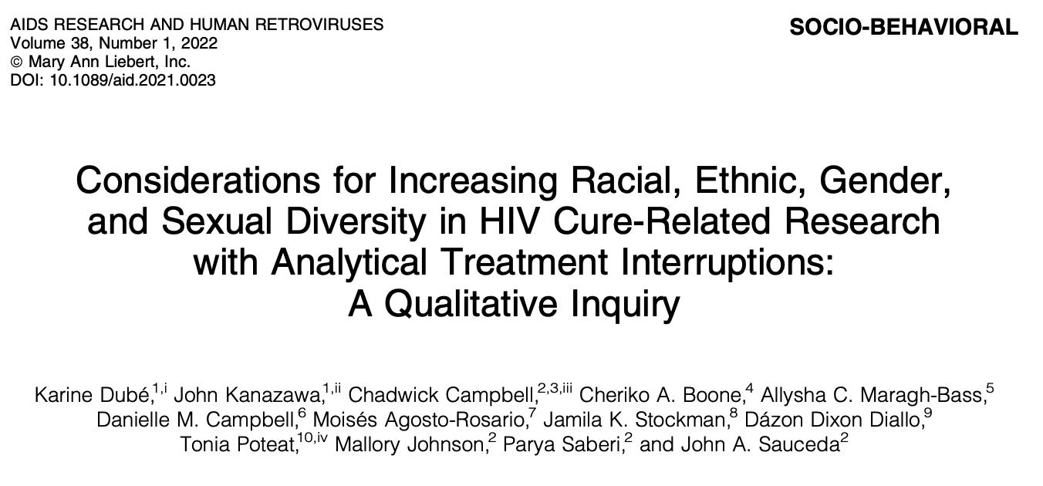
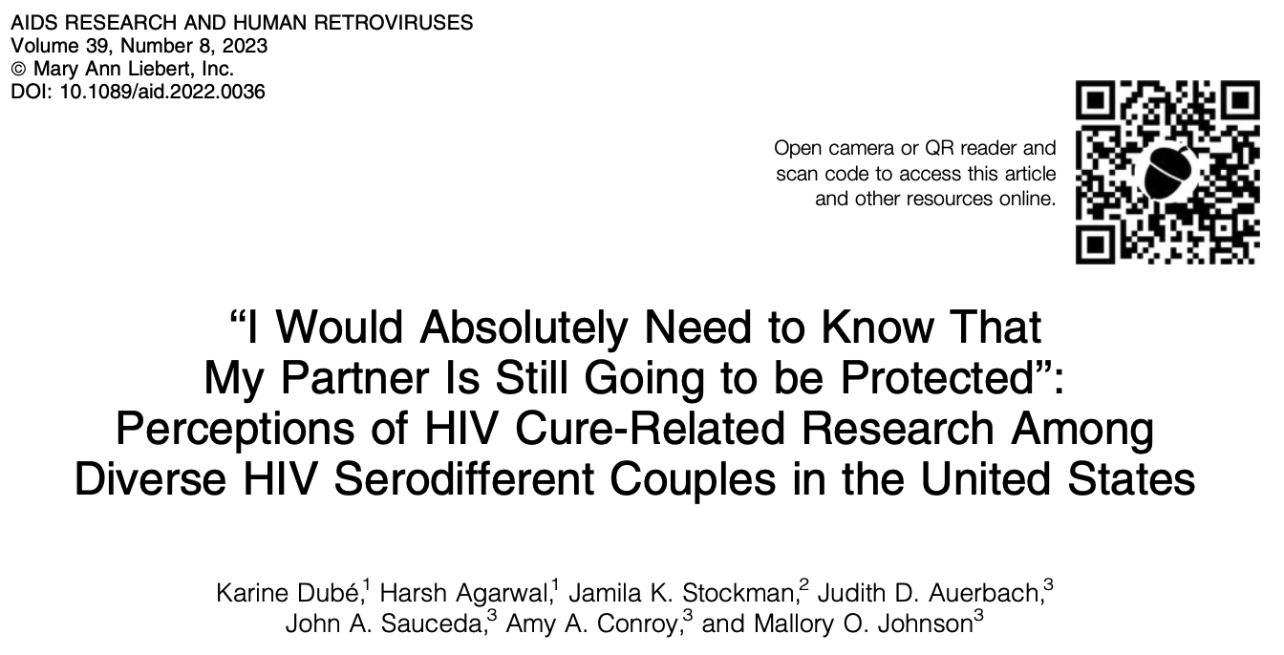
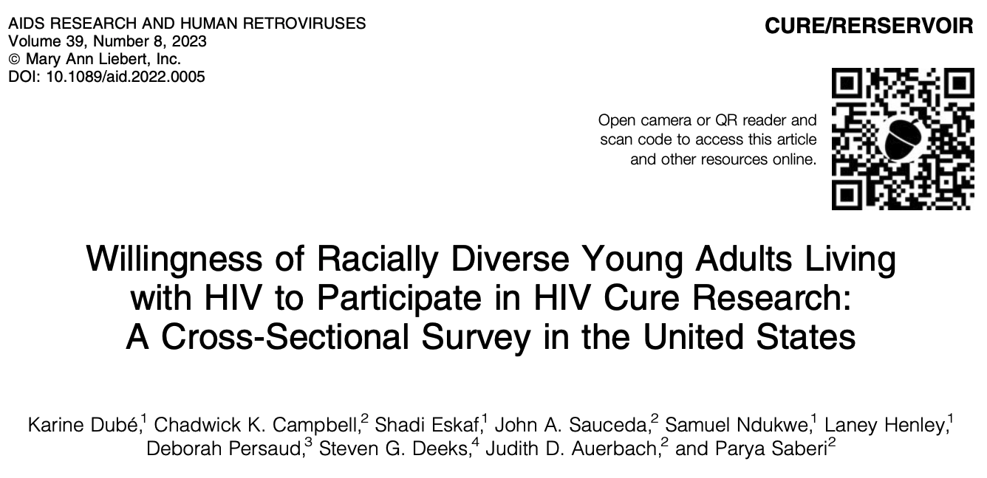
Basic BSSSR: Understanding Behavioral & Social Factors
Use of language to define HIV cure research
Understanding community perceptions and knowledge of HIV cure-related research
Communication and societal framing of
expectations around HIV cure research
Construction and management of HIV-related identities
Social meaning of curing HIV infection
Views of becoming detectable/undetectable and understanding of how the U = U movement shapes desires to engage in HIV cure-related research
Notes:
Basic BSSR is aimed at explicating both what people understand and feel about the notion of curing HIV; and what they understand and feel about HIV cure research, including their own willingness to participate in cure studies.

Slide 12
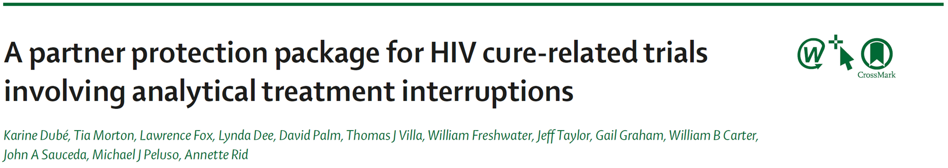
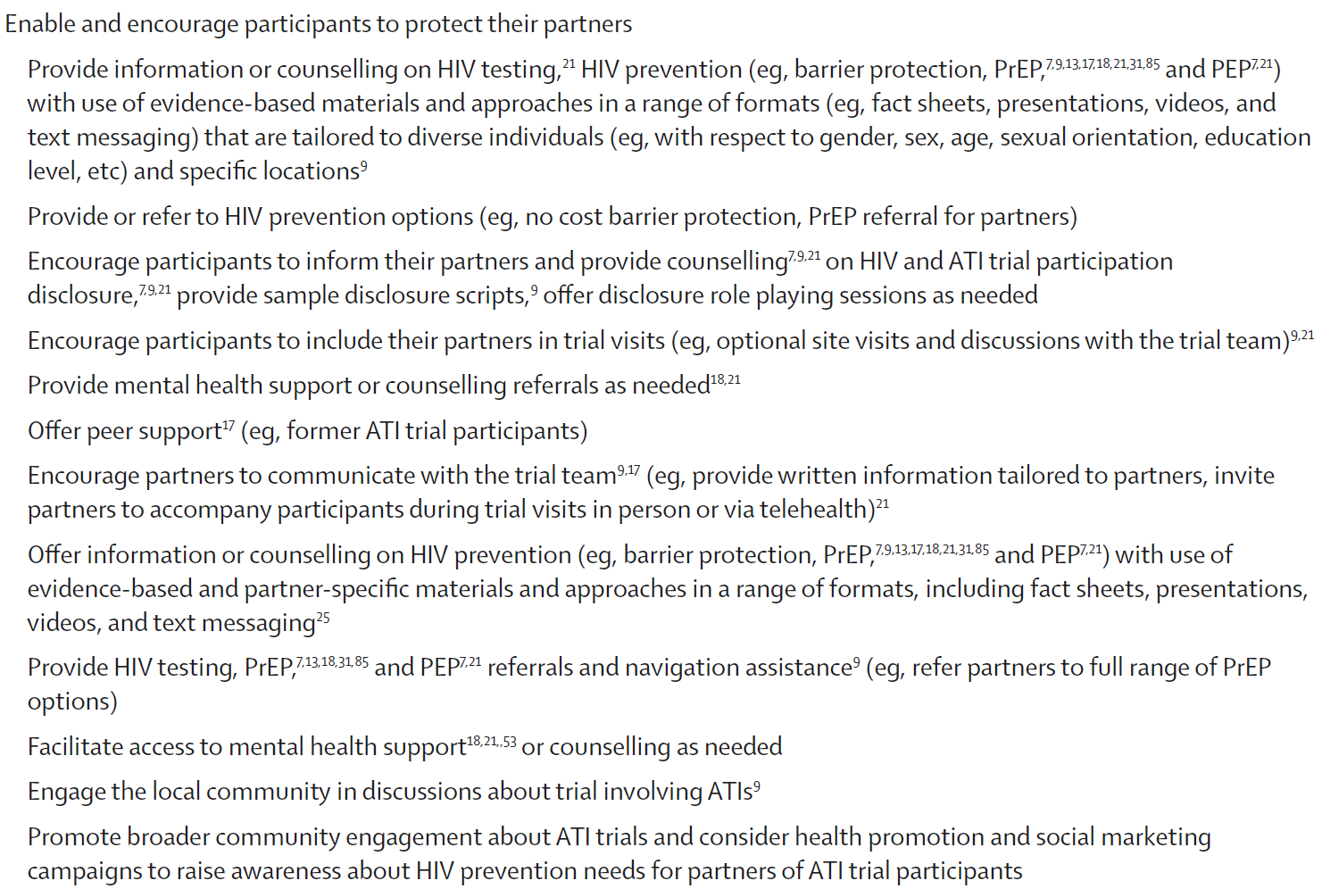
Elemental BSSR: Advancing Social & Behavioral Interventions
Counseling and support interventions to address psychological needs related to ATIs
Behavioral risk-reduction strategies during HIV cure and ATI studies to minimize third-party risks (i.e. counseling, PrEP provision, adherence to partner protection measures, HIV testing referral)
HIV stigma reduction interventions
Notes:
How best to manage concerns about stopping treatment during trials.
How to minimize risk of HIV transmission to partners while participating in ATI studies – partner protection packages.

Slide 13
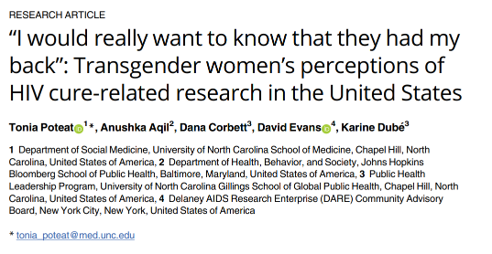
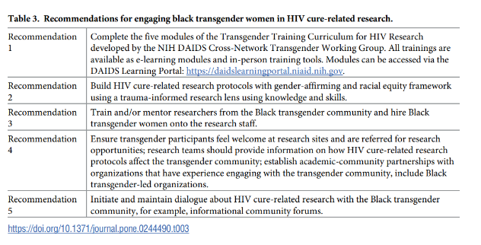
Supportive BSSR: Strengthening the Design and Outcomes of Biomedically-Focused Clinical Trials
Desirable target approach and product profiles
Acceptability of specific HIV cure research strategies
Assessing psycho-social factors for people living with HIV re: cure studies
HIV cure researchers’ and HIV care providers’ attitudes & practices
Improving informed consent processes and understanding or risks and benefits of cure research
Patient-reported measures during the course of HIV cure research participation
Assessing and supporting adherence to HIV testing and viral load monitoring schedules, as well as ATIs, in cure-related clinical trial protocols
Strategies to mitigate social impacts and harms during trial participation
Factors affecting or enhancing the involvement of diverse and under-represented populations in research, such as women and minoritized groups

Slide 14
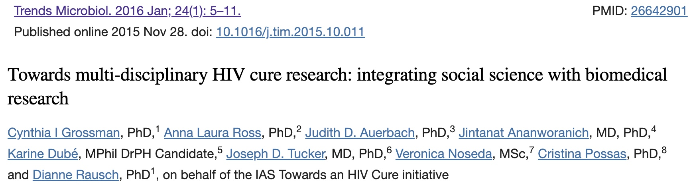
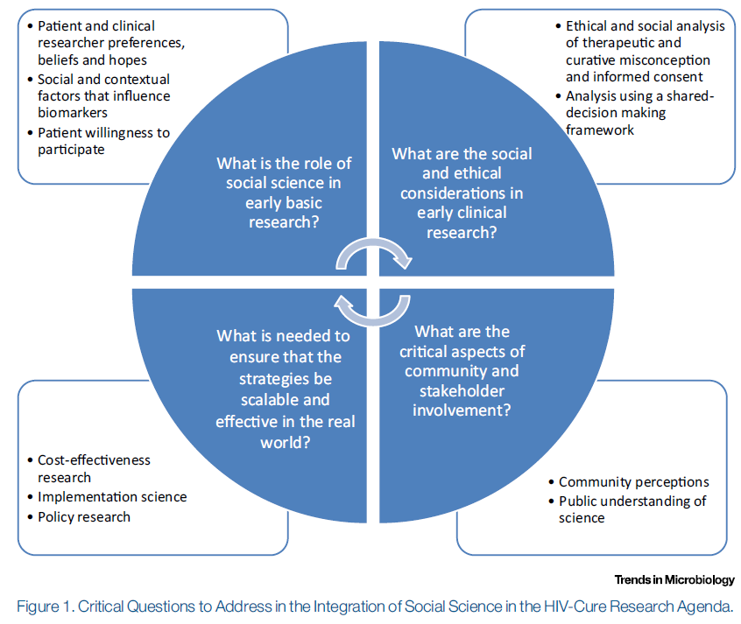
Integrative BSSR: Advancing Implementation of Integrated, Combination, and Multi-Disciplinary Approaches
Decision tools for making informed choices about cure strategy
Behavioral interventions to support patient retention and completion of cure regimen
Anticipating research needs on factors affecting implementation of cure strategies
Development of HIV cure strategies with scalability in mind
Integrating cost-effectiveness research and anticipating performance benchmarks for implementation
Notes:
Integrative science in HIV cure means crafting multidisciplinary approaches for both research and implementation of cure strategies.
It also involves community engagement, as is articulated in this earlier framework for integrated HIV cure research by Grossman et al. (2016).
Social sciences can provide the empirical foundation to inform community perceptions around HIV cure research and to ensure that all research has the strongest ethical foundations.

Slide 15
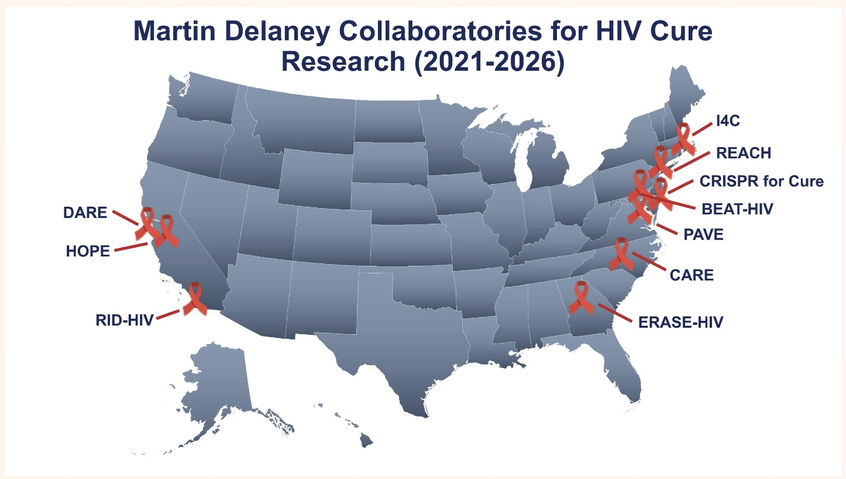
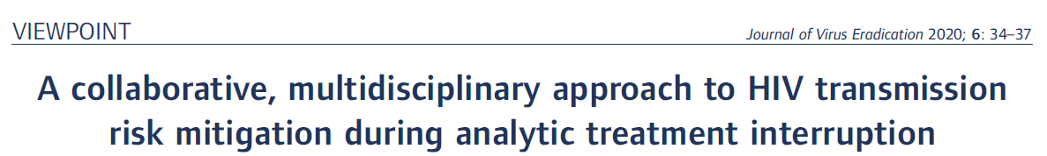
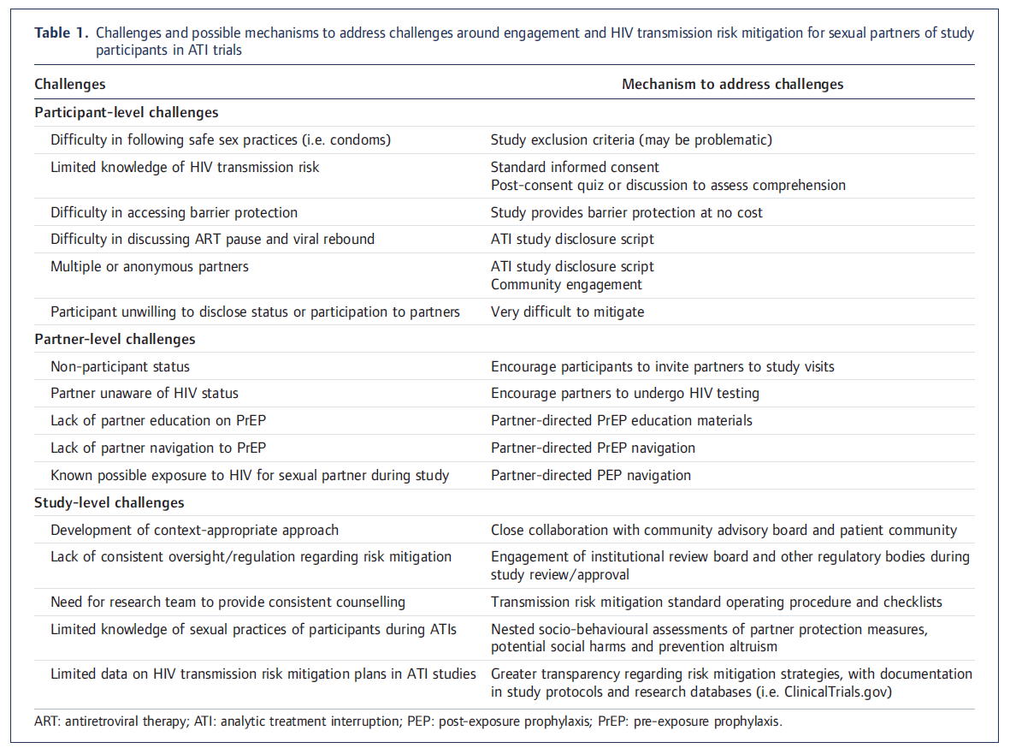

Martin Delaney Collaboratories
Notes:
Examples of ”integrative science” efforts:
1) NIH-funded Martin Delaney Collaboratories
10 research teams leading an international collaborative investigation into HIV cure strategies.
Purpose is to foster dynamic, multidisciplinary collaborations between basic, applied, and clinical researchers studying HIV persistence and developing potential curative strategies.
Main areas of focus:
Basic and clinical research to characterize persistent HIV reservoirs and to determine the mechanisms associated with viral latency, post-treatment control, and viral rebound
Applied research to develop and test therapeutic strategies for eradicating or controlling residual virus using in vitro, ex vivo, and animal models
Designing clinical trial protocols to test safety, tolerability, and initial proof-of-concept of curative therapies
Community engagement to advance research literacy, set realistic expectations of success, and address potential concerns regarding acceptability, enrollment, safety, or ethics

Slide 16
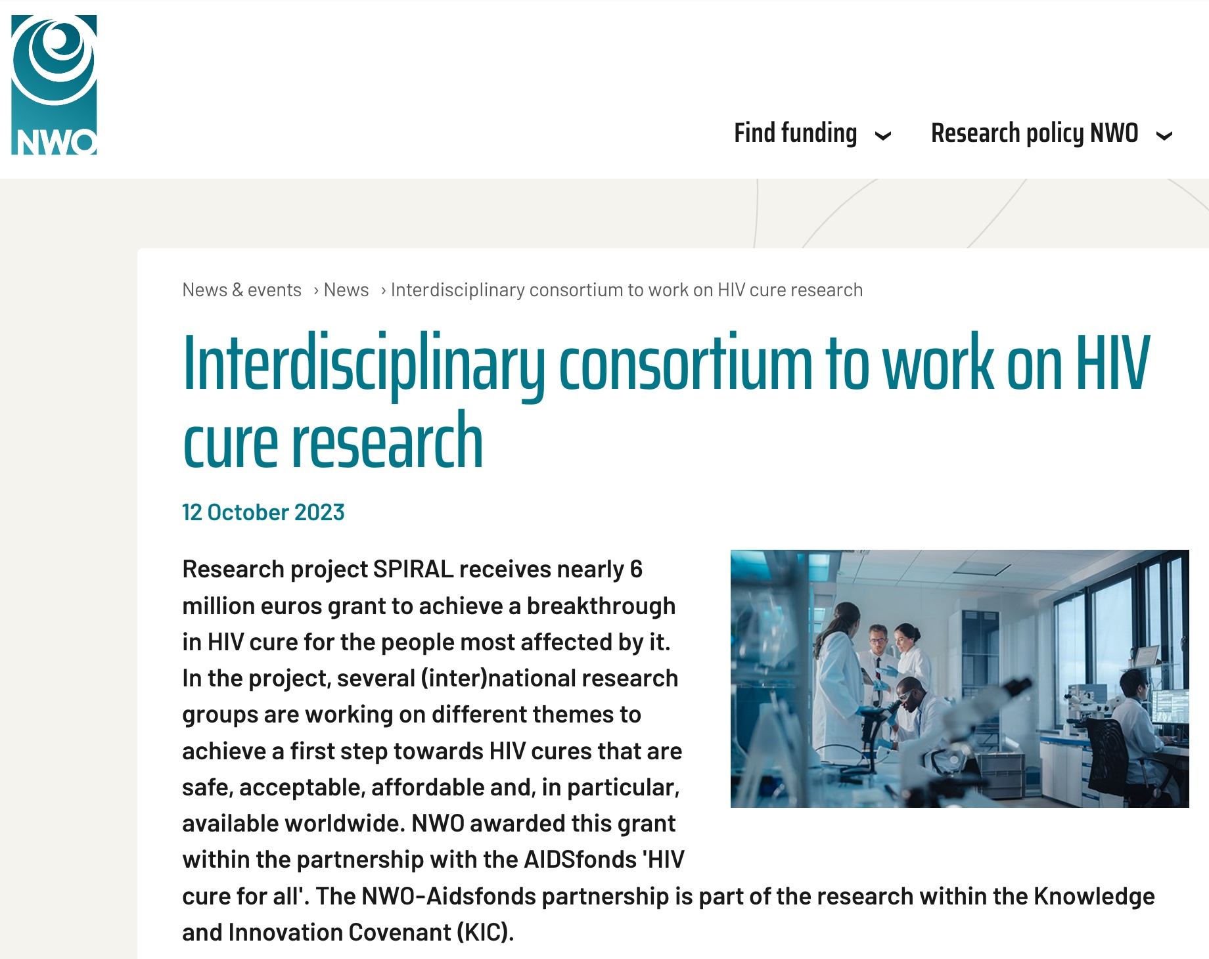
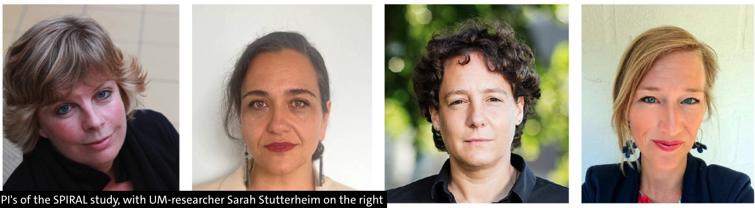
SPIRAL Project (2023)
Sources: Interdisciplinary consortium to work on HIV cure research | NOW; New research: HIV cure for the group hardest hit - News - Maastricht University
Notes:
2) SPIRAL Project:
Collaborative Project funded by the Dutch Research Council (NWO) and Aidsfonds.
Women-led team:
Biomedical scientists: Monique Nijhuis (UMC Utrecht) and Tokameh Mahmoudi (Erasmus MC)
Social scientist: Sara Stutterheim (Maastricht U)
Infectious disease specialist: Godelieve de Bree (Amsterdam UMC)
In collaboration with other researchers in the Netherlands, Uganda, South Africa, and Zambia
Focus is on ensuring that an HIV cure will be available to people with HIV subtypes other than B—most especially women in sub-Saharan Africa.
The consortium works closely with communities and projects are co-led by senior and junior researchers.

Slide 17
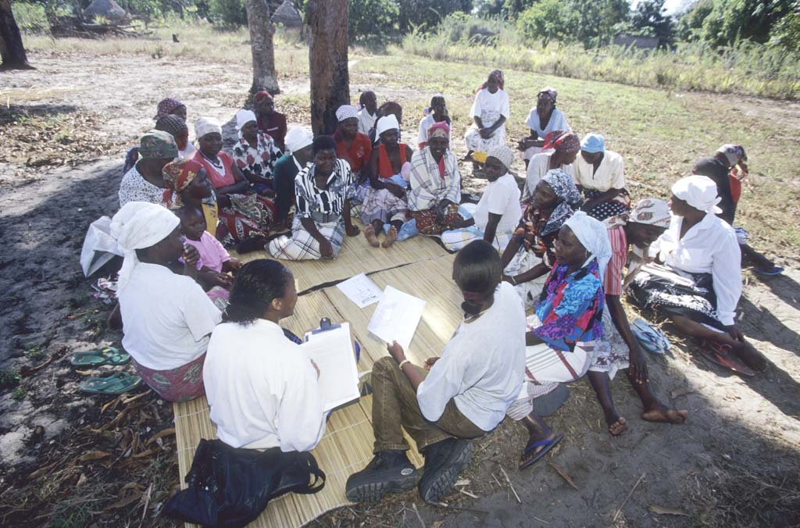
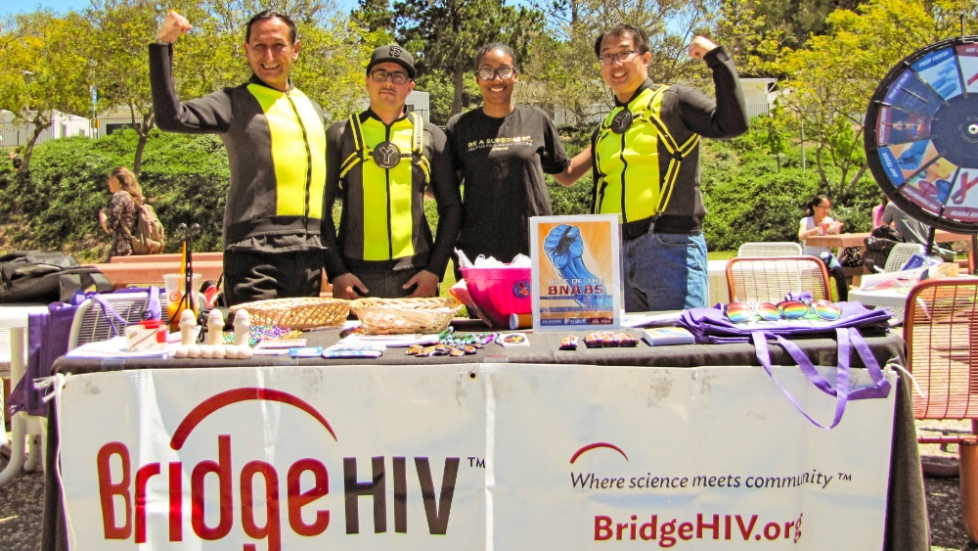
Community Engagement in Research: “Nothing About Us Without Us”
Notes:
All of these integrative and collaborative research efforts require the participation of people living with or vulnerable to HIV infection.
Engagement of communities in HIV research is now taken as a given, and it comes from a long history of AIDS activism.
Nothing About Us Without Us core principle is: people with lived experience of a disease or social reality should be the central voice in decision-making about directions in policy and programming that affect them

Slide 18
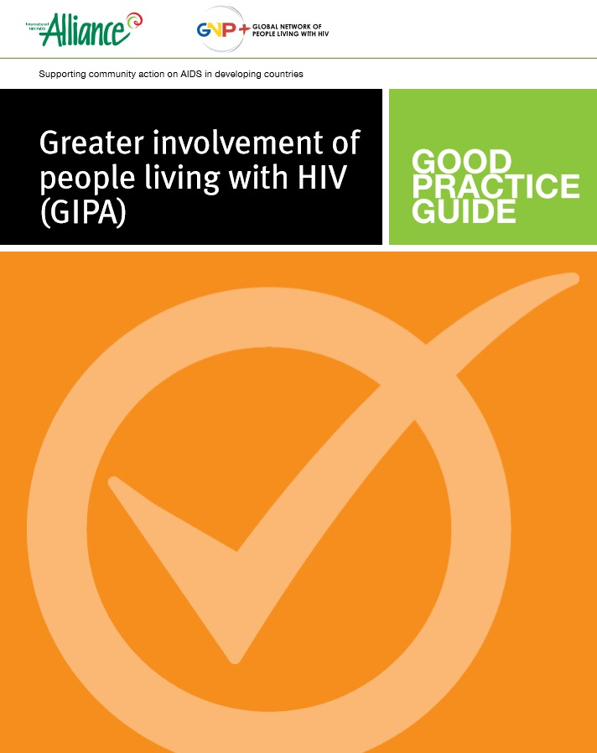
Institutionalizing Community Engagement
Denver Principles: 1983
Greater Involvement of People Living with AIDS (GIPA): 1994
Notes:
That principle of community engagement has been codified and institutionalized over the years, beginning with the Denver Principles in 1983.
Greater Involvement of People with AIDS--informed by Denver Principles—was formalized and endorsed by 42 countries at the 1994 Paris AIDS Summit.
GIPA aims to realize the rights and responsibilities of people living with HIV, including their right to self-determination and participation in decision-making processes that affect their lives.” (from UNAIDS).
It was endorsed at two subsequent high-level UN- meetings in 2001 and 2006.

Slide 19
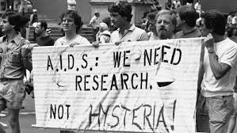
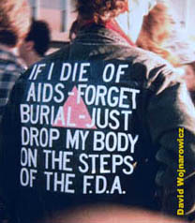
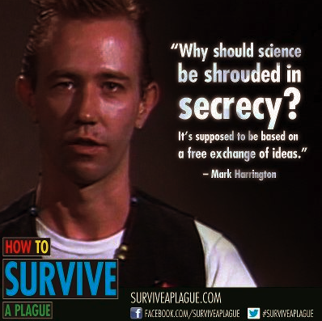
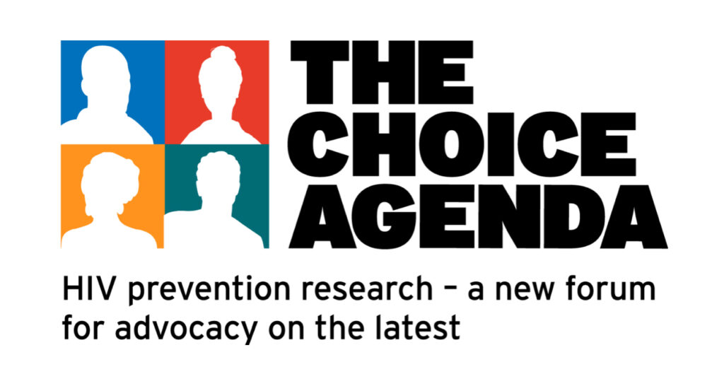
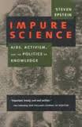
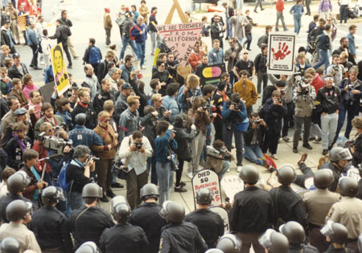
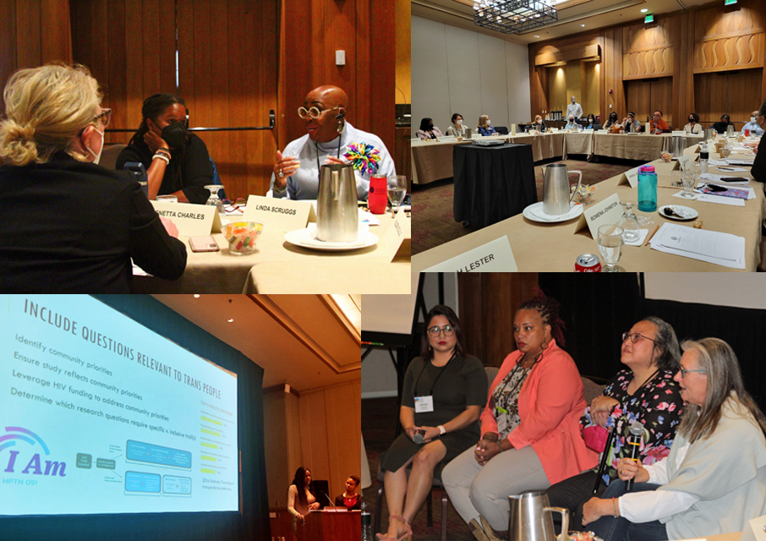
Research Advocacy
Notes:
These principles have played out in HIV research advocacy over the years.
The earliest focus of AIDS advocacy was on the need for treatment, as people were dying quickly, with no end in sight.
Treatment advocacy in the U.S. began in the early 1980s when activists urged the FDA to more rapidly approve experimental drugs, arguing that people with AIDS had nothing to lose by trying them, given their impending, inevitable demise.
But soon shifted to the NIH where basic research was supported that would eventually lead to the development of drugs.
A key feature of of this movement is that AIDS activists became self-taught experts in the science, realizing that they would be most effective if they could engage the scientific establishment on its own terms and then disrupt it.
Once they demonstrated their scientific acumen, the establishment “let them in” and engaged them in developing the HIV/AIDS science agenda.
Activist were concerned about the ethics of clinical research from the point of community education and engagement.
They insisted that clinical trial populations should be representative of people most affected by AIDS – gay men, people who use drugs, and people with hemophilia; and they flipped some of the standard ethics approaches around informed consent and protection from harm, arguing that people had a right to choose to assume some risk inherent in testing experimental drugs.

Slide 20
Community Engagement in Clinical Trials
Notes:
We see the evolution of this research advocacy and the principle of “nothing about us without us” play out very clearly in the context of HIV prevention, treatment, and cure clinical trials, in which
community engagement is a key element.

Slide 21
Community Advisory Boards
Notes:
In this context, community engagement typically is constructed within the framework of what clinical researchers need to do to ensure that the right kind of people are recruited, retained, and adherent in the clinical trials that the researchers want to do, and that there is community buy-in.
A common way to facilitate this is through a Community Advisory Board (CAB).
In general, the role of CABS includes:
serve as a voice for the community and local study participants;
provide input into study design and local study procedures;
work to ensure that research strategies acknowledge and respect the values and cultural/ethnic differences among participants.
assist in the planning, development, and implementation of research;
assess community impact and ensure community concerns are considered;
provide leadership and scientists with feedback on projects, as requested;
alert scientists to community issues and hot topics in HIV;
review grant proposals and journal articles, when feasible;
assist to develop community dissemination and outreach strategies.

Slide 22
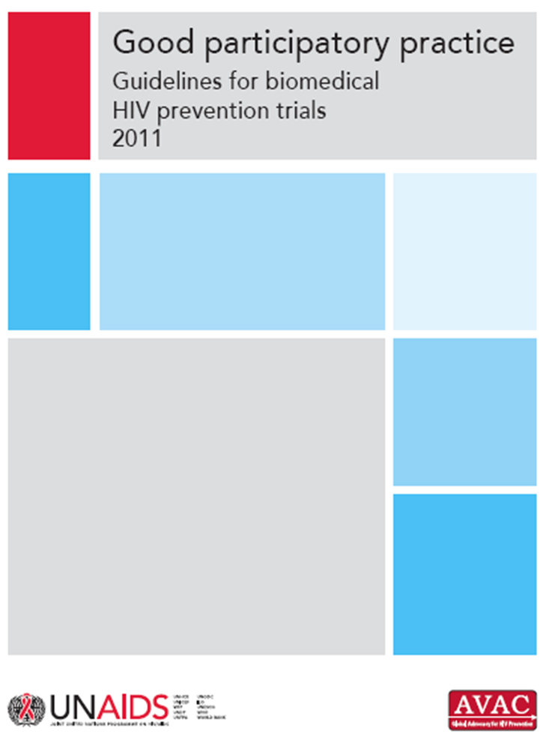
Good Participatory Practices (GPP)
Core Ethics Principles:
Respect for persons and their autonomy
Beneficence—maximize benefits and minimize risks for participants
Justice—fairness and equity in choice of location and participation
Notes:
But, community engagement requires much more than CABS . . .
In the case of human research, it requires adherence to a set of ethical principles to protect the rights and well-being of study participants and their surrounding communities.
These have been articulated in the form of a guidance document shown here.
The first edition of the Good Participatory Practice Guidelines for biomedical HIV prevention trials was published in 2007 by the Joint United Nations Programme on HIV/AIDS (UNAIDS) and AVAC and updated in 2011.

Slide 23
A Framework for Community Collaborative Research
Notes:
These ethics help guide collaborative research, as outlined in this framework by Brizay and colleagues.
Whether called action research (AR) participatory action research (PAR), community-based research (CBR) and community-based participatory research (CBPR), the key is to ensure meaningful partnership between researchers and community representatives in all phases of research—from determining what questions to ask; to designing and implementing the study; to analyzing and disseminating its results.

Slide 24
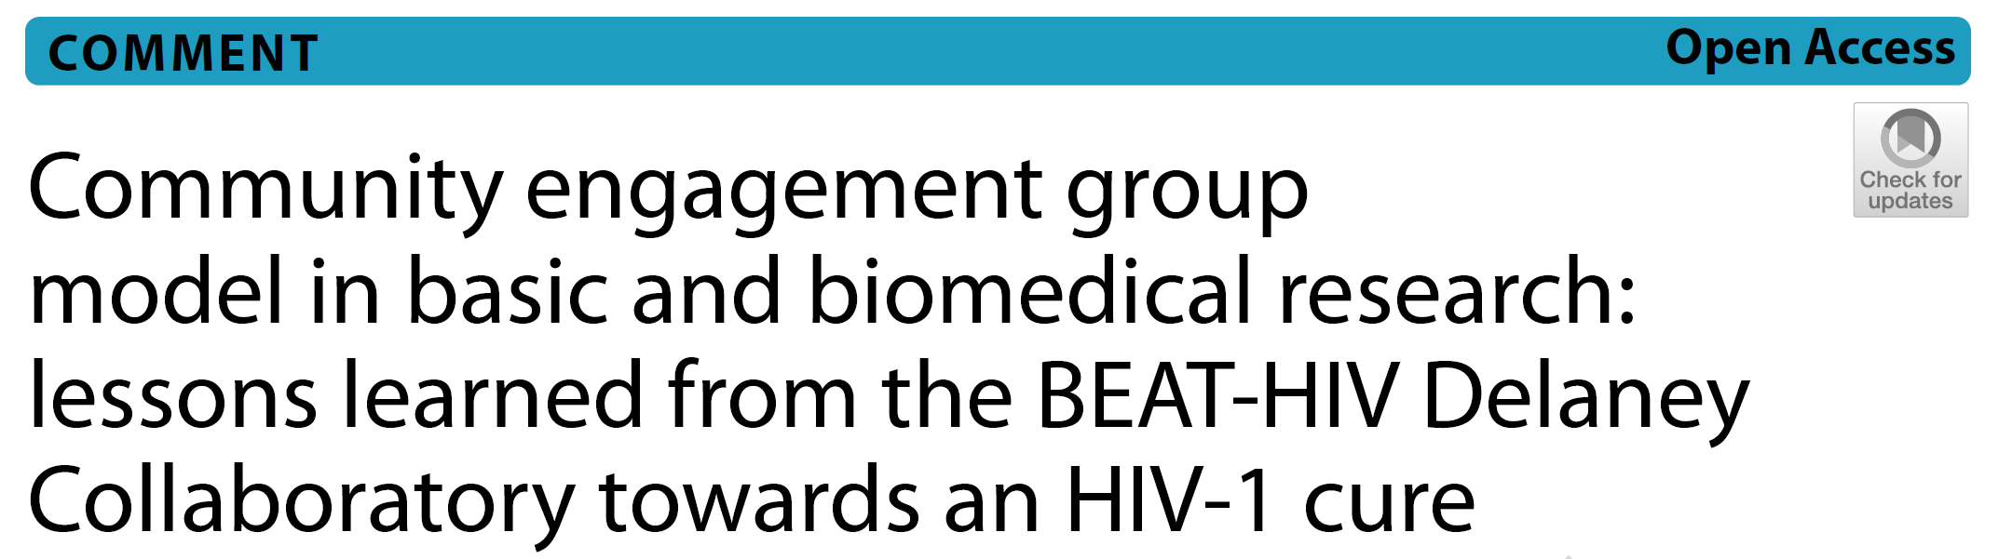
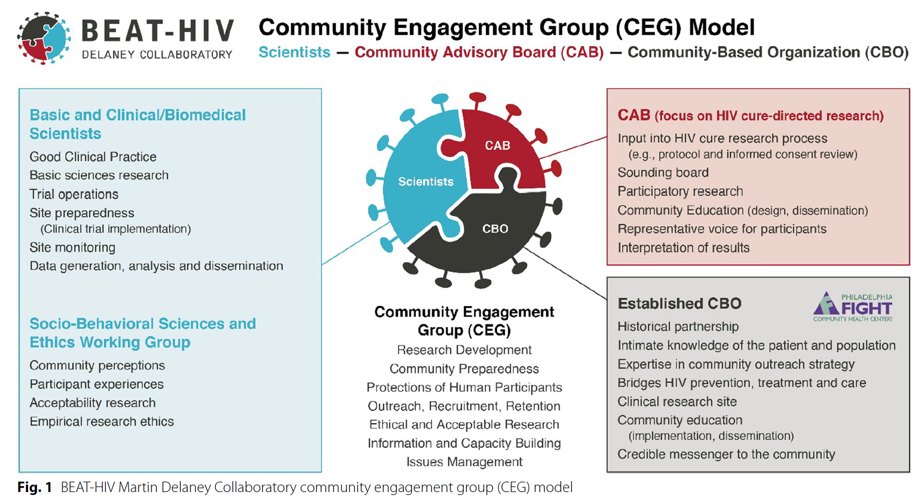
Community Engagement Model
BEAT-HIV CEG Model Principles:
Sharing community vision to integrate efforts
Democratic group control on agenda and projects
Independent contributions to group programmatic goals
Shared leadership assignments
Independence while strengthening collaborations
For more details: https://pubmed.ncbi.nlm.nih.gov/37291622/
Notes:
Returning to our HIV cure example, I’d like to show a couple of examples of how this community-collaborative research approach has been implemented.
The first comes from the BEAT-HIV Collaboratory, whose CEG model integrates basic and clinical/biomedical scientists, a socio-behavioral sciences and ethics working group, a CAB and an established CBO – Philadelphia FIGHT
The CAB focuses on providing input into the research process, acts as a sounding board, and engages in community education, and members participates in designing socio-behavioral research projects
Philadelphia FIGHT provides the historical partnership and knowledge of the patient/participant population, and provides expertise in community outreach, and also helps bridge HIV prevention, treatment and care; it is also a clinical research site

Slide 25
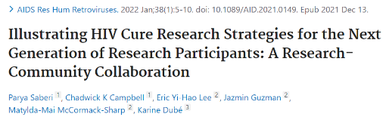

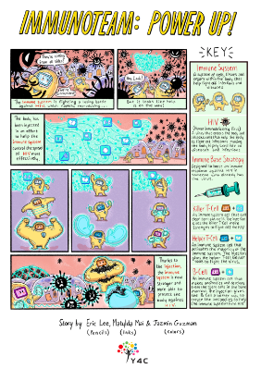
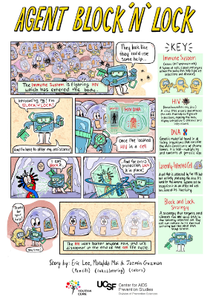
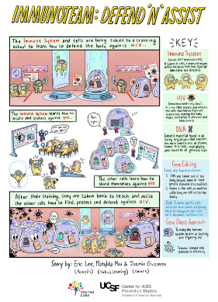

Youth4Cure
https://youth4cure.ucsf.edu/hiv-cure-research-illustrations
Notes:
Youth4Cure is another example of a research-community collaboration, in which partners in the youth advisory group helped develop educational materials about HIV cure approaches that were appropriate and engaging for their peers as potential participants in HIV cure studies.

Slide 26


Research Gatekeepers & Stakeholders
Wilson, et al. Nature Medicine, 2021
MacQueen, et al. Stakeholder Engagement Toolkit for HIV Prevention Trials. FHI 360, 2012.
Notes:
It is important to understand that individuals in a defined community are only part of a large web that includes gatekeepers and stakeholders that may have similar or different interests in relation to health research and with whom collaborations are necessary.

Slide 27

HIV Cure Research Stakeholders
Notes:
Recognizing this, Noorman et al. undertook a systematic review of studies assessing HIV cure research stakeholders.
The authors note: “ . . . Effective stakeholder engagement in HIV cure research is imperative, not only for the translation of basic science findings to the clinic, and, accordingly, participation in clinical trials but also because working together with stakeholders is ethical and just. It redresses power imbalances, creates accountability, and reduces inequality between researchers and PWHIV.”
The authors analyzed results of studies focused on three stakeholder types: 1) people with HIV; key populations (e.g., MSM, PWID, transgender people; kin; activists); and professionals (e.g., researchers, health care professionals, policy makers, bioethicists, drug company reps.)
They found both similarities and differences in what different stakeholders perceived about risks and benefits of participating in cure trials, definitions of what “cure” means; desirable attributes of an HIV cure; partner protections; etc. —all of which should be addressed in future research.

Slide 28



Application & Impact of GPP & Community/Stakeholder Engagement
Notes:
The models of stakeholder engagement from HIV have been extended to other realms of health research, including TB and COVID-19.
An important question, though, is what impact these efforts have had on the conduct and outcomes of research.
We all agree that stakeholder engagement is valuable in principle, but it’s a fair question to ask what it has actually achieved.
This is explored in a JIAS supplement I co-edited with Kate MacQueen in 2018.
We and the co-authors of articles in the volume highlight some of the gaps in the evidence base for community engagement, including a lack of standardized measures and the importance of developing a theory-based framework for evaluation of engagement practices.
To help redress this gap, just last week, AVAC released its new online clearinghouse of case studies and analyses demonstrating the impact of GPP in practice, along with tools, templates and trainings for GPP implementation.

Slide 29
Conclusions
Mitigating, if not eliminating, HIV epidemics requires a comprehensive and integrated research agenda that considers biological, behavioral, and social phenomena equally and simultaneously.
Research must be informed by and be of use to communities of people most affected by HIV and its individual and social consequences.
While we cannot expect all researchers to be fluent in all relevant scientific disciplines, we can and must expect—and prepare—them to respectfully engage all types of inquiry, including those from the communities and populations we serve.

Slide 30
Acknowledgements
Paul Gaist, Office of AIDS Research, NIH
Mike Stirratt, National Institute of Mental Health, NIH
Karine Dubé, University of California San Diego
Jane Simoni, Office of Behavioral and Social Science Research, NIH
Kate MacQueen, FHI 360

