Slide 1
Identifying gaps in HIV care in the Netherlands using data from Statistics Netherlands (CBS)
Vita Jongen
28 November 2023

Slide 2
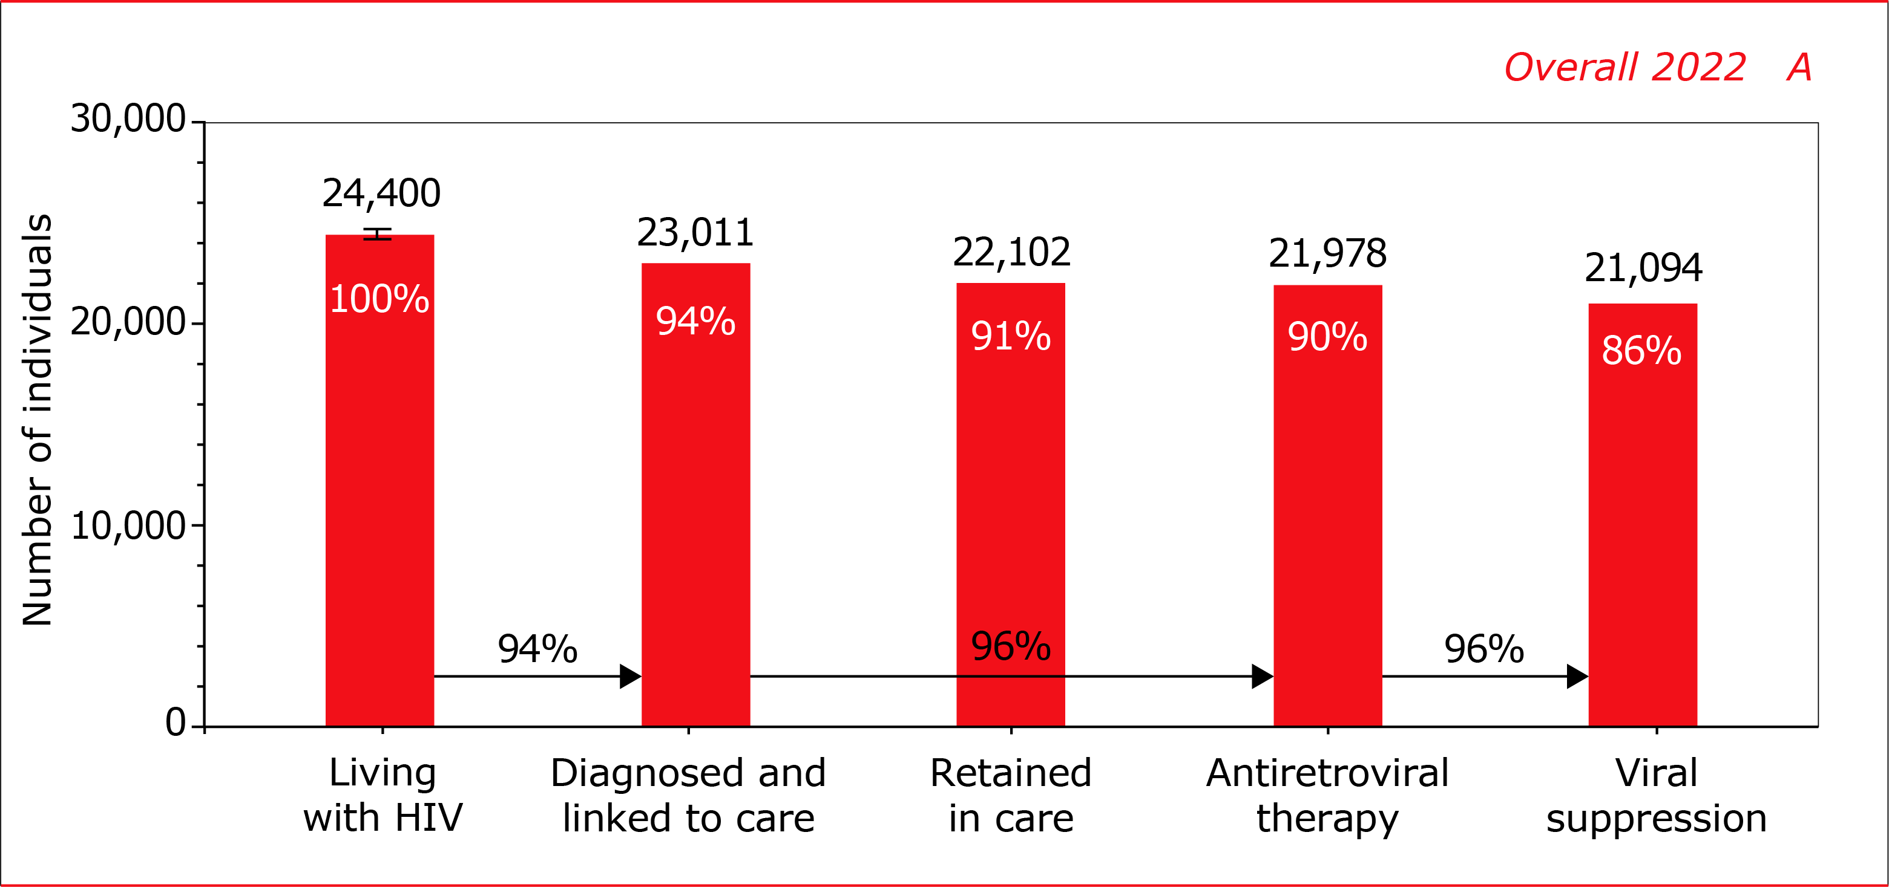
Introduction
14% potentially has a detectable HIV-RNA= 3,311 individuals
What are the circumstances of these individuals?
Can this information be translated into actionable insights?

Slide 3
What does CBS add?
Only some information on socio-demographic factors
Limited information on people with lagging progression through the HIV care continuum
No information on people who disengage from HIV care
Socio-economic and detailed demographic factors
Data on health care consumption

Slide 4
Methods
All data of individuals with HIV registered by SHM were combined with data from Statistics Netherlands
Combined using date of birth, gender, 4 numbers of postal code
Data used until 31 December 2021

Slide 5
Methods
Income
Financial assistance
Education
Employment
Migration
Household
Medication use
(Mental) health care

Slide 6
Results
In 2021, 22,672 individuals ever registered with SHM
310 (1%) had migrated or died by 2021, according to CBS
Data of 20,996 individuals (94%) could be combined
Data of 3,846 individuals new in care from 2015 onwards
Results based on calculations by SHM using non-public microdata from Statistics Netherlands

Slide 7
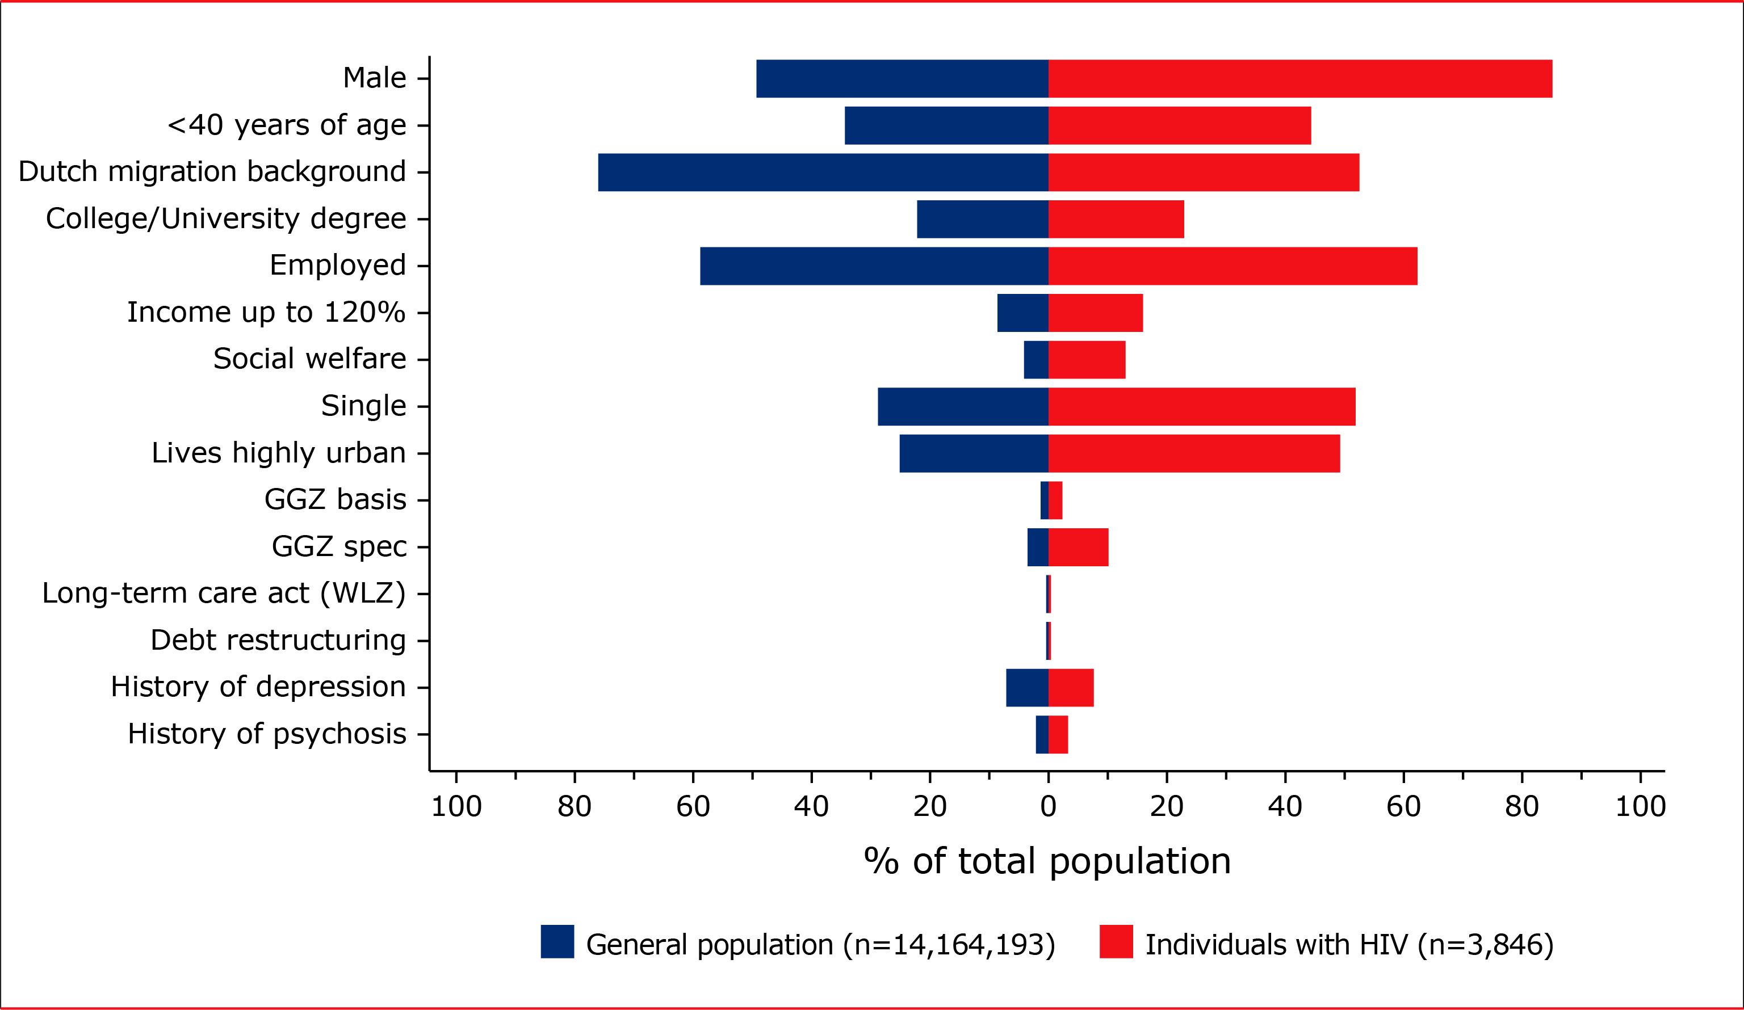
Description of the population
Compared to the general Dutch population, individuals linked to care were more often:
Younger
Male
From single-person households
Living in highly urban areas
Lowest income level
Receiving social welfare
Results based on calculations by SHM using non-public microdata from Statistics Netherlands

Slide 8
Men who have sex with men
Results based on calculations by SHM using non-public microdata from Statistics Netherlands

Slide 9
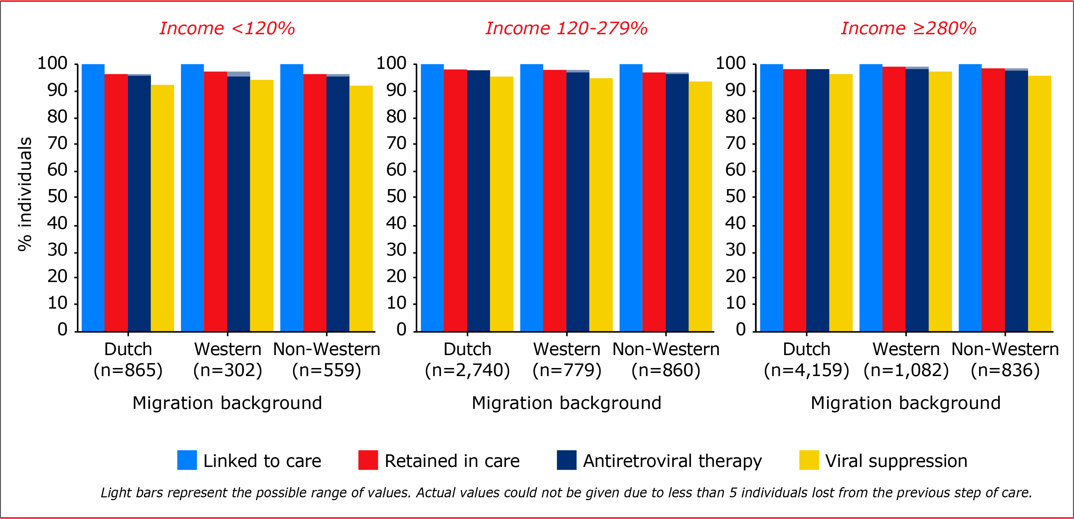
HIV care continuum – Migration & income
Results based on calculations by SHM using non-public microdata from Statistics Netherlands

Slide 10
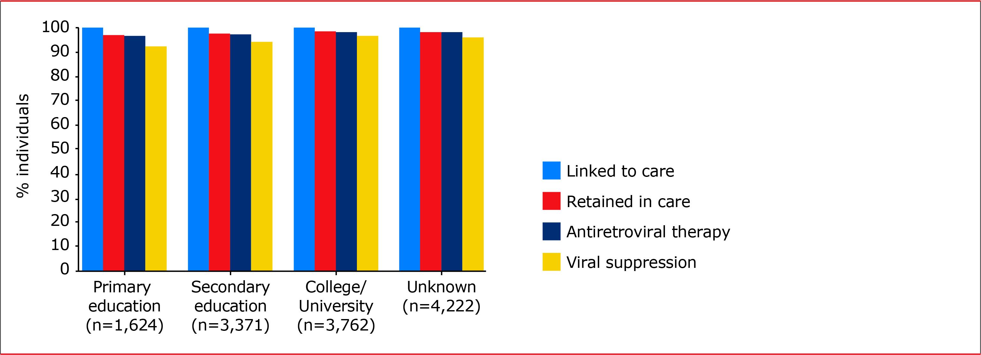
HIV care continuum – Education
Results based on calculations by SHM using non-public microdata from Statistics Netherlands

Slide 11
New HIV diagnoses
2,904 new HIV diagnoses
37% recent infection (HIV acquisition in previous 12 months)
11% late-stage diagnosis (CD4 200-350 cells/mm³)
19% advanced HIV disease (CD4<200 cells/mm³/ AIDS defining event)
28% other/chronic HIV (CD4>350 cells/mm³)
5% unclassified stage
Results based on calculations by SHM using non-public microdata from Statistics Netherlands

Slide 12
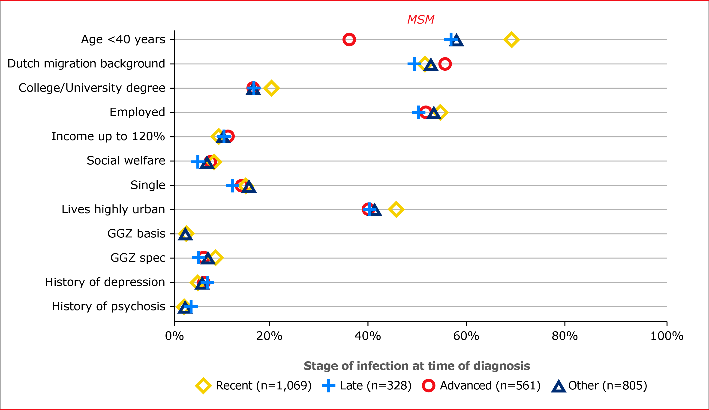
New HIV diagnoses
2,904 new HIV diagnoses
37% recent infection
11% late-stage diagnosis
19% advanced HIV disease
28% other/chronic HIV
5% unclassified stage
Results based on calculations by SHM using non-public microdata from Statistics Netherlands

Slide 13
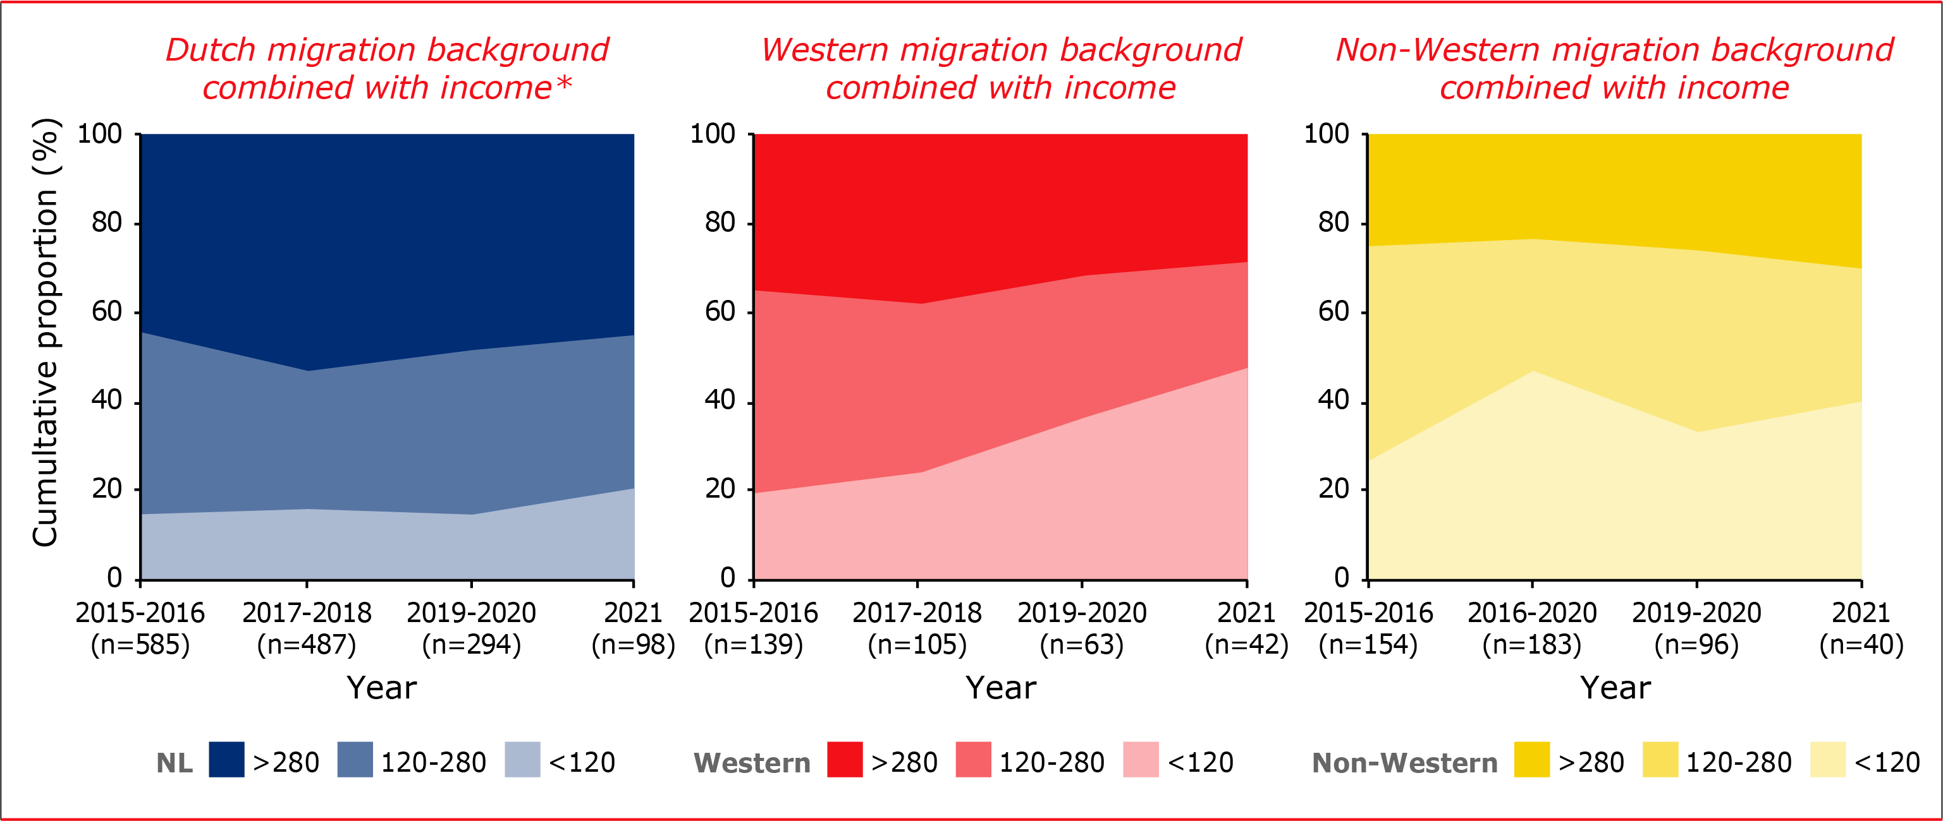
New HIV diagnoses
* Sum of new diagnoses do not add up to the total new HIV diagnoses among MSM. To provide an approximation of the percentage, data involving fewer than ten people were kept at ten people.
Results based on calculations by SHM using non-public microdata from Statistics Netherlands

Slide 14
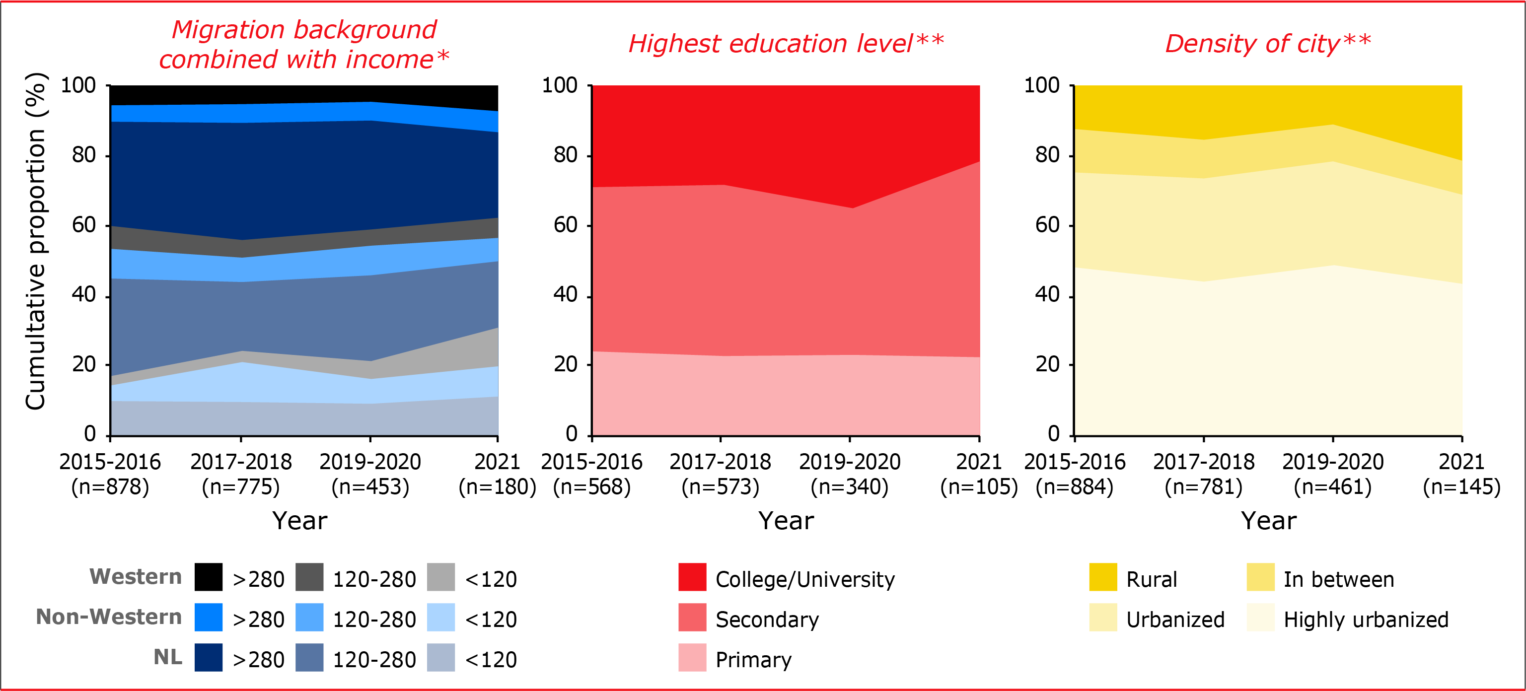
New HIV diagnoses
** Sum of new diagnoses do not add up to the total new HIV diagnoses among MSM due to missing data.
Results based on calculations by SHM using non-public microdata from Statistics Netherlands

Slide 15
Other men and women
Results based on calculations by SHM using non-public microdata from Statistics Netherlands

Slide 16
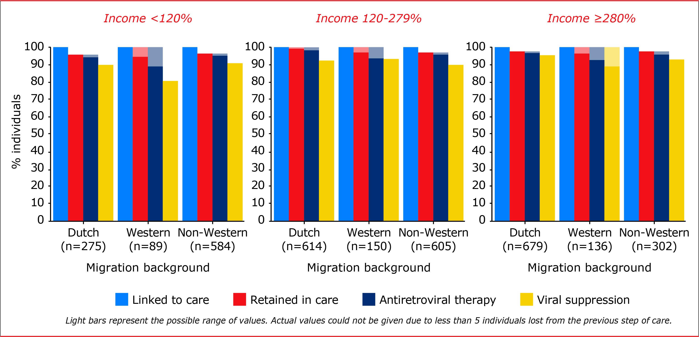
HIV care continuum – Migration & income (other men)
Results based on calculations by SHM using non-public microdata from Statistics Netherlands

Slide 17
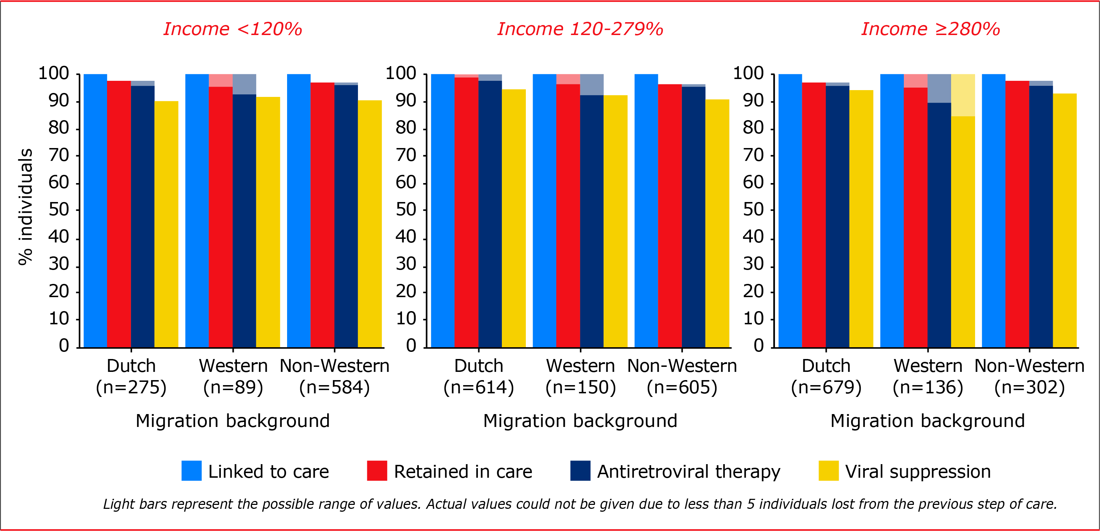
HIV care continuum – Migration & income (women)
Results based on calculations by SHM using non-public microdata from Statistics Netherlands

Slide 18
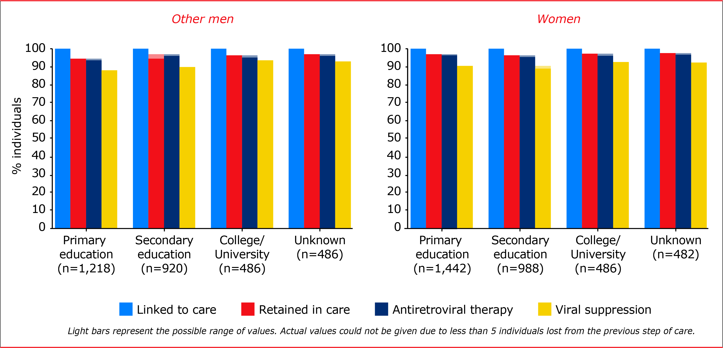
HIV care continuum – Education
Results based on calculations by SHM using non-public microdata from Statistics Netherlands

Slide 19
Conclusion
Visible differences and gaps
(more information in Chapter 1.2 of Monitoring Report)
BUT
More work needed to pinpoint factors associated affecting (sub)optimal progression through the HIV care continuum
Results based on calculations by SHM using non-public microdata from Statistics Netherlands

Slide 20
Acknowledgements
All ATHENA cohort participants
SHM:
Marc van der Valk
Anders Boyd
Sacha Boucherie
Ard van Sighem
Colette Smit
Ferdinand Wit
Daniela Bezemer
AHTI:
Rosan van Zoest
Mark Verhagen

Slide 21
Acknowledgements
Amsterdam UMC, AMC site, Amsterdam: HIV treating physicians: M. van der Valk*, M.A. van Agtmael, M. Bomers, S.E. Geerlings, A. Goorhuis, V.C. Harris, J.W. Hovius, B. Lemkes, F.J.B. Nellen, E.J.G. Peters, T. van der Poll, J.M. Prins, K.C.E. Sigaloff, V. Spoorenberg, M. van Vugt, W.J. Wiersinga, F.W.M.N. Wit. HIV nurse consultants: H. Berends, C. Bruins, J. van Eden, I.J. Hylkema-van den Bout, L.M. Laan, F.J.J. Pijnappel, S.Y. Smalhout, M.E. Spelbrink, A.M. Weijsenfeld. HIV clinical virologists/chemists: N.K.T. Back, M.T.E. Cornelissen, R. van Houdt, M. Jonges, S. Jurriaans, C.J. Schinkel, M.R.A. Welkers, K.C. Wolthers. Admiraal De Ruyter Ziekenhuis, Goes: HIV treating physicians: M. van den Berge*, A. Stegeman. HIV nurse consultants: S. Baas, L. Hage de Looff. HIV clinical virologists/chemists: A. van Arkel, J. Stohr, B. Wintermans. Catharina Ziekenhuis, Eindhoven: HIV treating physicians: M.J.H. Pronk*, H.S.M. Ammerlaan, C. de Bree. HIV nurse consultants: E.S. de Munnik, S. Phaf. HIV clinical virologists/chemists: B. Deiman, A.R. Jansz, V. Scharnhorst, J. Tjhie, M.C.A. Wegdam. DC Klinieken Lairesse – Hiv Focus Centrum, Amsterdam: HIV treating physicians: J. Nellen*, A. van Eeden, E. Hoornenborg, S de Stoppelaar. HIV nurse consultants: W. Alers, L.J.M. Elsenburg, H. Nobel. HIV clinical virologists/chemists:C.J. Schinkel.ETZ (Elisabeth-TweeSteden Ziekenhuis), Tilburg: HIV treating physicians: M.E.E. van Kasteren*, M.A.H. Berrevoets, A.E. Brouwer. HIV nurse specialist: B.A.F.M. de Kruijf-van de Wiel. HIV nurse consultants: A. Adams, M. Pawels-van Rijkevoorsel. HIV data collection: B.A.F.M. de Kruijf-van de Wiel. HIV clinical virologists/chemists: A.G.M. Buiting, J.L. Murck. Erasmus MC, Rotterdam: HIV treating physicians: C. Rokx*, A.A. Anas, H.I. Bax, E.C.M. van Gorp, M. de Mendonça Melo, E. van Nood, J.L. Nouwen, B.J.A. Rijnders, C.A.M. Schurink, L. Slobbe, T.E.M.S. de Vries-Sluijs. HIV nurse consultants: N. Bassant, J.E.A. van Beek, M. Vriesde, L.M. van Zonneveld. HIV data collection: J. de Groot. HIV clinical virologists/chemists: J.J.A. van Kampen, M.P.G Koopmans, J.C. Rahamat-Langendoen. Flevoziekenhuis, Almere: HIV treating physicians: J. Branger*, R.A. Douma. HIV nurse consultant: A.S. Cents-Bosma, M.A. Mulder. HagaZiekenhuis, Den Haag: HIV treating physicians: E.F. Schippers*, C. van Nieuwkoop. HIV nurse consultants: J. Geilings, E. van de Ven. HIV data collection: G. van der Hut. HIV clinical virologists/chemists: N.D. van Burgel. HMC (Haaglanden Medisch Centrum), Den Haag: HIV treating physicians: E.M.S. Leyten*, L.B.S. Gelinck, F. Mollema. HIV nurse consultants: M. Langbein, G.S. Wildenbeest. HIV clinical virologists/chemists: T. Nguyen. Isala, Zwolle: HIV treating physicians: P.H.P. Groeneveld*, J.W. Bouwhuis, A.J.J. Lammers. HIV nurse consultants: A.G.W. van Hulzen, S. Kraan, M.S.M. Kruiper. HIV clinical virologists/chemists: S.B. Debast, G.H.J. Wagenvoort. Leids Universitair Medisch Centrum, Leiden: HIV treating physicians: A.H.E. Roukens*, M.G.J. de Boer, H. Jolink, M.M.C. Lambregts, H. Scheper.HIV nurse consultants: N. van Holten, D. van der Sluis. HIV clinical virologists/chemists: E.C.J. Claas, E. Wessels.Maasstad Ziekenhuis, Rotterdam: HIV treating physicians: J.G. den Hollander*, R. El Moussaoui, K. Pogany. HIV nurse consultants: C.J. Brouwer, D. Heida-Peters, E. Mulder, J.V. Smit, D. Struik-Kalkman. HIV data collection: T. van Niekerk. HIV clinical virologists/chemists: O. Pontesilli, C. van Tienen. Maastricht UMC+, Maastricht: HIV treating physicians: S.H. Lowe*, A.M.L. Oude Lashof, D. Posthouwer, A. Stoop, M.E. van Wolfswinkel. HIV nurse consultants: R.P. Ackens, M. Elasri, K. Houben-Pintaric, J. Schippers. HIV clinical virologists/chemists: T.R.A. Havenith, M. van Loo. Medisch Centrum Leeuwarden, Leeuwarden: HIV treating physicians: M.G.A. van Vonderen*, L.M. Kampschreur, C. Timmer. HIV nurse consultants: M.C. van Broekhuizen, S. Faber HIV clinical virologists/chemists: A. Al Moujahid. Medisch Spectrum Twente, Enschede: HIV treating physicians: G.J. Kootstra*, C.E. Delsing. HIV nurse consultants: M. van der Burg-van de Plas, L. Scheiberlich. Noordwest Ziekenhuisgroep, Alkmaar: HIV treating physicians: W. Kortmann*, G. van Twillert*, R. Renckens, J. Wagenaar. HIV nurse consultants & HIV data collection: D. Ruiter-Pronk, B. Stander. HIV clinical virologists/chemists: J.W.T. Cohen Stuart, M. Hoogewerf, W. Rozemeijer, J.C. Sinnige. OLVG, Amsterdam: HIV treating physicians: K. Brinkman*, G.E.L. van den Berk, K.D. Lettinga, M. de Regt, W.E.M. Schouten, J.E. Stalenhoef, S.M.E. Vrouenraets. HIV nurse consultants: H. Blaauw, G.F. Geerders, M.J. Kleene, M. Knapen, M. Kok, I.B. van der Meché, A.J.M. Toonen, S. Wijnands, E. Wttewaal. HIV clinical virologists: D. Kwa, T.J.W. van de Laar. Radboudumc, Nijmegen: HIV treating physicians: R. van Crevel*, K. van Aerde, A.S.M. Dofferhoff, S.S.V. Henriet, H.J.M. ter Hofstede, J. Hoogerwerf, O. Richel. HIV nurse consultants: M. Albers, K.J.T. Grintjes-Huisman, M. de Haan, M. Marneef. HIV clinical virologists/chemists: M. McCall, J. Rahamat-Langendoen, E. Ruizendaal. HIV clinical pharmacology consultant: D. Burger. Rijnstate, Arnhem: HIV treating physicians: E.H. Gisolf*, M. Claassen, R.J. Hassing,. HIV nurse consultants: G. ter Beest, P.H.M. van Bentum, Y. Neijland, M. Valette. HIV clinical virologists/chemists: C.M.A. Swanink, M. Klein Velderman. Spaarne Gasthuis, Haarlem: HIV treating physicians: S.F.L. van Lelyveld*, R. Soetekouw. HIV nurse consultants: L.M.M. van der Prijt, J. van der Swaluw. HIV clinical virologists/chemists: J.S. Kalpoe, A. Wagemakers, A. Vahidnia. Medisch Centrum Jan van Goyen, Amsterdam: HIV treating physicians: F.N. Lauw, D.W.M. Verhagen. HIV nurse consultants: M. van Wijk. Universitair Medisch Centrum Groningen, Groningen: HIV treating physicians: W.F.W. Bierman*, M. Bakker, R.A. van Bentum, M.A. van den Boomgaard, J. Kleinnijenhuis, E. Kloeze, A. Middel, D.F. Postma, H.M. Schenk, Y. Stienstra, M. Wouthuyzen-Bakker. HIV nurse consultants: A. Boonstra, M.M.M. Maerman, D.A. de Weerd. HIV clinical virologists/chemists: K.J. van Eije, M. Knoester, C.C. van Leer-Buter, H.G.M. Niesters. Universitair Medisch Centrum Utrecht, Utrecht: HIV treating physicians: T.Mudrikova*, R.E. Barth, A.H.W. Bruns, P.M. Ellerbroek, M.P.M. Hensgens, J.J. Oosterheert, E.M. Schadd, A. Verbon, B.J. van Welzen. HIV nurse consultants: B.M.G. Griffioen-van Santen, I. de Kroon. HIV clinical virologists/chemists: R. Schuurman, F.M. Verduyn Lunel, A.M.J. Wensing.
Coordinating center Board of directors: M. van der Valk, S. Zaheri. HIV data analysis: A.C. Boyd, D.O. Bezemer, V.W. Jongen, A.I. van Sighem, C. Smit, F.W.M.N. Wit Data HIV data management and quality control: M.M.J. Hillebregt, T.J. Woudstra, T. Rutkens HIV data monitoring: D. Bergsma, N.M. Brétin, L.E. Koster, K.J. Lelivelt, L. van de Sande, M.J.C. Schoorl, K.M. Visser, S.T. van der Vliet HIV data collection: F. Paling, M. van den Akker, O.M. Akpomukai, R. Alexander, Y.M. Bakker, L. Bastos Sales, A. El Berkaoui, M. Bezemer-Goedhart, E.A. Djoechro, J.M. Grolleman, I. El Hammoud, M.R. Khouw, C.R.E. Lodewijk, E.G.A. Lucas, S. van Meerveld-Derks, H.W. Mulder, L. Munjishvili, C.M.J. Ree, R. Regtop, A.F. van Rijk, Y.M.C. Ruijs-Tiggelman, P.P. Schnörr, R. van Veen, W.H.G. van Vliet-Klein Gunnewiek, E.C.M Witte. Patiënt registration: D. Bergsma, N.M. Brétin, Y.M.C. Ruijs-Tiggelman.

