Slide 1
SHM 2023 Monitoring Report
16th Netherlands Conference on HIV Pathogenesis, Epidemiology, Prevention and Treatment
28 November 2023
Speakers
Ard van Sighem
Vita Jongen
Rosan van Zoest

Slide 2
A special thank you to…
SHM Co-authors
Ard van Sighem Daniela Bezemer Judith Branger
Ferdinand Wit Sacha Boucherie Kees Brinkman
Colette Smit Yunka de Waart Mark Claassen
Anders Boyd Wim Don Suzanne Geerlings
Vita Jongen Mireille Koenen Liesbeth van Leeuwen
Marc van der Valk Sima Zaheri Tania Mudrikova
Jeannine Nellen
ACS Curaçao Kees van Nieuwkoop
Jeffrey Koole Diederik van de Wetering Eline Op de Coul
Sonia Boender Esther Rooijakkers Bart Rijnders
Neeltje Kootstra Gonneke Hermanides Casper Rokx
Lia van der Hoek Marije Hofstra Annemarie van Rossum
Maria Prins Ashley Duits Mark Verhagen
Janneke Heijne Berend van Welzen
Anne Wensing
Tom Wolfs
Rosan van Zoest
Notes:
First of all, we would like to give a special thanks to the people listed on this slide for their contribution to this year’s HIV Monitoring Report, including our colleagues at SHM and all external experts who were involved in writing of the report.

Slide 3
Acknowledgements
Clinical centres: Amsterdam UMC, AMC site, Amsterdam: HIV treating physicians: M. van der Valk, M.A. van Agtmael, M. Bomers, S.E. Geerlings, A. Goorhuis, V.C. Harris, J.W. Hovius, B. Lemkes, F.J.B. Nellen, E.J.G. Peters, T. van der Poll, J.M. Prins, K.C.E. Sigaloff, V. Spoorenberg, M. van Vugt, W.J. Wiersinga, F.W.M.N. Wit. HIV nurse consultants: H. Berends, C. Bruins, J. van Eden, I.J. Hylkema-van den Bout, L.M. Laan, F.J.J. Pijnappel, S.Y. Smalhout, M.E. Spelbrink, A.M. Weijsenfeld. HIV clinical virologists/chemists: N.K.T. Back, M.T.E. Cornelissen, R. van Houdt, M. Jonges, S. Jurriaans, C.J. Schinkel, M.R.A. Welkers, K.C. Wolthers. Emma Kinderziekenhuis (Amsterdam UMC, AMC site), Amsterdam: HIV treating physicians: M. van der Kuip, D. Pajkrt. HIV nurse consultants: F.M. Hessing, A.M. Weijsenfeld. Admiraal De Ruyter Ziekenhuis, Goes: HIV treating physicians: M. van den Berge, A. Stegeman. HIV nurse consultants: S. Baas, L. Hage de Looff. HIV clinical virologists/chemists: A. van Arkel, J. Stohr, B. Wintermans. Catharina Ziekenhuis, Eindhoven: HIV treating physicians: M.J.H. Pronk, H.S.M. Ammerlaan, C. de Bree. HIV nurse consultants: E.S. de Munnik, S. Phaf. HIV clinical virologists/chemists: B. Deiman, A.R. Jansz, V. Scharnhorst, J. Tjhie, M.C.A. Wegdam. DC Klinieken Lairesse – Hiv Focus Centrum, Amsterdam: HIV treating physicians: J. Nellen, A. van Eeden, E. Hoornenborg, S de Stoppelaar. HIV nurse consultants: W. Alers, L.J.M. Elsenburg, H. Nobel. HIV clinical virologists/chemists: C.J. Schinkel. ETZ (Elisabeth-TweeSteden Ziekenhuis), Tilburg: HIV treating physicians: M.E.E. van Kasteren, M.A.H. Berrevoets, A.E. Brouwer. HIV nurse specialist: B.A.F.M. de Kruijf-van de Wiel. HIV nurse consultants: A. Adams, M. Pawels-van Rijkevoorsel. HIV data collection: B.A.F.M. de Kruijf-van de Wiel. HIV clinical virologists/chemists: A.G.M. Buiting, J.L. Murck. Erasmus MC, Rotterdam: HIV treating physicians: C. Rokx, A.A. Anas, H.I. Bax, E.C.M. van Gorp, M. de Mendonça Melo, E. van Nood, J.L. Nouwen, B.J.A. Rijnders, C.A.M. Schurink, L. Slobbe, T.E.M.S. de Vries-Sluijs. HIV nurse consultants: N. Bassant, J.E.A. van Beek, M. Vriesde, L.M. van Zonneveld. HIV data collection: J. de Groot. HIV clinical virologists/chemists: J.J.A. van Kampen, M.P.G Koopmans, J.C. Rahamat-Langendoen. Erasmus MC Sophia Kinderziekenhuis, Rotterdam: HIV treating physicians: P.L.A. Fraaij, A.M.C. van Rossum, C.L. Vermont. HIV nurse consultants: L.C. van der Knaap. Flevoziekenhuis, Almere: HIV treating physicians: J. Branger, R.A. Douma. HIV nurse consultant: A.S. Cents-Bosma, M.A. Mulder. HagaZiekenhuis, Den Haag: HIV treating physicians: E.F. Schippers, C. van Nieuwkoop. HIV nurse consultants: J. Geilings, E. van de Ven. HIV data collection: G. van der Hut. HIV clinical virologists/chemists: N.D. van Burgel. HMC (Haaglanden Medisch Centrum), Den Haag: HIV treating physicians: E.M.S. Leyten, L.B.S. Gelinck, F. Mollema. HIV nurse consultants: M. Langbein, G.S. Wildenbeest. HIV clinical virologists/chemists: T. Nguyen. Isala, Zwolle: HIV treating physicians: P.H.P. Groeneveld, J.W. Bouwhuis, A.J.J. Lammers. HIV nurse consultants: A.G.W. van Hulzen, S. Kraan, M.S.M. Kruiper. HIV clinical virologists/chemists: S.B. Debast, G.H.J. Wagenvoort. Leids Universitair Medisch Centrum, Leiden: HIV treating physicians: A.H.E. Roukens, M.G.J. de Boer, H. Jolink, M.M.C. Lambregts, H. Scheper. HIV nurse consultants: N. van Holten, D. van der Sluis. HIV clinical virologists/chemists: E.C.J. Claas, E. Wessels. Maasstad Ziekenhuis, Rotterdam: HIV treating physicians: J.G. den Hollander, R. El Moussaoui, K. Pogany. HIV nurse consultants: C.J. Brouwer, D. Heida-Peters, E. Mulder, J.V. Smit, D. Struik-Kalkman. HIV data collection: T. van Niekerk. HIV clinical virologists/chemists: O. Pontesilli, C. van Tienen. Maastricht UMC+, Maastricht: HIV treating physicians: S.H. Lowe, A.M.L. Oude Lashof, D. Posthouwer, A. Stoop, M.E. van Wolfswinkel. HIV nurse consultants: R.P. Ackens, M. Elasri, K. Houben-Pintaric, J. Schippers. HIV clinical virologists/chemists: T.R.A. Havenith, M. van Loo. Medisch Centrum Leeuwarden, Leeuwarden: HIV treating physicians: M.G.A. van Vonderen, L.M. Kampschreur, C. Timmer. HIV nurse consultants: M.C. van Broekhuizen, S. Faber HIV clinical virologists/chemists: A. Al Moujahid. Medisch Spectrum Twente, Enschede: HIV treating physicians: G.J. Kootstra, C.E. Delsing. HIV nurse consultants: M. van der Burg-van de Plas, L. Scheiberlich. Noordwest Ziekenhuisgroep, Alkmaar: HIV treating physicians: W. Kortmann, G. van Twillert, R. Renckens, J. Wagenaar. HIV nurse consultants & HIV data collection: D. Ruiter-Pronk, B. Stander. HIV clinical virologists/chemists: J.W.T. Cohen Stuart, M. Hoogewerf, W. Rozemeijer, J.C. Sinnige. OLVG, Amsterdam: HIV treating physicians: K. Brinkman, G.E.L. van den Berk, K.D. Lettinga, M. de Regt, W.E.M. Schouten, J.E. Stalenhoef, S.M.E. Vrouenraets. HIV nurse consultants: H. Blaauw, G.F. Geerders, M.J. Kleene, M. Knapen, M. Kok, I.B. van der Meché, A.J.M. Toonen, S. Wijnands, E. Wttewaal. HIV clinical virologists: D. Kwa, T.J.W. van de Laar. Radboudumc, Nijmegen: HIV treating physicians: R. van Crevel, K. van Aerde, A.S.M. Dofferhoff, S.S.V. Henriet, H.J.M. ter Hofstede, J. Hoogerwerf, O. Richel. HIV nurse consultants: M. Albers, K.J.T. Grintjes-Huisman, M. de Haan, M. Marneef. HIV clinical virologists/chemists: M. McCall, J. Rahamat-Langendoen, E. Ruizendaal. HIV clinical pharmacology consultant: D. Burger. Rijnstate, Arnhem: HIV treating physicians: E.H. Gisolf, M. Claassen, R.J. Hassing. HIV nurse consultants: G. ter Beest, P.H.M. van Bentum, Y. Neijland, M. Valette. HIV clinical virologists/chemists: C.M.A. Swanink, M. Klein Velderman. Spaarne Gasthuis, Haarlem: HIV treating physicians: S.F.L. van Lelyveld, R. Soetekouw. HIV nurse consultants: L.M.M. van der Prijt, J. van der Swaluw. HIV clinical virologists/chemists: J.S. Kalpoe, A. Wagemakers, A. Vahidnia. Medisch Centrum Jan van Goyen, Amsterdam: HIV treating physicians: F.N. Lauw, D.W.M. Verhagen. HIV nurse consultants: M. van Wijk. Universitair Medisch Centrum Groningen, Groningen: HIV treating physicians: W.F.W. Bierman, M. Bakker, R.A. van Bentum, M.A. van den Boomgaard, J. Kleinnijenhuis, E. Kloeze, A. Middel, D.F. Postma, H.M. Schenk, Y. Stienstra, M. Wouthuyzen-Bakker. HIV nurse consultants: A. Boonstra, M.M.M. Maerman, D.A. de Weerd. HIV clinical virologists/chemists: K.J. van Eije, M. Knoester, C.C. van Leer-Buter, H.G.M. Niesters. Beatrix Kinderziekenhuis (Universitair Medisch Centrum Groningen), Groningen: HIV treating physicians: B.R. Brandsema, E.H. Schölvinck, A.R. Verhage. HIV nurse consultants: N. van der Woude. HIV clinical virologists/chemists: M. Knoester, C.C. van Leer-Buter, H.G.M. Niesters. Universitair Medisch Centrum Utrecht, Utrecht: HIV treating physicians: T.Mudrikova, R.E. Barth, A.H.W. Bruns, P.M. Ellerbroek, M.P.M. Hensgens, J.J. Oosterheert, E.M. Schadd, A. Verbon, B.J. van Welzen. HIV nurse consultants: B.M.G. Griffioen-van Santen, I. de Kroon. HIV clinical virologists/chemists: R. Schuurman, F.M. Verduyn Lunel, A.M.J. Wensing. Wilhelmina Kinderziekenhuis, UMC Utrecht, Utrecht: HIV treating physicians: Y.G.T. Loeffen, T.F.W. Wolfs. HIV nurse consultants: M. Kok. HIV clinical virologists/chemists: F.M. Verduyn Lunel, A.M.J. Wensing. Curaçao Medical Center, Willemstad (Curaçao): HIV treating physicians: E.O.W. Rooijakkers, D. van de Wetering. HIV nurse consultants: A. Alberto. Data collection: I. der Meer.
COORDINATING CENTRE: Board of directors: M. van der Valk, S. Zaheri. HIV data analysis: A.C. Boyd, D.O. Bezemer, V.W. Jongen, A.I. van Sighem, C. Smit, F.W.M.N. Wit. Data HIV data management and quality control: M.M.J. Hillebregt, T.J. Woudstra, T. Rutkens. HIV data monitoring: D. Bergsma, N.M. Brétin, L.E. Koster, K.J. Lelivelt, L. van de Sande, M.J.C. Schoorl, K.M. Visser, S.T. van der Vliet. HIV data collection: F. Paling, M. van den Akker, O.M. Akpomukai, R. Alexander, Y.M. Bakker, L. Bastos Sales, A. El Berkaoui, M. Bezemer-Goedhart, E.A. Djoechro, J.M. Grolleman, I. El Hammoud, M.R. Khouw, C.R.E. Lodewijk, E.G.A. Lucas, S. van Meerveld-Derks, H.W. Mulder, L. Munjishvili, C.M.J. Ree, R. Regtop, A.F. van Rijk, Y.M.C. Ruijs-Tiggelman, P.P. Schnörr, R. van Veen, W.H.G. van Vliet-Klein Gunnewiek, E.C.M Witte. Patient registration: D. Bergsma, N.M. Brétin, Y.M.C. Ruijs-Tiggelman.
All people with HIV who allow us to collect and analyse their data
Notes:
Of course, the Monitoring Report wouldn’t be there without the efforts of all health care professionals in the HIV treatment centres across the country.
Finally, we would like to thank all people living with HIV for their trust and allowing us to collect and analyse their data.

Slide 4
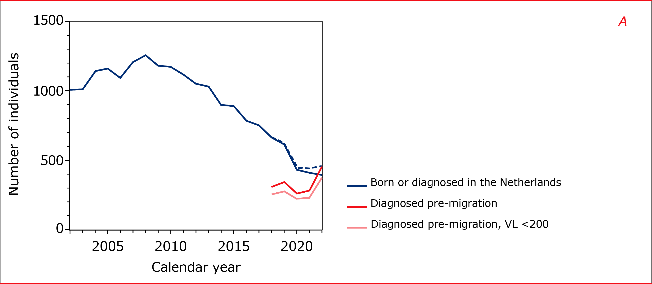
Decreasing trend in annual number of new HIV diagnoses appears to be levelling off in 2022
2022
2021
393
410
454
280
NB: information on diagnosis abroad and date of arrival has been part of SHM data collection since early 2018.
Notes:
Coming now to some key results of our latest monitoring report, we see that the decreasing trend in the annual number of newly-diagnosed HIV infections has continued in 2022 but also appears to be levelling off.
In 2022, there were 393 newly-diagnosed HIV infections compared to 410 in 2021.
On top of that, there were 454 people born abroad who moved to the Netherlands in 2022 with a documented HIV diagnosis before arriving in the country.

Slide 5
Decreasing trend in annual number of new HIV diagnoses appears to be levelling off in 2022
2022
2021
393
410
454
280
Ukraine | 187 | 41%
Russian Federation | 33 | 7%
NB: information on diagnosis abroad and date of arrival has been part of SHM data collection since early 2018.
Notes:
Among these 454 migrants, 187, or 41%, originated from Ukraine, while 33, or 7%, were from the Russian Federation.

Slide 6
Decreasing trend in annual number of new HIV diagnoses appears to be levelling off in 2022
2022
2021
393
410
454
280
Ukraine | 187 | 41%
Russian Federation | 33 | 7%
85% with RNA <200 copies/ml
NB: information on diagnosis abroad and date of arrival has been part of SHM data collection since early 2018.
Notes:
85% of the migrants already had a suppressed viral load when they first presented for HIV care after arriving in the Netherlands.

Slide 7
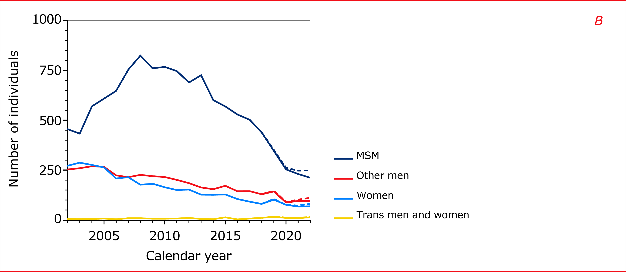
Decreasing trend in annual number of new HIV diagnoses appears to be levelling off in 2022
393
213
54%
96
24%
70
18%
14
4%
Notes:
Among the 393 new HIV diagnoses in 2022, the majority, 54%, were in MSM, while 24% were in other men, 18% in women, and 4% in transgender men and women.

Slide 8
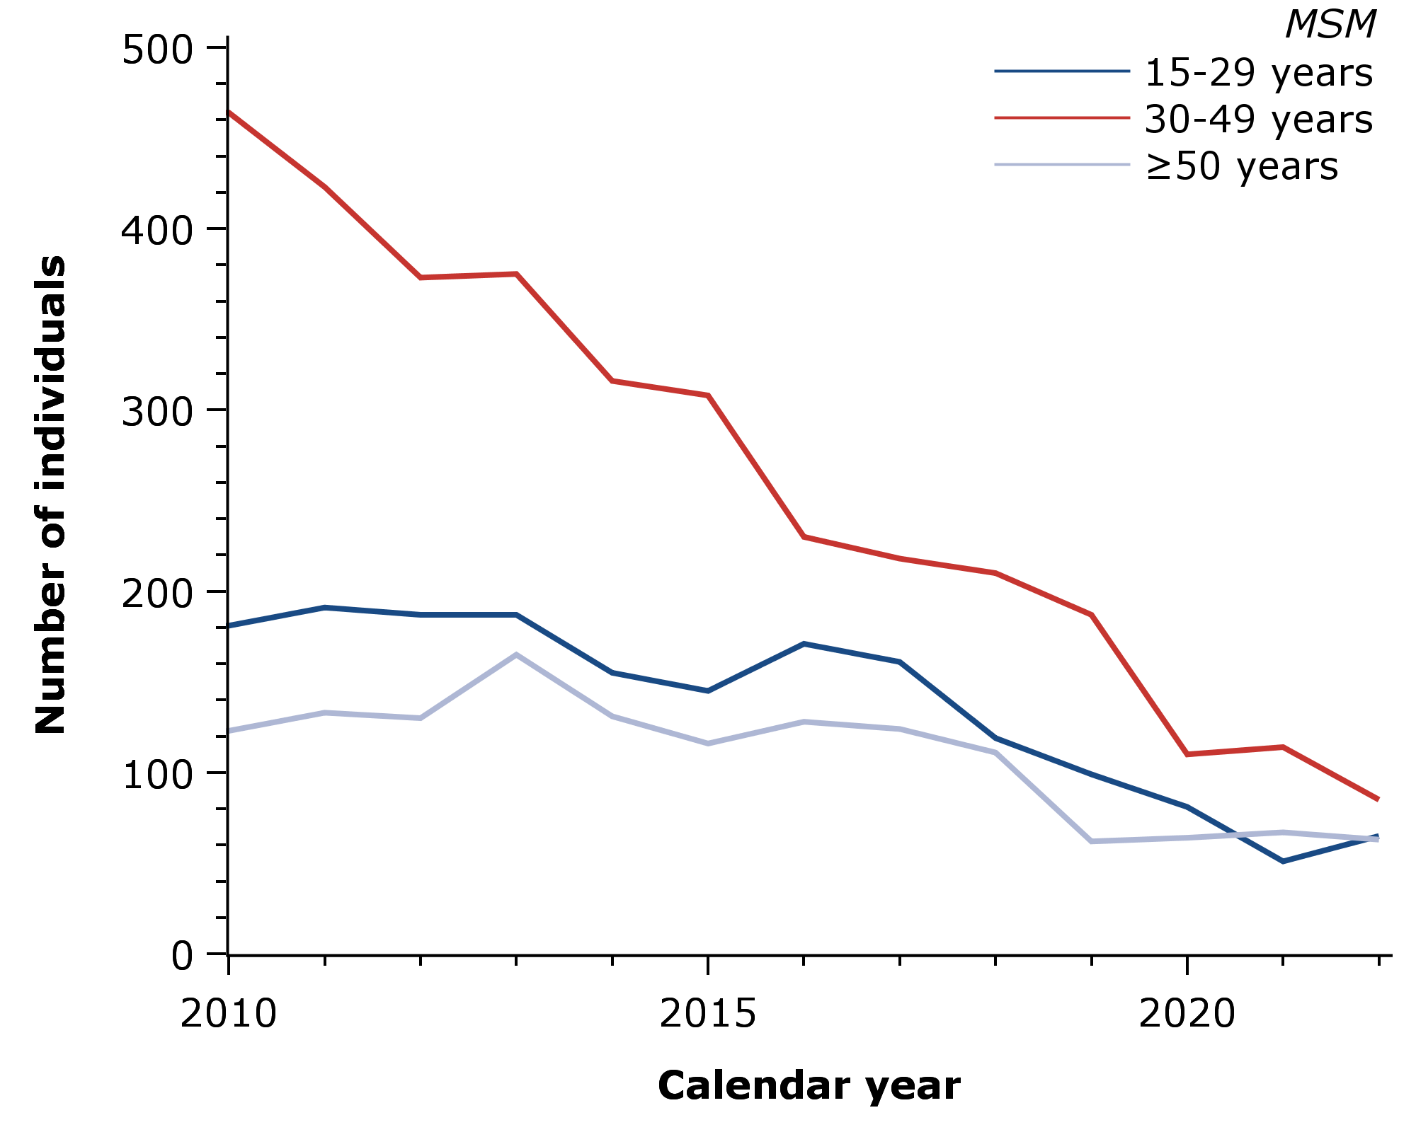
Decrease in new HIV diagnoses among MSM strongest in 30-49 years old
“This could signal that younger and older men who have sex with men are less aware of the various ways to prevent HIV, or that they find preventative measures more difficult to access than men aged 30 to 50 years old”
-82%
-64%
-49%
Notes:
Among men who have sex with men, the steepest decrease in the annual number of new HIV diagnoses was seen in men between 30 and 50 years of age.
In 2010, there were 464 diagnoses, and by 2022 the number had decreased by 82% to 85.
The decrease in number of new diagnoses was less pronounced in MSM below 30 years of age (64%) and MSM 50 years of age or older (49%).
We think this may signal that younger and older MSM are less aware of the various ways to prevent HIV, or that they find preventative measures more difficult to access than men between 30 and 50 years of age.

Slide 9
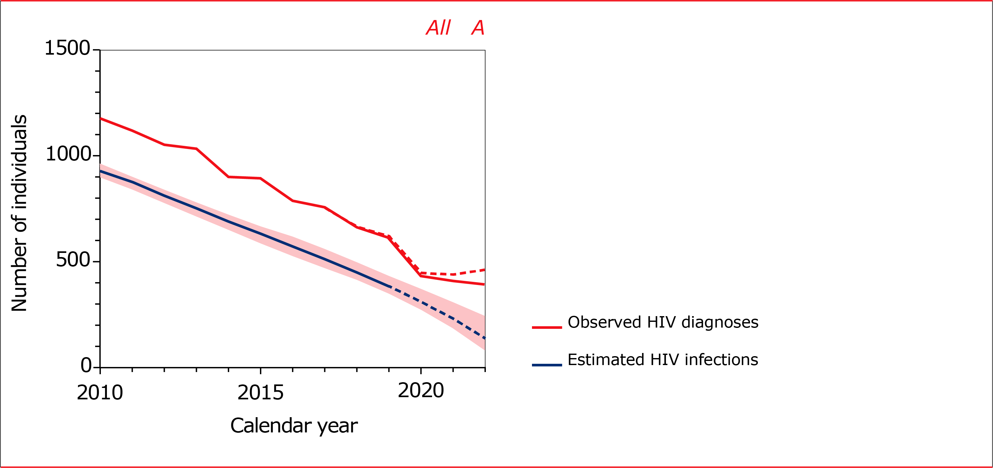
Decline in newly-acquired HIV infections continued in 2022
2010
2022
930
(890 – 960)
140
(80 – 240)
-85%
(73 – 91)
End of 2022
24,400
?
1,390
Notes:
Meanwhile, the estimated number of newly-acquired HIV infections decreased from 930 in 2010 to 140 in 2022, which is a decrease of 85%, albeit with quite a large uncertainty around the estimates.
Overall, by the end of 2022 we estimate that there were 24,400 people with HIV in the Netherlands, of whom 1,390 remained undiagnosed.

Slide 10
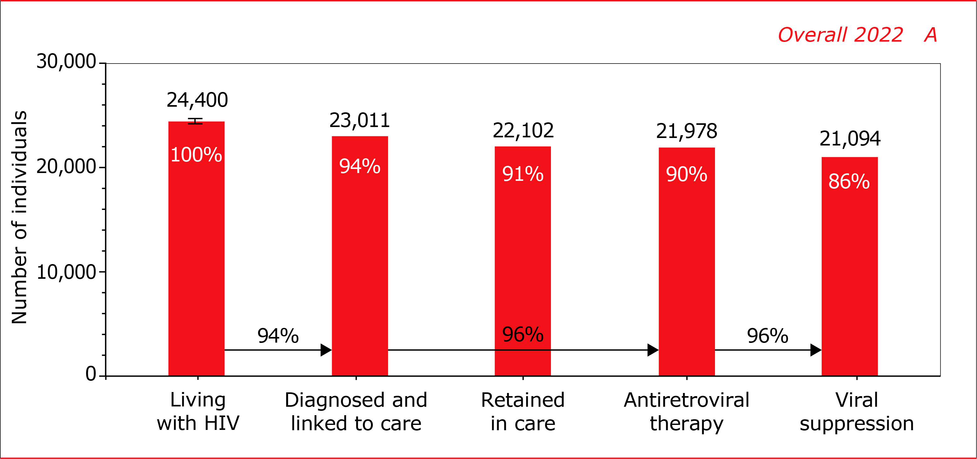
Continuum of HIV care : closing in on UNAIDS’ 2025 95-95-95 targets
94%
diagnosed
96%
on ART
5
96%
viral suppression
95-95-95 in 2025
Notes:
The Netherlands is closing in on UNAIDS’ 95-95-95 targets for 2025, which state that 95% of people with HIV should be diagnosed, 95% of those diagnosed are on treatment, and 95% of those treated have a suppressed viral load.
The current estimate for these targets stands at 94-96-96, which means that the UNAIDS’ 95-95-95 targets have almost been reached.

Slide 11
Continuum of HIV care : closing in on UNAIDS’ 2025 95-95-95 targets
Statistics Netherlands: 307 people who had died or moved abroad by the end of 2022
94%
diagnosed
96%
on ART
5
96%
viral suppression
95-95-95 in 2025
Notes:
New in this year’s monitoring report is that we were able to exclude 307 people who, according to Statistics Netherlands, had died or moved abroad by the end of 2022 – and should therefore not be counted in the continuum of care – but whose date of death or migration had not or not yet been recorded in the SHM database.
In the next presentation, you will hear more about how we used data from Statistics Netherlands.

Slide 12
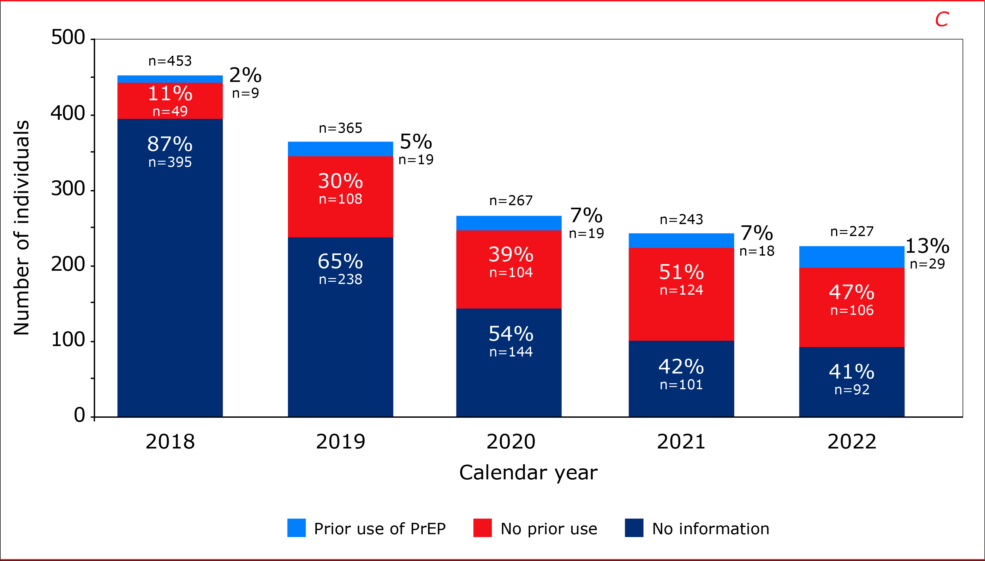
Growing proportion of MSM and trans men and women report prior use of PrEP
29 (13%) diagnoses in 2022 were in people who reported prior use of PrEP
Notes:
As you may know, SHM collects data on prior use of pre-exposure prophylaxis (PrEP) in all individuals newly diagnosed with HIV since 2018.
Among MSM and trans individuals, who are the primary target groups of the national PrEP programme, the proportion of people reporting prior use of PrEP, has steadily increased over calendar time.
In 2022, 29 (13%) of the 227 observed new diagnoses in MSM and trans individuals were in people who reported prior use of PrEP, while 106 (47%) people reported never to have used PrEP.
For 92 (41%) individuals, information on prior use of PrEP was not available.

Slide 13
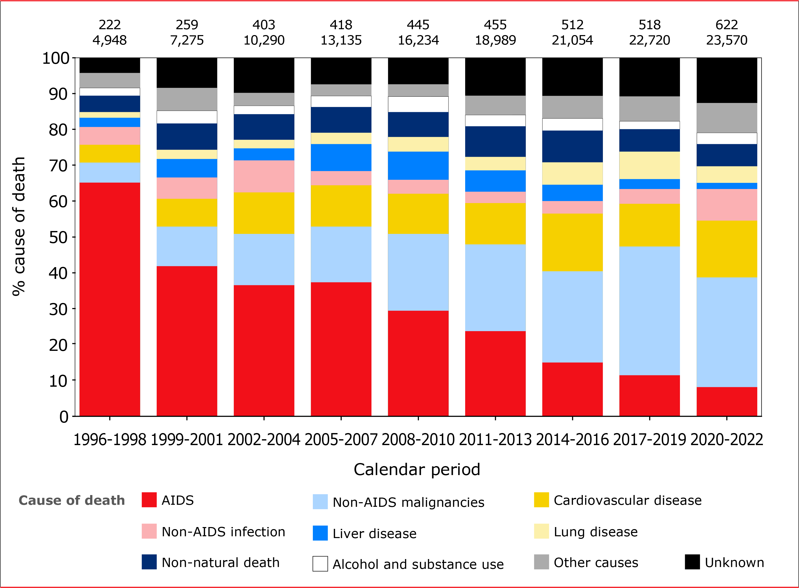
Downward trend in the proportion of deaths due to HIV continued in 2022
ca. 17 AIDS-related deaths per year in 2020-2022, driven largely by late entry into care.
21 AIDS deaths in 2022
Notes:
Since combination treatment became available in 1996, there has been a sustained decline in the risk of death from AIDS as shown here in the red bars.
Death is now increasingly likely to be caused by non-AIDS comorbidities, including non-AIDS-defining malignancies and cardiovascular disease.
On average 17 people per year in 2020-2022 died of AIDS and these mainly include people presenting for care with a late-stage HIV infection.
For 2022, 21 AIDS deaths have so far been recorded.

Slide 14
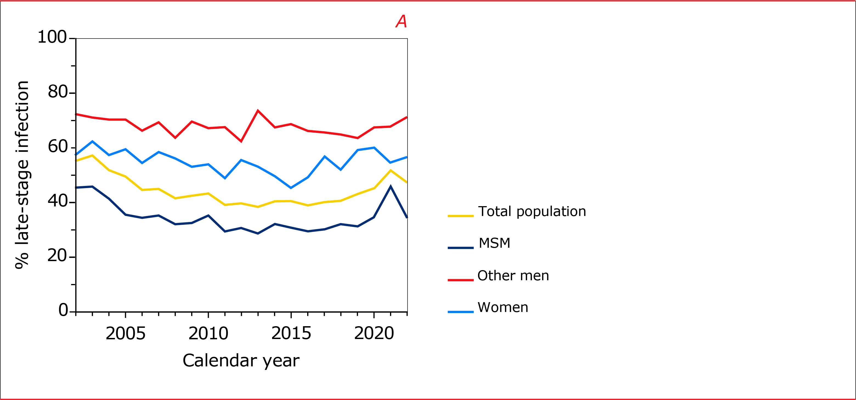
Diagnosis with late-stage HIV remains common
47% of people diagnosed in 2022 had late-stage HIV infection.
71%
67
57%
39
34%
72
Late-stage HIV: CD4 <350 cells/mm³ or AIDS, no evidence of recent HIV infection (Croxford 2022)
Notes:
As I just mentioned, one of the reasons there are still people who die of AIDS is that, unfortunately, still too many people are diagnosed with late-stage HIV infection, i.e., with a CD4 count <350 or with an AIDS-defining illness.
Among the people diagnosed in 2022, 47% had late-stage HIV infection, with the highest proportions seen in men other than MSM (71%) and women (57%).
Of note, proportions of late-stage HIV infections are lower than in previous years because people with evidence of having acquired HIV at most 12 months before diagnosis were classified as non-late, according to a new consensus definition published last year.

Slide 15
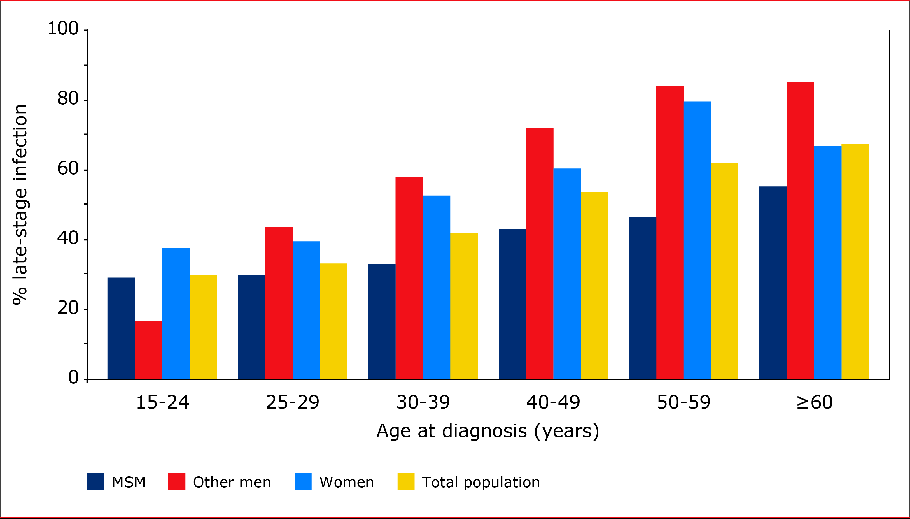
Older age is associated with a higher proportion of late-stage HIV
Late-stage HIV: CD4 <350 cells/mm³ or AIDS, no evidence of recent HIV infection (Croxford 2022)
Notes:
Older age is associated with a higher proportion of late-stage HIV infection.
In the total population – here in yellow – the proportion with late-stage HIV was 30% in people between 15 and 24 years of age at the time of diagnosis and increased to 67% for people diagnosed at 60 years of age or older.
In almost all age groups, the proportion with late-stage HIV was lowest for MSM and higher for other men and women.

Slide 16
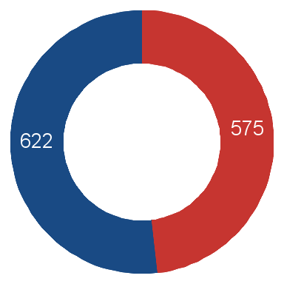
HIV-related hospitalisation and death within a year of diagnosis, 2020-2022
Recent or established HIV
 | 19 | 3%
 | 0 | 0%
Late-stage HIV
 | 206 | 36%
 | 16 | 3%
Late-stage HIV: CD4 <350 cells/mm³ or AIDS, no evidence of recent HIV infection (Croxford 2022)
Notes:
Finally, this year we looked at HIV-related hospitalisation and mortality within a year of diagnosis among people diagnosed with late-stage HIV compared to those diagnosed with a recent or established HIV infection with CD4 counts above 350 cells/mm3.
In the 575 people with late-stage HIV in 2020-2022, 36% were admitted to a hospital for HIV-related reasons, while 3% died as a direct result of HIV.
In contrast, among those with a non-late HIV infection, only 3% were hospitalised and no one died due to HIV.

